Slide 1

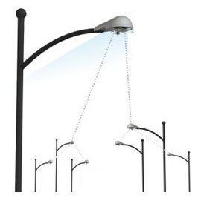
eNodeBs/ RAN
(UE-eNB-MME-S1APID)
MME Cluster
(UE Contexts)
HSS / SGW Nodes
PGW/ PCRF Nodes
UEs / IoT Devices
UE-MME-S1APID
MME Host₁
S6a
HSS₁
PCRF₁
HSS_{M}
PCRF_{N}
S1-MME
MME Host_{N}
DRB
S11
SGW₁
S5/S8
PGW₁
Control
Data
SGW_{N}
PGW_{N}
S1

