Slide 1

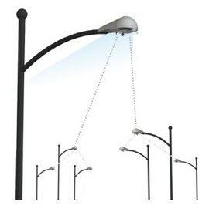
RAN
UE Contexts
UE DB
UEs / IoT Devices
eNodeBs
S6a
Control
Data
S1-MME
MME
HSS
DRB
S11
EPC
PCRF
S1-u
S5/S8
SGW
Internet
PGW
GUTI, UE-MME-S1APID
UE-eNB-MME-S1APID
S11-TEID,
S1-GTP TEID
S5-GTP TEID

