Slide 1
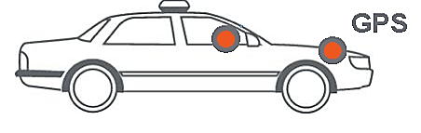
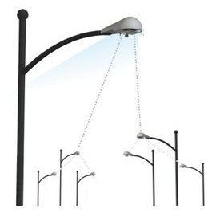
RAN
UE Contexts
UE DB
UEs / IoT Devices
eNodeBs
Control
Data
MME
HSS
EPC
SGW
Internet
PGW
GUTI, UE-MME-S1APID
UE-eNB-MME-S1APID
S11-TEID

