Slide 1

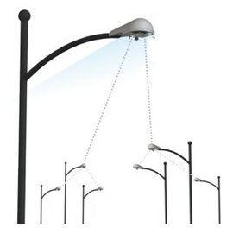
Control
Data
RAN
UEs / IoT Devices
eNodeBs
MME
HSS
EPC
Inter net
SGW
PGW

