Slide 1

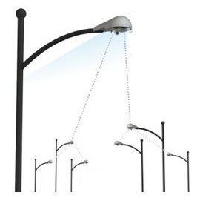
Control
RAN
UEs / IoT Devices
Data
eNodeBs
MME
HSS
EPC
SGW
PGW
Internet

