Slide 1
Network verification with outlier analyzer
An Overview
Astitv Nagpal
WINGS LAB
Stony Brook University
Department of Computer Science

Slide 2
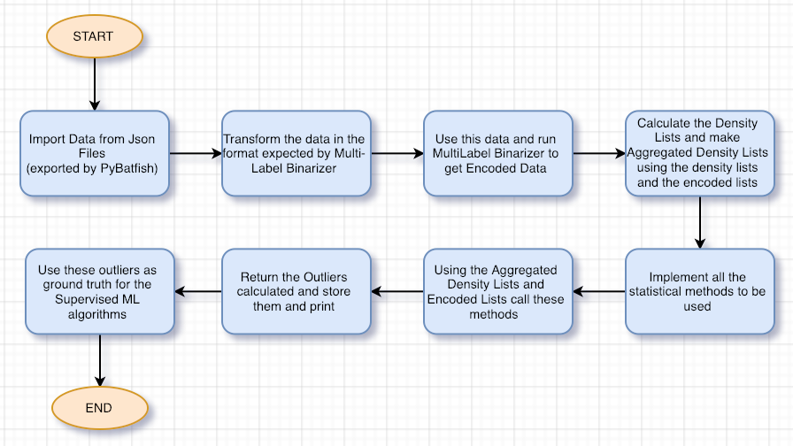
Statistical Based technique
Flow steps

Slide 3
Statistical Based technique
Analysis
Advantages:
They provide good estimation of outliers and at the same time are very easy to understand and implement.
For example: calculating outliers based on just the standard deviation, IQR is a very convenient/common technique in the data-science industry.
Disadvantages:
The statistical based techniques works really well when we have some well-defined arrangement of data. Eg Data follows Gaussian Dist.
But, for complicated datasets like network-data, these techniques might not do justice.
Hence, for our use-case they might give the outliers list but are not the preferred technique to perform outlier detection.

Slide 4
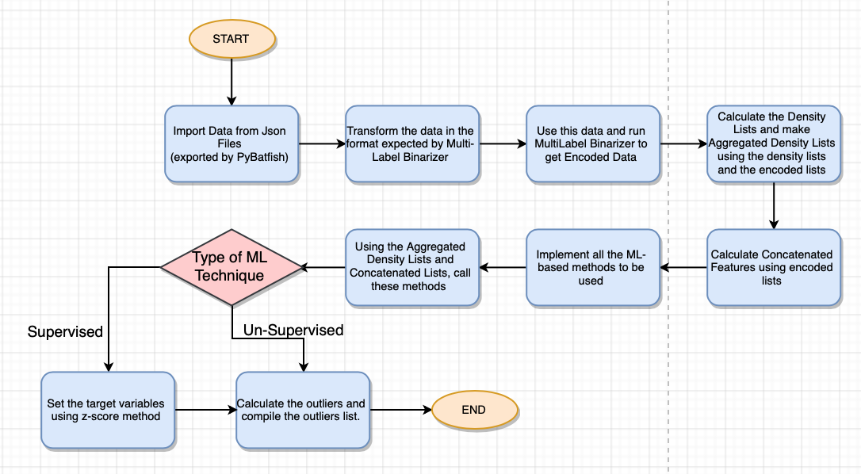
ML Based technique
Flow steps

Slide 5
ML Based technique
Analysis
Advantages:
These are more sophisticated techniques when compared to statistical methods and can work on complex data-sets.
They incorporate well written mathematical models to detect outliers or abnormal behavior in a data set.
There are few ML techniques that are specifically designed to calculate outliers in a complex data set.
Disadvantages:
Sometimes, the over-complication of these methods might become too sensitive for the outlier detection process.
In case of supervised learning algorithms, it becomes a challenge to set the target variable in outlier detection.
In our case, we are using z-score method to set the target variable for supervised learning algorithm.
In this case there are two major drawbacks: (i) the z-score method is implemented by us seeing our dataset performance and hence can be biased, (ii) our ML algorithm blindly accepts whatever target data we give it to be true. So what if z-score method in the first place was flawed. Then this error will get propagated in the future predictions as well.

Slide 6
Signature-based Approach
( Novel Technique )
Cluster the data using K-Means Clustering algorithm using an optimal value of K, calculated using an elbow graph.
Construct a prototypical signature for every cluster representing the most common characteristics.
Signature’s Grammar:
Include for Sig Calculation - format (sub-property, weight)
Include for Bug Calculation - format (sub-property, “!”)
No significance - format (sub-property, “*”)
It then compares the actual data points with the prototype signature and calculates the similarity score.

Slide 7
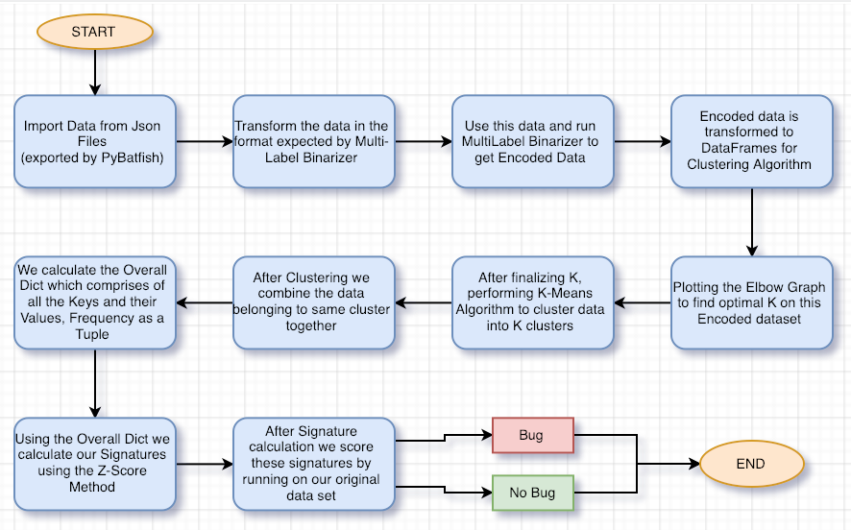
Signature Based technique
Flow steps

Slide 8
Signature Based technique
Analysis
Advantages:
This approach suits perfectly with our use case because:
This approach gives us the advantage of working specifically with our data set and yet keeping it generalized because of signature creation.
Also, we construct a prototypical structure, rather than analyzing the data directly and looking for data points that are anomalous relative to each other.
Disadvantages:
Computationally a little slower as clustering is involved which is a slower process in itself.
For a dataset with certain data points having multiple different keys and values occurring larger number of times might not give the best generalized structure.

Slide 9
Signature-based Approach
What next ?
After calculating the outliers we can use them as the target data for our supervised machine learning algorithms.
Hence, instead of using z-scores to set the target data we can use outliers generated from signature based technique as the target data set.
Moreover, for unsupervised ML techniques we can use this target data set to reinforce the ML model and fine tune it for more precision.

Slide 10
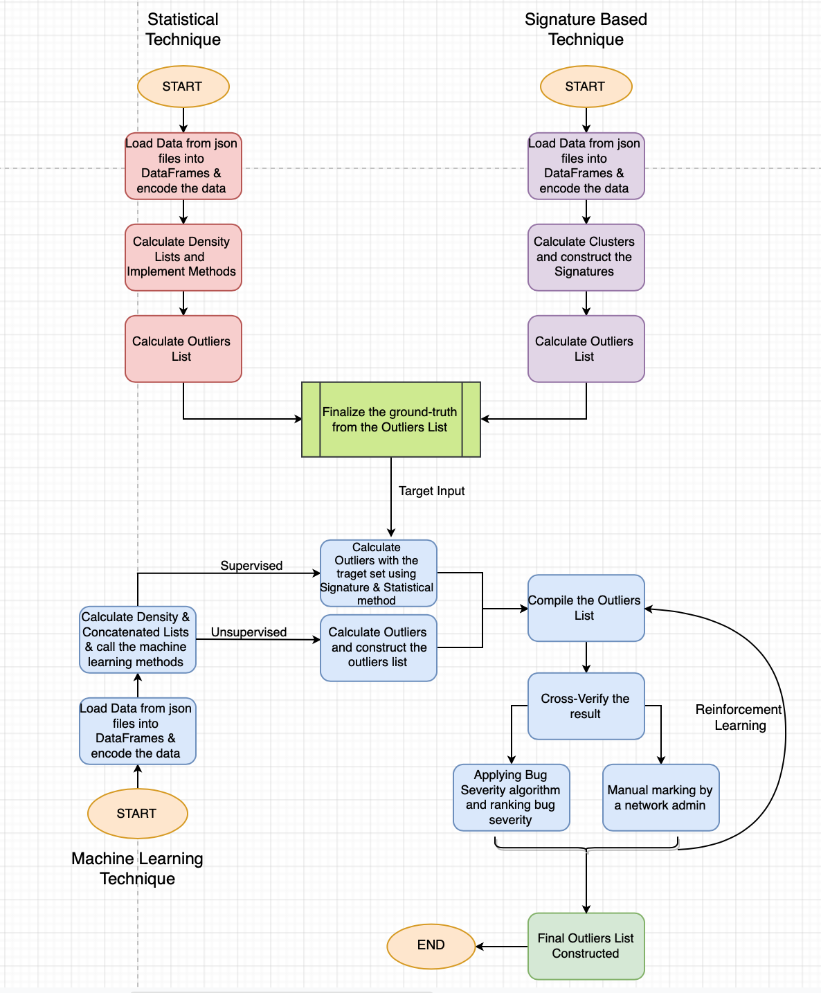
Signature Based technique - Step further
Flow steps

