Slide 1
Project Presentation of Industry Oriented Hands on Experience (22CS422)
On
Modern Dating Web App
Vasu Bholla
2210991517
Supervised By
Dr. Swati Goel
Department of Computer Science and Engineering,
Chitkara University, Punjab

Slide 2
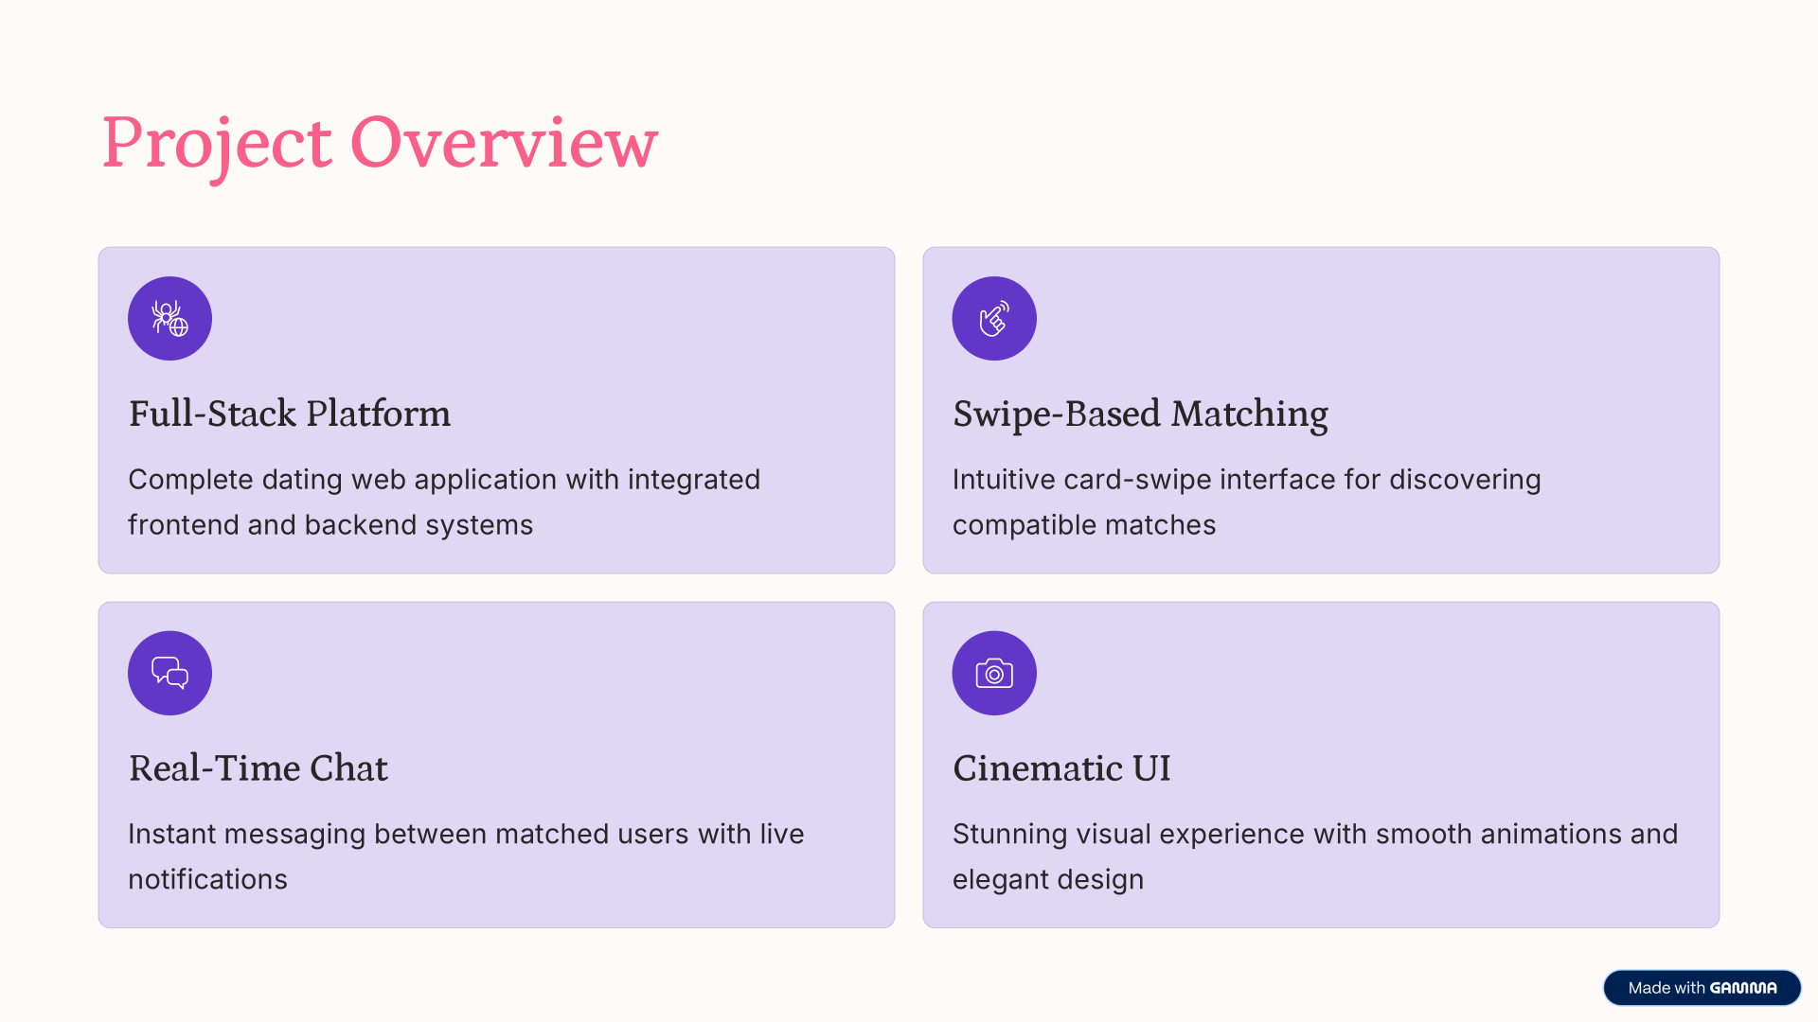
Project Overview
2

Slide 3
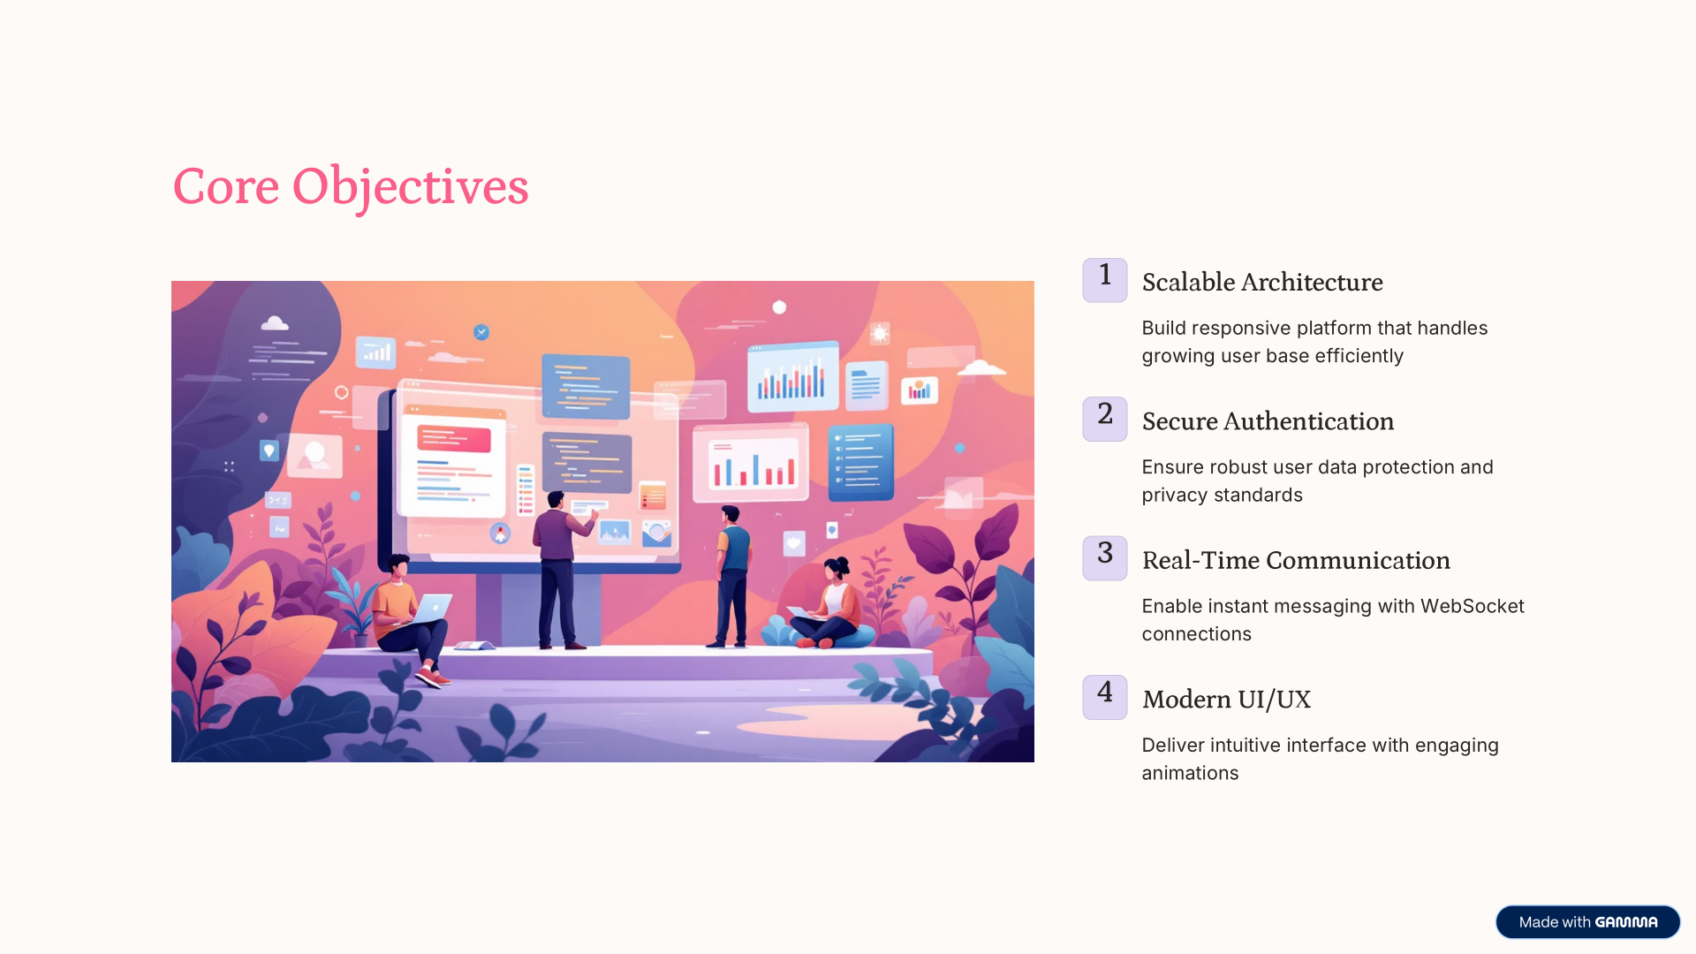
Core Objectives
3

Slide 4
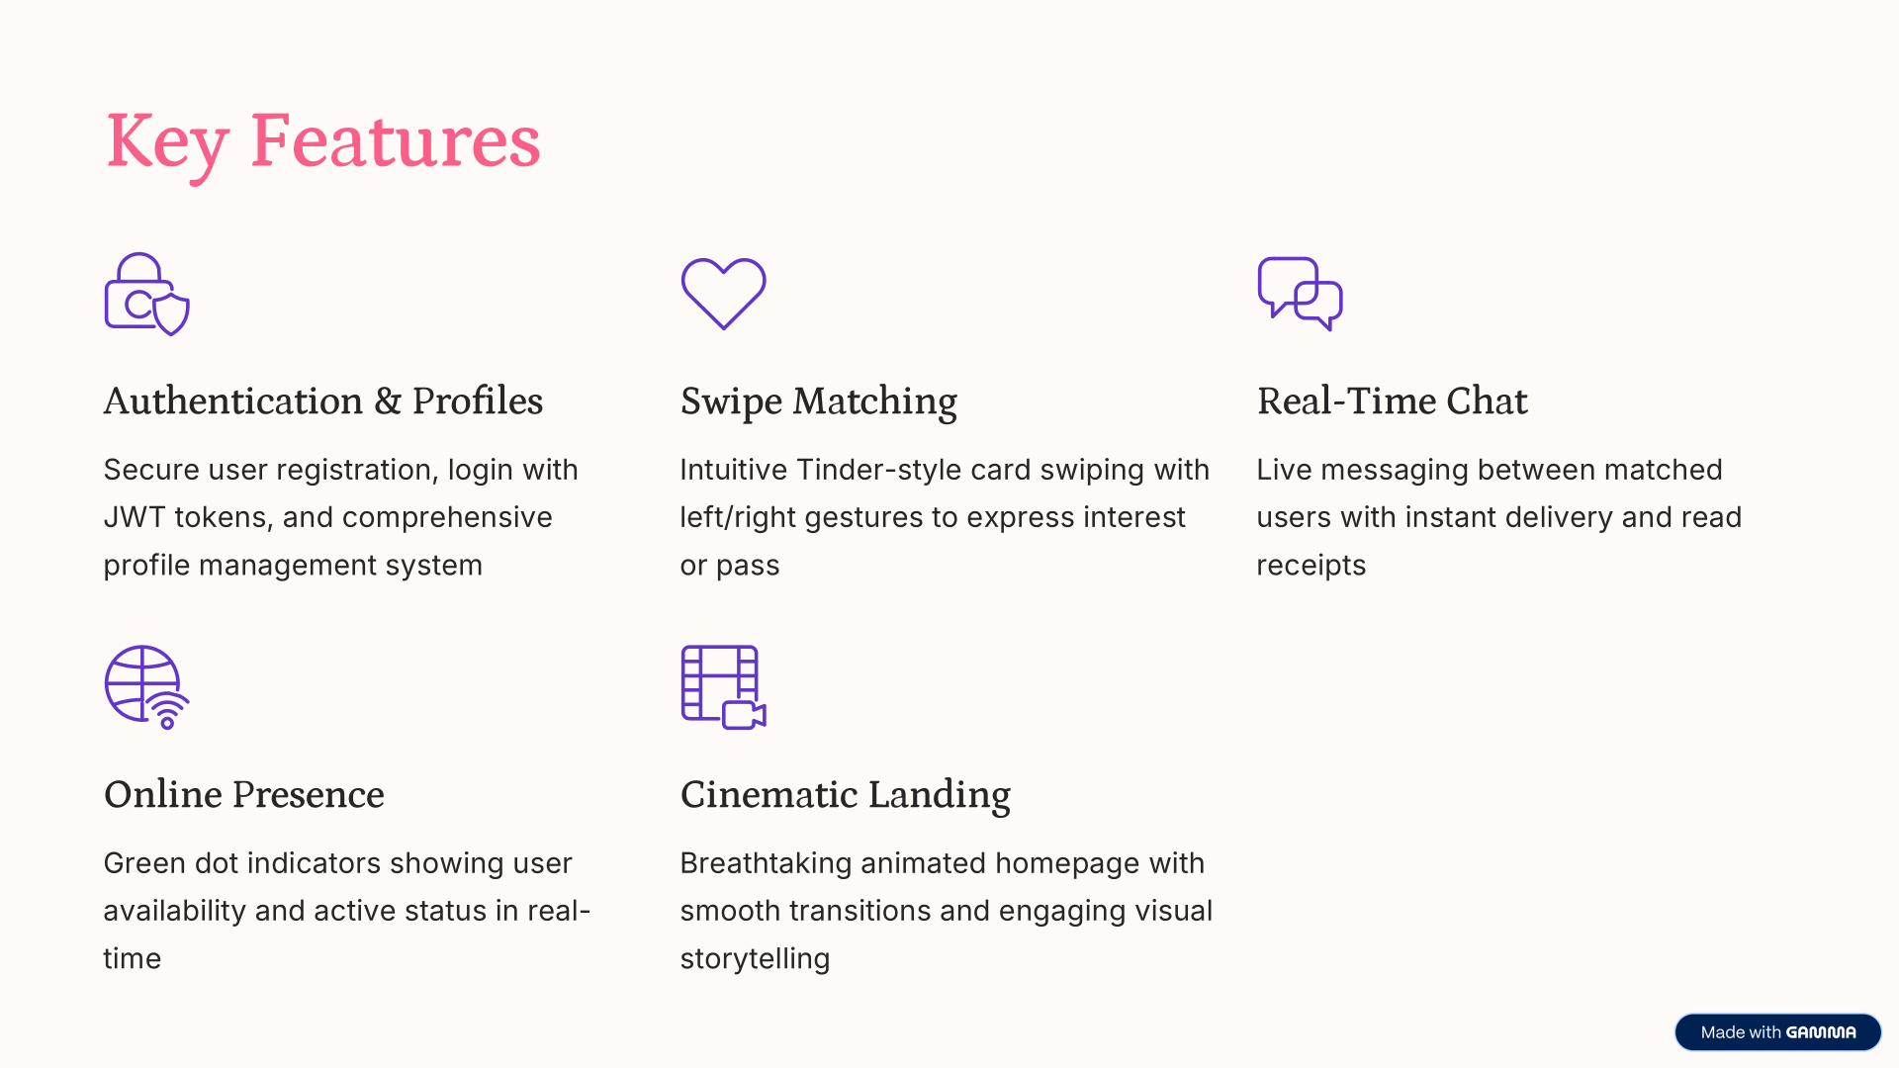
Key Features
4

Slide 5
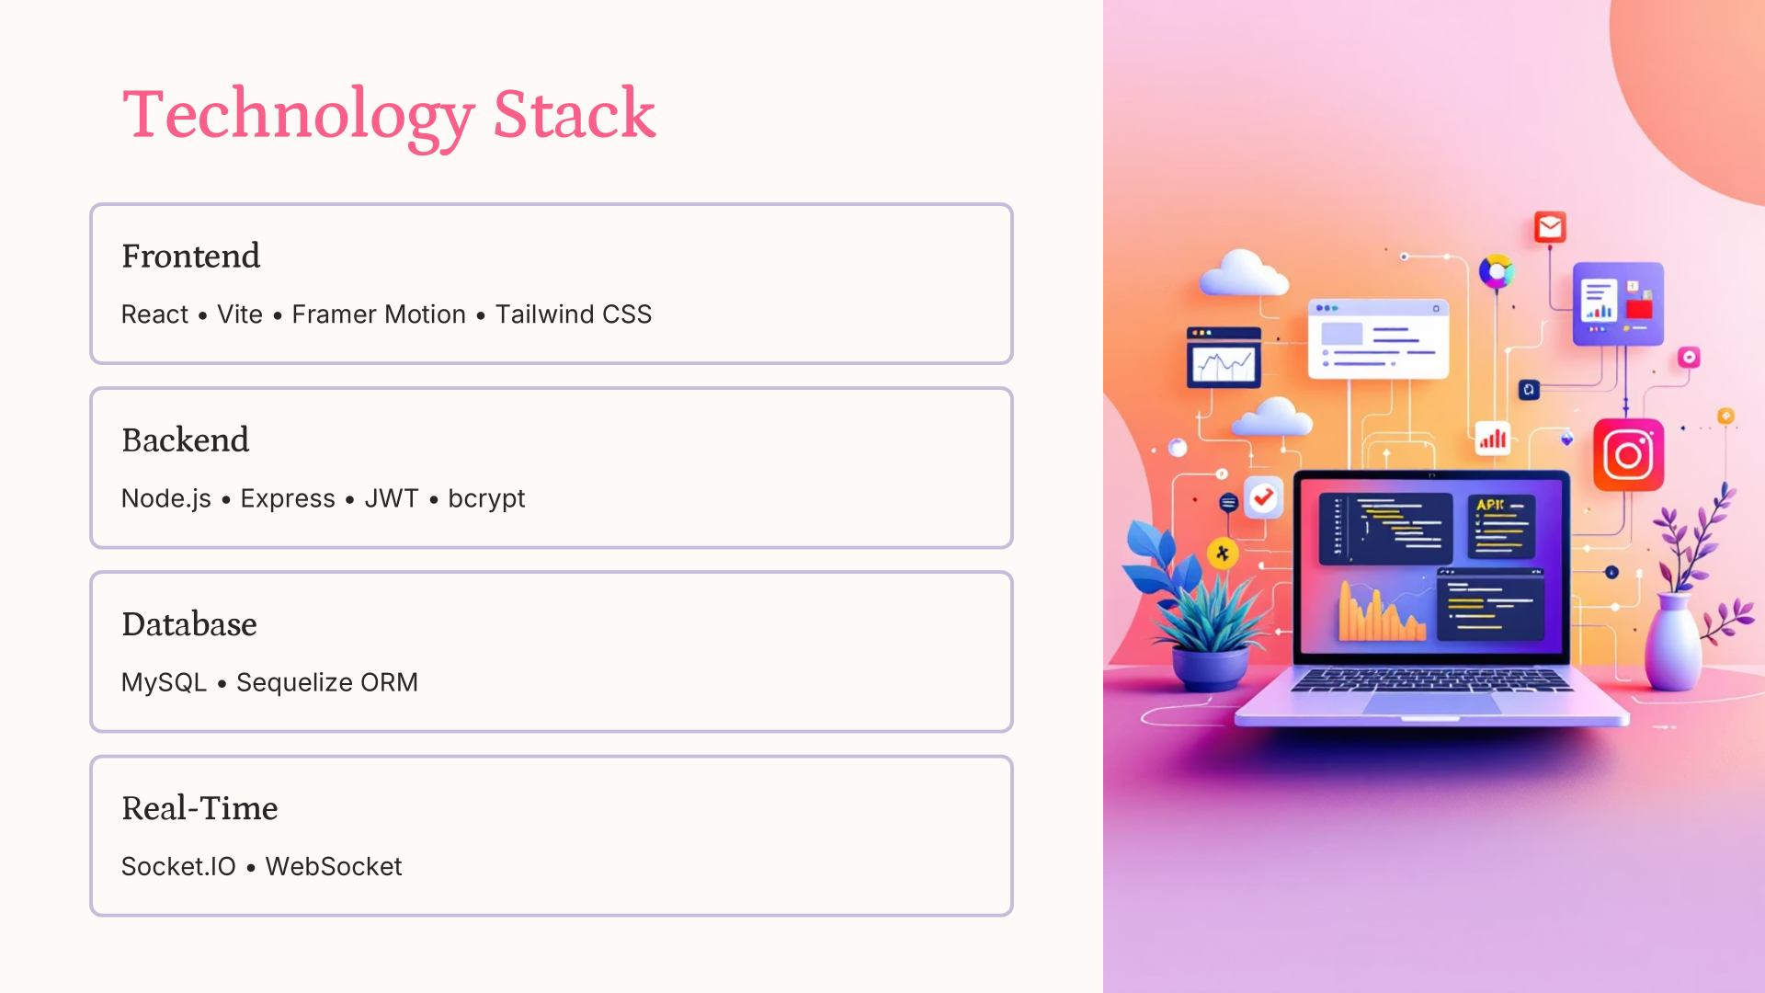
Technology Stack
5

Slide 6
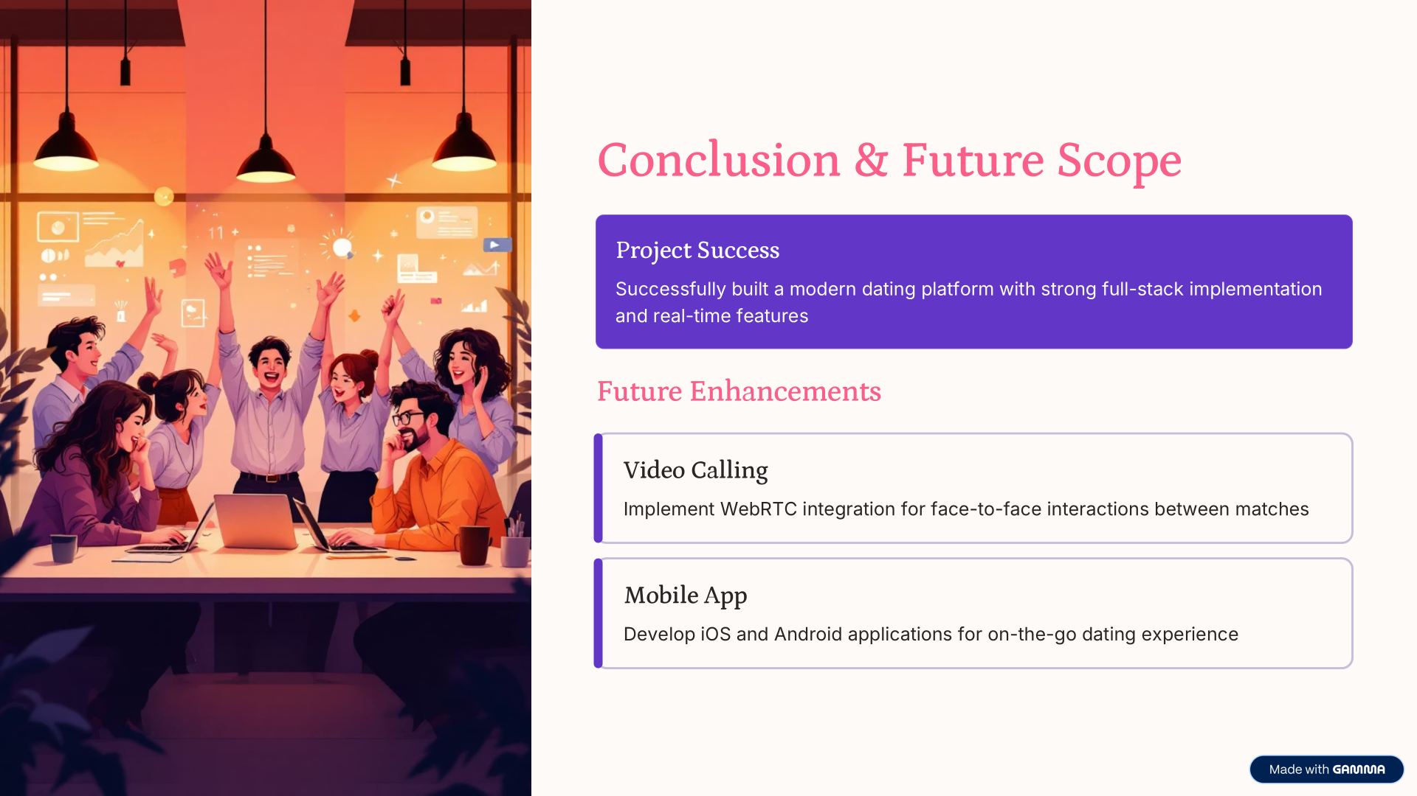
Conclusion & Future Scope
6

Slide 7
Thank You
7

