Slide 1

IMS ENGINEERING COLLEGE
CODE MANGA
SUBMITTED BY, GROUP 5
1-NAME- VASU TYAGI
Roll no-2101430100193
2-NAME- SHASHANK PANDEY
Roll no-2101430100160
3-NAME- ANKUR RANA
Roll no-2101430100029
4-NAME- SUBHAM GUPTA
Roll no-21014301000176
MENTOR-PROFF. N.U KHAN
Department of Computer Science & Engineering
IMS Engineering College, Ghaziabad, India
1
Notes:
1

Slide 2
Code manga
-Website

Slide 3
Introduction
Our primary for this mini project is to create a multipurpose website. The present section is consist of
Two parts
1.Codes
2.Games(in initial state)
Codes: This part will consist of source code of various problem
with their output.
Games:This part since now don’t have any content but it will be consist of web games such as tic tac toe or stone,paper,scissor on further development

Slide 4
Language used
1.HTML
2.CSS
3.Java script

Slide 5
HTML
HTML is a ancronym which stands for Hyper Text Markup Language which is used for creating web pages and web applications.
HTML elements are the building blocks of HTML pages.

Slide 6
CSS
Cascading Style Sheets (CSS) is a style sheet language used for describing the presentation of a document written in a markup language such as HTML or XML

Slide 7
Java script
JavaScript is the Programming Language for the Web.
JavaScript can update and change both HTML and CSS. JavaScript can calculate , manipulate and validate data.

Slide 8
Secondary goal
Our secondary goal after codes and games will be to increase the features in website so that it can serve more purposes the one of the idea of other section is to create a storage unit to store notes remotely and further more.

Slide 9
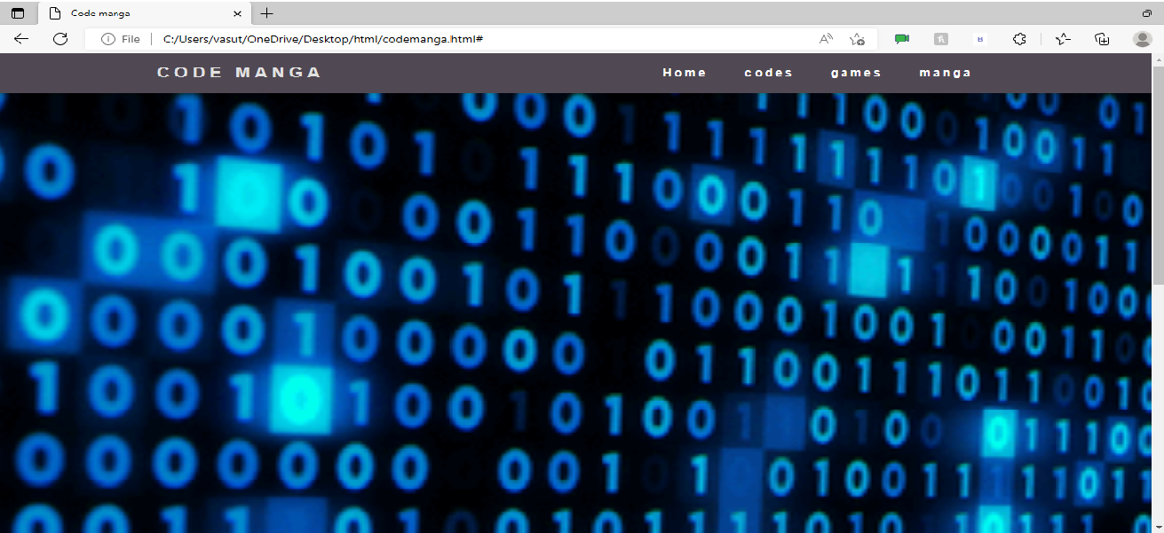
Home section

Slide 10
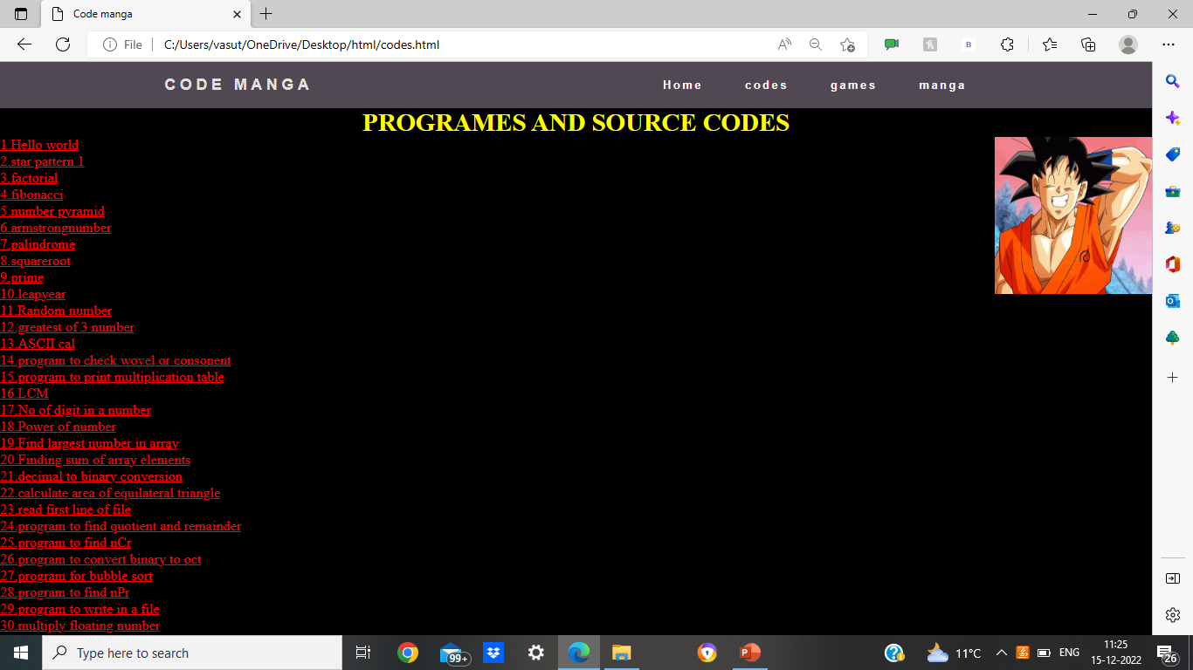
Code section

Slide 11
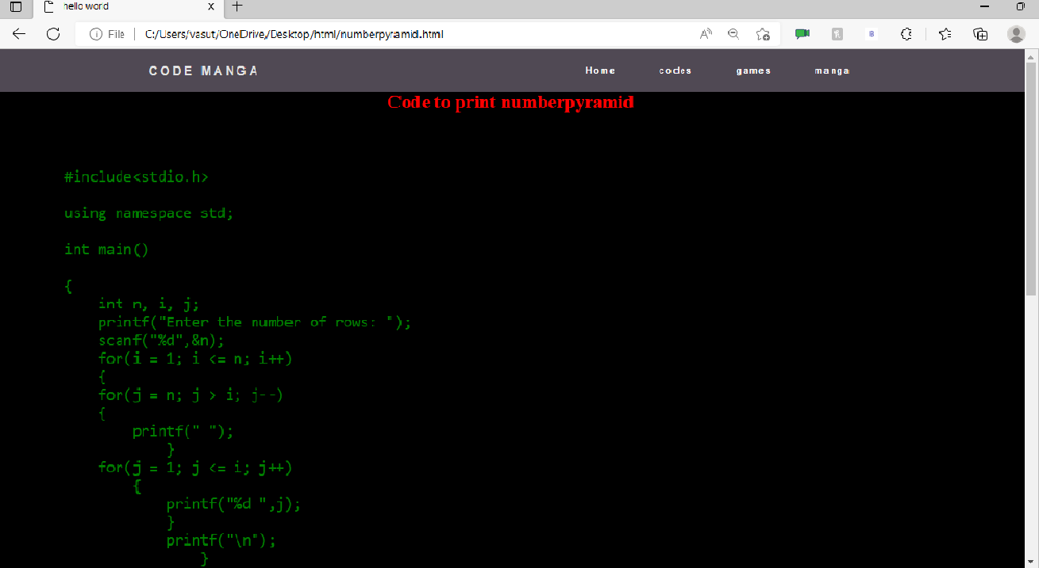
Source code section

Slide 12
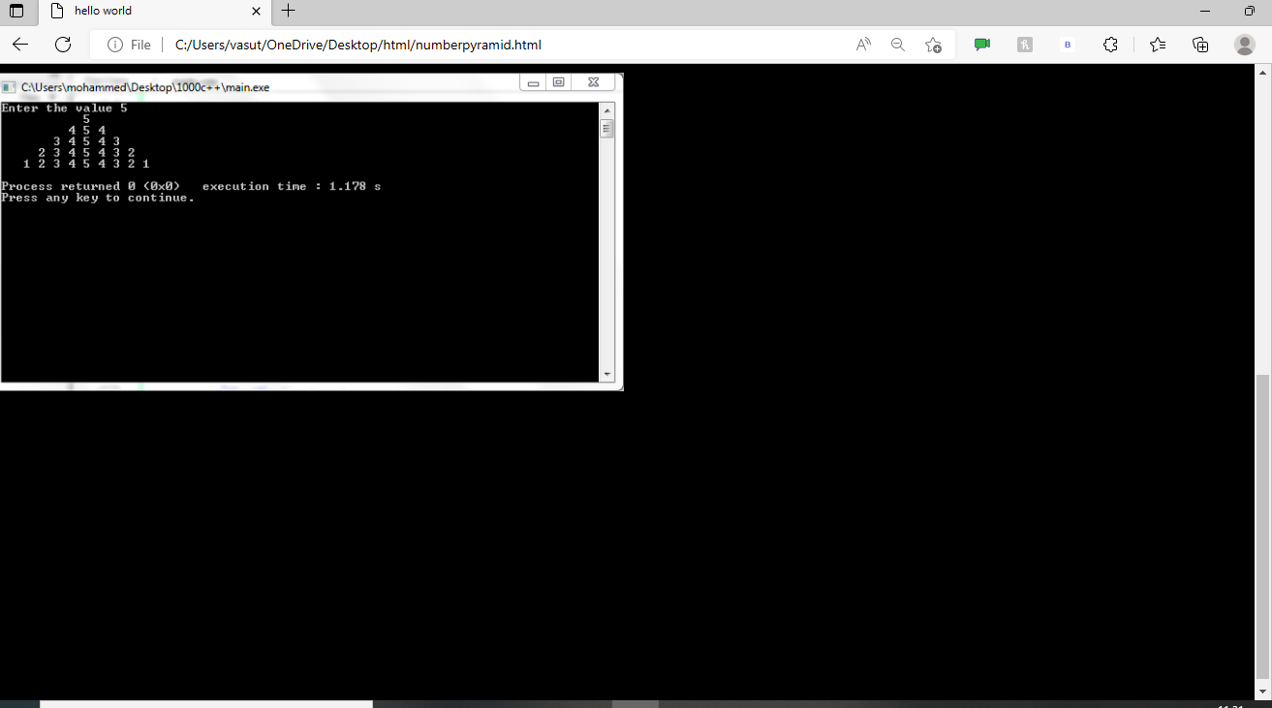
Output section

Slide 13
Team
1.Vasu tyagi
2.Shashank pandey
3.Ankur rana
4.Subham gupta

Slide 14
THANK YOU

