Slide 1
Digital Portfolio
STUDENT NAME: Vasu A
REGISTER NO AND NMID: 32324U18053 & astvu32332324u18053
DEPARTMENT: B.Sc Computer Science
COLLEGE: Voorhees College

Slide 2
PROJECT TITLE
Student portfolio by using frontend developement

Slide 3


AGENDA
Problem Statement
Project Overview
End Users
Tools and Technologies
Portfolio design and Layout
Features and Functionality
Results and Screenshots
Conclusion
Github Link
3/21/2024 Annual Review

Slide 4

PROBLEM STATEMENT
Many developers and designers struggle to showcase their work effectively. Traditional resumes don’t highlight creativity and interactivity, making it harder to stand out. A personal portfolio website solves this by providing an engaging and visually appealing way to present skills, projects, and achievements.

Slide 5

PROJECT OVERVIEW
This project is a responsive portfolio website that presents my skills, projects, and contact details. It is designed with modern UI principles, attractive color gradients, and a cursive font style for a professional yet creative look.

Slide 6

WHO ARE THE END USERS?
Recruiters & hiring managers looking for skilled developers
Potential clients who want to see past work before hiring
Peers & collaborators interested in my projects

Slide 7

TOOLS AND TECHNIQUES
HTML5 → structure of the website
CSS3 (Flexbox, Grid, Google Fonts, Gradients) → styling and layout
JavaScript → interactivity (scrolling, form submission alerts)
GitHub → version control and deployment

Slide 8
POTFOLIO DESIGN AND LAYOUT
Sticky navigation bar with smooth scrolling
Hero section introducing the developer
About section with a short bio
Projects section in a responsive grid layout
Contact form with client-side validation
Footer with branding
8

Slide 9

RESULTS AND SCREENSHOTS
(Here you would insert screenshots of your portfolio website – Home, About, Projects, Contact)
3/21/2024 Annual Review
9

Slide 10
FEATURES AND FUNCTIONALITY
Responsive design (works on mobile, tablet, and desktop)
Smooth scrolling navigation
Highlighted project cards
Interactive contact form with alert confirmation

Slide 11
RESULTS AND SCREENSHOTS
(Here you would insert screenshots of your portfolio website – Home, About, Projects, Contact)
3/21/2024 Annual Review
11

Slide 12
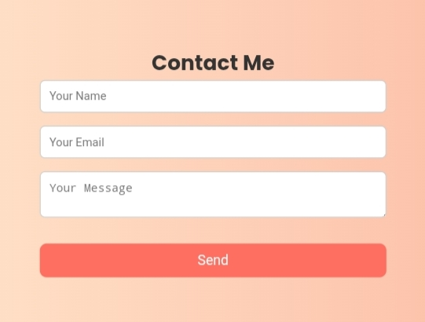
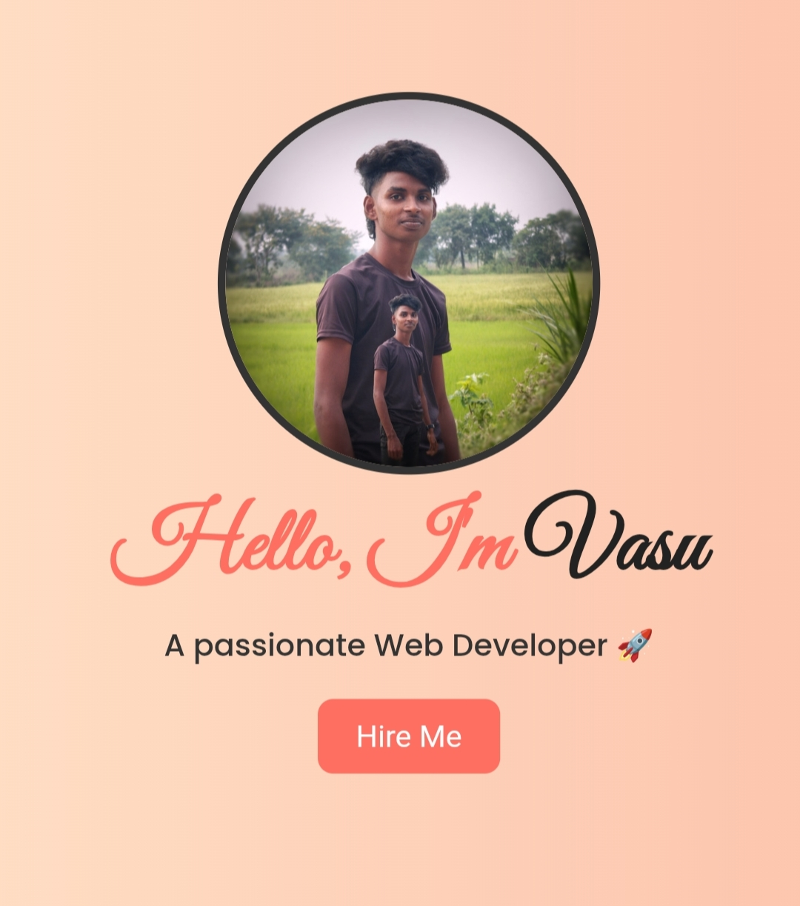
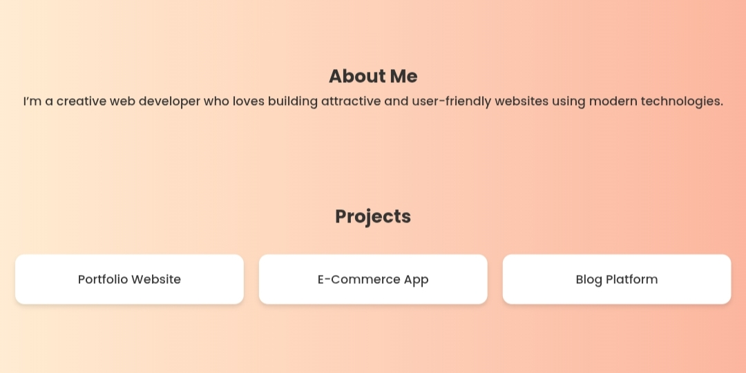

Slide 13
CONCLUSION
This portfolio website provides a modern, stylish, and responsive platform to showcase my projects and skills. It improves professional visibility and makes it easier for recruiters and clients to connect with me.
13

