Slide 1
Web Search Engine
ADVANCED COMPUTING CONCEPTS (03-60-654)
SCHOOL OF COMPUTER SCIENCE
UNIVERSITY OF WINDSOR
GUIDED BY: DR.LUIS RUEDA

Slide 2
GROUP NO #15
NAME | ENROLLMENT NO
MAITREE PATEL | 104914807
UTTAM SOLANKI | 104908710
MEET PATEL | 104882216
VASU SHAH | 104936654

Slide 3



WHAT IS WEB SEARCH ENGINE?
Web search engine is a platform that enables Internet users to search any content from World Wide Web(WWW).

Slide 4

WORKING OF WEB SEARCH ENGINE

Slide 5
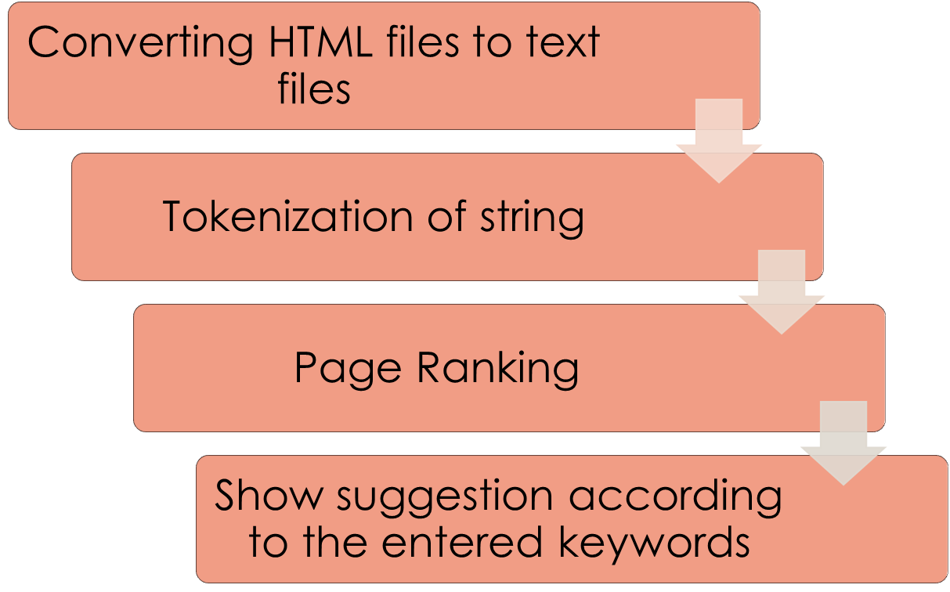
PROCESS FLOW OF THE SYSTEM

Slide 6
HTML TO TEXT
Parsing the HTML Files using String-tokenizer
Regex to rectify the html page

Slide 7
STRING TOKENIZER
String tokenizer is used to separate the keywords from the text file.
It takes regex pattern to tokenize data

Slide 8
PAGE RANKING
We have used ADT to store the data
HashTable< String, Object>
  String contains Keyword
  Object contains Information regarding URL and Frequency
  Ex:
URL: w3c.html
Frequency: 500
Java
Object
URL: advjava.htm
Frequency: 450
URL: corejava.html
Frequency: 320

Slide 9
WHEN USER SEARCH FOR A SENTENCE:
When user search for a keyword, we generate token by splitting a query
HashTable< String, Object>
Token 1
Token 2

Slide 10
CONTINUE…
How to set the priority of web pages based on searched keywords(more than one)?
Example:
So, along with frequency, no of words that matched to the user query is also important to consider
Keywords | Java | Programming | Language
1. | 500 | 0 | 0
2. | 200 | 150 | 0
3. | 100 | 50 | 20

Slide 11
CONTINUE…
Keywords:
Total Frequency: 500
No of token:
Token 1: 2
Token 2: 300
Toke 3: 200
Page
Object
Keywords:
Total Frequency: 400
No of token:

Slide 12
CONTINUE…
For the search operation, keywords namely, Java Programming and Language will be fetched from the already stored Hash Table
After getting the data, it will be sorted and stored in linked Hash Map
LinkedHashMap<String, Object>
  String => url
  Object => { int numberOfWord;
  int frequency;
  TreeMap<String,Integer>;
  }

Slide 13
CONTINUE...
Now we are ready with data
This data is sorted through heap sort based on the priority rank
Here, no of words has high priority compare to the frequency

Slide 14
WHY HEAP SORT?
We have used Max heap to sort the web pages
Why to choose heap sort ?
Benefits:
  Fastest algorithm
  Efficient for Large dataset
Complexity:
  O(N* logN)

Slide 15
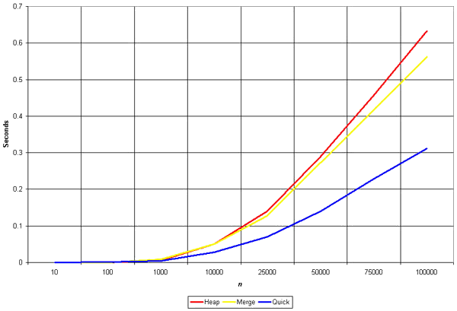
CONTINUE…

Slide 16
TRIES (TST)
Tries support pattern matching queries in time proportional to the pattern size
Tries provides an alphabetical ordered entries by key
Complexity: O(dm)
    d => size of the alphabets
    m => size of string pattern of the operation

Slide 17


Slide 18
CONCLUSION
We have developed the web search engine using various concept of data structure and algorithm, which will effectively fetch appropriate results according to the user query. Here, we have used abstract data type mainly, hash table, linked hash map, for an efficient results in minimal amount of time. Additionally, Tries data structure is used for suggestion.

Slide 19


