Slide 1
AIR QUALITY ANALYSIS AND PREDICTION IN TAMIL NADU

Slide 2
TABLE OF CONTENTS
01
02
ANALYZING AIR QUALITY TRENDS
IDENTIFYING POLLUTION HOTSPOTS
03
BUILDING PREDICTIVE MODEL FOR RSPM/PM10 LEVELS

Slide 3
Presented by the team members:
1.Shastivelan.G
2.Veeramani.G
3.Vasudevan.V.P
4.Jeyapradeepan.J
5.Christopher kishore

Slide 4
01
ANALYZING AIR QUALITY TRENDS

Slide 5
Data Collection:
Collect historical air quality data from monitoring stations in the region of interest. This data typically includes measurements of various pollutants such as particulate matter (PM2.5 and PM10), nitrogen dioxide (NO2), sulfur dioxide (SO2), ozone (O3), carbon monoxide (CO), and volatile organic compounds (VOCs).
Ensure data quality and consistency by checking for missing or erroneous data points.
2. Data Visualization:
Create time series plots or line graphs to visualize the trends in different pollutants over a specific time period (e.g., years or decades).
Use color coding or different lines to represent different pollutants for clarity.

Slide 6
3. Statistical Analysis:
Calculate summary statistics such as mean, median, standard deviation, and percentiles for each pollutant to understand the central tendency and variability of the data.
Perform trend analysis using statistical methods such as linear regression to determine if there is a statistically significant increase or decrease in pollutant levels over time.
4. Seasonal Variation:
Analyze seasonal patterns in air quality data. Pollution levels may vary throughout the year due to factors like weather, temperature, and human activities.
Use seasonal decomposition techniques to separate data into trend, seasonal, and residual components.

Slide 7
5. Identify Outliers:
Detect and investigate outlier data points that deviate significantly from the expected trends. Outliers may indicate exceptional events or measurement errors.
6. Spatial Analysis:
Analyze spatial variations in air quality by comparing data from different monitoring stations within the region.
Use geographic information systems (GIS) tools to map pollution levels and identify areas with consistently high or low air quality.
7. Source Apportionment:
Conduct source apportionment studies to identify the major sources of pollution contributing to poor air quality. This can involve using models or data analysis techniques.

Slide 8
02. IDENTIFYING
POLLUTION HOTSPOTS IN TAMILNADU

Slide 9
Access Air Quality Data:
Obtain access to air quality data from official sources like the Tamil Nadu Pollution Control Board (TNPCB), Central Pollution Control Board (CPCB), or other relevant government agencies. These organizations typically monitor air quality across various locations in the state
Select Pollutants of Interest:
Identify specific pollutants of interest, such as particulate matter (PM2.5 and PM10), nitrogen dioxide (NO2), sulfur dioxide (SO2), carbon monoxide (CO), ozone (O3), and volatile organic compounds (VOCs). Different pollutants have different sources and health impacts.

Slide 10
Analyze Historical Data:
Examine historical air quality data for different regions of Tamil Nadu. Look for areas where pollutant levels consistently exceed air quality standards or guidelines. These areas may indicate potential hotspots.
Consider Sources of Pollution:
Identify potential sources of pollution in the areas with poor air quality. Common sources include industrial facilities, vehicular traffic, construction activities, waste burning, and agricultural activities.

Slide 11
vUse Air Quality Index (AQI):
The Air Quality Index (AQI) is a standardized way to assess and compare air quality across regions. Calculate the AQI for different locations in Tamil Nadu and pinpoint areas with consistently high AQI values.
Consult Environmental Reports:
Review environmental impact assessments, reports, and studies conducted in the region. These documents often highlight pollution sources and their impact on air quality.

Slide 12
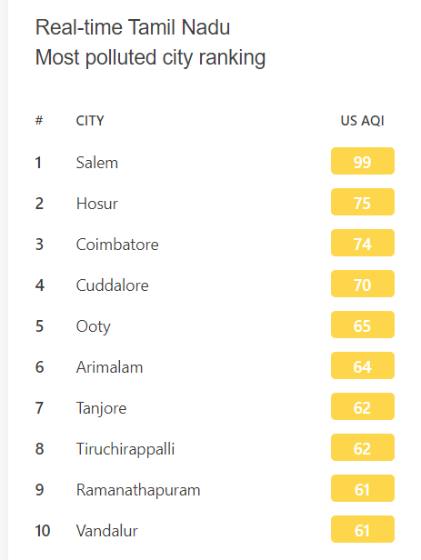
HOTSPOTS OF AIRPOLLUTION IN TAMILNADU

Slide 13
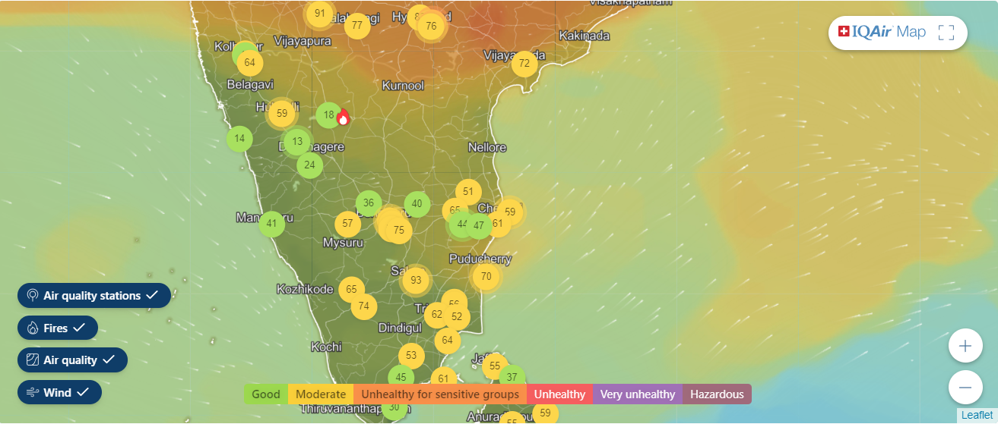
MAP OF HOTSPOTS

Slide 14
03.BUILDING PREDICTIVE MODEL FOR RSPM/PM10 LEVELS

Slide 15
Step 1: Data Collection
Gather historical air quality data for RSPM/PM10 levels in Tamil Nadu from sources like the Tamil Nadu Pollution Control Board (TNPCB) or the Central Pollution Control Board (CPCB). You would also need meteorological data, which you can obtain from local weather stations or online sources.
Step 2: Data Preprocessing
Clean and preprocess the data:
Handle missing values: Fill in missing values using interpolation or other suitable methods.
Outlier detection: Identify and address outliers that may skew the data.
Data transformation: Normalize or standardize the data if necessary.

Slide 16
Step 3: Feature Engineering
Create relevant features that can influence RSPM/PM10 levels:
Time-related features: Extract day of the week, month, season, and time of day from the date and time information.
Spatial features: Consider the location of monitoring stations and proximity to potential pollution sources.
Meteorological features: Include temperature, humidity, wind speed, and precipitation data.
Lagged variables: Incorporate historical air quality and meteorological data as lagged features.
Step 4: Data Splitting
Split the dataset into training, validation, and test sets. A common split might be 70% for training, 15% for validation, and 15% for testing.

Slide 17
Step 5: Model Selection
Choose an appropriate model for regression. In this example, let's use a Random Forest Regression model, which can handle nonlinear relationships and interactions in the data.
Step 6: Model Training
Train the Random Forest Regression model on the training dataset. The model will learn to predict RSPM/PM10 levels based on the input features.
Step 7: Model Evaluation
Evaluate the model's performance on the validation dataset using evaluation metrics like Mean Absolute Error (MAE) or Root Mean Squared Error (RMSE). Adjust hyperparameters if necessary to improve performance.

Slide 18
Step 8: Testing and Validation
Assess the model's generalization ability by evaluating it on the test dataset. Monitor whether the model meets air quality standards and guidelines.
Step 9: Interpretation and Insights
Interpret the model to understand which features contribute most to predictions and gain insights into factors affecting RSPM/PM10 levels in Tamil Nadu.
Step 10: Deployment and Continuous Monitoring
If the model performs well, deploy it for real-time predictions or periodic forecasts. Continuously monitor its performance and update it as needed with new data and improved techniques.

Slide 19
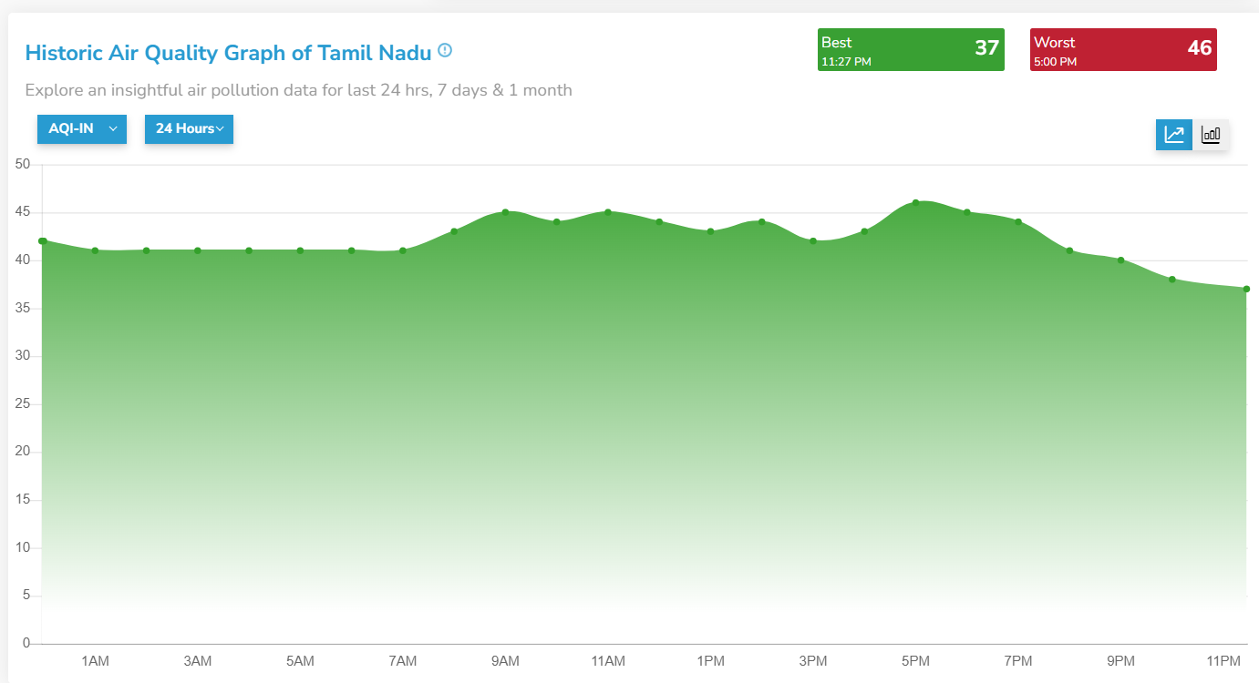
Air quality graph of tamilnadu

Slide 20
THANK YOU

