Slide 1


Automatic Backup and Restore for AWS RDS
PRESE
PRESENTED BY
P.Panasaramanna
R.Vasu
B.Syam kumar
P.Sanjay

Slide 2


Importance of Backup and Restore in Database Management
Data Protection
Regulatory Compliance
Backups safeguard against data loss due to human error, hardware failure, or other unexpected events.
Many industries require regular backups to meet legal and regulatory requirements for data retention.
Disaster Recovery
Business Continuity
Backups enable quick restoration of data and systems in the event of a disaster, minimizing downtime.
Reliable backup and restore processes ensure uninterrupted access to critical data and applications.

Slide 3
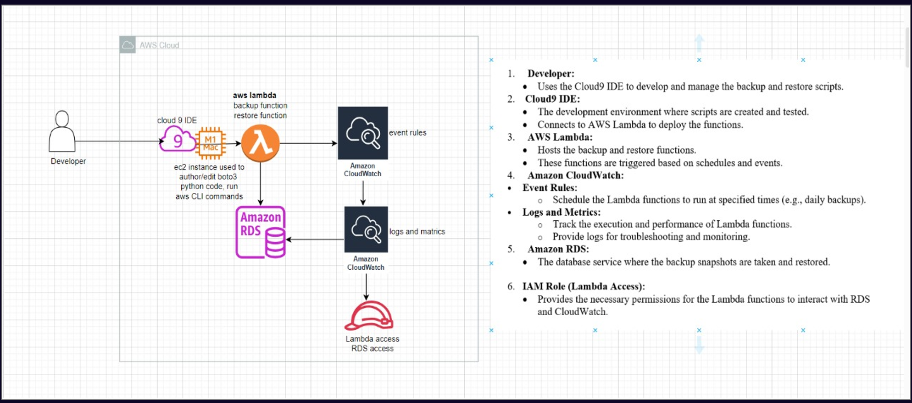

Slide 4

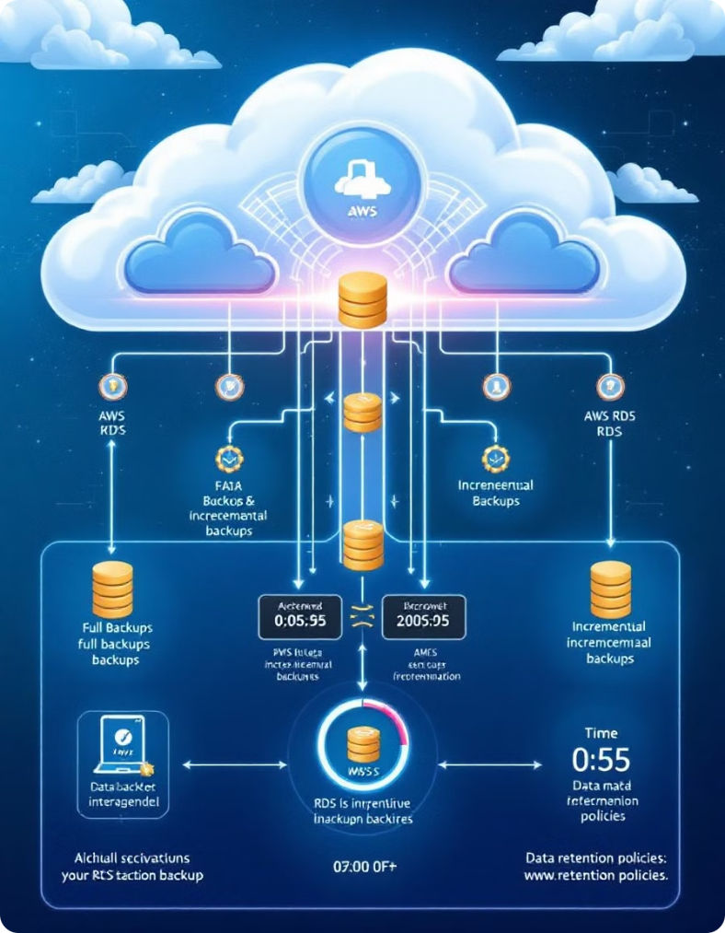
RDS Backup Fundamentals: Understanding Automated Backups
1
Full Backups
RDS automatically creates full backups of your database on a regular schedule.
2
Incremental Backups
RDS also generates incremental backups, capturing changes since the last full backup.
3
Backup Retention
RDS retains backups for a configurable number of days, ensuring data can be restored as needed.

Slide 5

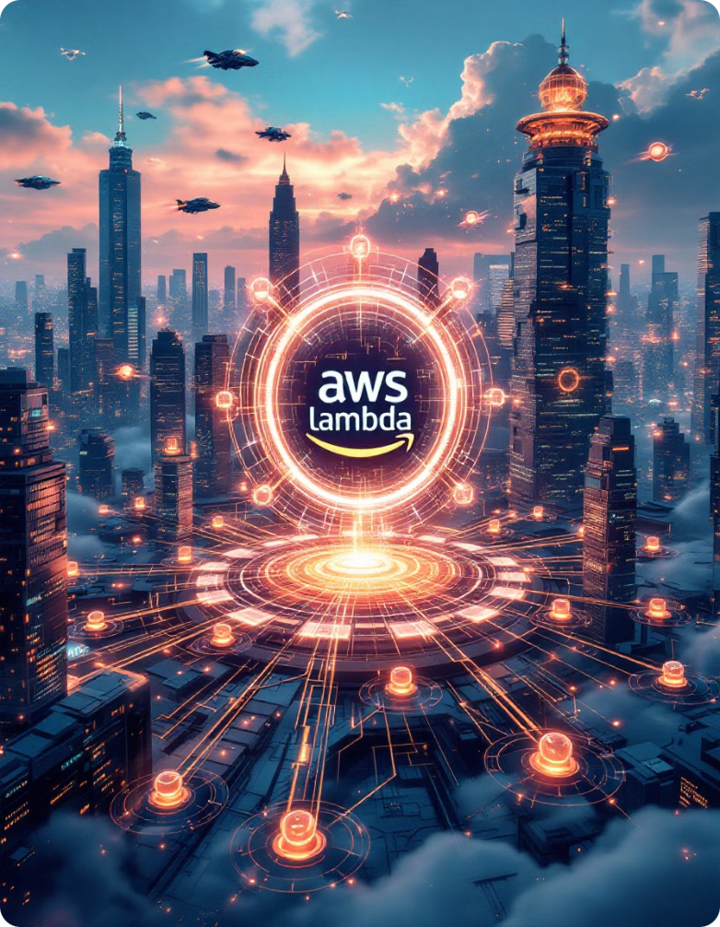
What is Lambda service in AWS
1
Serverless Computing
2
Event-Driven Architecture
AWS Lambda is a serverless computing service that allows you to run code without managing servers.
Lambda functions can be triggered by various events, such as database updates or API calls.
3
Scalability and Availability
Lambda automatically scales your code in response to increased demand, ensuring high availability.

Slide 6
IAM Role, Giving RDS Full Access and Lambda Basic Execution Access
RDS Full Access
Lambda Basic Execution
Granting the IAM role full access to RDS ensures the Lambda function can perform backup and restore operations.
The Lambda basic execution permission allows the function to log, monitor, and execute within the AWS environment.

Slide 7

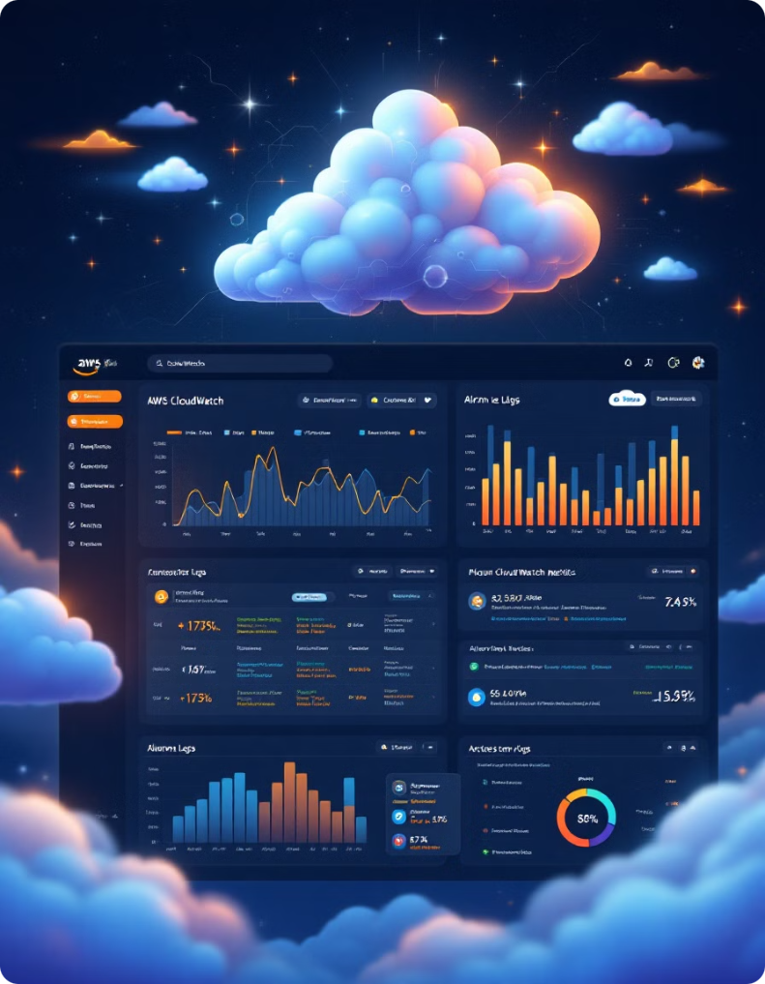

What is CloudWatch in AWS
Metrics
CloudWatch collects and tracks various metrics, such as CPU, memory, and network usage.
Alarms
CloudWatch can trigger alarms based on metric thresholds, allowing proactive monitoring and alerting.
Logs
CloudWatch aggregates and analyzes logs from various AWS services and applications.

Slide 8





Integrating Lambda with RDS
Trigger Event
A specific event, such as a database update, triggers the Lambda function.
Function Execution
The Lambda function performs the backup or restore operation on the RDS database.
Logging and Monitoring
CloudWatch collects and analyzes logs related to the Lambda-RDS integration.

Slide 9


Triggering Lambda Function Using CloudWatch
1
Event Rule Creation
CloudWatch event rules are set up to monitor specific RDS events, such as scheduled backups.
2
Triggering Lambda
When the monitored event occurs, CloudWatch triggers the corresponding Lambda function.
3
Automated Backup/Restore
The Lambda function then executes the backup or restore operation on the RDS database.

Slide 10


Thank You
Thank you for your time and attention. I hope this presentation has provided a comprehensive overview of automatic backup and restore for AWS RDS.

