Slide 1

WELCOME
Dept. of ECE, Aditya Engineering College

Slide 2

Underwater Image Enhancement using CLAHE
BATCH No. – (B9)
M.Pallavi - 19A95A0410
N.Vasu - 18A91A0498
K.Sudheer -18A91A0488
T.Siva Ram-17A91A04B3
Project Guide:
Dr. Gulivindala Suresh _{M.TECH., Ph.D.}
Professor,
Department of ECE,
2
Department of Electronics and Communication Engineering,
Aditya Engineering College(A)
ADB Road, Surampalem, East Godavari (Dt). A.P.

Slide 3
Contents
Aim
Objectives
Introduction
Pervious Model
CLAHE, White Balance, Color Correction, Weights
Results and discussion
Qualitative Results
Quantitative Results
Metrics for evaluating the quality
Conclusion

Slide 4
Aim
Aim of this project is to enhance the underwater images which are affected by color distortion, contrast reduction and haziness.
Dept. of ECE, Aditya Engineering College

Slide 5
Objectives
Contrast limited adaptive histogram equalization (CLAHE) is used for improve the visibility level of foggy image.
Initially, the original image is pre-processed by the white balance algorithm for colour correction.White balance algorithm involves the process of removing unrealistic color casts in an underwater image.
This color corrected image is treated with dark channel prior dehazing method to obtain contrast enhancement. These two input images viz., i. Color corrected and ii. Contrast enhanced are further processed by multiscale fusion strategy.
Experimentation can be carried out on standard database RUIE of 400 images and U45 dataset to evaluate the performance of this approach in terms of mean square error, peak-signal-to-noise-ratio
Dept. of ECE, Aditya Engineering College

Slide 6
Introduction
Due to scattering, absorption and refraction, Underwater images have low contrast, bluriness and color cast. This result in images being less clear and not trustworthy for applications.
The presence of dust particles leads to the phenomenon of scattering in underwater medium.
The reflected light from the outside of the object reaches the camera, and a scattering effect is formed when the light interacts with the floating particles present in the imaging medium.
The two types of scattering that affect underwater images are forward scattering and backward scattering
Forward scattering (randomly deviated light on its way from an object to the camera) generally leads to blurring of the image features.

Slide 7
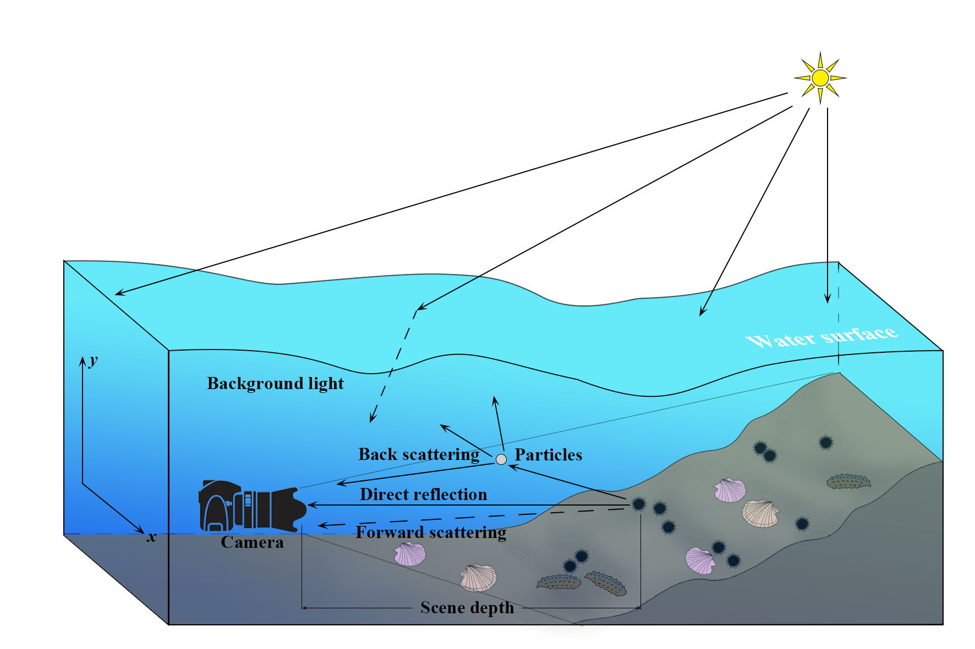

Slide 8
Backward scattering (the fraction of the light reflected by the water towards the camera before it actually reaches the objects in the scene) generally limits the contrast of the images, and haze like effect on the image
Absorption and scattering effects are due not only to the water itself but also to other components such as dissolved organic matter or small observable floating particles
The presence of the floating particles known as “marine snow” increase absorption and scattering effects.
The visibility range can be increased with artificial lighting but these sources not only suffer from the difficulty of scattering and absorption, but in addition tend to illuminate the scene in a non uniform fashion, producing a bright spot in the center of the image with a poorly illuminated area surrounding
Finally, as the amount of light is reduced when we go deeper, colors drop off one by one depending on their wavelengths.

Slide 9
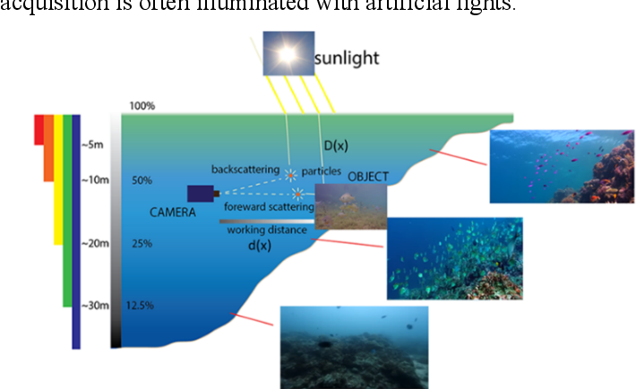

Slide 10
The blue color travels the longest in the water due to its shortest wavelength, making the underwater images to be dominated essentially by blue color.
Image enhancement techniques are used to intensify the image
White Balanced Approach:
This method is also known as Gray World Approach.
White-balancing removes the undesired color castings due to various
illumination or medium attenuation properties.
GAMMA CORRECTION :
Controls the overall brightness of an image.
SHARPENING :
Highlights edges and fine details in an image
WAVELET FUSION :
Process of combining two or more images into a single image by retaining important features from each

Slide 11
Contrast Limited adaptive histogram equalization:
Ordinary AHE tends to over amplify the contrast in near constant regions of the image.
CLAHE is a variant of adaptive histogram equalisation in which contrast amplification is limited, so as to reduce this problem of noise amplification.
In order to limit the noise amplification we use CLAHE .
In CLAHE, the contrast limited procedure has to be applied for each neighbourhood from which a transformation function is derived. Rather than taking the whole image, CLAHE prevents over amplification by dividing the image into small data regions called Tiles and then it performs contrast enhancement.

Slide 12

Previous Model
Global contrast weight(WG1)
Local contrast
Weight
(WL1)
Saliency weight
(WS1)
Exposedness
weight (WE1)
White balance
algorithm
Color Corrected
Image
Input 1
Normalized weight (W1)
Multi-scale Fusion
Output image
Original image
Contrast Enhanced Image
Dark channel
prior algorithm
Normalized weight (W2)
Input 2
Global contrast weight(WG2)
Local contrast
Weight(WL2)
Saliency weight(WS2)
Exposedness
weight (WE2)
12

Slide 13
Proposed Model
13

Slide 14
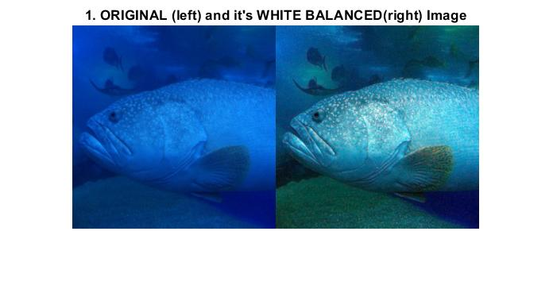
White Balancing :
This method is also known as Gray World Approach.
White-balancing removes the undesired color castings due to various illumination or medium attenuation properties.
Original Image
White Balancing

Slide 15
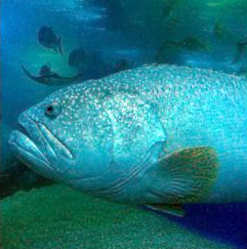
Color Correction:
Controls the overall brightness of an image.
SHARPENING :
Highlights edges and fine details in an image
Color Correction

Slide 16
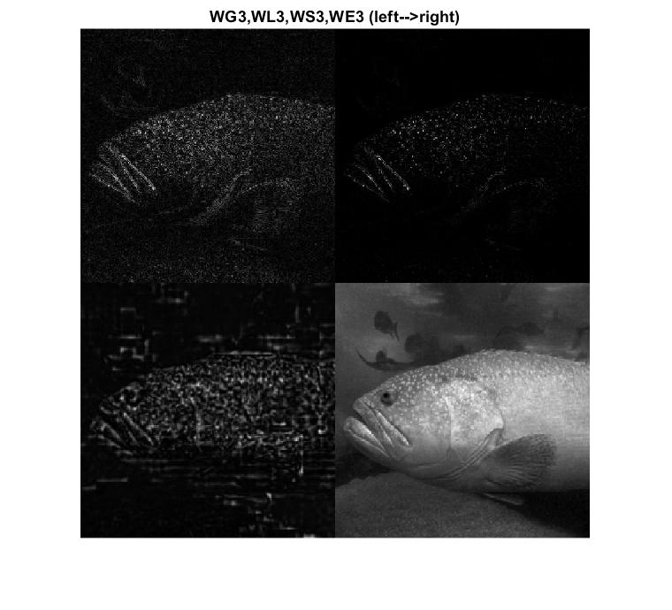
Global Contrast
Laplacian contrast weight (WL) deals with global contrast by applying a Laplacian filter on each input luminance channel and computing the absolute value of the filter result.
Global Contrast

Slide 17
Local contrast weight (WLC)
It comprises the relation between each pixel and its neighborhoods average.
The impactof this measure is to strengthen the local contrast appearance since it advantages the transitions mainly in the highlighted and shadowed parts of the second input.
Local Contrast

Slide 18
The (WLC) is computed as the standard deviation between pixel luminance level and the local average of its surrounding region:
WLC(x, y) =|| I^{k} - I^{k}_{wc} ||
where I^{k} represents the luminance channel of the input
I^{k}_{wc} represents the low-passed version of it.
The filtered version I^{k}_{wc} is obtained by employing a small 5 × 5,
([1, 4, 6, 4, 1]/16) separable binomial kernel with the high frequency cut-off value w_{hc} = π/2.75

Slide 19
Saliency weight
To measure this quality, we have employed the saliency algorithm
This computationally efficient saliency algorithm is straight forward to be implemented being inspired by the biological concept of center-surround contrast
However, the saliency map tends to favour highlighted areas.To increase the accuracy of results,we introduce the exposedness map to protect the mid tones that might be altered in some specific cases
Saliency

Slide 20
Exposedness weight
It evaluates how well a pixel is exposed.
This assessed quality provides an estimator to preserve a constant appearance of the local contrast, that ideally is neither exaggerated nor understated.
Commonly,the pixels tend to have a higher exposed appearance when their normalized values are close to the average value of 0.5.
Exposedness

Slide 21
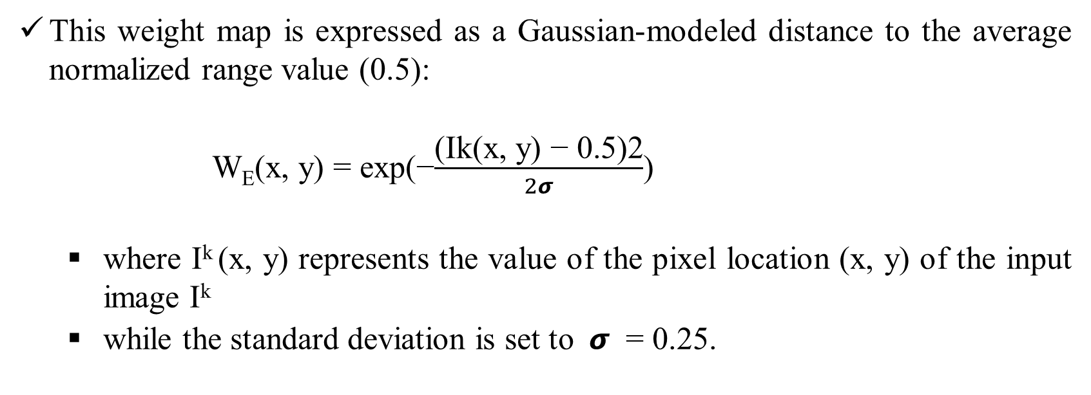
This weight map is expressed as a Gaussian-modeled distance to the average normalized range value (0.5):
W_{E}(x, y) = exp(−$\frac{\text{(}\text{Ik}\text{(}\text{x}\text{, }\text{y}\text{) − 0.5)2}}{2σ}$)
where $\text{I}\text{k}$(x, y) represents the value of the pixel location (x, y) of the input image $\text{I}\text{k}$
while the standard deviation is set to $σ$ = 0.25.

Slide 22
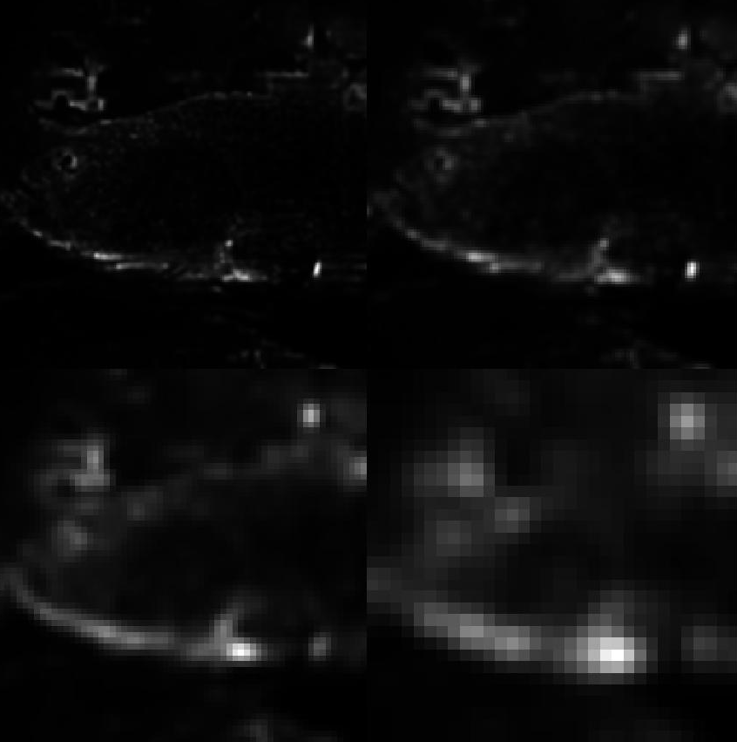
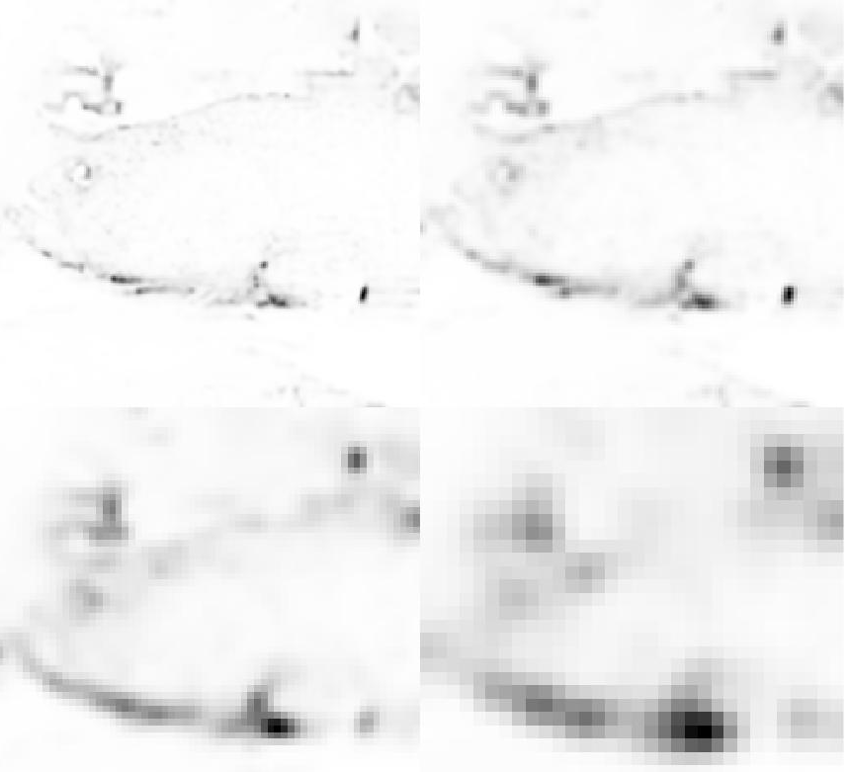
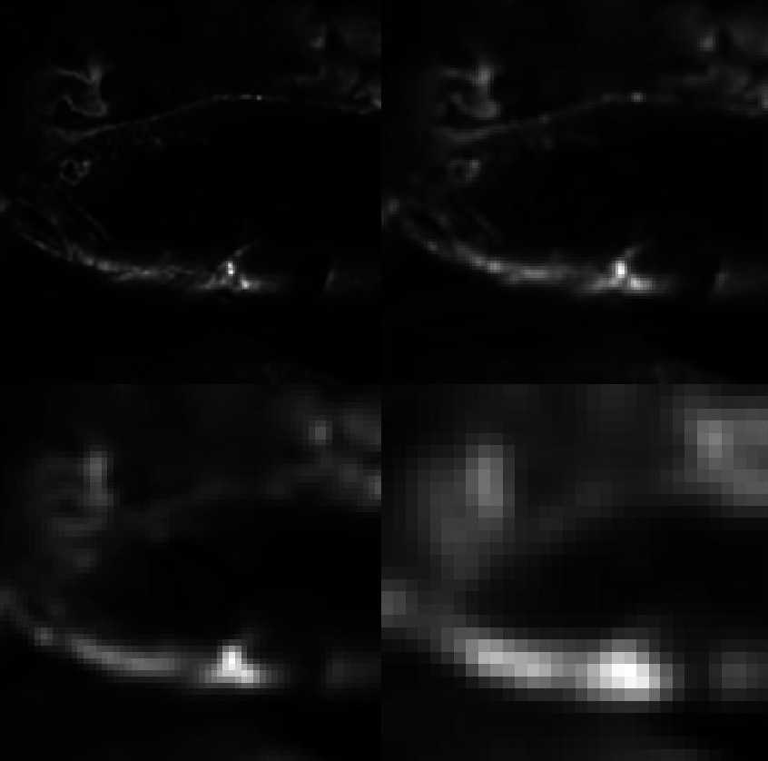
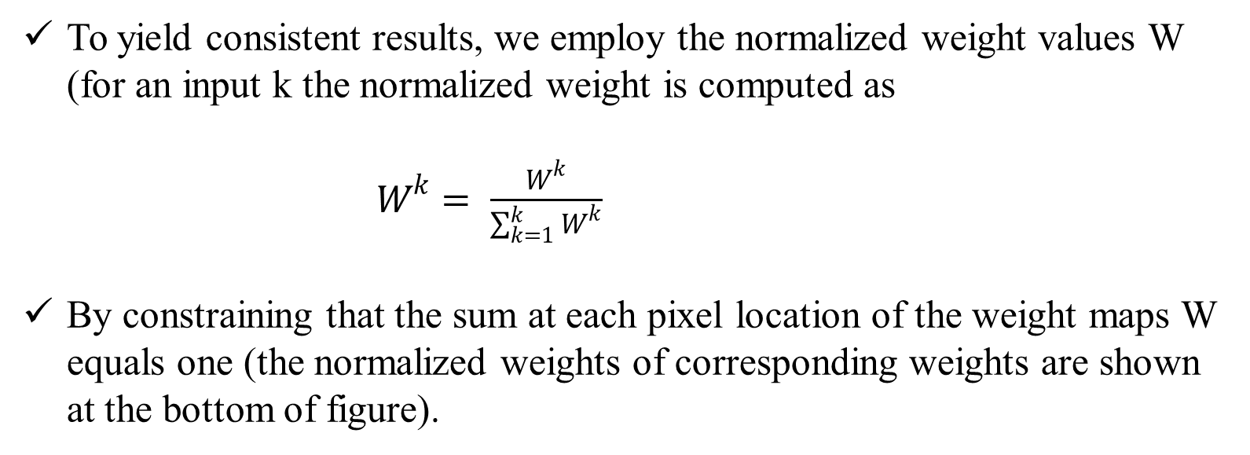
Normalized weights
To yield consistent results, we employ the normalized weight values W (for an input k the normalized weight is computed as
$W^{k}= \frac{W^{k}}{\sum_{k=1}^{k}{W^{k}}}$
By constraining that the sum at each pixel location of the weight maps W equals one (the normalized weights of corresponding weights are shown at the bottom of figure).

Slide 23

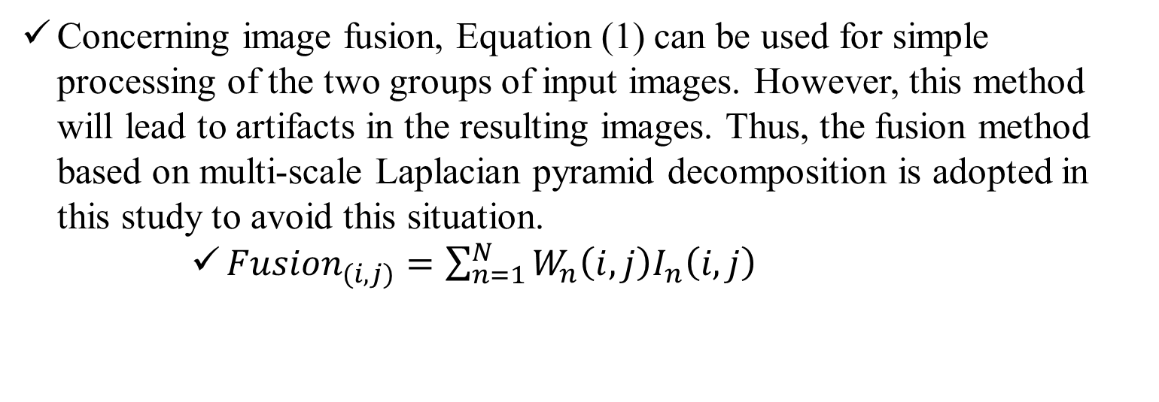
Multi-Scale Fusion
Concerning image fusion, Equation (1) can be used for simple processing of the two groups of input images. However, this method will lead to artifacts in the resulting images. Thus, the fusion method based on multi-scale Laplacian pyramid decomposition is adopted in this study to avoid this situation.
${Fusion}_{(i,j)}=\sum_{n=1}^{N}{W_{n}\left(i,j\right)I_{n}\left(i,j\right)}$
Fused Output

Slide 24
Results and discussion
Experimental results are exhibited to assess the performance of the proposed approach. Qualitative results, quantitative results, and applications are implemented, respectively.
Three existing excellent underwater images processing methods are utilized to compare with the proposed approach, that is, CLAHE, DCP, and FB.
Most of the images used for the experiments come from UIEB data set, U45 data set, and real-world underwater image enhancement (RUIE) dataset.
All experiments in this article were implemented in Matlab R2021b.

Slide 25
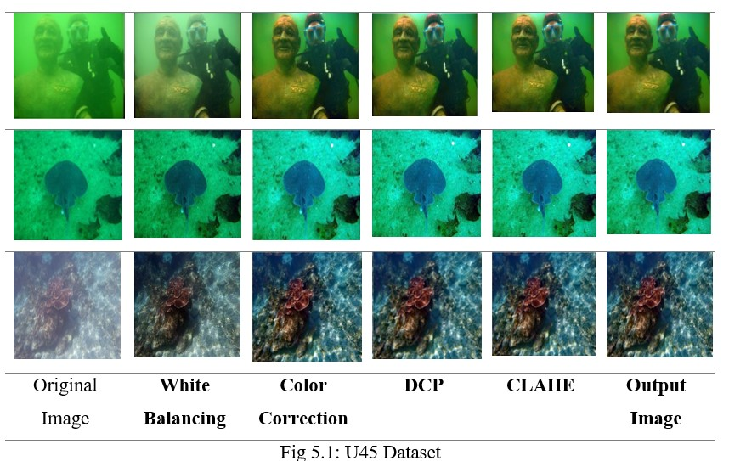
Qualitative Results:
The following images are from different datasets like U45, RUIE, and UIEB. Each block is the output of the images of different algorithms like White Balance, Color Correction, DCP, CLAHE, and finally, the fused Output image.

Slide 26
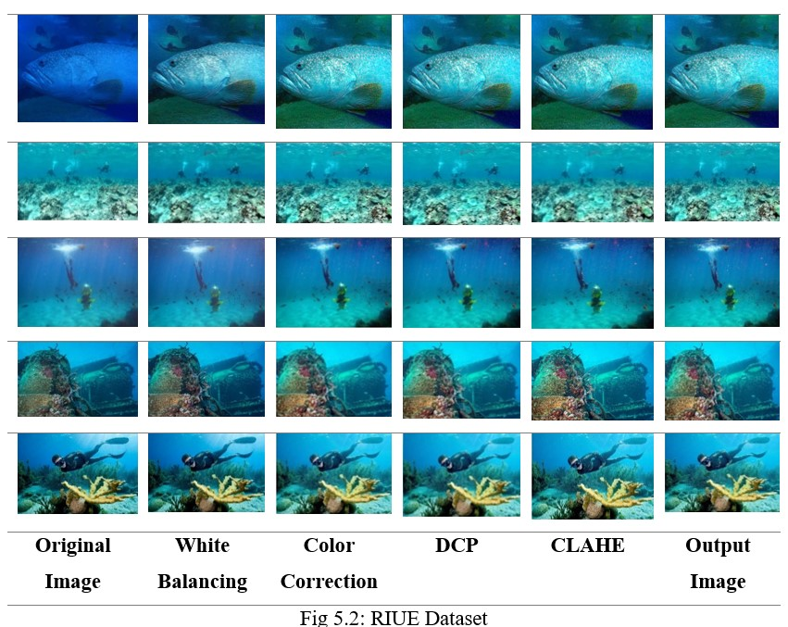

Slide 27
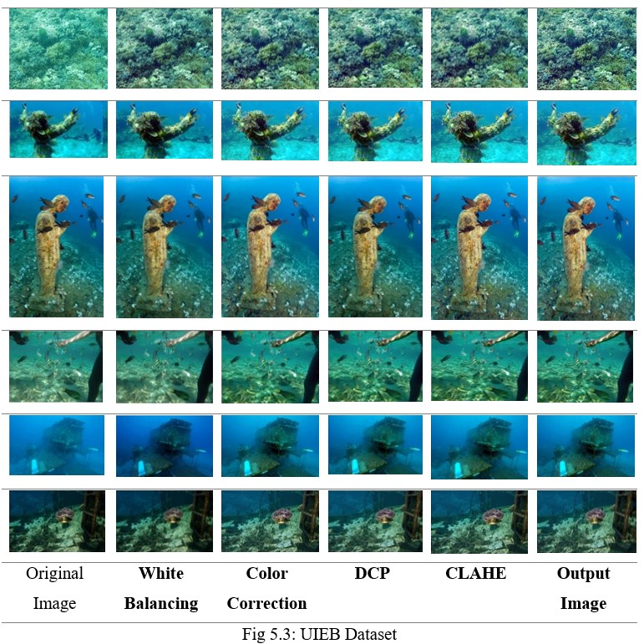

Slide 28
Qualitative results for U45 dataset
Metric | Results from [23] reference | Proposed Method
Entropy | 7.41 | 7.43
MSE | 2199.96 | 2216.48
PSNR | 16.467 | 16.55
SSIM | 0.68 | 0.69
UICM | -60.50 | -59.55
UISM | 7.13 | 7.20
UIConM | 0.75 | 0.78
UIQM | 3.07 | 3.14
UICQE | 0.57 | 0.58

Slide 29
Qualitative results for RUIE dataset
Metric | Results from [23] reference | Proposed Method
Entropy | 7.53 | 7.59
MSE | 2078.62 | 2076.77
PSNR | 15.94 | 16.17
SSIM | 0.40 | 0.42
UICM | -33.60 | -30.24
UISM | 4.48 | 4.30
UIConM | 0.78 | 0.80
UIQM | 3.18 | 3.21
UICQE | 0.55 | 0.56

Slide 30
Qualitative results for RUIE dataset
Metric | Results from [23] reference | Proposed Method
Entropy | 7.35 | 7.40
MSE | 1554.49 | 1407.55
PSNR | 17.88 | 18.59
SSIM | 0.76 | 0.77
UICM | -51.02 | -49.33
UISM | 5.28 | 5.17
UIConM | 1.34 | 1.36
UIQM | 4.90 | 5.05
UICQE | 0.56 | 0.57

Slide 31
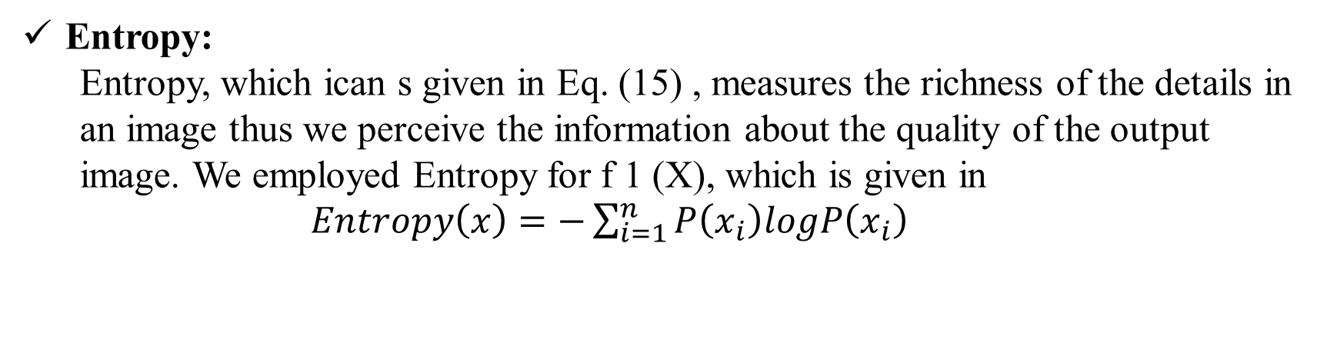
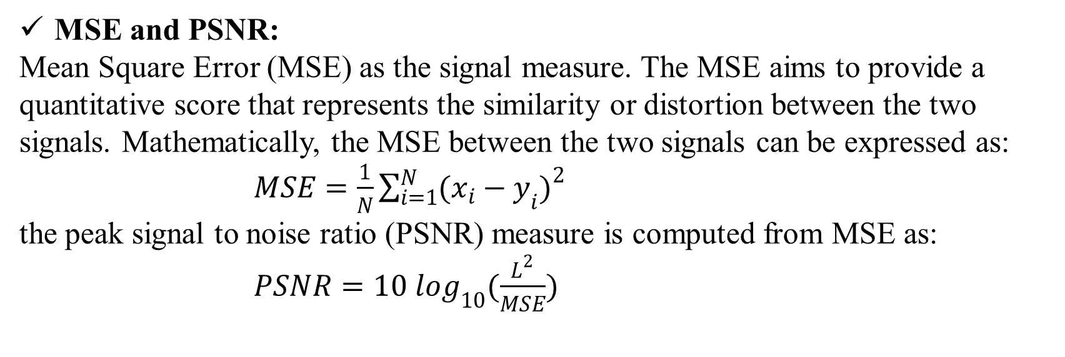
Metrics for evaluating the quality
Entropy:
Entropy, which ican s given in Eq. (15) , measures the richness of the details in an image thus we perceive the information about the quality of the output image. We employed Entropy for f 1 (X), which is given in
$Entropy\left(x\right)=−\sum_{i=1}^{n}{P\left(x_{i}\right)logP\left(x_{i}\right)}$
MSE and PSNR:
Mean Square Error (MSE) as the signal measure. The MSE aims to provide a quantitative score that represents the similarity or distortion between the two signals. Mathematically, the MSE between the two signals can be expressed as:
$MSE=\frac{1}{N}\sum_{i=1}^{N}{{(x_{i}−y_{i})}^{2}}$
the peak signal to noise ratio (PSNR) measure is computed from MSE as:
$PSNR=10 \log_{10}(\frac{L^{2}}{MSE})$

Slide 32
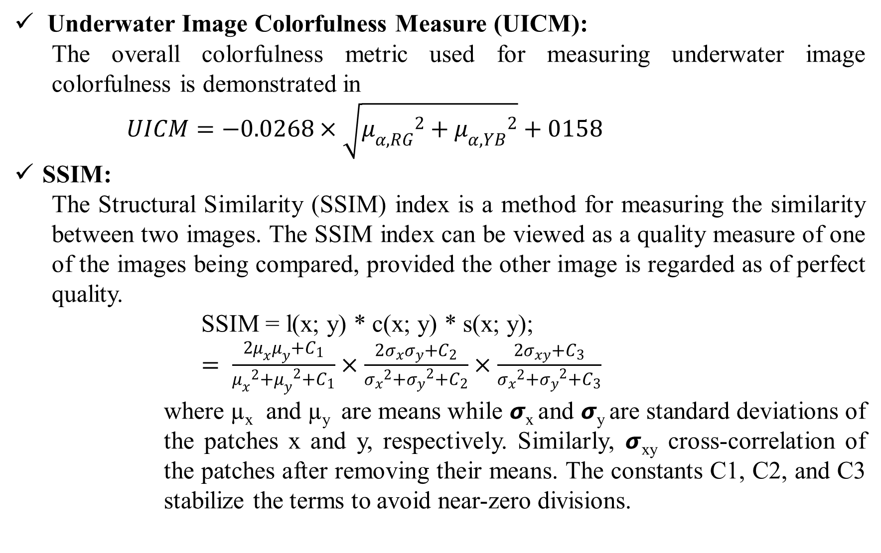
Underwater Image Colorfulness Measure (UICM):
The overall colorfulness metric used for measuring underwater image colorfulness is demonstrated in
$UICM=−0.0268×\sqrt{{μ_{α,RG}}^{2}+{μ_{α,YB}}^{2}}+0158$
SSIM:
The Structural Similarity (SSIM) index is a method for measuring the similarity between two images. The SSIM index can be viewed as a quality measure of one of the images being compared, provided the other image is regarded as of perfect quality.
SSIM = l(x; y) * c(x; y) * s(x; y);
$= \frac{2μ_{x}μ_{y}+C_{1}}{{μ_{x}}^{2}{{+μ}_{y}}^{2}+C_{1}}×\frac{2σ_{x}σ_{y}+C_{2}}{{σ_{x}}^{2}{{+σ}_{y}}^{2}+C_{2}}×\frac{2σ_{xy}+C_{3}}{{σ_{x}}^{2}{{+σ}_{y}}^{2}+C_{3}}$
where µ_{x} and µ_{y} are means while 𝞼_{x} and 𝞼_{y} are standard deviations of the patches x and y, respectively. Similarly, 𝞼_{xy} cross-correlation of the patches after removing their means. The constants C1, C2, and C3 stabilize the terms to avoid near-zero divisions.

Slide 33
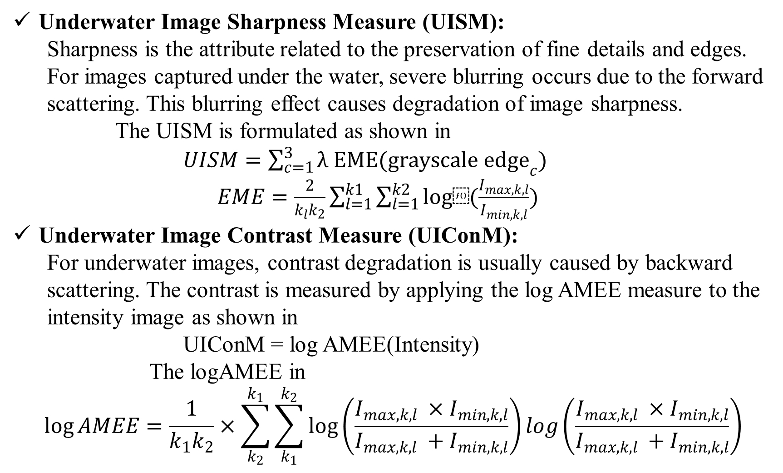
Underwater Image Sharpness Measure (UISM):
Sharpness is the attribute related to the preservation of fine details and edges. For images captured under the water, severe blurring occurs due to the forward scattering. This blurring effect causes degradation of image sharpness.
The UISM is formulated as shown in
$UISM=\sum_{c=1}^{3}{λ EME(grayscale {edge}_{c})}$
$EME=\frac{2}{k_{l}k_{2}}\sum_{l=1}^{k1}{\sum_{l=1}^{k2}{log⁡(\frac{I_{max,k,l}}{I_{min,k,l}}}})$
Underwater Image Contrast Measure (UIConM):
For underwater images, contrast degradation is usually caused by backward scattering. The contrast is measured by applying the log AMEE measure to the intensity image as shown in
UIConM = log AMEE(Intensity)
The logAMEE in
$$\log{AMEE=\frac{1}{k_{1}k_{2}}×\sum_{k_{2}}^{k_{1}}{\sum_{k_{1}}^{k_{2}}{\log\left(\frac{I_{max,k,l} ×{ I}_{min,k,l}}{I_{max,k,l} +{ I}_{min,k,l}}\right)log\left(\frac{I_{max,k,l} ×{ I}_{min,k,l}}{I_{max,k,l} +{ I}_{min,k,l}}\right)}}}$$

Slide 34
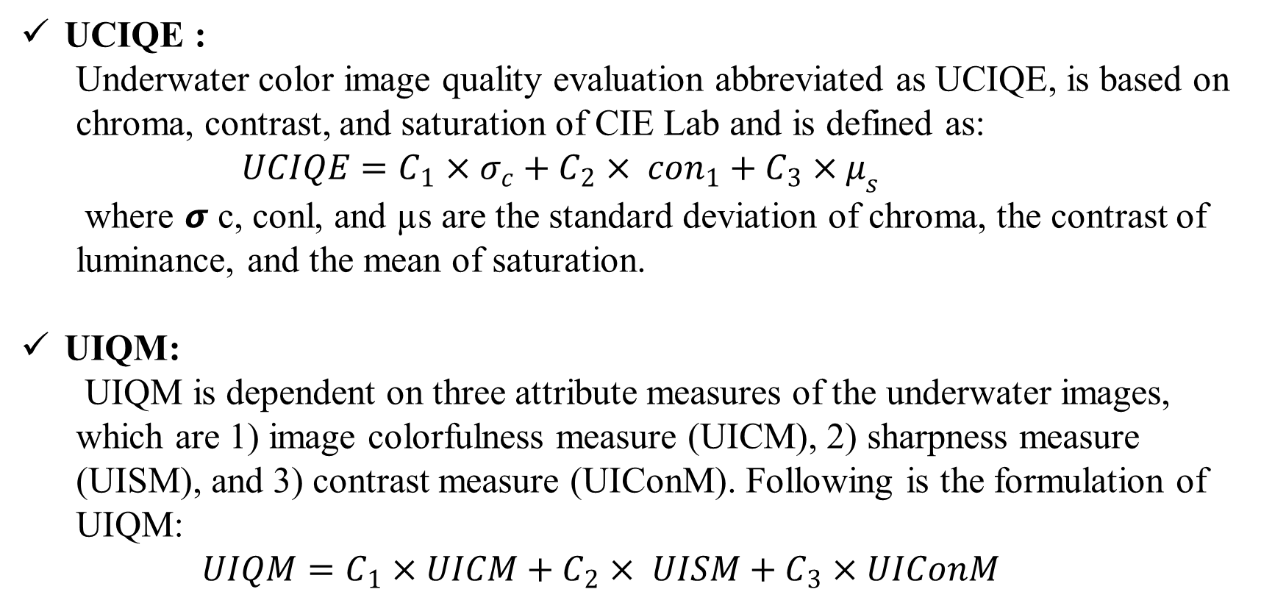
UCIQE :
Underwater color image quality evaluation abbreviated as UCIQE, is based on chroma, contrast, and saturation of CIE Lab and is defined as:
$UCIQE=C_{1}×σ_{c}+C_{2}× {con}_{1}+C_{3}×μ_{s}$
where 𝞼 c, conl, and µs are the standard deviation of chroma, the contrast of luminance, and the mean of saturation.
UIQM:
UIQM is dependent on three attribute measures of the underwater images, which are 1) image colorfulness measure (UICM), 2) sharpness measure (UISM), and 3) contrast measure (UIConM). Following is the formulation of UIQM:
$$UIQM=C_{1}×UICM+C_{2}× UISM+C_{3}×UIConM$$

Slide 35
Conclusion:
We proposed a new method to enhance the underwater images, by using the CLAHE algorithm in this project to achieve better contrast in images. We used MSE, PSNR, SSIM, UICM, UISM, UIConM, UIQM, and UICQE metrics to measure image contrast.
This approach has successfully corrected the color cast and removed the haze of the underwater image, based on the qualitative results obtained.
In addition to achieving the highest average UIQM value compared to those of the advanced methods, the quantitative results demonstrate that the proposed approach also maintains an excellent performance on different levels of distorted and hazy images.

Slide 36


Slide 37
THANK YOU!
Dept. of ECE, Aditya Engineering College

