Slide 1

WELCOME
Dept. of ECE, Aditya Engineering College

Slide 2

Underwater Image Enhancement using CLAHE
BATCH No. – (B9)
M.Pallavi - 19A95A0410
N.Vasu - 18A91A0498
K.Sudheer -18A91A0488
T.Siva Ram-17A91A04B3
Project Guide:
Dr. Gulivindala Suresh _{M.TECH., Ph.D.}
Professor,
Department of ECE,
2
Department of Electronics and Communication Engineering,
Aditya Engineering College(A)
ADB Road, Surampalem, East Godavari (Dt). A.P.

Slide 3
Contents
Block Diagram
White Balanced
CLAHE
Color Correction
Global Contrast
Local contrast
Saliency
Exposedness
Normalized weights

Slide 4

Proposed Model
Global contrast weight(WG1)
Local contrast
Weight(WL1)
Saliency weight(WS1)
Exposedness
weight (WE1)
White balance
algorithm
Color Corrected
Image
Input 1
Normalized weight (W1)
Dark channel
prior algorithm
Multi-scale Fusion
Output image
Original image
Contrast Enhanced Image
Normalized weight (W2)
Input 2
Global contrast weight(WG2)
Local contrast
Weight(WL2)
Saliency weight(WS2)
Exposedness
weight (WE2)
4

Slide 5
Image Reading
function img = load_image(num)
num=57
prefix = 'C:\Users\vasu\Desktop\matcodes\';
suffix = '.jpg';
path = [prefix,num2str(num),suffix];
img = imread(path);
end

Slide 6
clc;
clear all;
close all;
image=load_image;
img1 =white(image);lab1 = rgb_to_lab(img1);
lab2 = lab1;
lab2(:, :, 1) = adapthisteq(lab2(:, :, 1));
img2 = lab_to_rgb(lab2);
figure; imshow(img2),title("CLAHE image");
R1 = double(lab1(:, :, 1)/255);
R2 = double(lab2(:, :, 1)/255);
WL1 = Global_contrast(R1); WL2 = Global_contrast(R2);
WLC1=local_contrast(R1); WLC2=local_contrast(R2);
WS1 = saliency_detection(img1); WS2 = saliency_detection(img2);
WE1 = expo(R1); WE2 = expo(R2);
N1 = (WL1 + WLC1 + WS1 + WE1) ./ (WL1 + WLC1 + WS1 + WE1 + WL2 + WLC2 + WS2 + WE2);

Slide 7
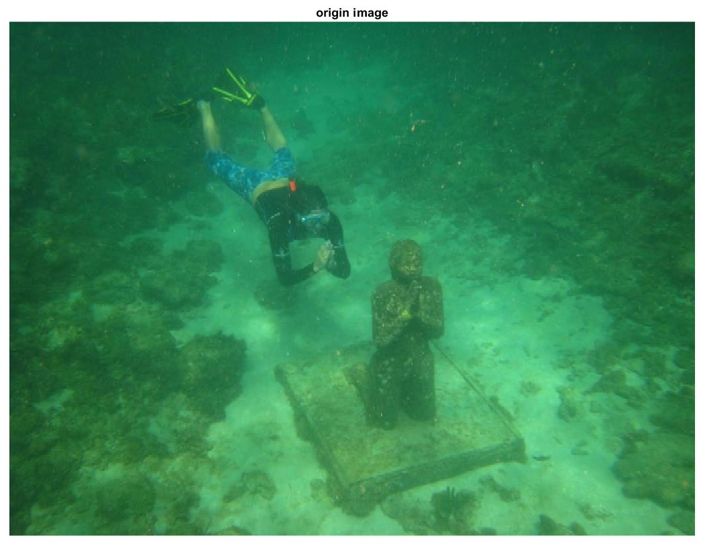
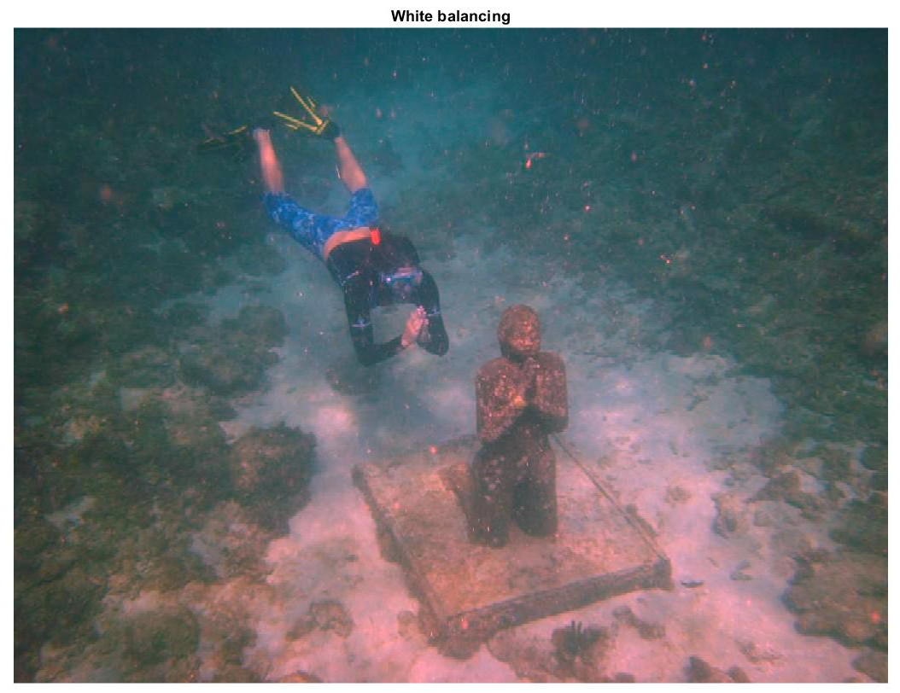
White Balancing :
This method is also known as Gray World Approach.
White-balancing removes the undesired color castings due to various illumination or medium attenuation properties.

Slide 8
function J=rgbImage_white_balance(img)
image=img;
rgbImage=image;
rgbImage=im2double(rgbImage);
grayImage = rgb2gray(rgbImage);
% Extract the individual red, green, and blue color channels.
redChannel = rgbImage(:, :, 1); greenChannel = rgbImage(:, :, 2); blueChannel = rgbImage(:, :, 3);
meanR = mean2(redChannel); meanG = mean2(greenChannel); meanB = mean2(blueChannel); meanGray = mean2(grayImage);
% Make all channels have the same mean
redChannel = (double(redChannel) * meanGray / meanR);greenChannel = (double(greenChannel) * meanGray / meanG);
blueChannel = (double(blueChannel) * meanGray / meanB);
%redChannel and blueChannel Correction
redChannel=redChannel-0.3*(meanG-meanR).*greenChannel.*(1-redChannel);
blueChannel=blueChannel+0.3*(meanG-meanB).*greenChannel.*(1-blueChannel);
% Recombine separate color channels into a single, true color RGB image.
rgbImage_white_balance = cat(3, redChannel, greenChannel, blueChannel);
figure;
imshow(rgbImage_white_balance);
title('White balancing'); end

Slide 9
Contrast Limited adaptive histogram equalization:
Ordinary AHE tends to over amplify the contrast in near constant regions of the image.
CLAHE is a variant of adaptive histogram equalisation in which contrast amplification is limited, so as to reduce this problem of noise amplification.
In order to limit the noise amplification we use CLAHE .
In CLAHE, the contrast limited procedure has to be applied for each neighbourhood from which a transformation function is derived. Rather than taking the whole image, CLAHE prevents over amplification by dividing the image into small data regions called Tiles and then it performs contrast enhancement.

Slide 10
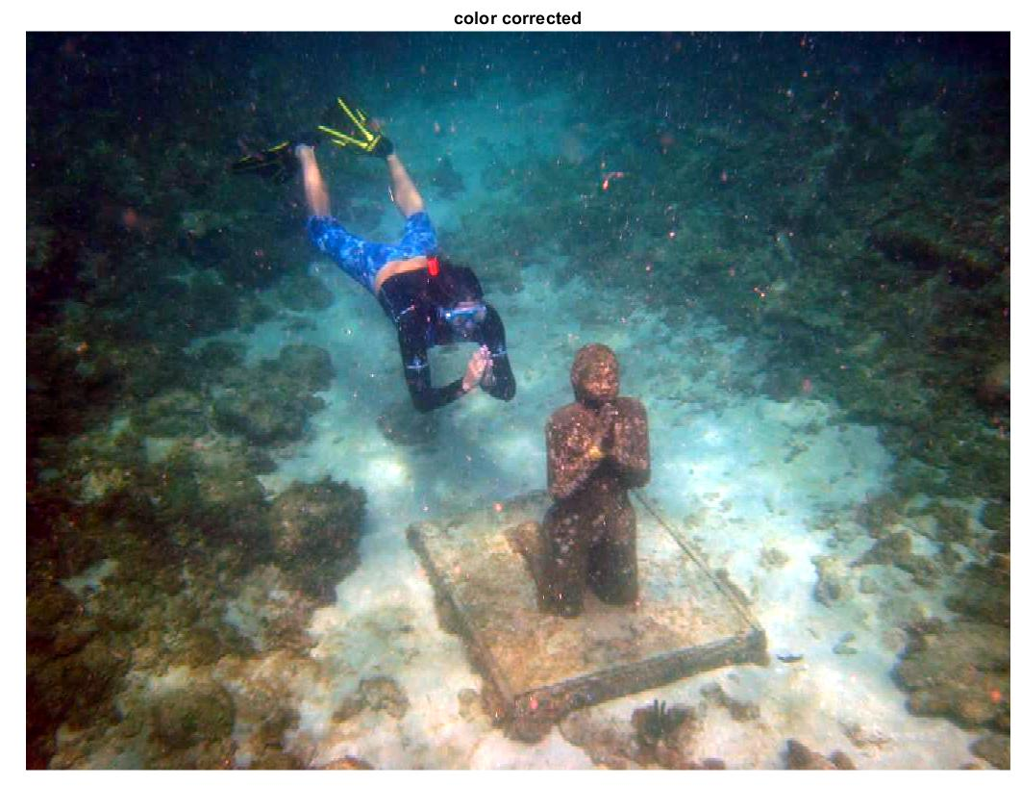
Color Correction:
Controls the overall brightness of an image.
SHARPENING :
Highlights edges and fine details in an image

Slide 11
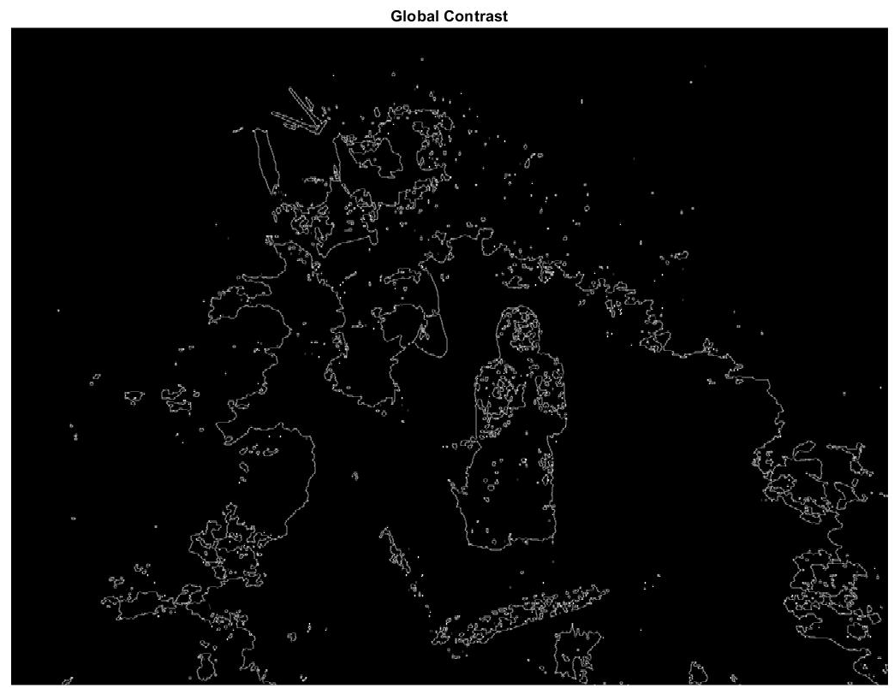
Global Contrast
Laplacian contrast weight (WL) deals with global contrast by applying a Laplacian filter on each input luminance channel and computing the absolute value of the filter result.

Slide 12

Local contrast weight (WLC)
It comprises the relation between each pixel and its neighborhoods average.
The impactof this measure is to strengthen the local contrast appearance since it advantages the transitions mainly in the highlighted and shadowed parts of the second input.

Slide 13
The (WLC) is computed as the standard deviation between pixel luminance level and the local average of its surrounding region:
WLC(x, y) =|| I^{k} - I^{k}_{wc} ||
where I^{k} represents the luminance channel of the input
I^{k}_{wc} represents the low-passed version of it.
The filtered version I^{k}_{wc} is obtained by employing a small 5 × 5,
([1, 4, 6, 4, 1]/16) separable binomial kernel with the high frequency cut-off value w_{hc} = π/2.75

Slide 14
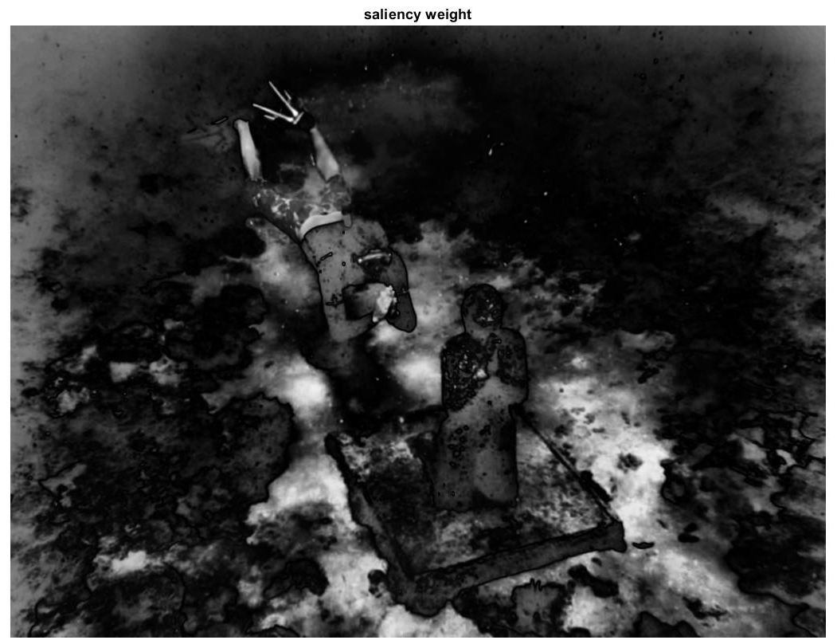
Saliency weight
To measure this quality, we have employed the saliency algorithm
This computationally efficient saliency algorithm is straight forward to be implemented being inspired by the biological concept of center-surround contrast
However, the saliency map tends to favour highlighted areas.To increase the accuracy of results,we introduce the exposedness map to protect the mid tones that might be altered in some specific cases

Slide 15
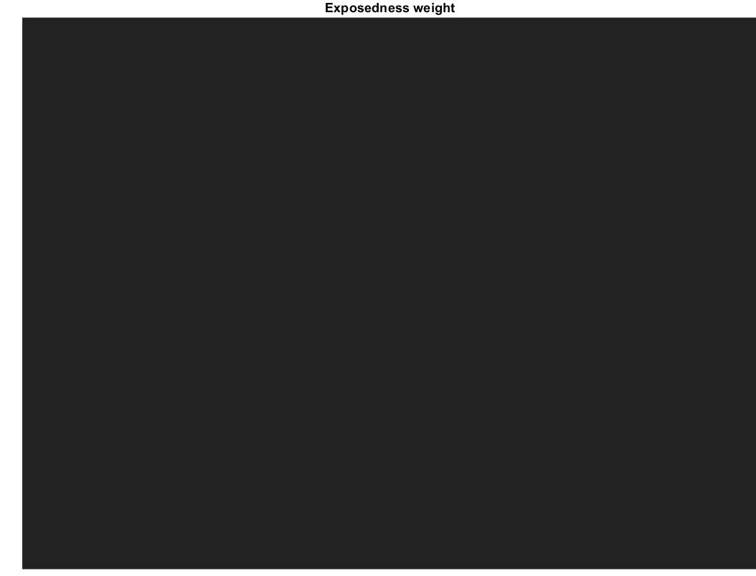
Exposedness weight
It evaluates how well a pixel is exposed.
This assessed quality provides an estimator to preserve a constant appearance of the local contrast, that ideally is neither exaggerated nor understated.
Commonly,the pixels tend to have a higher exposed appearance when their normalized values are close to the average value of 0.5.

Slide 16
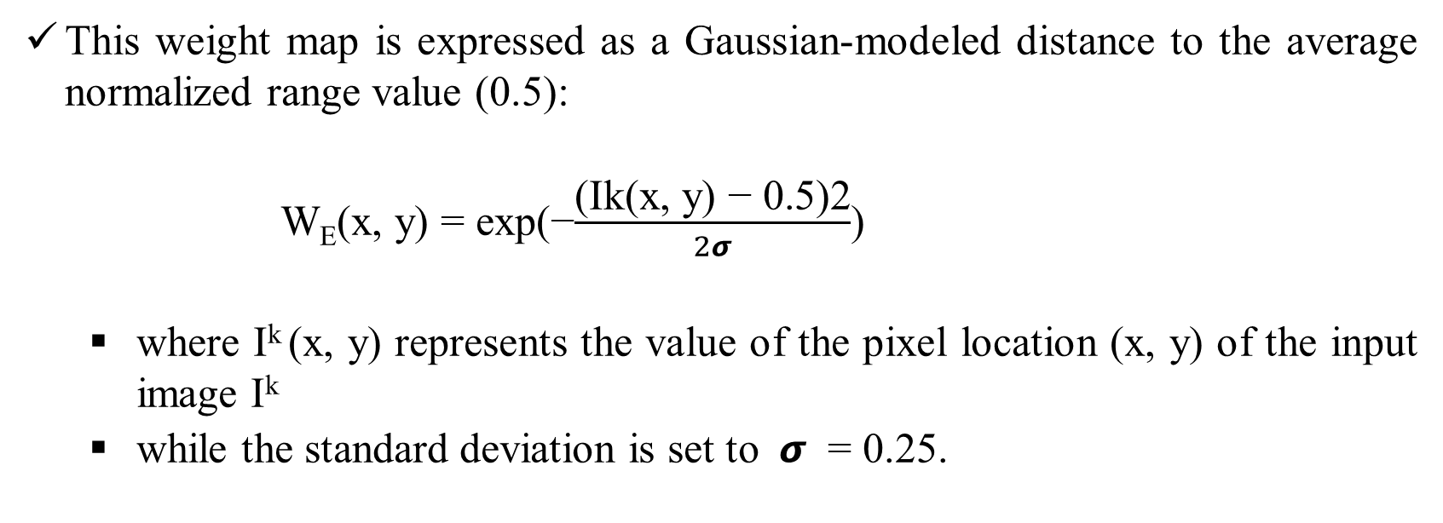
This weight map is expressed as a Gaussian-modeled distance to the average normalized range value (0.5):
W_{E}(x, y) = exp(−$\frac{\text{(}\text{Ik}\text{(}\text{x}\text{, }\text{y}\text{) − 0.5)2}}{2σ}$)
where $\text{I}\text{k}$(x, y) represents the value of the pixel location (x, y) of the input image $\text{I}\text{k}$
while the standard deviation is set to $σ$ = 0.25.

Slide 17
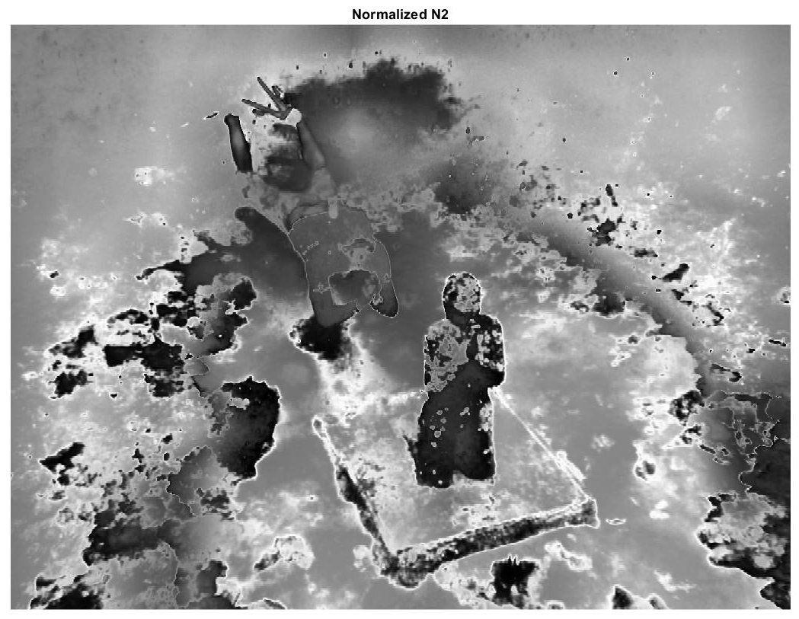
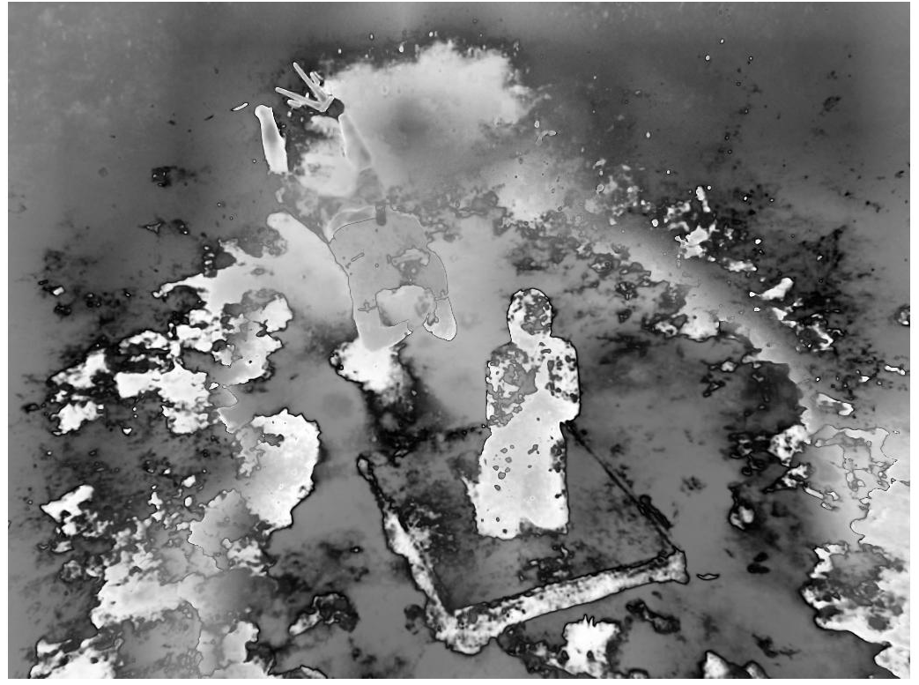
Normalized weights
To yield consistent results, we employ the normalized weight values W (for an input k the normalized weight is computed as
W^{k} = W^{k}/∑^{k}_{k=1} W^{k}
By constraining that the sum at each pixel location of the weight maps W equals one (the normalized weights of corresponding weights are shown at the bottom of figure).

Slide 18


Slide 19
Original image
Global contrast weight
(WG)
White balance
algorithm
Local contrast
Weight
(WL)
Color Corrected
Image
Normalized weight (W)
Multi-scale Fusion
Exposedness
weight (WE)
CLAHE
Output image
Dark channel
prior algorithm
Saliency weight
(WS)

Slide 20
THANK YOU!
Dept. of ECE, Aditya Engineering College

