Slide 1

WELCOME
Dept. of ECE, Aditya Engineering College

Slide 2

Underwater Image Enhancement using CLAHE
BATCH No. – (B9)
M.Pallavi - 19A95A0410
N.Vasu - 18A91A0498
K.Sudheer -18A91A0488
T.Siva Ram-17A91A04B3
Project Guide:
Dr. Gulivindala Suresh _{M.TECH., Ph.D.}
Professor,
Department of ECE,
2
Department of Electronics and Communication Engineering,
Aditya Engineering College(A)
ADB Road, Surampalem, East Godavari (Dt). A.P.

Slide 3
Contents
Aim
Objectives
Introduction
Literature Survey
Proposed Model
Estimated Project Completion time

Slide 4
Aim
Aim of this project is to enhance the underwater images which are affected by color distortion, contrast reduction and haziness.
Dept. of ECE, Aditya Engineering College

Slide 5
Objectives
Contrast limited adaptive histogram equalization (CLAHE) is used for improve the visibility level of foggy image.
Initially, the original image is pre-processed by the white balance algorithm for colour correction.White balance algorithm involves the process of removing unrealistic color casts in an underwater image.
This color corrected image is treated with dark channel prior dehazing method to obtain contrast enhancement. These two input images viz., i. Color corrected and ii. Contrast enhanced are further processed by multiscale fusion strategy.
Experimentation can be carried out on standard database RUIE of 400 images and U45 dataset to evaluate the performance of this approach in terms of mean square error, peak-signal-to-noise-ratio
Dept. of ECE, Aditya Engineering College

Slide 6
Introduction
Due to scattering, absorption and refraction, Underwater images have low contrast, bluriness and color cast. This result in images being less clear and not trustworthy for applications.
The presence of dust particles leads to the phenomenon of scattering in underwater medium.
The reflected light from the outside of the object reaches the camera, and a scattering effect is formed when the light interacts with the floating particles present in the imaging medium.
The two types of scattering that affect underwater images are forward scattering and backward scattering
Forward scattering (randomly deviated light on its way from an object to the camera) generally leads to blurring of the image features.

Slide 7
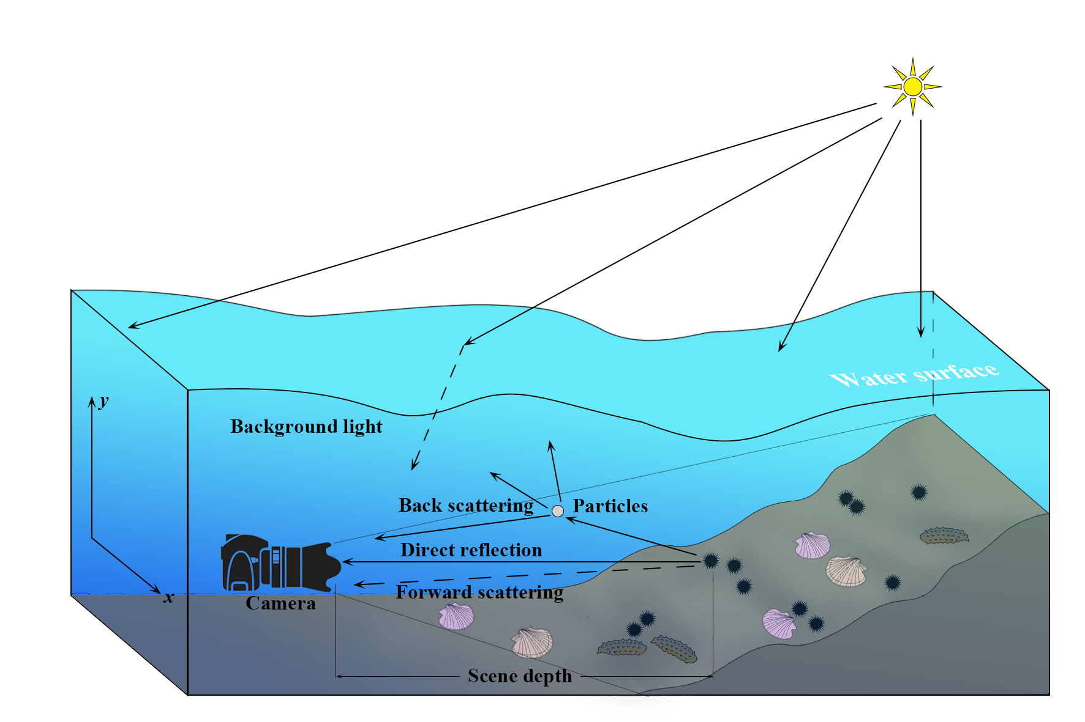

Slide 8
Backward scattering (the fraction of the light reflected by the water towards the camera before it actually reaches the objects in the scene) generally limits the contrast of the images, and haze like effect on the image
Absorption and scattering effects are due not only to the water itself but also to other components such as dissolved organic matter or small observable floating particles
The presence of the floating particles known as “marine snow” increase absorption and scattering effects.
The visibility range can be increased with artificial lighting but these sources not only suffer from the difficulty of scattering and absorption, but in addition tend to illuminate the scene in a non uniform fashion, producing a bright spot in the center of the image with a poorly illuminated area surrounding
Finally, as the amount of light is reduced when we go deeper, colors drop off one by one depending on their wavelengths.

Slide 9
The blue color travels the longest in the water due to its shortest wavelength, making the underwater images to be dominated essentially by blue color.
Image enhancement techniques are used to intensify the image
  White Balanced Approach:
    This method is also known as Gray World Approach.
    White-balancing removes the undesired color castings due to various
    illumination or medium attenuation properties.
  GAMMA CORRECTION :
    Controls the overall brightness of an image.
  SHARPENING :
    Highlights edges and fine details in an image
  WAVELET FUSION :
    Process of combining two or more images into a single image by retaining important features from each

Slide 10
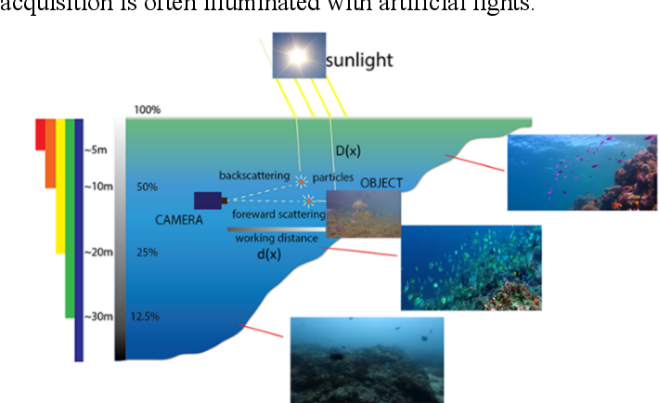

Slide 11
Contrast Limited adaptive histogram equalization:
Ordinary AHE tends to over amplify the contrast in near constant regions of the image.
CLAHE is a variant of adaptive histogram equalisation in which contrast amplification is limited, so as to reduce this problem of noise amplification.
In order to limit the noise amplification we use CLAHE .
In CLAHE, the contrast limited procedure has to be applied for each neighbourhood from which a transformation function is derived. Rather than taking the whole image, CLAHE prevents over amplification by dividing the image into small data regions called Tiles and then it performs contrast enhancement.

Slide 12
Literature Survey
S.No | TITLE | YEAR | METHODS | REMARKS
1. | Color Balance and Fusion for Underwater Image Enhancement | 2017 | white-balancing, Gamma Correction, multi-scale fusion | Computationally efficient,limited precision
2. | A Hybrid DCT-CLAHE Approach for Brightness Enhancement of Uneven-illumination Underwater Images | 2018 | Brightness Equalization; Image Enhancement; DCT Coefficient | The method is used to enhance only the too darkened or overly brightened regions of images by regulating the low-frequency part of image DCT coefficients.
Dept. of ECE, Aditya Engineering College

Slide 13
S.No | TITLE | YEAR | METHODS | REMARKS
3. | Underwater image enhancement using blending of CLAHE and percentile methodology | 2018 | Contrast-Limited Adaptive Histogram Equalization (CLAHE) and Percentile methodologies | A disadvantage of this method is its high 'instability'
4. | Practical Method for the Underwater Image Enhancement with Adjusted CLAHE | 2018 | histogram equalization and also contrast-limited adaptive histogram equalization | we can't exactly say, that this method is the best method for underwater image enhancement.
5. | Enhancement of Underwater Images using Improved CLAHE | 2018 | dynamic histogram equalization technique, contrast limited adaptive histogram equalization. | DHE does not preserve brightness of an image, CLAHE operates on small regions in the image, called tiles, rather than the entire image

Slide 14
S.No | TITLE | YEAR | METHODS | REMARKS
6. | Fast Under Water Image Enhancement for Real Time Applications | 2021 | histogram equalization techniques for dehazing and automatic white balancing algorithms, UIEB | A disadvantage of the method is that it is indiscriminate. It gives unsatisfactory results if the image contains multiple colour casts of variable colours and brightness.
7. | Underwater image enhancement using contrast limited adaptive histogram equalization and layered difference representation | 2021 | CLAHE ,LDR, Contrast correction, Color correction | This technique does not consider the spatial relationship between neighboring pixels.
8. | Fusion-Based Approach For Quality Enhancement Of Underwater Images | 2021 | EMDW, CLAHE, SVD, DWT, Weighted Average And Underwater Image Quality Measures | Contrast of the target area cannot be enhanced and there is background noise.

Slide 15
Proposed Model
Global contrast weight(WG1)
Local contrast
Weight(WL1)
Saliency weight(WS1)
Exposedness
weight (WE1)
White balance
algorithm
Color Corrected
Image
Input 1
Normalized weight (W1)
Dark channel
prior algorithm
Multi-scale Fusion
Output image
Original image
Contrast Enhanced Image
Normalized weight (W2)
Input 2
Global contrast weight(WG2)
Local contrast
Weight(WL2)
Saliency weight(WS2)
Exposedness
weight (WE2)
15

Slide 16
Estimated Project Completion time
Task | Duration
Implementation of the Proposed Model | 3 Month
Drafting Project Report | 1 Month
Software Tool Used: MATLAB
Dept. of ECE, Aditya Engineering College

Slide 17
Reference Papers
Yue Zhang, Fuchun Yang, Weikai HeFirst Published September 30, 2020, An approach for underwater image enhancement based on color correction and dehazing, Research Article https://doi.org/10.1177/1729881420961643
Codruta O. Ancuti,Cosmin Ancuti,Christophe De Vleeschouwer,Philippe Bekaert Published 05 October 2017,Color Balance and Fusion for Underwater Image Enhancement, DOI: 10.1109/TIP.2017.2759252
Diksha Garg, Naresh Kumar Garg & Munish Kumar Published 20 March 2018,Underwater image enhancement using blending of CLAHE and percentile methodologies, https://doi.org/10.1007/s11042-018-5878-8
Omer Deperlioglu and Utku Kose Published 30 September 2018,Practical Method for the Underwater Image Enhancement with Adjusted CLAHE, DOI: 10.1109/IDAP.2018.8620727
Meng Ge,Qingqing Hong,Lifeng Zhang Published 29 December 2018, A Hybrid DCT-CLAHE Approach for Brightness Enhancement of Uneven-illumination Underwater Images, https://doi.org/10.1145/3301506.3301539
Ashutosh Mishra,Manish Gupta,Pankaj Sharma Published 29 December 2018,Enhancement of Underwater Images using Improved CLAHE, DOI: 10.1109/ICACAT.2018.8933665

Slide 18
Guzin Ulutas & Beste Ustubioglu Published 01 February 2021,Underwater image enhancement using contrast limited adaptive histogram equalization and layered difference representation, https://doi.org/10.1007/s11042-020-10426-2
M SOMASEKAR and SS MURUGAN Published 2021,Fusion-Based Approach For Quality Enhancement Of Underwater Images
Aruna Bhat,Aadhar Tyagi, Aarsh Verdhan and Vaibhav Verma published 4 April 2021,Fast Under Water Image Enhancement for Real Time Applications, DOI: 10.1109/I2CT51068.2021.9417963

Slide 19


Slide 20
THANK YOU!
Dept. of ECE, Aditya Engineering College

