Slide 1

WELCOME
Dept. of ECE, Aditya Engineering College

Slide 2
Data Analysis Using AI Platform in Google Cloud
APSSDC
Project Guide:
Mr. U.LOKESH
Associate Android Developer,
APSSDC.
Nurukurthi Vasu -18A91A0498
A R M Krishna yadav -18A91A0461
Department of Electronics and Communication Engineering
Aditya Engineering College (A)

Slide 3

Contents
Aditya Engineering College (A)
Introduction
Technology overview
Objectives
Methodology
Project Steps
Conclusion

Slide 4
Aditya Engineering College (A)
Introduction
Data Science
Data science is the domain of study that deals with vast volumes of data using modern tools and techniques to find unseen patterns, derive meaningful information, and make business decisions. Data science uses complex machine learning algorithms to build predictive models

Slide 5
Technology overview
Google cloud
AI Platform
BigQuery

Slide 6
Objectives
To analyzing a data set stored in BigQuery using AI Platform to perform queries and present the data using various statistical plotting techniques
The analysis will help you discover patterns in the data that will allow you to predict probable arrival time delays given the initial flight details and actual departure time

Slide 7
Methodology
Create a Notebook instance
Use Pandas and Seaborn to visualize Bigquery data
Iterate through the analysis process to refine the relationship between departure delays and arrival delays

Slide 8
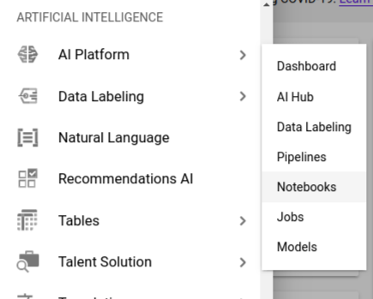
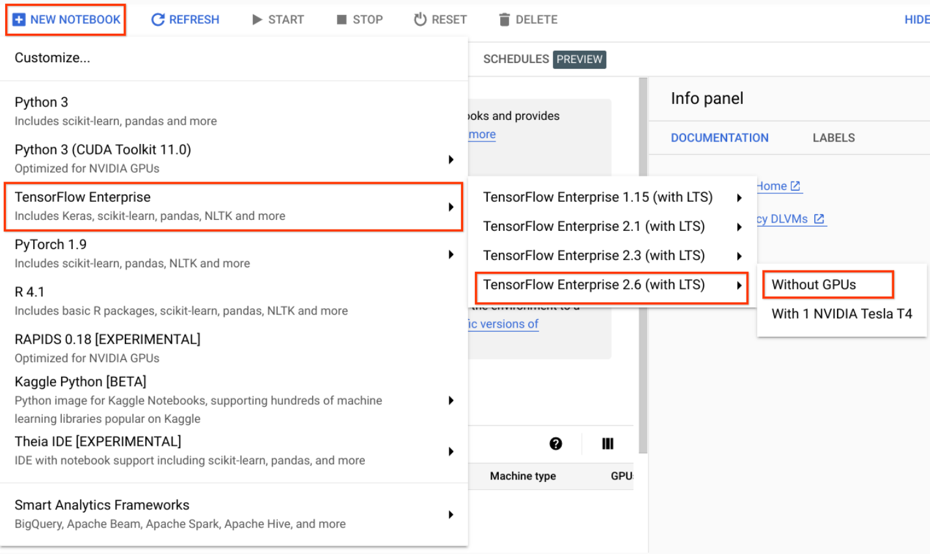
PROJECT:
Step 1: Launch AI Platform Notebook

Slide 9
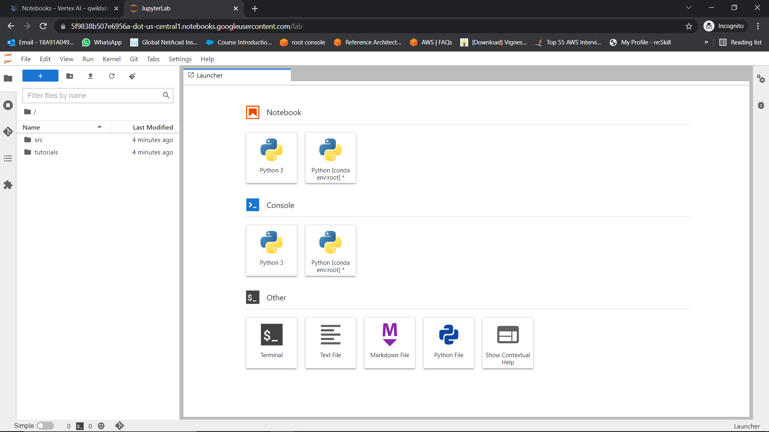
In JupyterLab, start a new notebook by clicking on Notebook > Python 3

Slide 10
Step 2:Visualize data in AI Platform
a) Update latest version of the BigQuery Python Client Library
!pip install --user --upgrade google-cloud-bigquery
!pip install --user --upgrade google-cloud-monitoring
!pip install --upgrade google-cloud-bigquery-storage
b)BigQuery client
import matplotlib.pyplot as plt
import seaborn as sns
from google.cloud import bigquery
client = bigquery.Client()

Slide 11
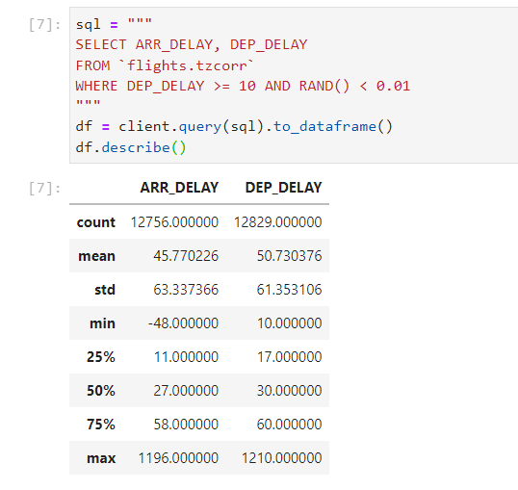
Step 3:Run Queries
A random value in a BigQuery query to select about 1% of the dataset.

Slide 12
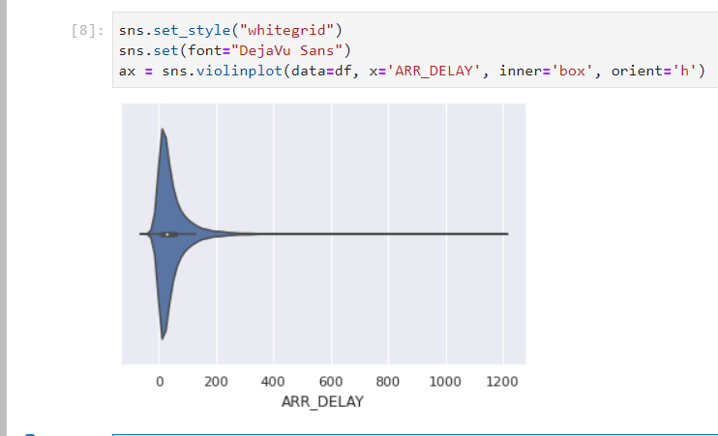
The code in the new cell to display a Seaborn violin chart that shows the distribution dataframe that contains the 1% sample of delay times for flights that departed 10 or more minutes late

Slide 13
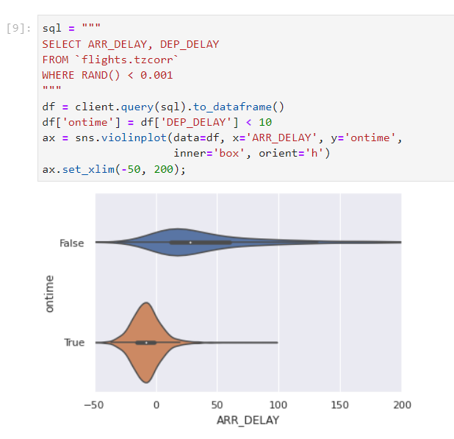
So now look at the difference between flights that depart more than 10 minutes late and those that depart less than 10 minutes late

Slide 14
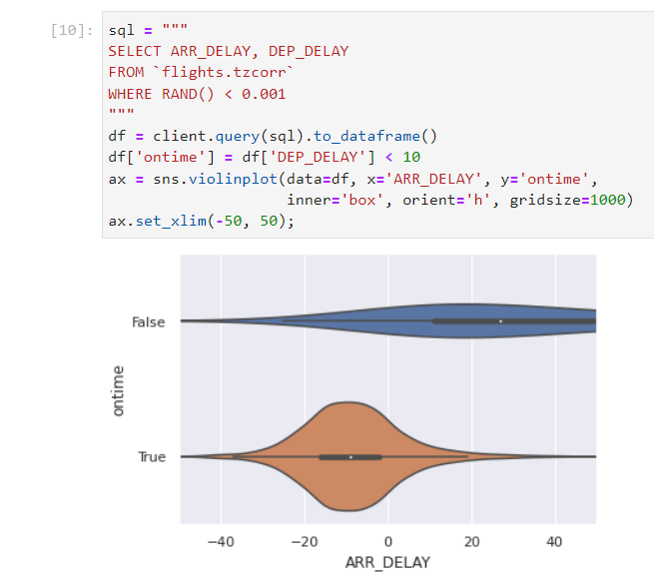
This clearly shows that the 10 minute departure delay threshold definitely divides the dataset into two very different datasets, which is clearly shown by the box plots in the center of these two distributions.

Slide 15
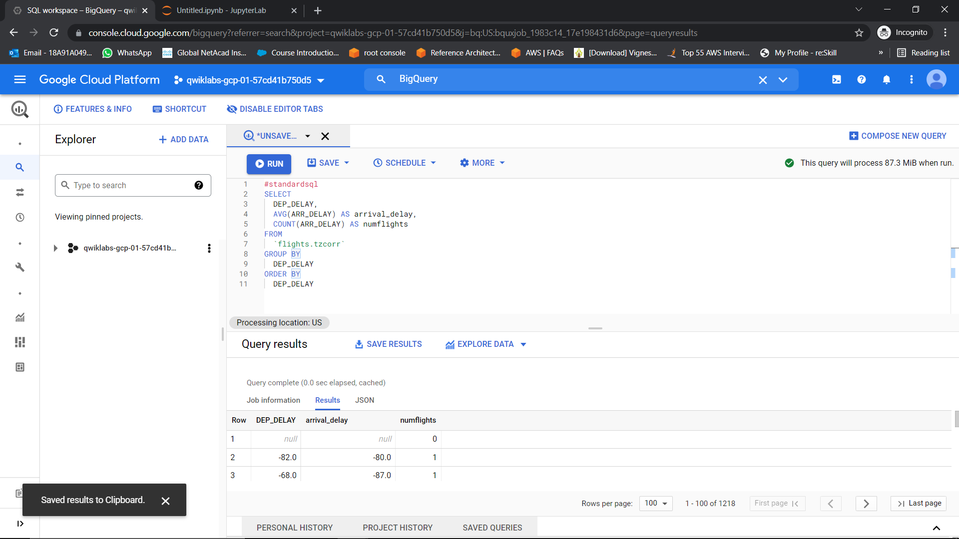
average arrival delay for every unique departure delay and returns more than 1200 different values

Slide 16
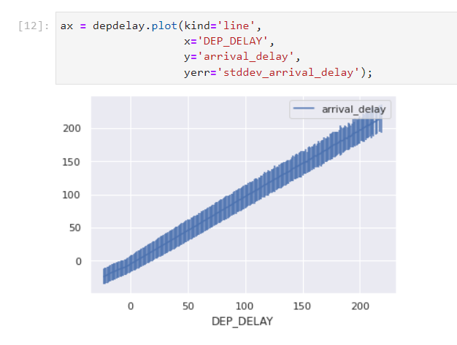
Python code to use Pandas itself to plot average arrival delay and the standard deviation for each delay

Slide 17
Applying a probabilistic decision threshold
The purpose of all of this analysis has been to develop a model that will allow you to predict whether a flight that as departed will arrive late.
Specifically, you are attempting to develop a model that will allow you to predict whether a given flight has more than a 30% probability of arriving 15 or more minutes late

Slide 18
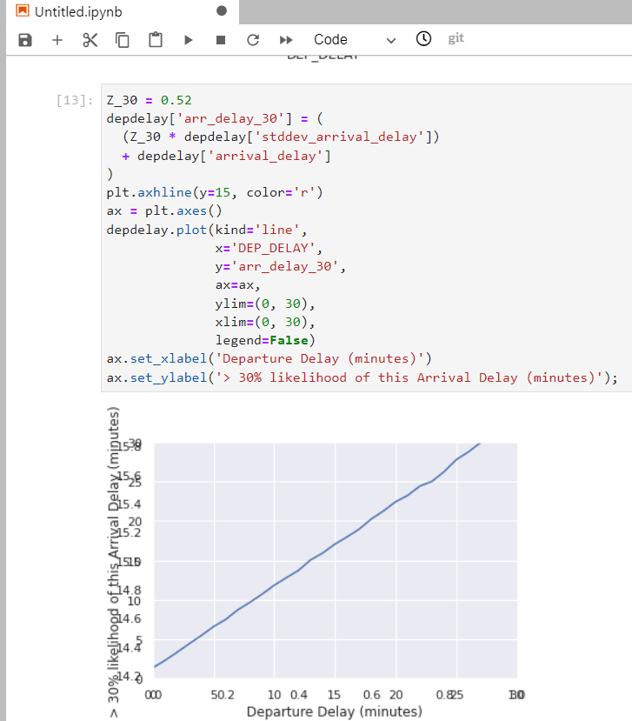
you can see that the decision criteria of a 30% probability that a flight will arrive 15 or more minutes late corresponds to a departure delay of 13 minutes (or more).

Slide 19
Conclusion
Hence analysed how a data set stored in BigQuery using AI Platform to perform queries and present the data using various statistical plotting techniques

Slide 20


Slide 21

THANK YOU!
Dept. of ECE, Aditya Engineering College

