Slide 1
Clustering
CS771: Introduction to Machine Learning
Purushottam Kar

Slide 2
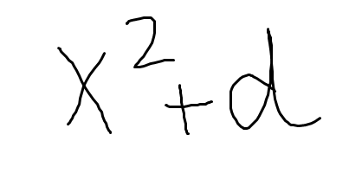
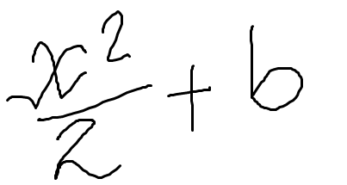
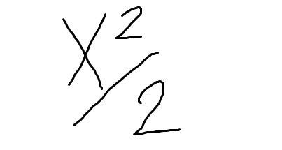
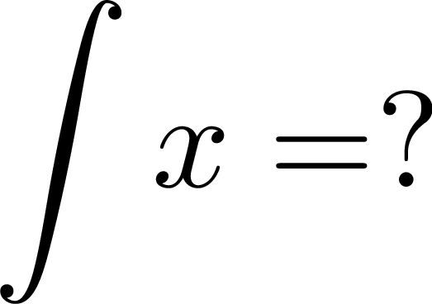
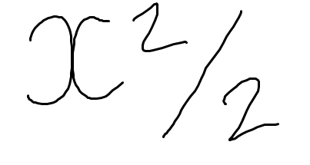
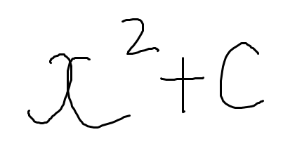
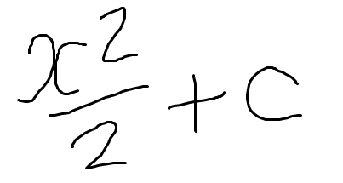
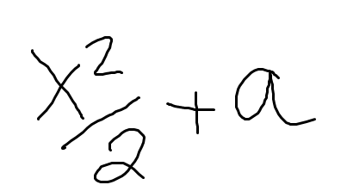

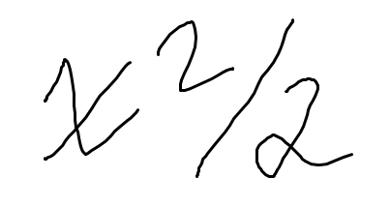
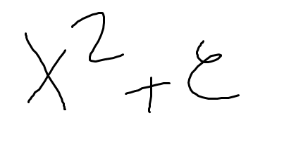
How to grade an exam
Grouping similar objects together is the task of clustering
4/5
gradescope
Q1.
5/5
5 marks
2/5
No labels here – that is why clustering is often called an unsupervised learning problem

Slide 3

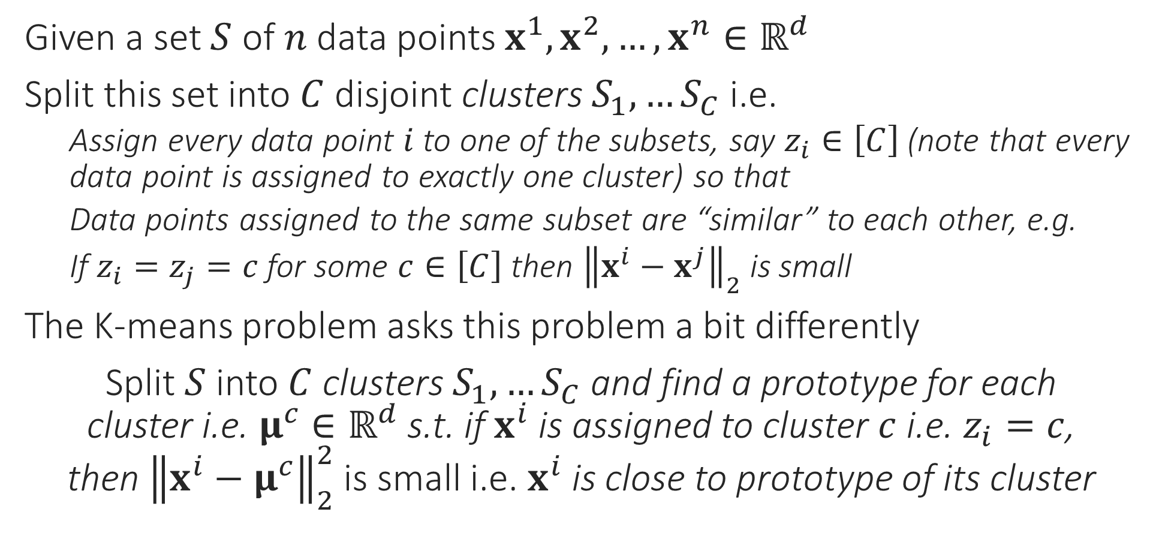
Clustering
The technical term used in books/papers is centroid
Given a set $S$ of $n$ data points $x^{1},x^{2},…,x^{n}∈ℝ^{d}$
Split this set into $C$ disjoint clusters $S_{1},…S_{C}$ i.e.
Assign every data point $i$ to one of the subsets, say $z_{i}∈\left[C\right]$(note that every data point is assigned to exactly one cluster) so that
Data points assigned to the same subset are “similar” to each other, e.g.
If $z_{i}=z_{j}=c$ for some $c∈\left[C\right]$ then ${\left\|x^{i}−x^{j}\right\|}_{2}$ is small
The K-means problem asks this problem a bit differently
Split $S$ into $C$ clusters $S_{1},…S_{C}$ and find a prototype for each cluster i.e. $μ^{c}∈ℝ^{d}$ s.t. if $x^{i}$ is assigned to cluster $c$ i.e. $z_{i}=c$, then ${\left\|x^{i}−μ^{c}\right\|}_{2}^{2}$ is small i.e. $x^{i}$ is close to prototype of its cluster
centroid
centroid

Slide 4




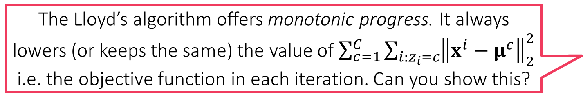
K-means clustering
$\min_{\left\{μ^{c}∈ℝ^{d}\right\},\left\{z_{i}∈\left[C\right]\right\}}{\sum_{c=1}^{C}{\sum_{i:z_{i}=c}{{\left\|x^{i}−μ^{c}\right\|}_{2}^{2}}}}$
This optimization problem is NP hard to solve ☹
Popular heuristic: Lloyd’s algorithm (often called k-means algorithm)
Uses a technique called alternating minimization
Observation 1: if we fix all $μ^{c}$, obtaining optimal assignments $z_{i}$ is very simple
Assign each data point to the cluster whose prototype is closest!
Observation 2: if we fix all assignments $z_{i}$, obtaining optimal prototypes simple
$\min_{\left\{μ^{c}∈ℝ^{d}\right\}}{\sum_{c=1}^{C}{\sum_{i:z_{i}=c}{{\left\|x^{i}−μ^{c}\right\|}_{2}^{2}}}}$ -- all that is needed is $\min_{μ^{c}}{\sum_{i:z_{i}=c}{{\left\|x^{i}−μ^{c}\right\|}_{2}^{2}}}$
Apply first order optimality to deduce that optimal value of $μ^{c}$ is simply the average of all data points assigned to the cluster $c$ – repeat for all $c∈\left[C\right]$
Keep repeating these two steps again and again
The Lloyd’s algorithm offers monotonic progress. It always lowers (or keeps the same) the value of $\sum_{c=1}^{C}{\sum_{i:z_{i}=c}{{\left\|x^{i}−μ^{c}\right\|}_{2}^{2}}}$ i.e. the objective function in each iteration. Can you show this?
K-MEANS/LLOYD’S ALGORITHM
Initialize means ${\left\{μ^{c}\right\}}_{c=1…C}$
For $i∈\left[n\right]$, update $z_{i}$ using $\left\{μ^{c}\right\}$
Let $z_{i}=\arg{\min_{c}{ {\left\|x^{i}−μ^{c}\right\|}_{2}^{2}}}$
Let $n_{c}=$ # points assigned to $c$
Update $μ^{c}=\frac{1}{n_{c}}\sum_{i:z_{i}=c}{x^{i}}$
Repeat until convergence
This looks a bit like coordinate minimization where we fix all but one coordinate and update that one coordinate to its optimal value
True, coordinate minimization can be thought of as a special case of alternating optimization ☺

Slide 5



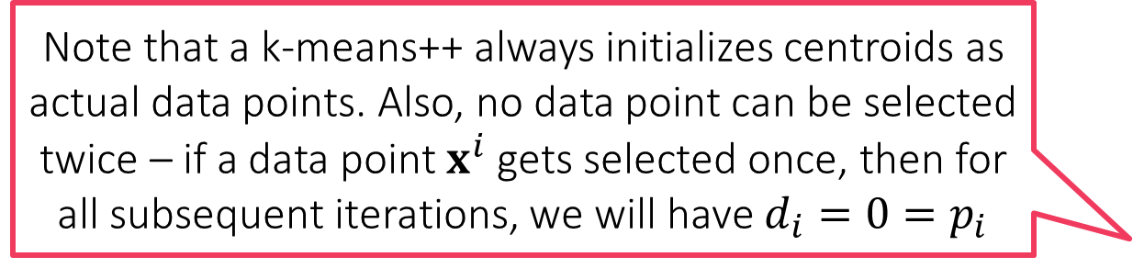
K-means++ Initializer
Note that a k-means++ always initializes centroids as actual data points. Also, no data point can be selected twice – if a data point $x^{i}$ gets selected once, then for all subsequent iterations, we will have $d_{i}=0=p_{i}$
Initializes k-means with centroids that are well spread out
Provable guarantees: Arthur and Vassilvitskii, SODA 2007
Widely used in practice: especially beneficial if $k$ is large
K-MEANS++ INITIALIZER
Select first centroid randomly $μ^{1}=x^{i}$, where $i∼UNIF\left(\left[n\right]\right)$
For $j=2,…,k$
For all $i∈\left[n\right]$, calculate $d_{i}=\min_{l∈1,…,j−1}{{\left\|x^{i}−μ^{l}\right\|}_{2}}$
Set $μ^{j}=x^{i}$ where $i$ is chosen with probability $p_{i}=\frac{d_{i}^{2}}{\sum_{s=1}^{n}{d_{s}^{2}}}$

Slide 6
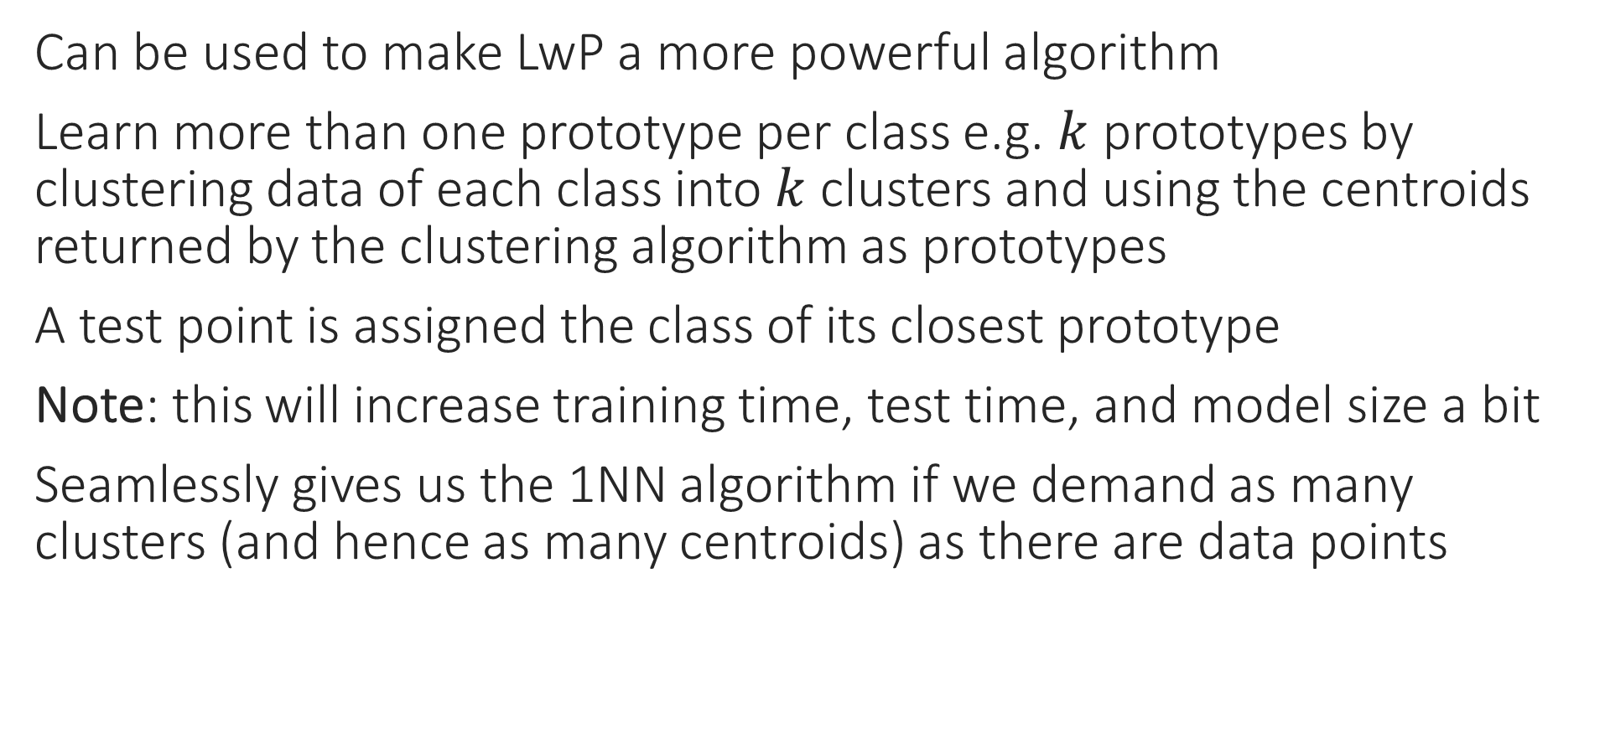
Some applications of clustering
Can be used to make LwP a more powerful algorithm
Learn more than one prototype per class e.g. $k$ prototypes by clustering data of each class into $k$ clusters and using the centroids returned by the clustering algorithm as prototypes
A test point is assigned the class of its closest prototype
Note: this will increase training time, test time, and model size a bit
Seamlessly gives us the 1NN algorithm if we demand as many clusters (and hence as many centroids) as there are data points

Slide 7
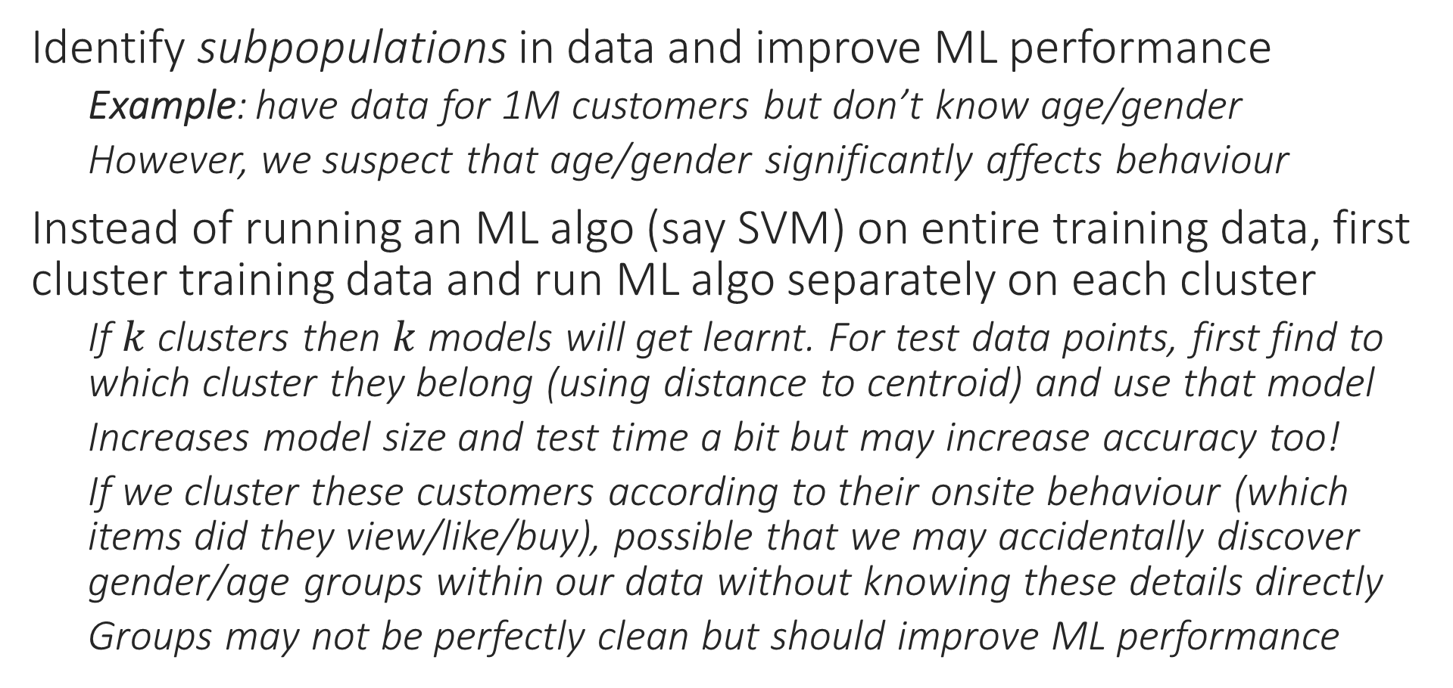
Some applications of clustering
Identify subpopulations in data and improve ML performance
Example: have data for 1M customers but don’t know age/gender
However, we suspect that age/gender significantly affects behaviour
Instead of running an ML algo (say SVM) on entire training data, first cluster training data and run ML algo separately on each cluster
If $k$ clusters then $k$ models will get learnt. For test data points, first find to which cluster they belong (using distance to centroid) and use that model
Increases model size and test time a bit but may increase accuracy too!
If we cluster these customers according to their onsite behaviour (which items did they view/like/buy), possible that we may accidentally discover gender/age groups within our data without knowing these details directly
Groups may not be perfectly clean but should improve ML performance

Slide 8

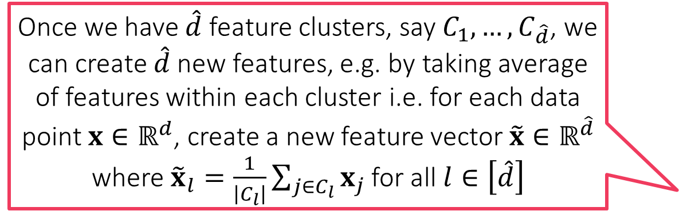
Some applications of clustering
Features for features!!
Reduce number of features (also called dimensionality reduction)
Example: have 1M features i.e. $x^{i}∈ℝ^{d}$ for $d=$ 1M but we suspect many of these features are redundant or encode similar information
Example: synonyms in bag of words (“buy” vs “purchase”)
Can cluster features together into $\hat{d}≪d$ clusters
To do this, we first need a way to represent features themselves
Method 1: represent feature $j$ using values it takes on the $n$ train data points
$z^{j}=\left[x_{j}^{1},x_{j}^{2},…,x_{j}^{n}\right]∈ℝ^{n}$ for all $j∈\left[d\right]$
Method 2: represent feature $j$ using avg value it takes on points of each class
Let $n_{c}$ denote number of train data points that belong to class $c∈\left[C\right]$
$z^{j}=\left[\frac{1}{n_{1}}\sum_{i:y^{i}=1}{x_{j}^{i}},\frac{1}{n_{2}}\sum_{i:y^{i}=2}{x_{j}^{i}},…,\frac{1}{n_{C}}\sum_{i:y^{i}=C}{x_{j}^{i}}\right]∈ℝ^{C}$ for all $j∈\left[d\right]$
Once we have $\hat{d}$ feature clusters, say $C_{1},…,C_{\hat{d}}$, we can create $\hat{d}$ new features, e.g. by taking average of features within each cluster i.e. for each data point $x∈ℝ^{d}$, create a new feature vector $\tilde{x}∈ℝ^{\hat{d}}$ where ${\tilde{x}}_{l}=\frac{1}{\left|C_{l}\right|}\sum_{j∈C_{l}}{x_{j}}$ for all $l∈\left[\hat{d}\right]$
This trick is often called feature clustering or feature agglomeration and is a form of dimensionality reduction. Will see other dimensionality reduction techniques later

Slide 9

Variations in clustering
Might want to prevent empty clusters – balanced clustering
Might want the algorithm to automatically learn the appropriate number of clusters $C$
May treat $C$ as a hyperparameter and tune it using validation
Agglomerative clustering, Chinese restaurant process automatically do this
Might not be happy with Euclidean distance as notion of “similarity” – clustering with Bregman divergences
Several other problem variants known e.g. k medoids (uses general $d\left(x^{i},μ^{c}\right)$ instead of ${\left\|x^{i}−μ^{c}\right\|}_{2}^{2}$ and $μ^{c}$ must be one of the data points), soft k-means (a data point can belong to multiple clusters)
K-medoids preferable when centroids/prototypes must be real data points
Notice that imposing (resp. encouraging) balance among the clusters can be seen as a form of a constraint (resp. regularization) on clustering. The k-medoid problem also can be seen as a form of constrained clustering

