Slide 1

AI-Based Fake Review Detection System
An intelligent platform using Artificial Intelligence and Natural Language Processing to automatically identify genuine and fraudulent customer feedback — protecting consumer trust and platform credibility at scale.
ACADEMIC RESEARCH PROJECT
AI · NLP · MACHINE LEARNING

Slide 2

The Growing Threat of Fake Reviews
Consumer Deception
Fabricated reviews mislead purchasing decisions, causing buyers to select inferior products based on false social proof.
Reputation Damage
Malicious negative reviews unfairly harm legitimate businesses, distorting their public image and search rankings.
Platform Erosion
Widespread fraud undermines trust in review ecosystems, driving users away from otherwise valuable platforms.
Manual Moderation Limits
Human reviewers cannot scale to match the volume and sophistication of modern coordinated fraud campaigns.

Slide 3

System Architecture & Workflow
Review Collection
Feature Extraction
Authenticity Output
Ingest raw review text
Linguistic, sentiment, behavioral
Score generation and dashboard
Text Preprocessing
AI Classification
Tokenize, remove stop-words, stem
Machine learning model evaluates
The system processes reviews through a structured pipeline — from raw text ingestion through NLP preprocessing, multi-dimensional feature extraction, and machine learning classification — ultimately delivering an authenticity score and actionable moderation insights via an admin dashboard.

Slide 4
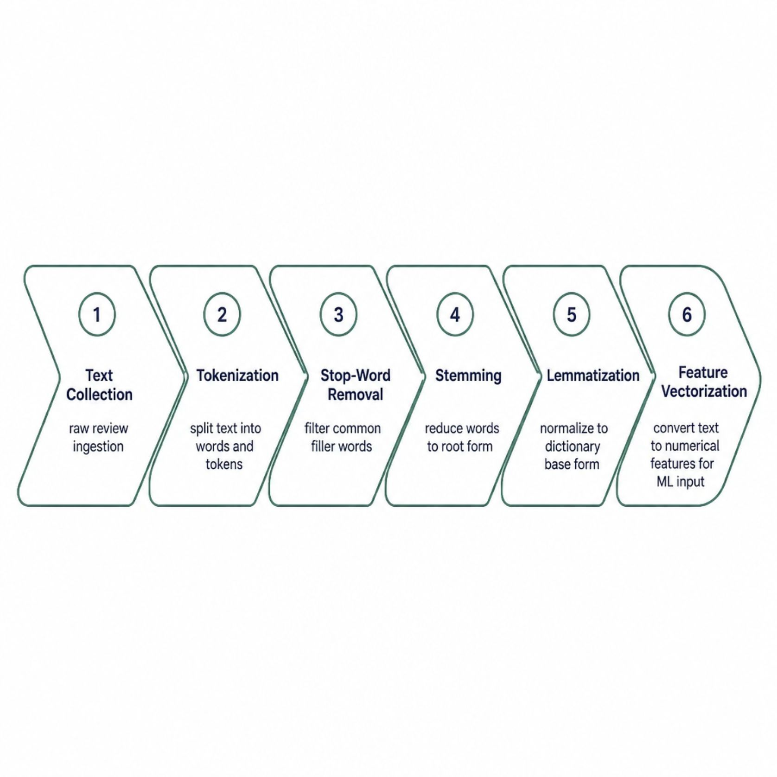
NLP Preprocessing Pipeline
Why NLP Preprocessing Matters
Raw review text is noisy and unstructured. The preprocessing pipeline transforms natural language into clean, normalized features that machine learning models can accurately interpret.
Removes linguistic noise and irrelevant tokens
Standardizes vocabulary across diverse reviewers
Enables consistent sentiment and pattern detection
Reduces dimensionality for faster, more accurate classification

Slide 5




Core Detection Technologies
Machine Learning Classification
Sentiment Analysis
Supervised algorithms — including Logistic Regression, Random Forest, and SVM — classify reviews as genuine or fraudulent with high precision.
Detects emotional polarity and extreme sentiment bias — a common signal in paid or incentivized fake reviews.
Reviewer Behavior Analysis
Linguistic Feature Extraction
Examines posting frequency, rating patterns, and account history to flag suspicious reviewer profiles and coordinated campaigns.
Analyzes syntax complexity, vocabulary richness, and writing style anomalies that distinguish human from fabricated content.

Slide 6
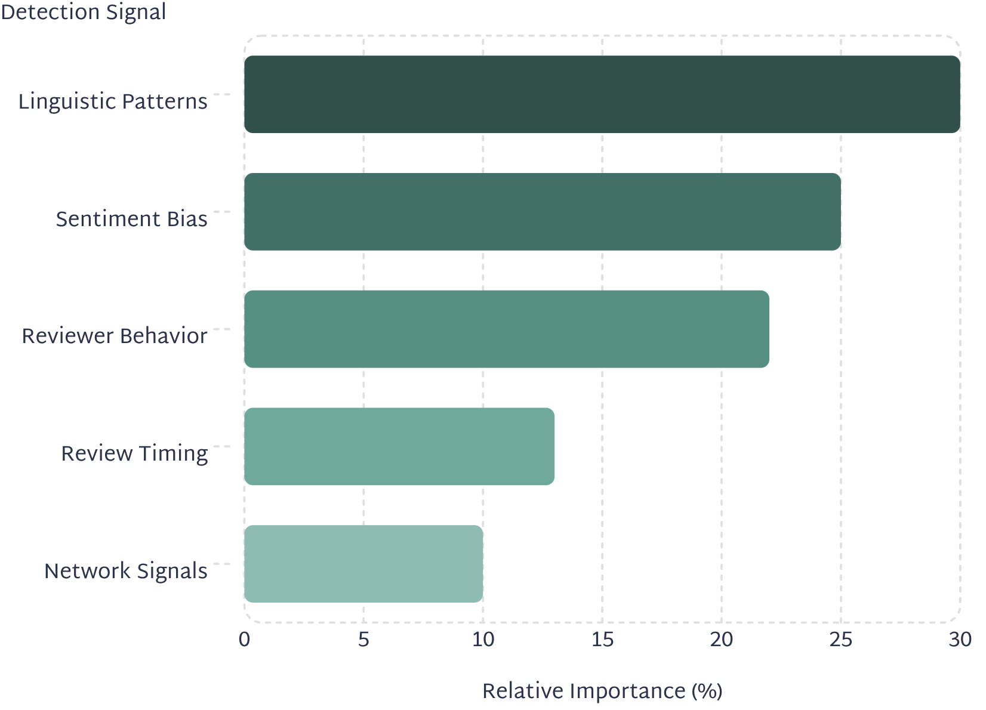
Authenticity Scoring & Classification
How the Score Is Computed
Each review receives a composite authenticity score (0–100) by weighting multiple detection signals. Reviews below a configurable threshold are flagged for moderator review or auto-removed.
Score ≥ 70
Score 40–69
Score < 40
✅ Genuine — Published
⚠️ Suspicious — Flagged
🚫 Fraudulent — Removed

Slide 7
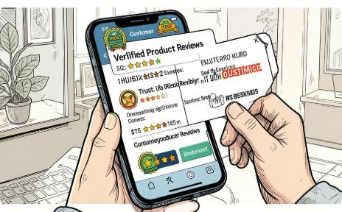



Platform Features by User Role
Customers
Administrators
Moderators
Business Analysts
View verified review badges, authenticity scores, and filtered genuine-only feedback to make confident purchasing decisions.
Manage users, configure detection thresholds, generate fraud reports, and oversee platform-wide review integrity.
Review flagged content queues, override automated decisions, and maintain accurate classification records.
Access sentiment trends, fraud statistics, reviewer insights, and historical analytics to inform strategy.

Slide 8

Implementation Methodology
Feature Engineering
Model Training
NLP preprocessing and vectorization.
Train classifiers and tune hyperparameters.
Data Collection
Deployment & Monitoring
Scrape reviews and label genuine vs fake.
API integration, live scoring, continuous retraining.
The system follows a rigorous four-phase methodology — from labeled data collection through feature engineering, model training with cross-validation, and production deployment with continuous performance monitoring and retraining.

Slide 9
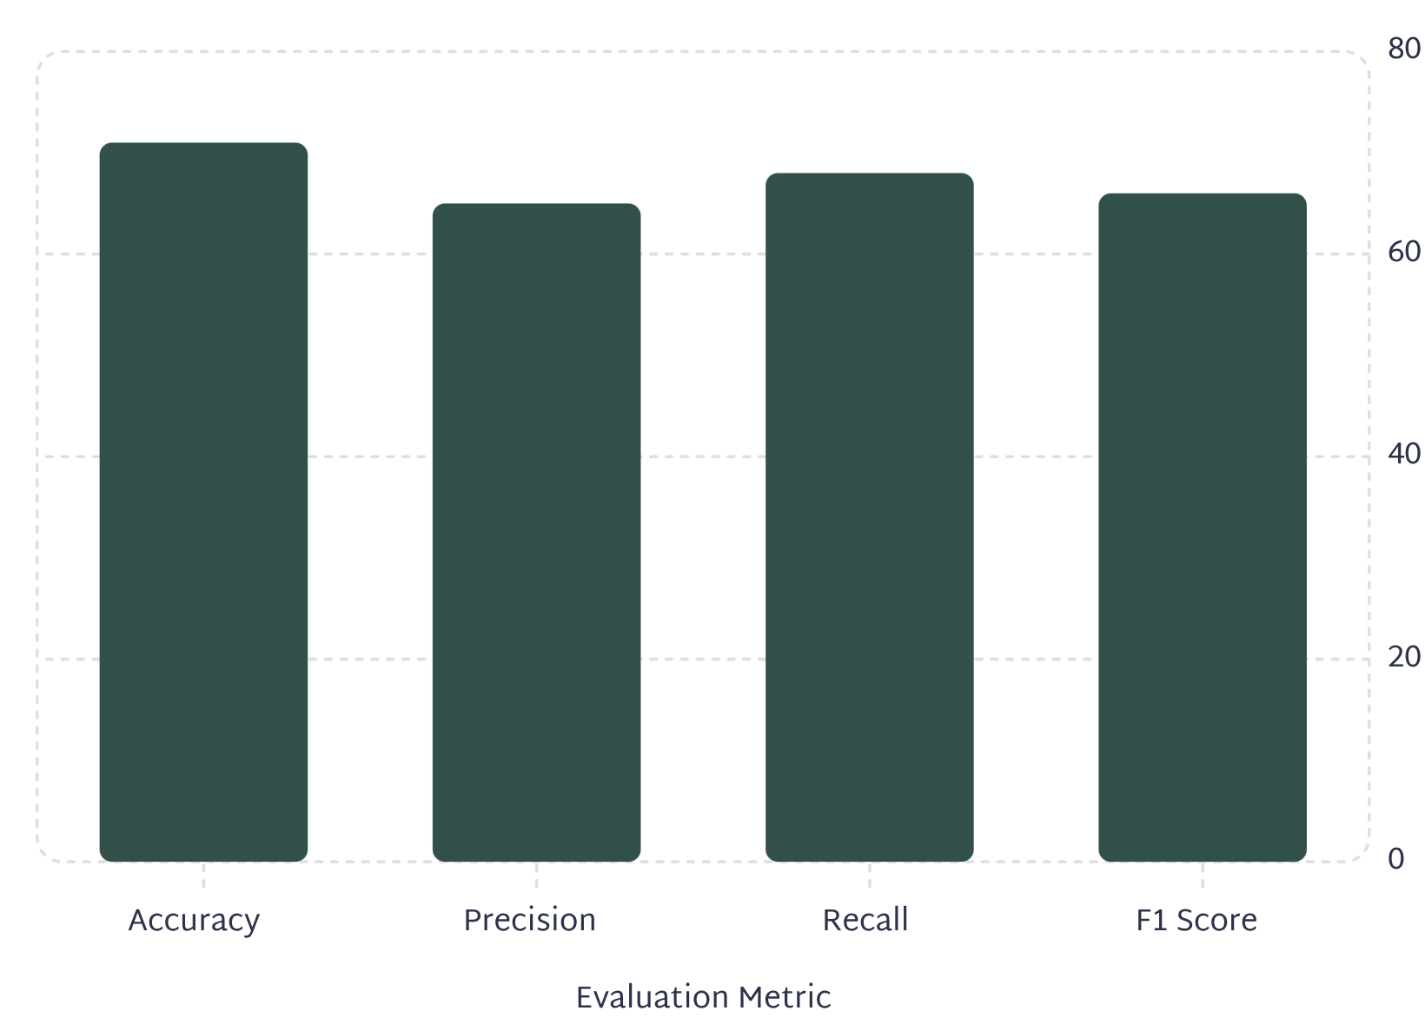
Model Performance & System Benefits
Key Advantages Over Manual Moderation
Higher Accuracy: AI models consistently outperform human reviewers on large-scale datasets
Scalability: Processes thousands of reviews per minute with no latency
Consistency: Eliminates subjective bias and reviewer fatigue
Cost Efficiency: Dramatically reduces manual moderation overhead
Trust & Credibility: Strengthens platform reputation and consumer confidence

Slide 10
Future Enhancements & Roadmap
Transformer Models
1
Upgrade to BERT-based architectures for deeper semantic understanding and contextual fraud detection.
2
Multilingual Detection
Extend NLP pipelines to support global languages and cross-cultural review patterns.
Explainable AI
3
Provide transparent, interpretable reasoning behind each classification decision for auditor trust.
4
Real-Time Detection
Deploy streaming inference for instant fraud flagging at the moment of review submission.
Cloud & E-Commerce Integration
5
Enable seamless API integration with major platforms and scalable cloud-native deployment.

