Slide 1
Microsoft PowerPoint 101
Instructor: Kyle Pew

Slide 2

PowerPoint Basics
PowerPoint Interface
Quick Access Toolbar (QAT)
PowerPoint Ribbon
PowerPoint Presentation Interface
PowerPoint Status Bar (ie. Views)
Creating New Presentation
FILE – NEW
CTRL + N
Create New Slide
CTRL + M
HOME – SLIDES – NEW SLIDE
Bullet List
TAB = demote
SHIFT + TAB = promote

Slide 3
Formatting Paragraphs
The quick brown fox jumps over the lazy dog. The quick brown fox jumps over the lazy dog. The quick brown fox jumps over the lazy dog. The quick brown fox jumps over the lazy dog.
The quick brown fox jumps over the lazy dog. The quick brown fox jumps over the lazy dog. The quick brown fox jumps over the lazy dog. The quick brown fox jumps over the lazy dog.
‘=Rand(2,4)

Slide 4
Adding Columns
The quick brown fox jumps over the lazy dog. The quick brown fox jumps over the lazy dog. The quick brown fox jumps over the lazy dog. The quick brown fox jumps over the lazy dog.
The quick brown fox jumps over the lazy dog. The quick brown fox jumps over the lazy dog. The quick brown fox jumps over the lazy dog. The quick brown fox jumps over the lazy dog.
The quick brown fox jumps over the lazy dog. The quick brown fox jumps over the lazy dog. The quick brown fox jumps over the lazy dog. The quick brown fox jumps over the lazy dog.

Slide 5

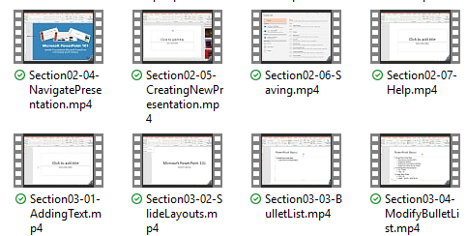
Inserting Images
MEOW!
INSERT tab – IMAGES – PICTURES or ONLINE PICS
Use a TITLE AND CONTENT slide
INSERT tab – IMAGES -- SCREENSHOT

Slide 7
Fun with PowerPoint Tables
COMMAND | SHORTCUT
SAVE | CTRL + S
NEW PRESENTATION | CTRL + N
NEW SLIDE | CTRL + M
SAVE AS | CTRL + SHIFT + S or F12
PRINT | CTRL + P
HELP | F1
UNDO | CTRL + Z
VIEW PRESENTATION | F5
OPEN FILE | CTRL + O
COMMAND | SHORTCUT
CUT | CTRL + X
COPY | CTRL + C
PASTE | CTRL + V
Bold | CTRL + B
End Slide Show | ESC
Expand/Collapse Ribbon | CTRL + 1
Select All | CTRL + A
Copy Formatting Only | CTRL + SHIFT C
Paste Formatting Only | CTRL + SHIFT + V
https://support.office.com/en-us/article/Use-keyboard-shortcuts-to-create-PowerPoint-presentations-ebb3d20e-dcd4-444f-a38e-bb5c5ed180f4

Slide 8
Even More Fun with Tables
OFFICE
ITEM | BREADBOX | COLOR
Towel | YES | Blue
Speakers | NO | Black
Tape | NO | Red
Printer | YES | White
KITCHEN
ITEM | BREADBOX | COLOR
Breadbox | NO | Clear
Toaster | NO | Silver
Cutting board | NO | Brown
Chair | YES | Brown

Slide 9
Excel Table!

Slide 10
PowerPoint Chart

Slide 11
Excel Chart

