Slide 1

OPTIMIZATION TECHNIQUES
ASSIGNMENT 1

Slide 2

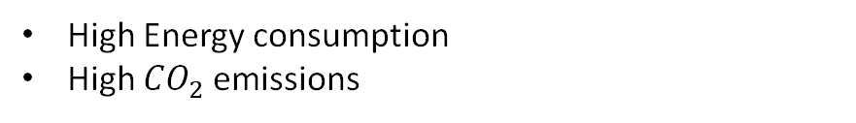
INTRODUCTION
Usage as Construction materials
Concrete Production
Sustainable concrete aims to reduce environmental impact while maintaining mechanical strength.
High Energy consumption
High ${CO}_{2}$ emissions
High
Compressive Strength
Low
Energy Consumption
“Understanding the relationship between compressive strength and energy consumption helps in designing eco-friendly concrete mixes.”
Measures how much load concrete can withstand before failure
The amount of energy required to produce the concrete mix.

Slide 3
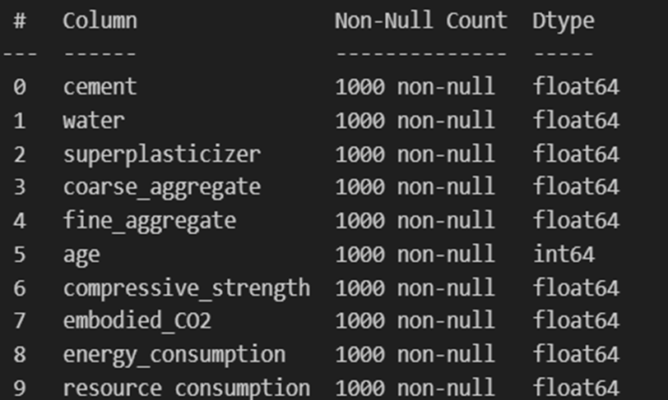
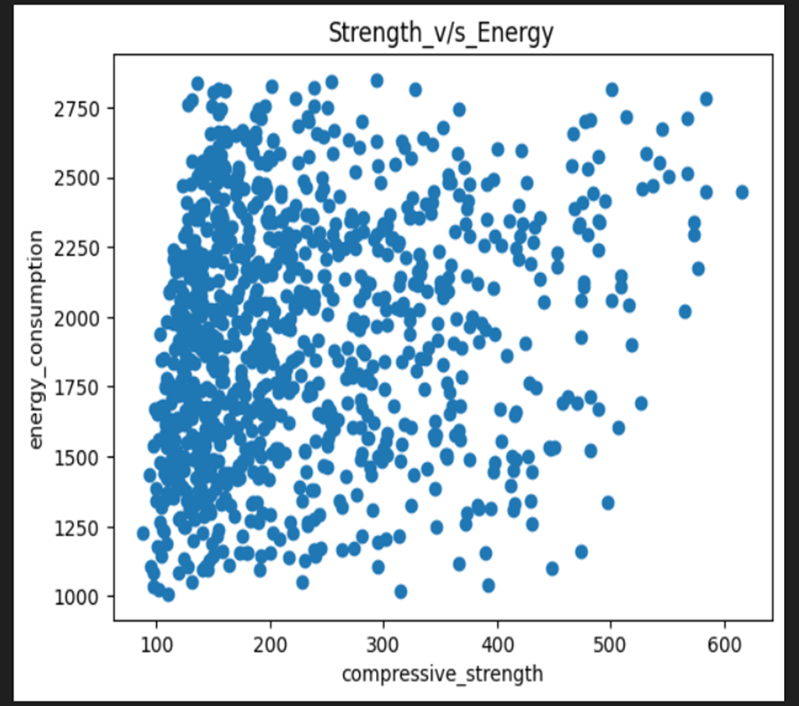
Concrete Data
1000 samples
10 Variables
Goal
Identifying patterns between compressive strength and energy consumption, how it varying with each other.
Preparing a machine learning model for given dataset & optimizing the output.
From the given scatter plot, we can’t conclude how energy consumption varies with compressive strength

Slide 4
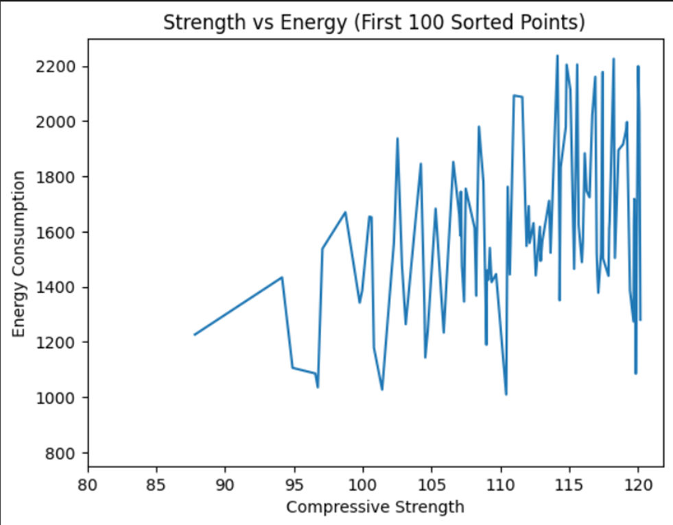
Consider 100 samples from initial 1000 samples and check how energy consumption varies with compressive strength.
From the plot we can see that, as compressive strength increase energy consumption also increases

Slide 5
Steps Followed for ANN Modelling
Data Preparation | The dataset was loaded and inspected for missing values. Input variables and output variables were separated
Feature Scaling | Input features were normalized using MinMaxScaler. Scaling was applied to bring all values within the range 0 to 1, which improves neural network training stability.
Dataset Splitting | The dataset was divided into three subsets: Training dataset – used to train the ANN model.(70%) Validation dataset – used to tune model performance during training.(15%) Test dataset – used to evaluate the final model performance.(15%)
Model Training | The neural network was trained using the training dataset. Validation data was used to monitor model performance and prevent overfitting
Model Evaluation | The trained model was evaluated using training, validation, and test datasets

Slide 6
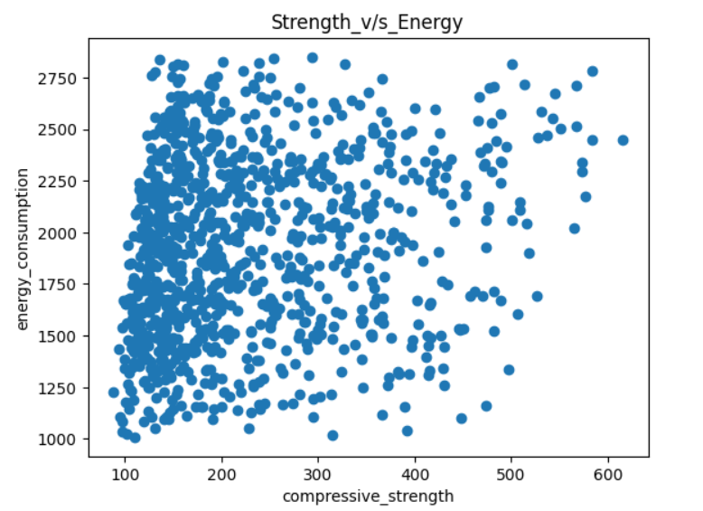

ANN ARCHITECTURE
NORMALIZATION
Input Layer
↓
Hidden Layer 1 → 8 neurons (ReLU activation)
↓
Hidden Layer 2 → 10 neurons (ReLU activation)
↓
Dropout Layer → 0.2
↓
Hidden Layer 3 → 8 neurons (ReLU activation)
↓
Dropout Layer → 0.2
↓
Output Layer → 2 neurons (Linear activation)
The dataset shows a scattered distribution with features having different ranges. Therefore, Min–Max scaling was applied to normalize the data to the range [0,1], ensuring stable neural network training and avoiding negative values that may arise with Standard Scaling.

Slide 7
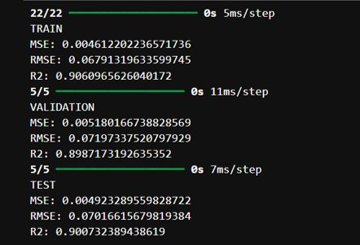
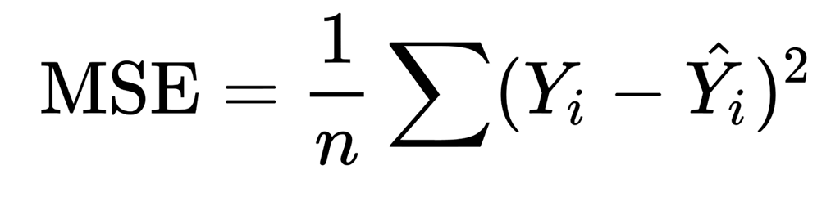
TRAINING CONFIGURATION & METRICS
Parameter | Value
Optimizer | Adam optimizer was used for efficient gradient-based optimization
Loss Function | Mean Squared Error (MSE)
Epochs | Model was trained for a max of 200 epochs
Batch size | Model processes 16 samples before updating weights
Early Stopping | Enabled to prevent overfitting Watches validation loss, if the monitored metric does not improve for 5 consecutive epochs, training stops.
​​
​

Slide 8
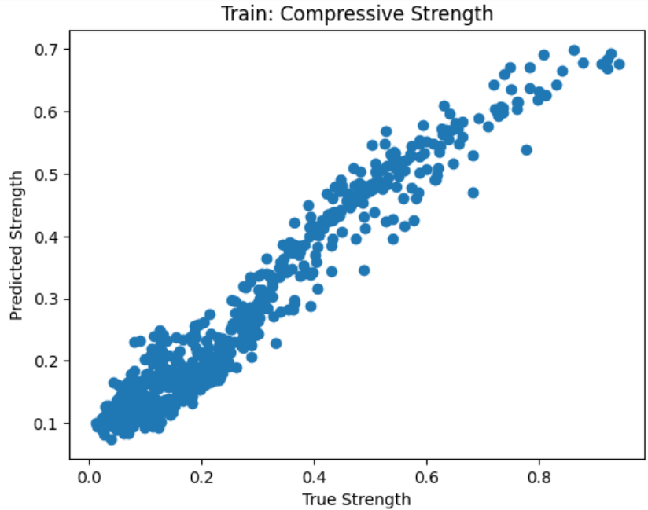
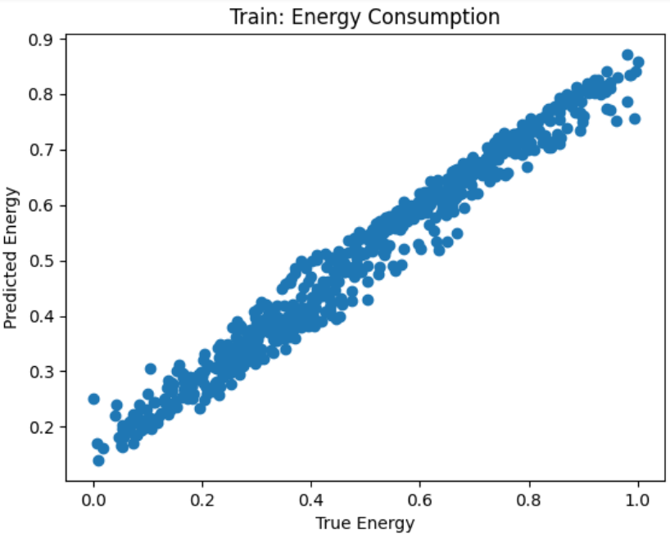

Slide 9
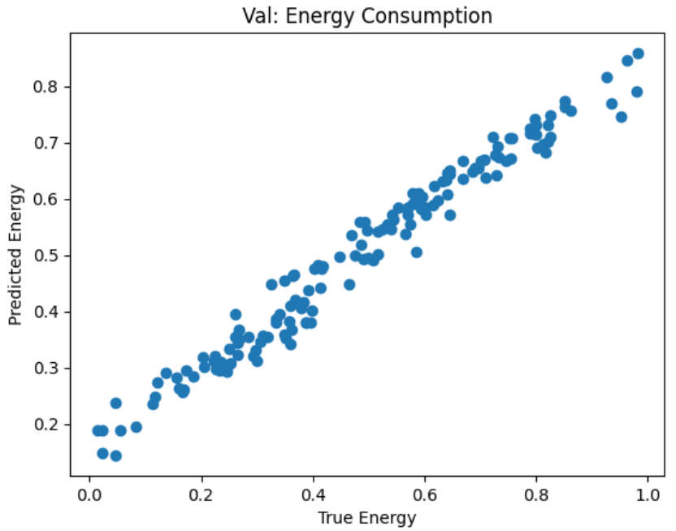
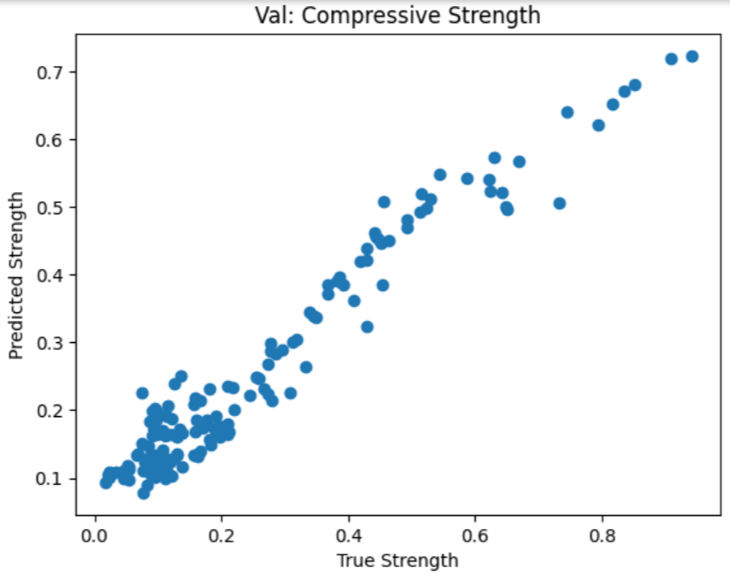

Slide 10
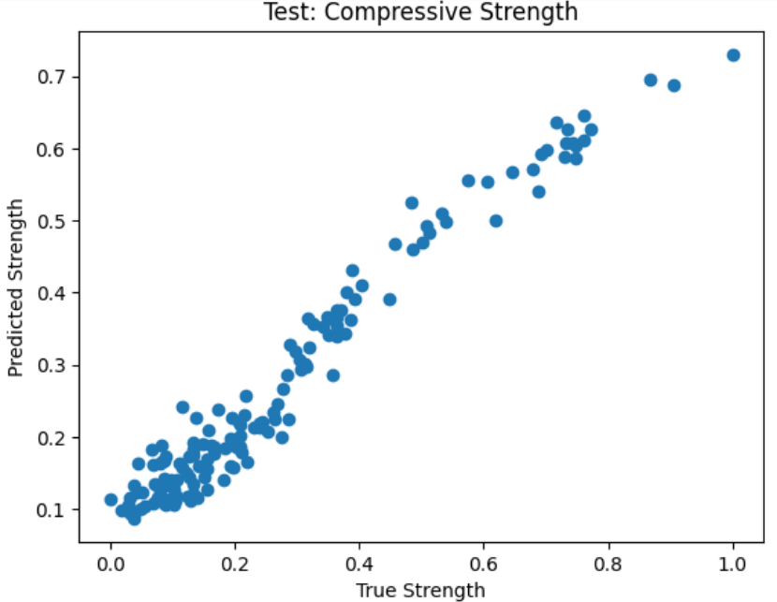
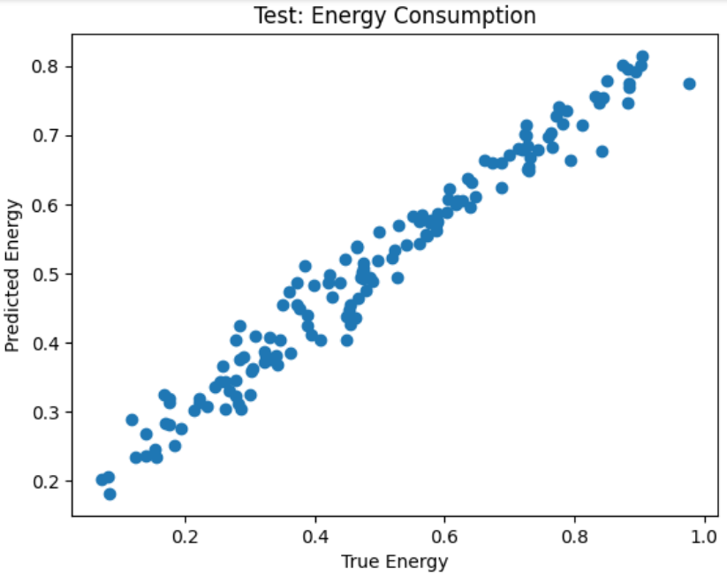

Slide 11
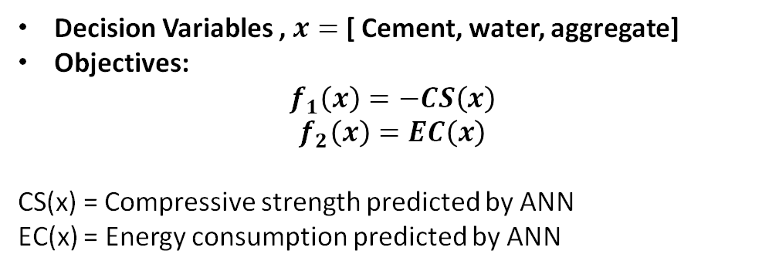
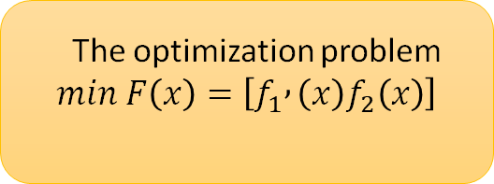
Optimization Problem Definition and Formulation
Inputs
Cement, Water, Superplasticizer, Coarse Aggregate, Fine Aggregate ,Age, Embodied ,CO₂,Resource Consumption.
Outputs
Compressive strength
Energy consumption
ANN predicts
maximize strength
minimize energy
More cement → Higher strength → Higher energy consumption
Need for Multi-Objective Optimization
multiple optimal solutions
NSGA-II
Conflict Between Objectives
Decision Variables , $x=$ [ Cement, water, aggregate]
Objectives:
$$f_{1}\left(x\right)=−CS\left(x\right)$$
$$f_{2}\left(x\right)=EC\left(x\right)$$
CS(x) = Compressive strength predicted by ANN
EC(x) = Energy consumption predicted by ANN
The optimization problem
$$min F\left(x\right)=\left[f_{1} , \left(x\right)f_{2}\left(x\right)\right]$$

Slide 12
Multi-Objective Optimization
Many real-world engineering problems involve multiple objectives that must be optimized simultaneously.
In sustainable concrete design, two key objectives are considered: maximize strength and minimize energy.
Conflicting Objectives in Concrete Design
The objectives conflict, requiring multi-objective optimization instead of a single solution.
Compressive Strength
Higher cement increases strength but raises energy.
Energy Consumption
Lower cement reduces energy but risks durability.

Slide 13
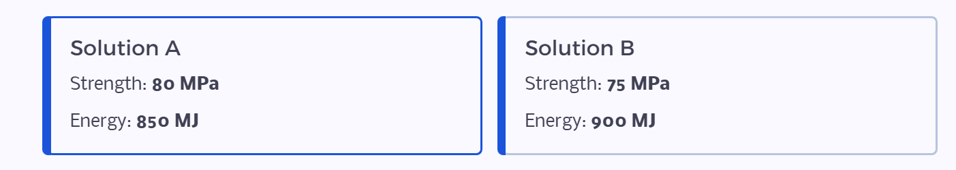
Dominance Concept in Multi-Objective Optimization
In multi-objective optimization, solutions are compared using dominance.
Consider this example:
Solution A dominates B because it has both higher compressive strength (80 > 75 MPa) and lower energy consumption (850 < 900 MJ).
Thus, B is considered a dominated solution.
Solutions that are not dominated by any other solution are called non-dominated solutions and represent the best trade-off between objectives. These solutions form the Pareto optimal set.

Slide 14
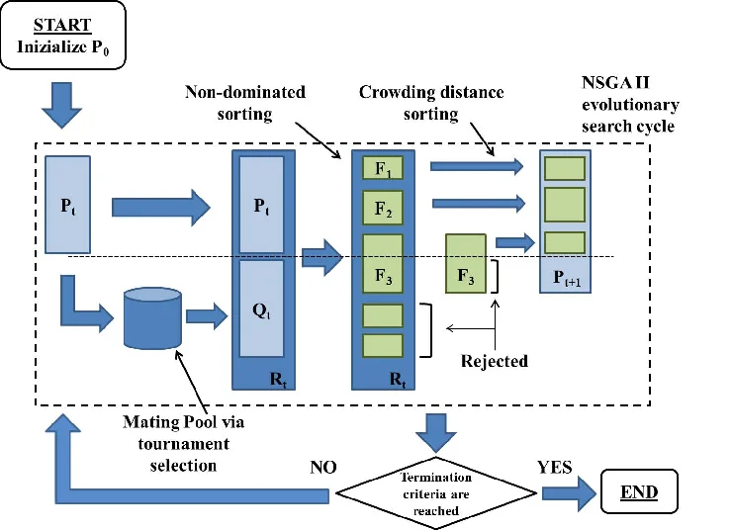
Multi-Objective Optimization using NSGA-II
NSGA-II (Non-Dominated Sorting Genetic Algorithm II) is an evolutionary optimization algorithm used to solve problems with multiple conflicting objectives.

Slide 15
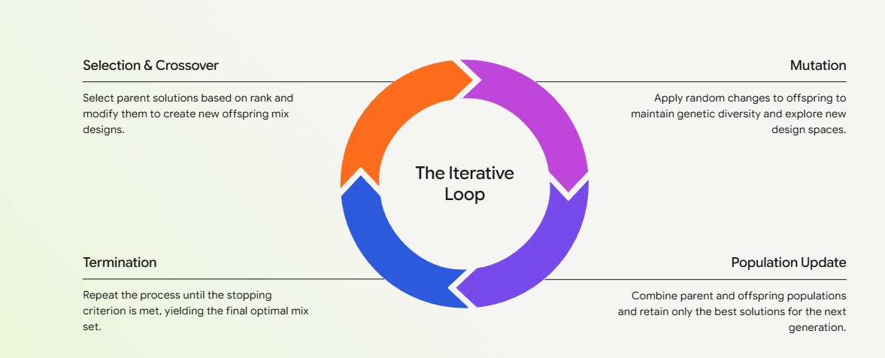
NSGA-II Workflow

Slide 16
Optimization
Concrete Mix Variables(Cement, Water, Aggregates, etc.)
Generate Initial Population of Mix Designs (Popln = 100)
(NSGA-II Algorithm)
Predict Compressive Strength & Energy Consumption using ANN model
Non-Dominated Sorting
Rank solutions based on Pareto dominance
Evolve New Mix Designs by mimicking natural evolution
Objective Evaluation:
Maximize Strength
Minimize Energy
Repeat for 200 generations.
NSGA-II generate the Pareto Front
Pareto front: optimal concrete mix designs showing the best trade-off
Selection, Crossover and Mutation

Slide 17
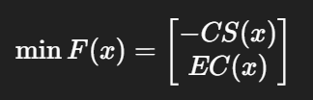
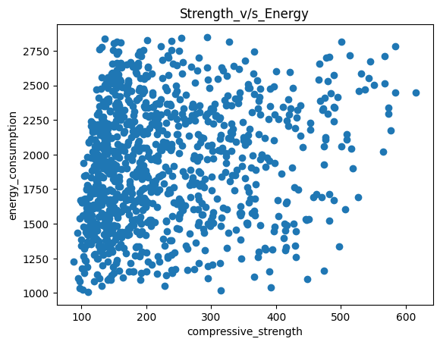
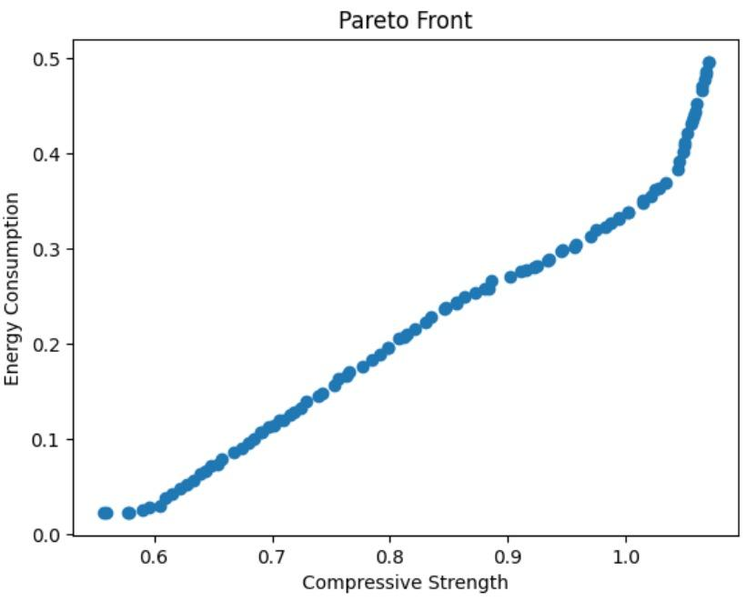
Pareto Front
Pareto fronts represent the best balance between competing objectives.
Objectives
Minimize Energy consumption
Maximize Compressive Strength
By Using NSGA - II
Algorithm
Raw data points
Optimal design points
Notes:
https://www.biochempeg.com/article/61.html, moments define how larger molecules affect the data

Slide 18

Observations
{
It removed dominated solutions, leaving only optimal design points
High strength
region
{
Dominance condition check
Efficient region
{
Region | Design Priority
Low strength | Sustainability
High Strength | Heavy load structures
Balanced mix | General construction
Eco-friendly region
Trade-off between compressive
strength & energy consumption
Engineers can select a mix depending on design priorities
Notes:
https://chatgpt.com/c/69b01502-d4ec-8320-8cb2-ebbc7299a1cc read this for understanding

Slide 19
Thank you

