Slide 1

DEPARTMENTOF COPUTER SCIENCEAND ENGINEERING(AI&ML)
A MAJOR PROJECT REVIEW ON
Graph Convolutional Network-Based Model for Megacity Real Estate Valuation
BATCH NO : AIML – MJOB8
INTERNAL GUIDE: Mrs.M.SRIKALA
Assistant professor DEPT OF CSE(AI&ML)
A.SHRUTI G.MAHITHA S.JHANSI K.VASUDEVA REDDY
228R1A6668
228R1A6687
228R1A66C2
228R1A6698

Slide 2


Abstract
Introduction
Literature survey
Problem Statement Justification
Objectives of Proposed System
Methodologies of the Proposed System
Design Phase of the Proposed System
UML Diagrams
Implementation of code
Output
Scope of the project
Conclusion

Slide 3
ABSTRACT :
Real estate price prediction is challenging due to high prices, complex influencing factors, and uncertain attributes.
Accurate valuation is crucial because of strong demand for both owner-occupied and investment properties.
Proposed A-SRGCNN model: an improved version of SRGCNN with an external attention mechanism.
Model tested on datasets from Shanghai, Melbourne, and San Diego.
A-SRGCNN effectively captures spatial relationships between property data.
Outperforms benchmark models in price prediction accuracy.
Zonal and time-division experiments in Shanghai show spatial and price aggregation (similar prices in same zones).
Demonstrates strong potential for accurate megacity real estate valuation.

Slide 4
INTRODUCTION:
Real estate valuation is vital for urban planning, investment, and housing policies in megacities.
Price prediction is difficult due to: Complex spatial and temporal factors, Rapid market Strong interdependence between property attributes.
Traditional models struggle with non-linear relationships and spatial dependencies.
Graph Convolutional Neural Networks (GCNNs) can model spatial structures and capture property linkages.
Proposed A-SRGCNN model:
Based on SRGCNN with external attention mechanism.
Enhances feature extraction and generalizability.
Tested on datasets from Shanghai, Melbourne, and San Diego.
Achieves higher accuracy than benchmark models in real estate valuation.
Contributes to AI-driven, reliable property price prediction for megacities.
fluctuations,

Slide 5
LITERATURE SURVEY:
S.No | Author(s) | Year | Title of Paper | Type of Paper | Remarks / Limitations
1 | Zhao et al. | 2025 | A Spatio-Temporal Graph Neural Network for Urban Home Price Forecasting | IEEE Trans | Requires dense spatio- temporal datasets
2 | Li et al. | 2024 | Spatial-Graph Learning for Urban Housing Price Prediction | IEEE Trans | Needs high-resolution geospatial data
3 | Chen et al. | 2024 | Real Estate Price Forecasting Using Graph Attention Networks | IEEE Trans | High computational cost due to attention mechanism
4 | Wang et al. | 2024 | Urban Housing Price Mapping Using Deep Graph Networks | IEEE Conf | Limited multi-city experiments
5 | Yang et al. | 2023 | GCN-Based Model for Megacity Real Estate Valuation | IEEE J | Tested only on Shanghai dataset

Slide 6
EXISTING SYSTEM
The existing real estate valuation system mainly depends on traditional statistical models and machine-learning methods.
These models work with structured data but fail to capture spatial relationships, struggle to generalize across different regions, and do not consider time-based price variations, making predictions less accurate in real-world scenarios.
Hedonic Pricing Models (HPMs)
Use linear regression based on property features.
Limitation: Cannot handle non-linear patterns or dynamic market behavior.
Traditional Machine Learning Models
Models like Random Forest, Gradient Boosting, XGBoost.
Limitation: Treat properties independently and ignore spatial dependencies.
Spatial Regression Models
Consider geographical influence using spatial matrices.
Limitation: Require predefined spatial weights and assume linear relationships.

Slide 7
PROBLEM STATEMENT JUSTIFICATION
Existing real estate valuation methods give inaccurate results because they ignore
spatial relationships between properties.
Traditional ML models depend only on tabular data and fail to generalize to different cities.
These models struggle when there is limited labeled data available for training.
There is no real-time, user-friendly system for property price prediction in current methods.
A GCN-based approach is needed to learn spatial connections between neighboring properties.
Semi-supervised learning helps improve accuracy even with fewer labeled samples. 7.Integrating the model into a Django web app provides easy access, better usability, and scalable real-time predictions.

Slide 8
OBJECTIVES OF THE PROPOSED SYSTEM
The proposed system uses Graph Convolutional Networks (GCNs) combined with a Django-based web application to provide a more accurate and intelligent real estate price prediction model. Unlike traditional methods, this system learns spatial relationships between properties, works even with limited labeled data through semi-supervised learning, and includes an interactive platform for real-time predictions.
GCN for Spatial Learning – Learns how nearby properties influence each other, improving prediction accuracy.
External Attention – Detects hidden relationships in data for better generalization across locations.
Semi-Supervised Learning – Works well even with limited labeled data by using both labeled and unlabeled samples.
Django Web Application – Provides login, price prediction, past history, and admin controls for real-time usage.
Cloud Deployment – Supports AWS/Google Cloud/Heroku for large-scale, fast predictions.
High Performance – Achieves lower error rates than Random Forest, XGBoost, and other GCN models.

Slide 9
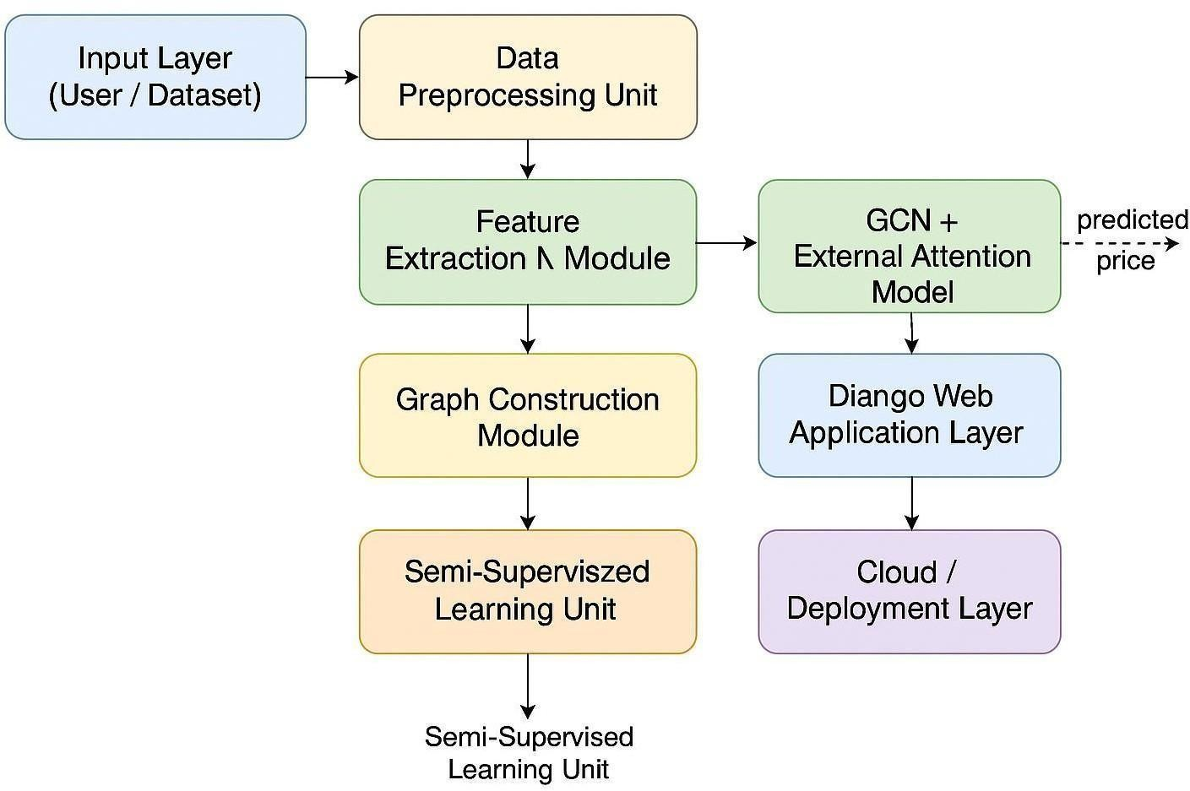
BLOCK DIAGRAM

Slide 10
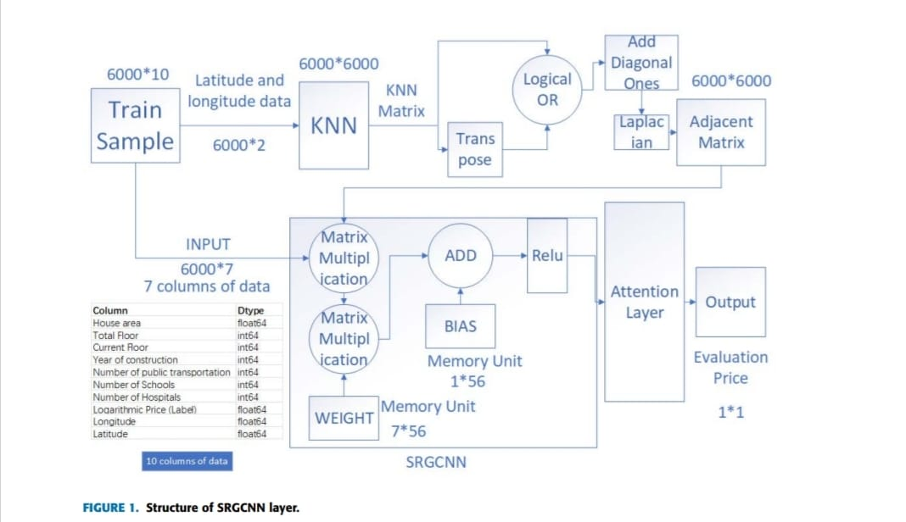

Slide 11
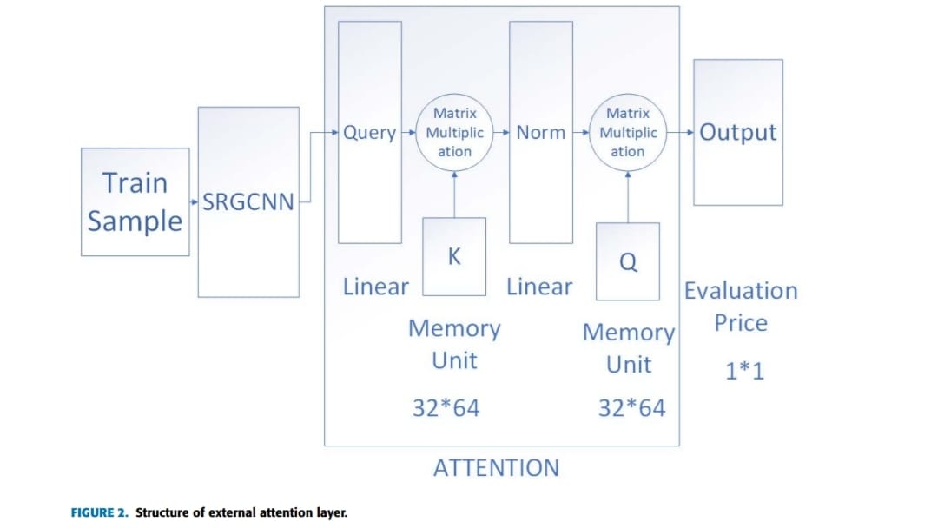

Slide 12
METHODOLOGIES OF THE PROPOSED SYSTEM
Data Collection & Preprocessing
Collect property data (location, price, features).
Clean, normalize, and prepare data for graph construction.
Graph Construction
Convert properties into nodes.
Create edges based on spatial closeness or neighborhood relationships.
Generate adjacency matrix for the GCN model.
Feature Extraction
Use property attributes (size, location, type, etc.) as node features.
Prepare input vectors for the GCN.
GCN Model with External Attention
Apply Graph Convolutional Networks to learn spatial dependencies.
Add External Attention (EA) to capture hidden relationships and improve accuracy.

Slide 13
Semi-Supervised Learning
Train the model using both labeled and unlabeled data.
Helps improve performance even with limited labeled datasets
Model Training & Evaluation
Train using datasets (e.g., Shanghai, Melbourne).
Evaluate error rate, accuracy, and compare with existing models.
Integration with Django Web Application
Deploy the trained model in a Django backend.
Provide user features: login, property input, price prediction, prediction history.
Provide admin features: user management, monitoring.
Deployment & Cloud Support
Deploy the web application on AWS/Google Cloud/Heroku.
Enable real-time, scalable predictions for users.

Slide 14
DESIGN PHASE OF PROPOSED SYSTEM
Collect Data
Gather property details like location, size, and price.
Prepare the Data
Clean the data, remove missing values, and organize it properly.
Create the Graph
Treat each property as a node and connect nearby properties to show spatial relationships.
Design the GCN Model
Build a Graph Convolutional Network with External Attention to learn patterns.
Train the Model
Use both labeled and unlabeled data to improve accuracy.
Build the Web Application
Create a Django-based interface for users to enter details and get predictions.
Deploy the System
Host the application on cloud platforms so users can access it anywhere.

Slide 15
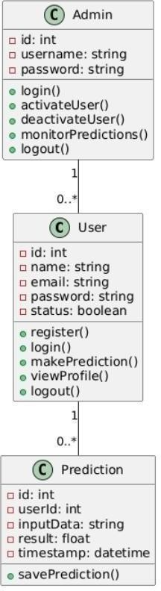
UML DIAGRAMS
Class Diagram:

Slide 16
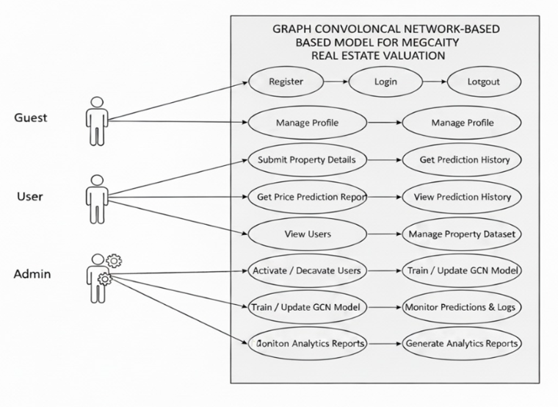
Use Case Diagram

Slide 17
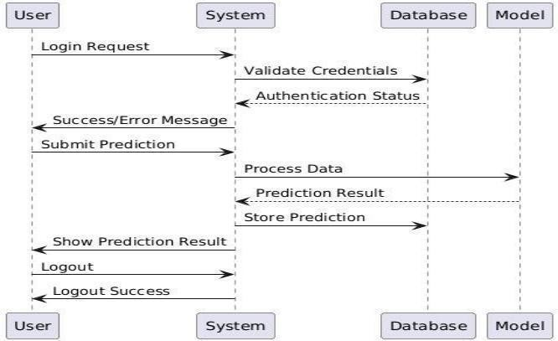
Sequence diagram

Slide 18
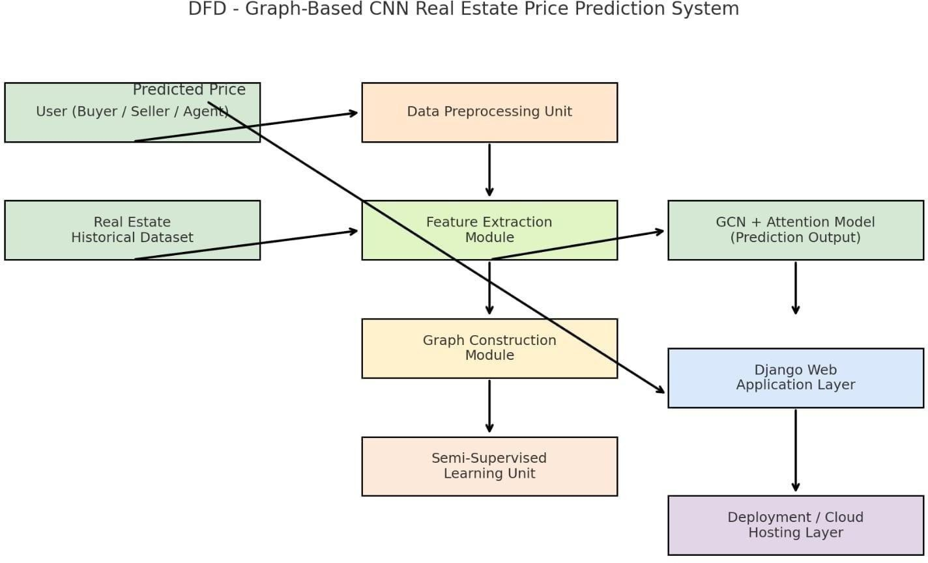
Data Flow Diagram

Slide 19
Implementation of code :
import torch
import torch.nn as nn
import torch.nn.functional as F
from torch_geometric.nn import GCNConv
from torch_geometric.data import Data
class ExternalAttention(nn.Module):
def __init__(self, d, m=64):
super().__init__()
self.q = nn.Linear(d, m)
self.k = nn.Linear(m, d)
def forward(self, x):
return self.k(F.softmax(self.q(x), dim=1))

Slide 20
class ASRGCNN(nn.Module):
def __init__(self, in_f, h=64):
super().__init__()
self.g1 = GCNConv(in_f, h)
self.g2 = GCNConv(h, h)
self.attn = ExternalAttention(h)
self.fc = nn.Linear(h, 1)
def forward(self, x, e):
x = F.relu(self.g1(x, e))
x = F.relu(self.g2(x, e))
x = self.attn(x)
return self.fc(x)
# dummy data
n, f = 100, 10
data = Data(
x=torch.randn(n, f),
edge_index=torch.randint(0, n, (2, 300)),
y=torch.randn(n, 1),
)

Slide 21
model = ASRGCNN(f)
opt = torch.optim.Adam(model.parameters(), lr=0.001)
loss_fn = nn.MSELoss()
for i in range(100):
opt.zero_grad()
loss = loss_fn(model(data.x, data.edge_index), data.y)
loss.backward()
opt.step()
if (i + 1) % 10 == 0:
print("Epoch", i + 1, "Loss", round(loss.item(), 4))
print("\nPredictions:\n", model(data.x, data.edge_index)[:5])

Slide 22
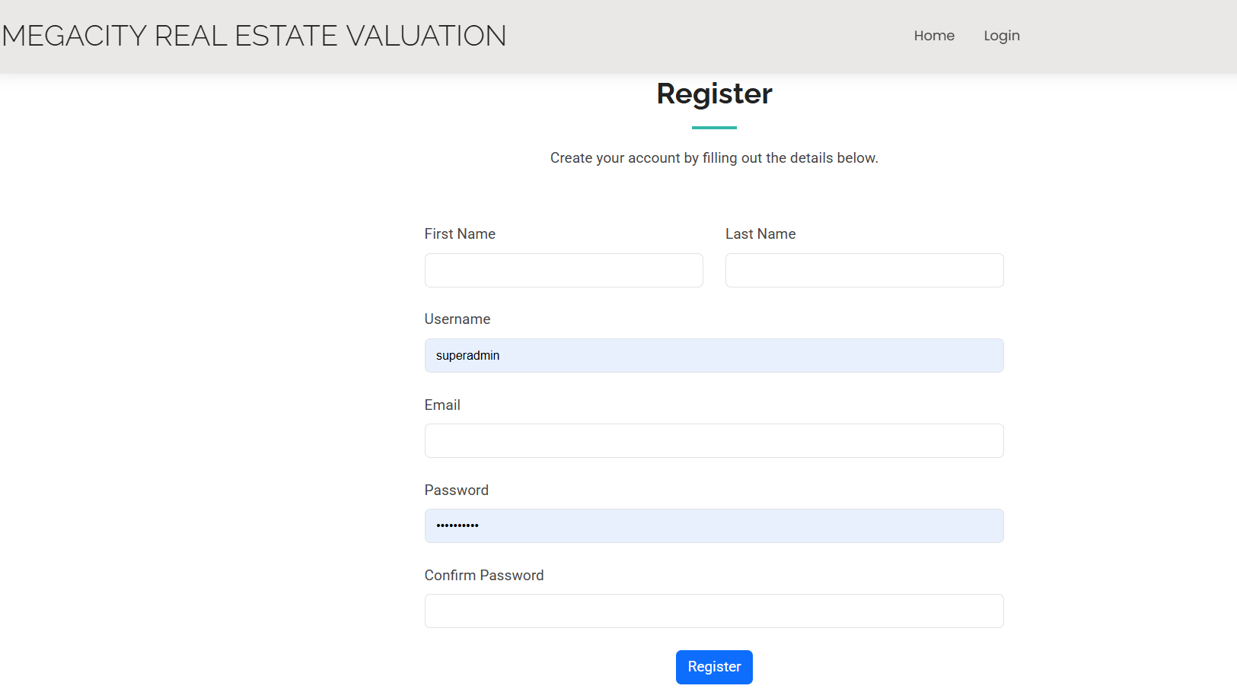
OUTPUT

Slide 23
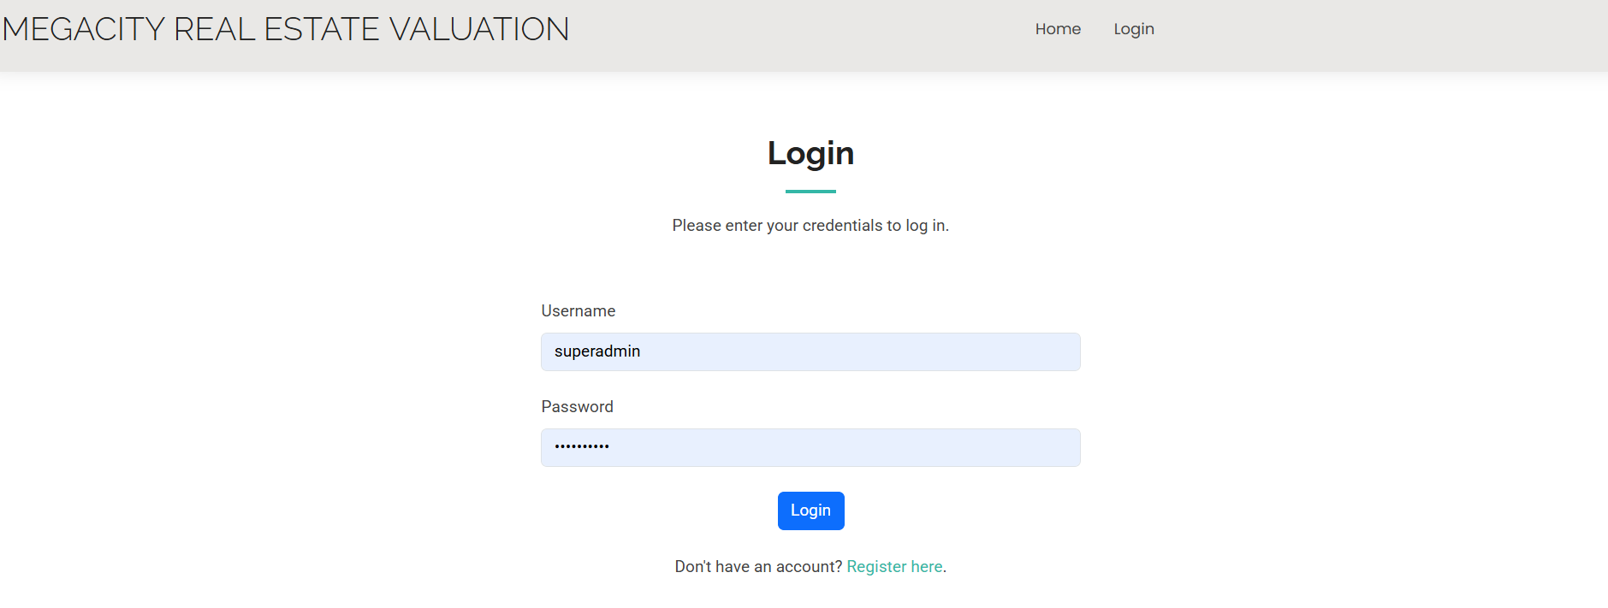

Slide 24
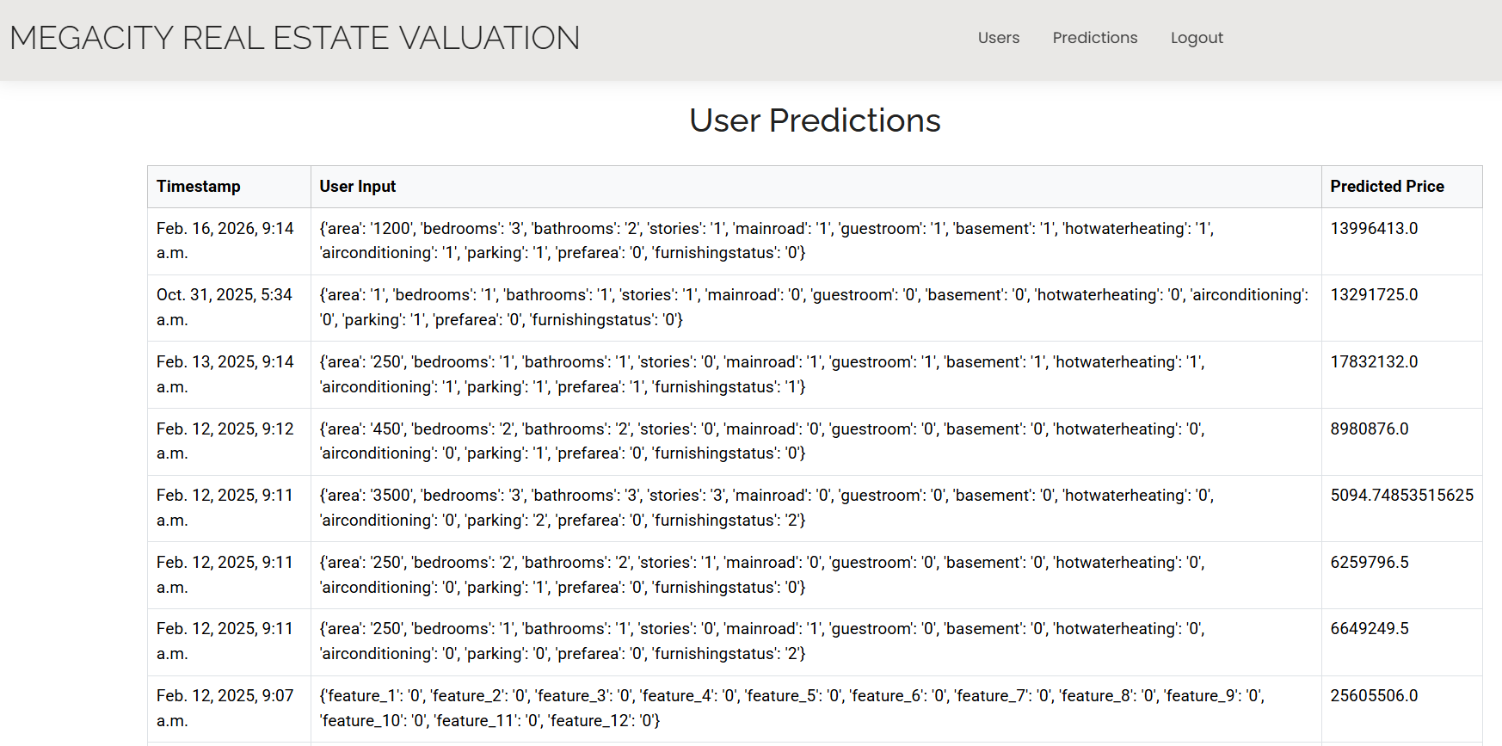

Slide 25
FUTURE SCOPE OF THE PROJECT
Build a model that accurately predicts real estate prices.
Use location data to understand spatial relationships between properties.
Improve prediction accuracy using an external attention mechanism.
Test the model on different city datasets to check general performance.
Compare the model with other machine-learning methods to show its effectiveness.

Slide 26
CONCLUSION
The model can predict house prices accurately and works very well.
The attention layer helps the model understand important links between houses.
It performs better than many common machine-learning models.
It can predict prices in different areas and future times effectively.
Overall, the model is useful and reliable for real estate price estimation.

Slide 27


