Slide 1

Breast Cancer Classification Using Mammogram Images by G. Laxmisai(21MIS7119) P. Vasudha Rani (21MIS7121)
Under Guidance of
Dr. B.V. Gokulnath

Slide 2
AGENDA
INTRODUCTION
TECHNOLOGIES USED
PROBLEM STATEMENT
OBJECTIVES
LITERATURE SURVEY
ABOUT THE DATASET
PROPOSED METHODOLOGY
RESULTS AND COMPARITIVE ANALYSIS
FUTURE WORK
CONCLUSION

Slide 3
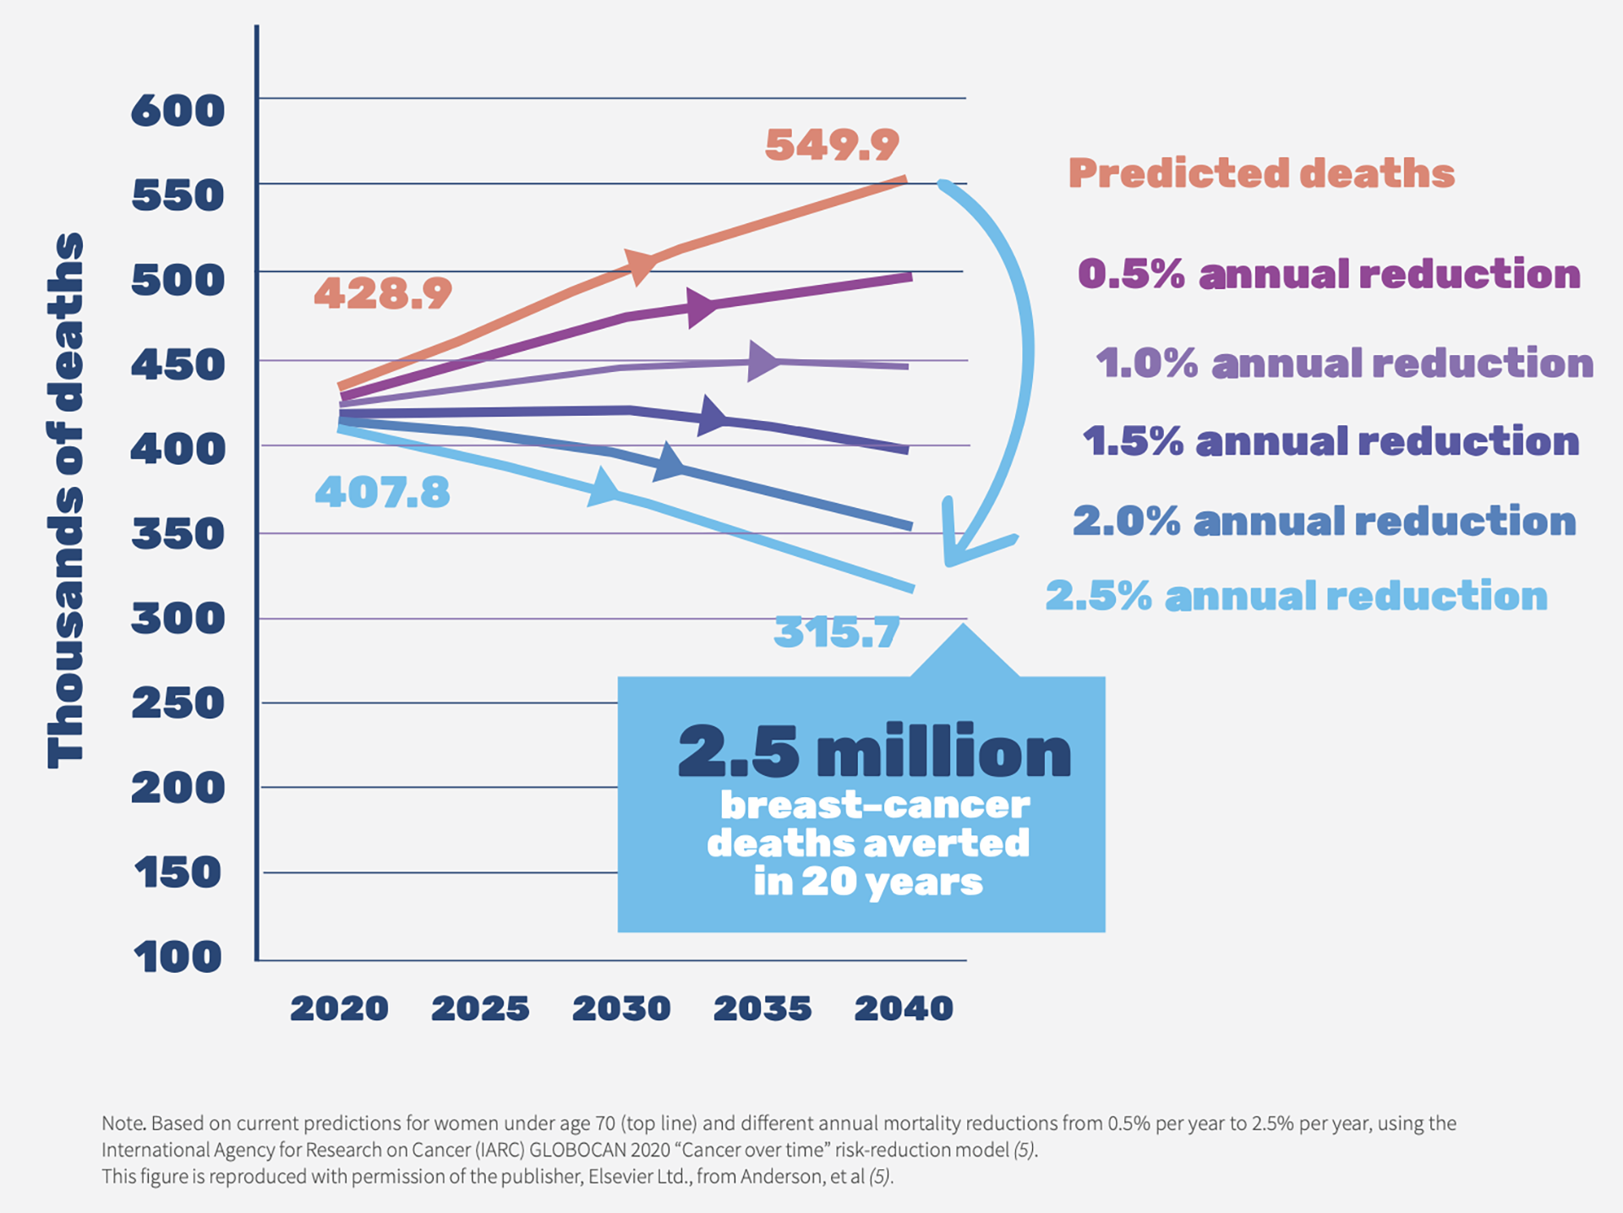
Introduction
Breast cancer is the most frequently occurring cancer in women and involves the uncontrolled growth of abnormal breast cells that form tumors.
If not identified and treated, these tumours can spread throughout the body, become fatal, and cause death.
Detection is critical to improving treatment outcomes and survival rates.

Slide 4
Technologies Used
Deep Learning: A subset of machine learning focused on algorithms inspired by the structure and function of the brain called artificial neural networks.
Capable of learning from large amounts of data, making it particularly effective for tasks like classification, image recognition, natural language processing, and more. Example models are CNN, RNN etc.
Data Augmentation Techniques such as rotations, flips, zooms, and shifts to increase the diversity and improve the generalization of the training data.
Transfer Learning with Pretrained Models like DenseNet, Inception, and XceptionNet to improve learning efficiency and accuracy.
GPU Acceleration: Accelerated the training process using GPU hardware capabilities, including NVIDIA GPUs and Google Colab with GPU runtime.
TensorFlow and Keras Frameworks: Employed these frameworks for building, training, and deploying deep learning models, facilitating easy implementation and experimentation.
Utilized metrics such as accuracy, precision, recall, F1-score, and ROC-AUC to evaluate model performance, aiding in the comparison and selection of the best model.
Python :Used as the primary language for implementing deep learning models, benefiting from its rich ecosystem of libraries and tools for data processing, model building, and evaluation.

Slide 5
Problem Statement
Breast cancer is a major health concern globally, and early detection is crucial for improving treatment outcomes and survival rates.
Mammograms are one of the most effective tools for detection of breast cancer.
Interpreting mammograms can be challenging and requires expert radiologists to differentiate between benign and malignant breast lesions.
The goal of this project is to develop a robust and accurate machine learning model to classify mammogram images as either benign or malignant.
This model aims to assist radiologists by providing a second opinion, thereby enhancing the diagnostic process and reducing the risk of misdiagnosis. The successful implementation of this project could lead to more efficient and accurate detection of breast cancer, ultimately saving lives.

Slide 6
Objectives
Utilize CNNs to automatically extract relevant features such as textures, edges, and patterns from mammogram images, which are crucial for distinguishing between benign and malignant tissues.
Combine Convolutional Neural Networks (CNN) with Vision Transformers (ViT) to leverage the strengths of both architectures.
Compare the hybrid model's performance with standalone models.
Model Comparisons: We are focusing on training our dataset on multiple models to check the validation accuracies and to have a report.
Aimed to identify the model that provides the highest accuracy and reliability in distinguishing between benign and malignant breast cancer images for detection and improved patient outcomes.

Slide 7
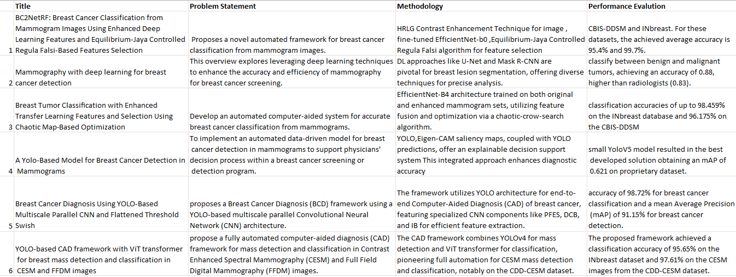
Literature Survey

Slide 8
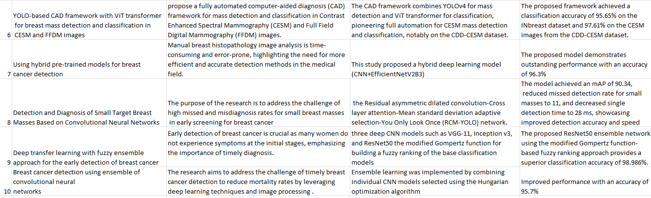
Literature Survey

Slide 9
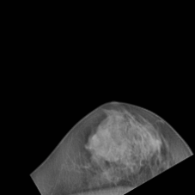
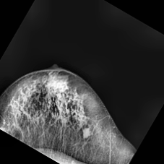
About the Dataset
Utilizing a CLAHE-enhanced mammogram dataset from Kaggle, the model aims to accurately classify images into two categories: Benign and Malignant.
Benign conditions can include cysts, fibroadenomas, and calcifications that do not spread or pose a significant threat to health.
Malignant tumors are characterized by uncontrolled cell growth and have the potential to invade surrounding tissues and metastasize to other parts of the body.
These images indicate the presence of cancerous tumors in the breast tissue.
Malignant
Benign

Slide 10
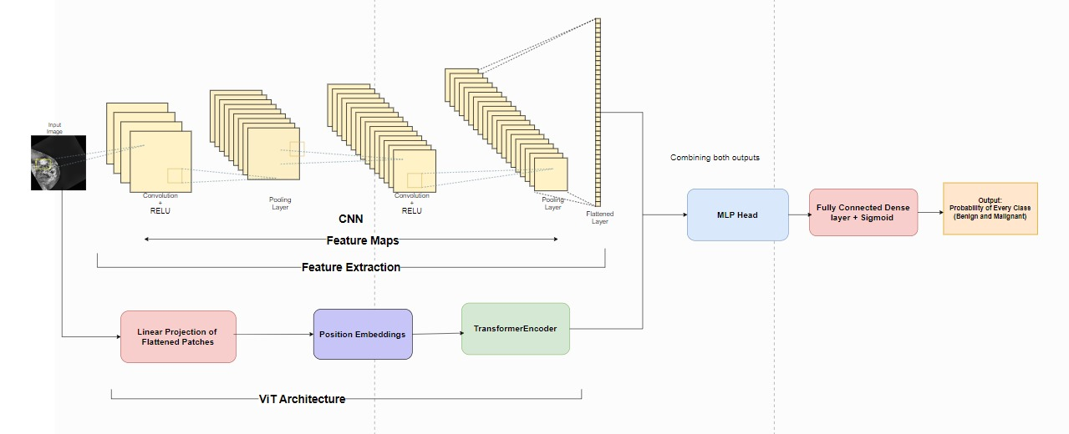
Proposed Methodology (Hybrid Model)
Combination of CNN and ViT:
Developed a hybrid model that integrates Convolutional Neural Networks (CNNs) for local feature extraction with Vision Transformers (ViTs) for capturing global context.
Architecture Diagram of Hybrid Model

Slide 11
Proposed Methodologies (Other Models we implemented)
Convolutional Neural Networks (CNNs): Utilize CNNs to automatically extract detailed local features from mammogram images, focusing on capturing textures, edges, and patterns.
CNN with Pretrained Models:
DenseNet: Leverage DenseNet for its dense connectivity pattern, which helps in efficient feature reuse and improves gradient flow during training.
Inception v3: Utilize Inception v3 for its multi-scale feature extraction capabilities through its parallel convolutional paths.
SE-ResNet: Employ SE-ResNet for its integration of Squeeze-and-Excitation blocks, enhancing the model's ability to focus on important features.
XceptionNet: Use XceptionNet for its depthwise separable convolutions, which improve feature extraction efficiency and model performance.

Slide 12
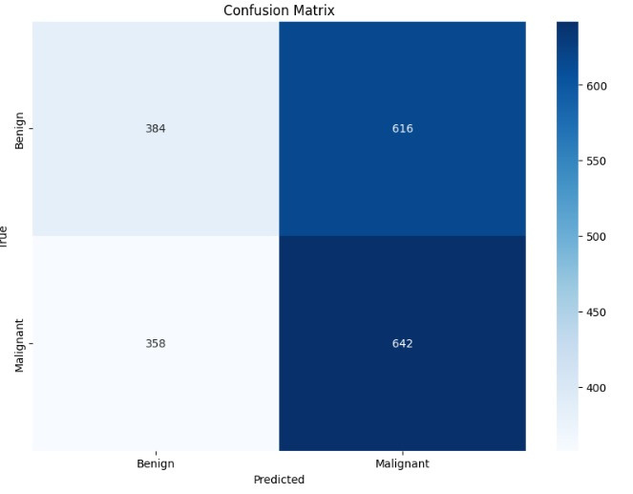
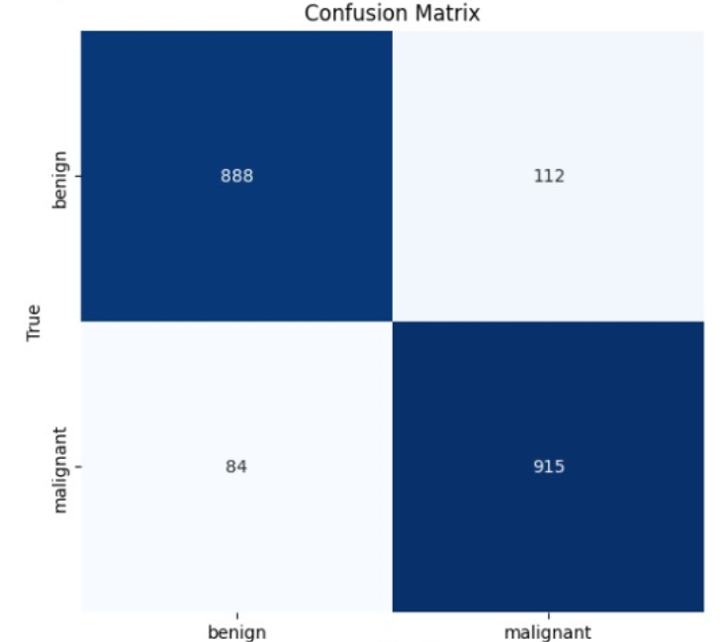
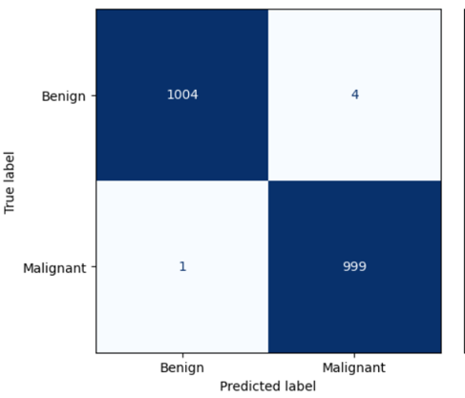
Results and comparative Analysis
For Proposed Hybrid(CNN +ViT) Model
For Pretrained Models
For CNN Model
Confusion Matrices

Slide 13
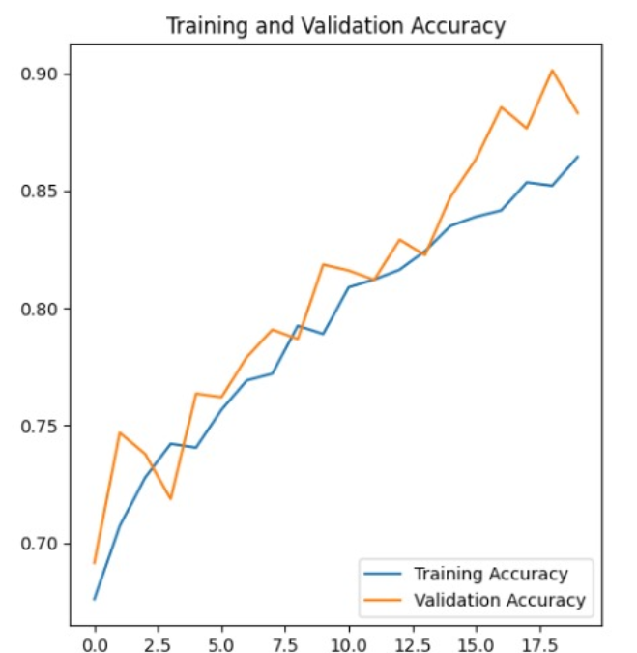
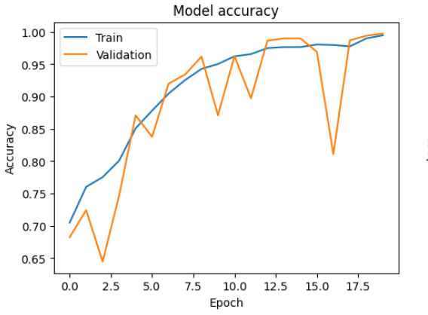
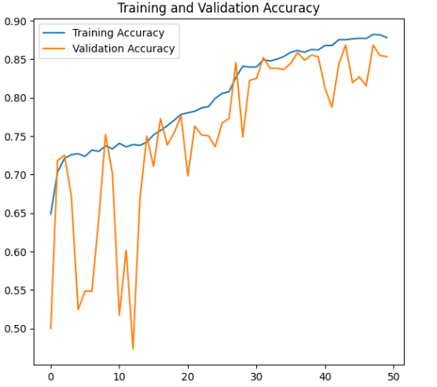
For CNN Model
For Proposed Hybrid(CNN +ViT) Model
For Pretrained Models
MODEL | Training Accuracy | Validation Accuracy | Training Loss | Validation Loss
CNN | 0.878 | 0.853 | 0.306 | 0.332
Hybrid(CNN+ ViT) | 0.853 | 0.901 | 0.323 | 0.260
DenseNET121 | 0.994 | 0.997 | 0.015 | 0.009
Inception V3 | 0.983 | 0.995 | 0.047 | 0.016
XceptionNET | 1.00 | 1.00 | - | -
SE - ResNet | 0.954 | 0.962 | 0.114 | 0.106

Slide 14
Conclusion
In this study on the classification of breast cancer using mammogram images, we compared various deep learning models, including CNN, Hybrid (CNN + ViT), DenseNET121, Inception V3, XceptionNET, and SE-ResNet.
Our results show that pretrained models like DenseNET121 and Inception V3 achieved exceptionally high validation accuracies of 0.997 and 0.995, respectively while XceptionNET achieved a perfect validation accuracy of 1.00, which, while impressive, may indicate potential overfitting.
On the other hand, our proposed Hybrid (CNN + ViT) model, designed to leverage both convolutional neural networks and vision transformers, achieved a notable validation accuracy of 0.901.
Despite not having the highest accuracy, the Hybrid model's architectural innovation makes it a robust alternative with potential for further development.

Slide 15
FUTURE SCOPE
Further development of the Hybrid (CNN + ViT) model can be explored by fine-tuning the integration of CNN and ViT components to enhance performance and accuracy.
Developing ensemble methods that combine the strengths of multiple models (e.g., Hybrid, DenseNET121, Inception V3) to achieve higher classification performance. And working with large datasets.

Slide 16
References
Jabeen, K., Khan, M. A., Balili, J., Alhaisoni, M., Almujally, N. A., Alrashidi, H., ... & Cha, J. H. (2023). BC2NetRF: breast cancer classification from mammogram images using enhanced deep learning features and equilibrium-jaya controlled regula falsi-based features selection. Diagnostics, 13(7), 1238.
Wang, L. (2024). Mammography with deep learning for breast cancer detection. Frontiers in Oncology, 14, 1281922.
Chakravarthy, S., Nagarajan, B., Kumar, V. V., Mahesh, T. R., Sivakami, R., & Annand, J. R. (2024). Breast tumor classification with enhanced transfer learning features and selection using chaotic map-based optimization. International Journal of Computational Intelligence Systems, 17(1), 18.
Prinzi, F., Insalaco, M., Orlando, A., Gaglio, S., & Vitabile, S. (2024). A yolo-based model for breast cancer detection in mammograms. Cognitive Computation, 16(1), 107-120.
Mohammed, A. D., & Ekmekci, D. (2024). Breast Cancer Diagnosis Using YOLO-Based Multiscale Parallel CNN and Flattened Threshold Swish. Applied Sciences, 14(7), 2680.
Hassan, N. M., Hamad, S., & Mahar, K. (2024). YOLO-based CAD framework with ViT transformer for breast mass detection and classification in CESM and FFDM images. Neural Computing and Applications, 36(12), 6467-6496.
Zarif, S., Abdulkader, H., Elaraby, I., Alharbi, A., Elkilani, W. S., & Pławiak, P. (2024). Using hybrid pre-trained models for breast cancer detection. Plos one, 19(1), e0296912.
Tan, L., Liang, Y., Xia, J., Wu, H., & Zhu, J. (2024). Detection and Diagnosis of Small Target Breast Masses Based on Convolutional Neural Networks. Tsinghua Science and Technology, 29(5), 1524-1539.
Sannasi Chakravarthy, S. R., Bharanidharan, N., Vinoth Kumar, V., Mahesh, T. R., Alqahtani, M. S., & Guluwadi, S. (2024). Deep transfer learning with fuzzy ensemble approach for the early detection of breast cancer. BMC Medical Imaging, 24(1), 82.
Nadkarni, S., & Noronha, K. (2024). Breast cancer detection using ensemble of convolutional neural networks. International Journal of Electrical & Computer Engineering (2088-8708), 14(1).

Slide 17


