Slide 1
ToDo Application
Sr. No. | NAME | ROLL NO.
1 | Sangeeta Singh | 32257
GUIDE
Mr. Nilesh S. Shirude
DEPARTMENT OF
ELECTRONICS AND TELECOMMUNICATION ENGINEERING
PUNE INSTITUTE OF COMPUTER TECHNOLOGY
PUNE – 43

Slide 2
Introduction
Welcome to the introduction of our Todo Application project.
In today's fast-paced world, managing tasks efficiently is essential for productivity and success.
Our Todo Application aims to provide a user-friendly and feature-rich platform for task management.

Slide 3
Proposed System
User Registration and Login
Task Creation and Management
Task Organization
Task Collaboration
Reminders and Notifications
Task Status and Progress Tracking
User-Friendly Interface
Responsive Design

Slide 4
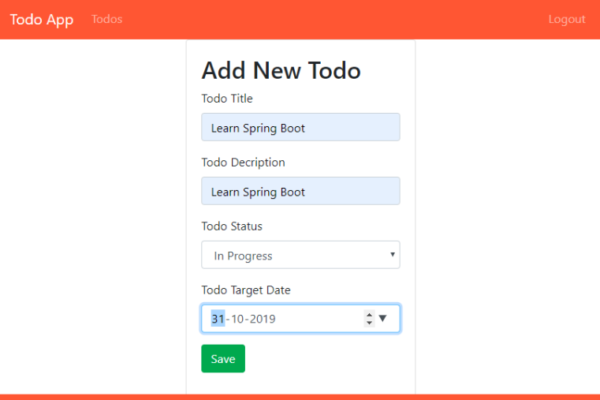
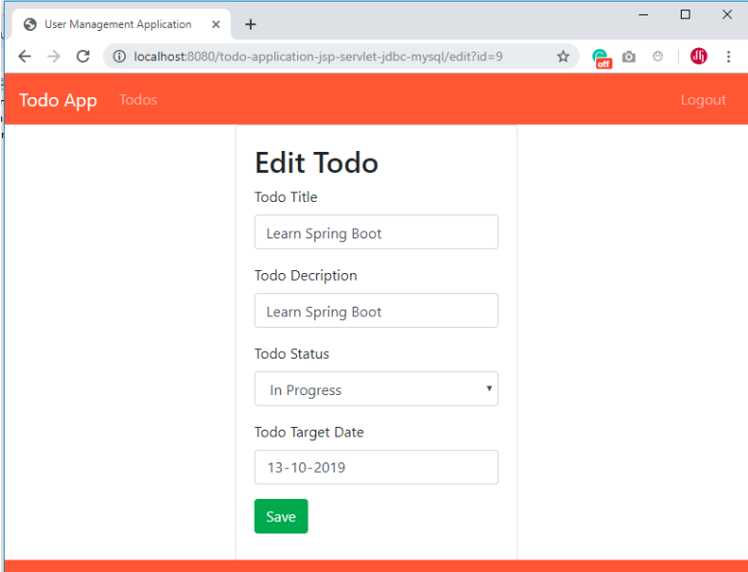
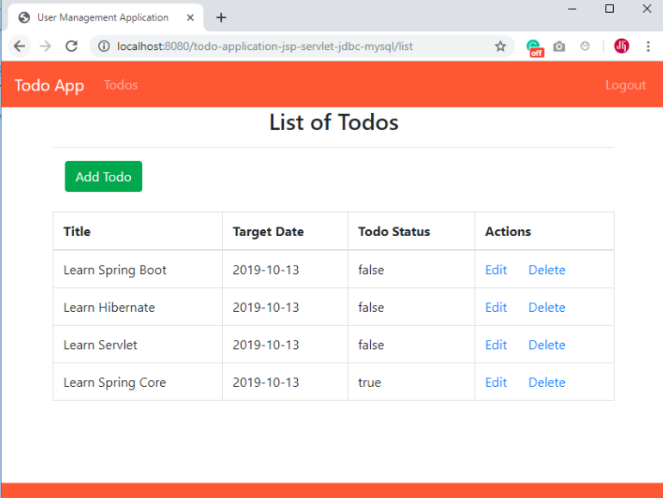
Animation of project

Slide 5
Algorithm / flowchart
Start
Initialize the application and load the user interface.
Prompt the user to register or log in with their credentials.
Validate the user input and authenticate the user.
Collect task details such as title, description, due date, and priority.
Provide options to edit, delete, or mark tasks as completed.
Enable users to share tasks with others and assign tasks to team members.
Implement real-time updates and notifications for task collaboration.
Set up reminders and notifications for upcoming tasks or approaching deadlines.
Notify users through email, push notifications, or in-app alerts.
Display visual indicators or progress bars to represent task completion.
Design an intuitive and user-friendly interface for easy navigation and interaction.
Implement responsive design principles to ensure compatibility across different devices.
End

Slide 6
Source code explanation
Model-View-Controller (MVC) Architecture
Database Integration
User Interface Design
Form Handling and Data Validation
Session Management
Code Modularization and Reusability

Slide 7
Result:
The implementation of the Todo Application has resulted in a fully functional and user-friendly system that allows users to efficiently manage their tasks. The application offers features such as task creation, editing, and deletion, user authentication and security, integration with a MySQL database for data persistence, a responsive user interface, efficient task tracking and organization, and enhanced productivity and time management. The successful implementation demonstrates the effectiveness of JSP, Servlet, JDBC, and MySQL in building robust web-based applications.

Slide 8
Conclusion:
In conclusion, the development of the Todo Application using JSP, Servlet, JDBC, and MySQL has proven to be a valuable project with numerous benefits. The application provides users with a convenient and efficient way to manage their tasks, enhancing their productivity and organization. The project also demonstrates the practical application of key technologies in web development and database management. Through the implementation process, valuable insights and knowledge were gained in areas such as user interface design, database integration, and server-side programming. Overall, the Todo Application project has successfully achieved its objectives and has the potential to be further expanded and enhanced in the future.

Slide 9
Application, future scope:
Integration with mobile platforms
Collaboration features
Reminders and notifications
Data analysis and reporting
Integration with other productivity tools
Customization options

Slide 10
References:
Oracle Java Documentation: https://docs.oracle.com/javase/8/docs/
JavaServer Pages (JSP) Documentation: https://tomcat.apache.org/tomcat-8.5-doc/jsp-howto.html
3. Servlet API Documentation: https://tomcat.apache.org/tomcat-8.5-doc/servletapi/
4. JDBC Tutorial: https://docs.oracle.com/javase/tutorial/jdbc/
5. MySQL Documentation: https://dev.mysql.com/doc/
6. Eclipse IDE Documentation: https://help.eclipse.org/latest/index.jsp
7. Apache Tomcat Documentation: https://tomcat.apache.org/tomcat-8.5-doc/
8. W3Schools (HTML, CSS, JavaScript): https://www.w3schools.com/
9. Bootstrap Documentation: https://getbootstrap.com/docs/4.6/getting-started/introduction/
10. Stack Overflow: https://stackoverflow.com/

Slide 11
THANK YOU!!

