Slide 1
Bias Detection & Responsible AI in AI Hiring Systems
Academic Project | IBM HR Analytics Dataset

Slide 2
Agenda
1. Introduction to Responsible AI
2. Problem Statement & Dataset
3. System Architecture
4. Data Preprocessing & Feature Engineering
5. AI Hiring Model – Training & Evaluation
6. Fairness & Bias Detection (Unit 2)
7. Bias Visualization & Analysis
8. Interpretability & Explainability (Unit 3)
9. SHAP Analysis & Feature Importance
10. Individual Candidate Explanations
11. Ethics & Accountability Audit (Unit 4)
12. Privacy Preservation (Unit 5)
13. Privacy-Accuracy-Fairness Tradeoffs
14. Correlation vs Causation Analysis
15. Nudge Theory & Counterfactual Explanations
16. Dashboard Demo
17. Key Findings & Conclusion

Slide 3
Introduction to Responsible AI (Unit 1)
• Responsible AI ensures AI systems are fair, transparent,
accountable, and privacy-preserving.
• Key Principles:
→ Fairness: No discrimination based on protected attributes
→ Transparency: Explainable decision-making
→ Accountability: Clear ownership of AI outcomes
→ Privacy: Protection of personal data
→ Beneficence: AI should benefit all stakeholders
• Why it matters in Hiring:
→ AI hiring tools can perpetuate historical biases
→ Legal compliance (EU AI Act, EEOC 4/5ths rule)
→ Ethical obligation to candidates

Slide 4
Problem Statement
Problem:
AI-powered hiring systems can introduce or amplify biases
against protected groups (gender, age, ethnicity).
Objective:
Build a Responsible AI pipeline that:
✓ Detects bias in hiring predictions
✓ Explains model decisions transparently
✓ Audits ethical risks systematically
✓ Preserves candidate privacy
Dataset: IBM HR Employee Attrition
• 1,470 employees × 35 features
• Target: Attrition (Yes/No → Hired/Not Hired)
• Sensitive attributes: Gender, Age

Slide 5
System Architecture
Pipeline Flow:
Dataset (IBM HR)
↓
Data Preprocessing
↓
Model Training (LR, RF, DT)
↓
┌──────┬──────┬──────┐
↓ ↓ ↓ ↓
Fairness Explain Privacy
Analysis ability Module
↓ ↓ ↓
└──────┼──────┘
↓
Ethics Audit → Dashboard
Tech Stack:
Python, Scikit-learn, SHAP, Fairlearn,
diffprivlib, Streamlit, python-pptx

Slide 6
Data Preprocessing & Feature Engineering
Steps performed:
1. Data Cleaning:
• Dropped constant columns (EmployeeCount, Over18, etc.)
• Mapped target: Attrition Yes→1, No→0
• Handled missing values
2. Feature Engineering:
• Created AgeGroup bins (18-30, 31-40, 41-50, 51-60)
• Created IncomeGroup quartiles
• Binary gender encoding
3. Encoding & Scaling:
• Label-encoded all categorical features
• StandardScaler on numeric features
4. Sensitive Attributes Identified:
• Gender (Male/Female)
• Age Group (Young/Senior)

Slide 7
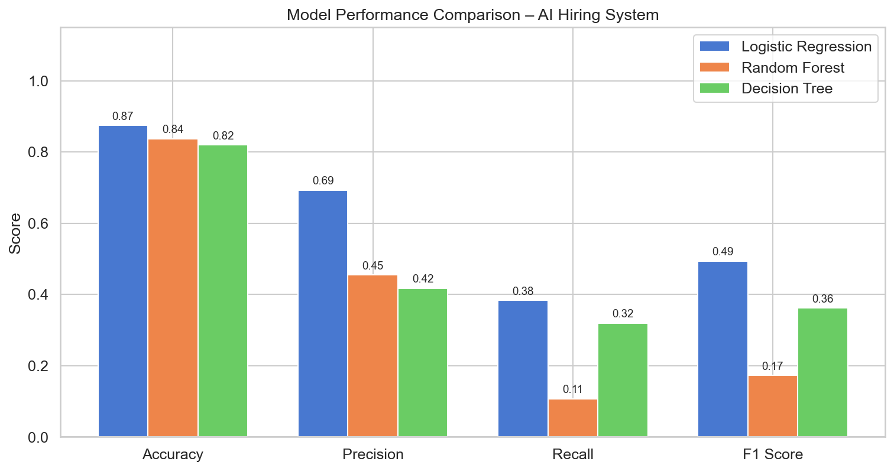
AI Hiring Model – Training & Evaluation
Three models trained for hiring prediction:
Three models trained for hiring prediction:
1. Logistic Regression (interpretable, baseline)
2. Random Forest (ensemble, high accuracy)
3. Decision Tree (intrinsically interpretable)
Evaluation Metrics:
Logistic Regression: Acc=0.8741, P=0.6923, R=0.383, F1=0.4932
Random Forest: Acc=0.8367, P=0.4545, R=0.1064, F1=0.1724
Decision Tree: Acc=0.8197, P=0.4167, R=0.3191, F1=0.3614

Slide 8
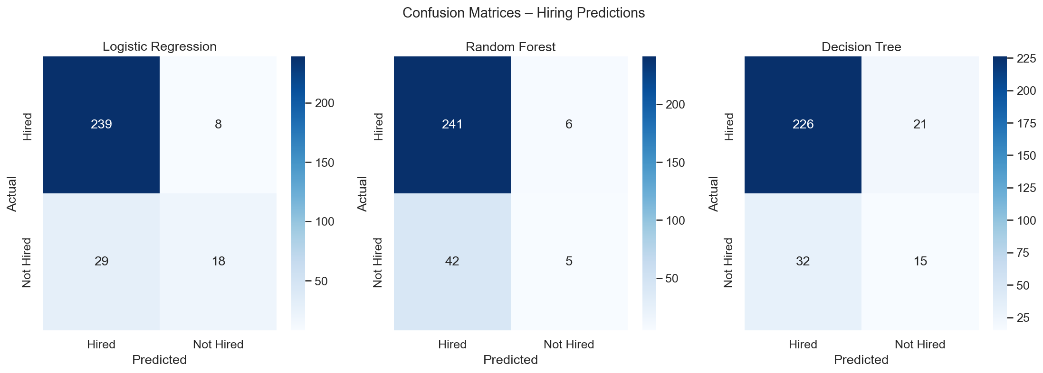
Model Evaluation – Confusion Matrices
Confusion matrices showing True/False Positive/Negative rates for each model

Slide 9
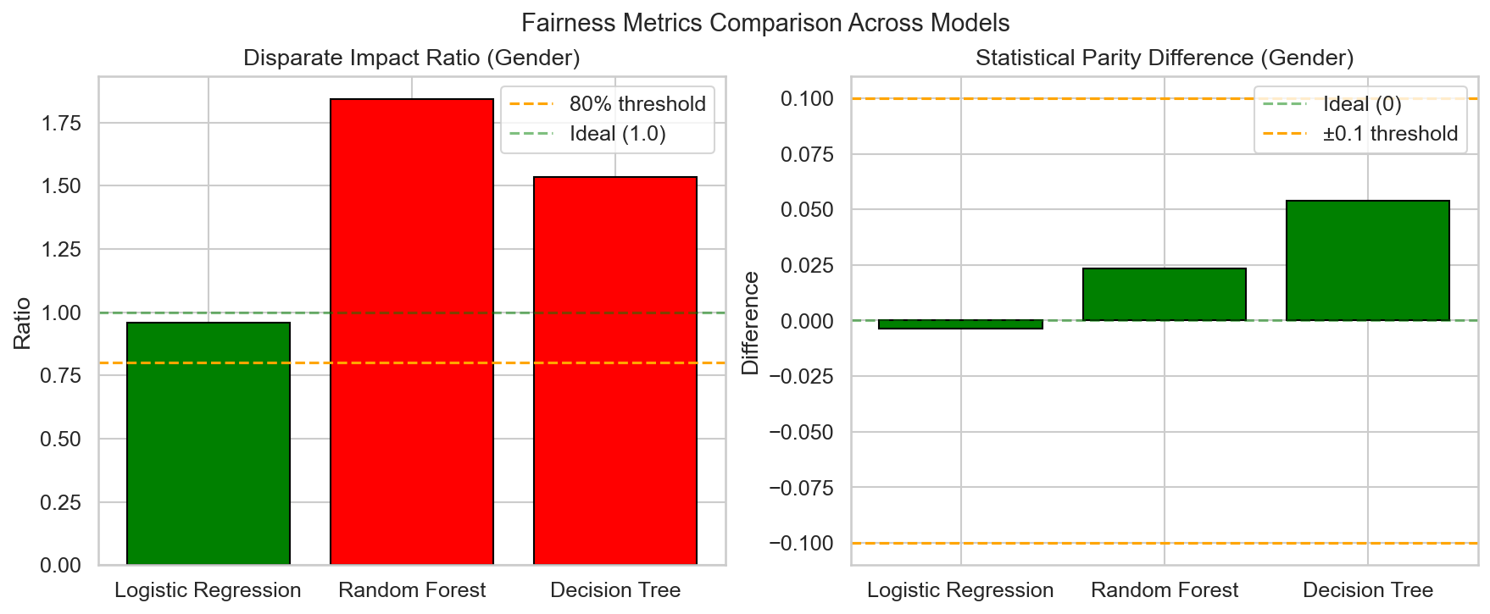
Fairness & Bias Detection (Unit 2)
Fairness Metrics Implemented:
Fairness Metrics Implemented:
1. Demographic Parity:
P(ŷ=1|G=0) should equal P(ŷ=1|G=1)
2. Equal Opportunity:
TPR should be equal across groups
3. Disparate Impact (80% Rule):
Ratio = P(ŷ=1|unprivileged) / P(ŷ=1|privileged)
Ratio < 0.8 → adverse impact detected
4. Statistical Parity Difference:
SPD = P(ŷ=1|unprivileged) - P(ŷ=1|privileged)
Ideal value = 0
Libraries: Fairlearn, AIF360, custom implementations

Slide 10
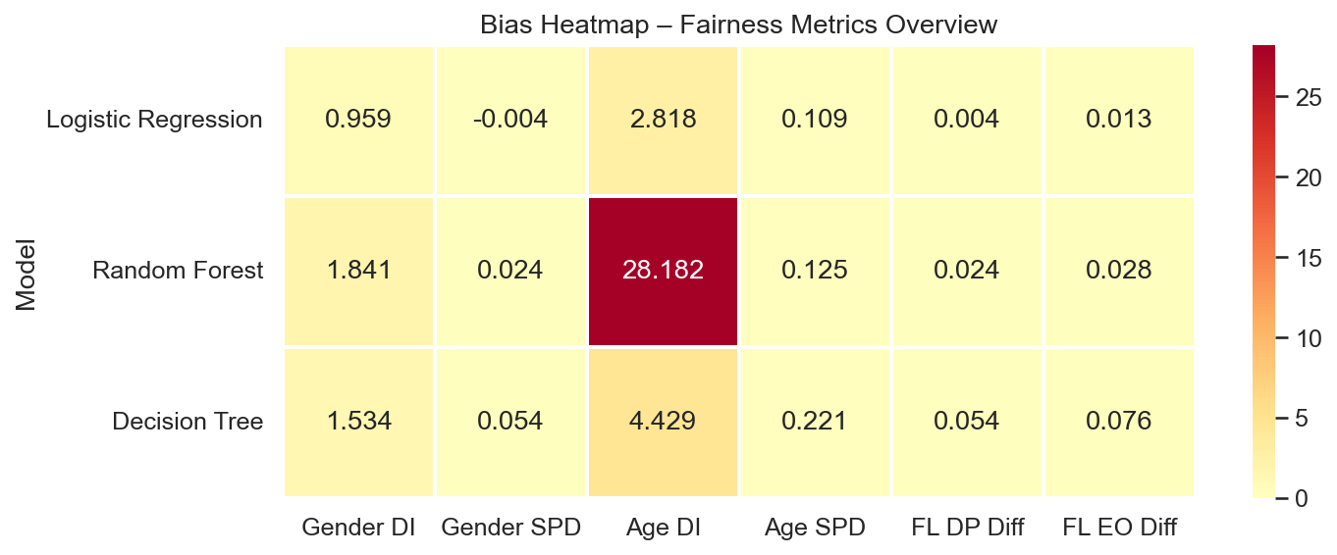
Bias Heatmap – All Models & Attributes
Heatmap showing fairness metrics across models for Gender and Age groups

Slide 11
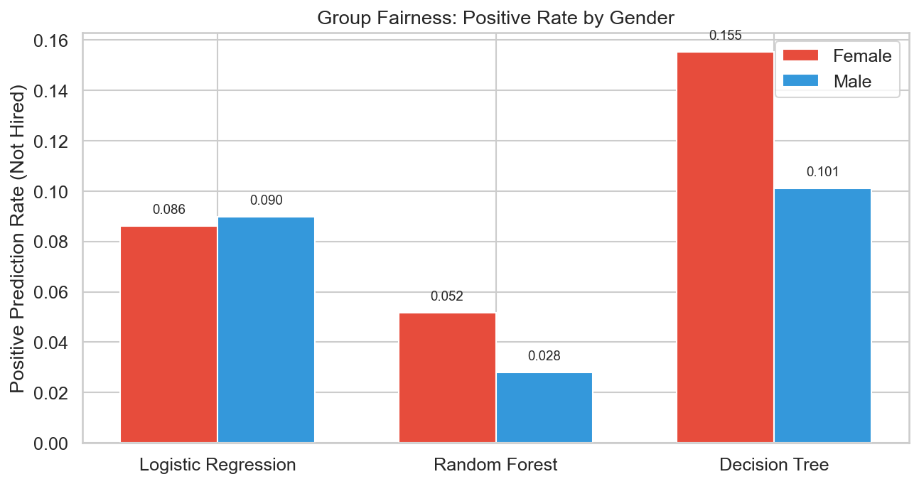
Group Fairness – Gender Analysis
Positive prediction rates by gender for each model

Slide 12
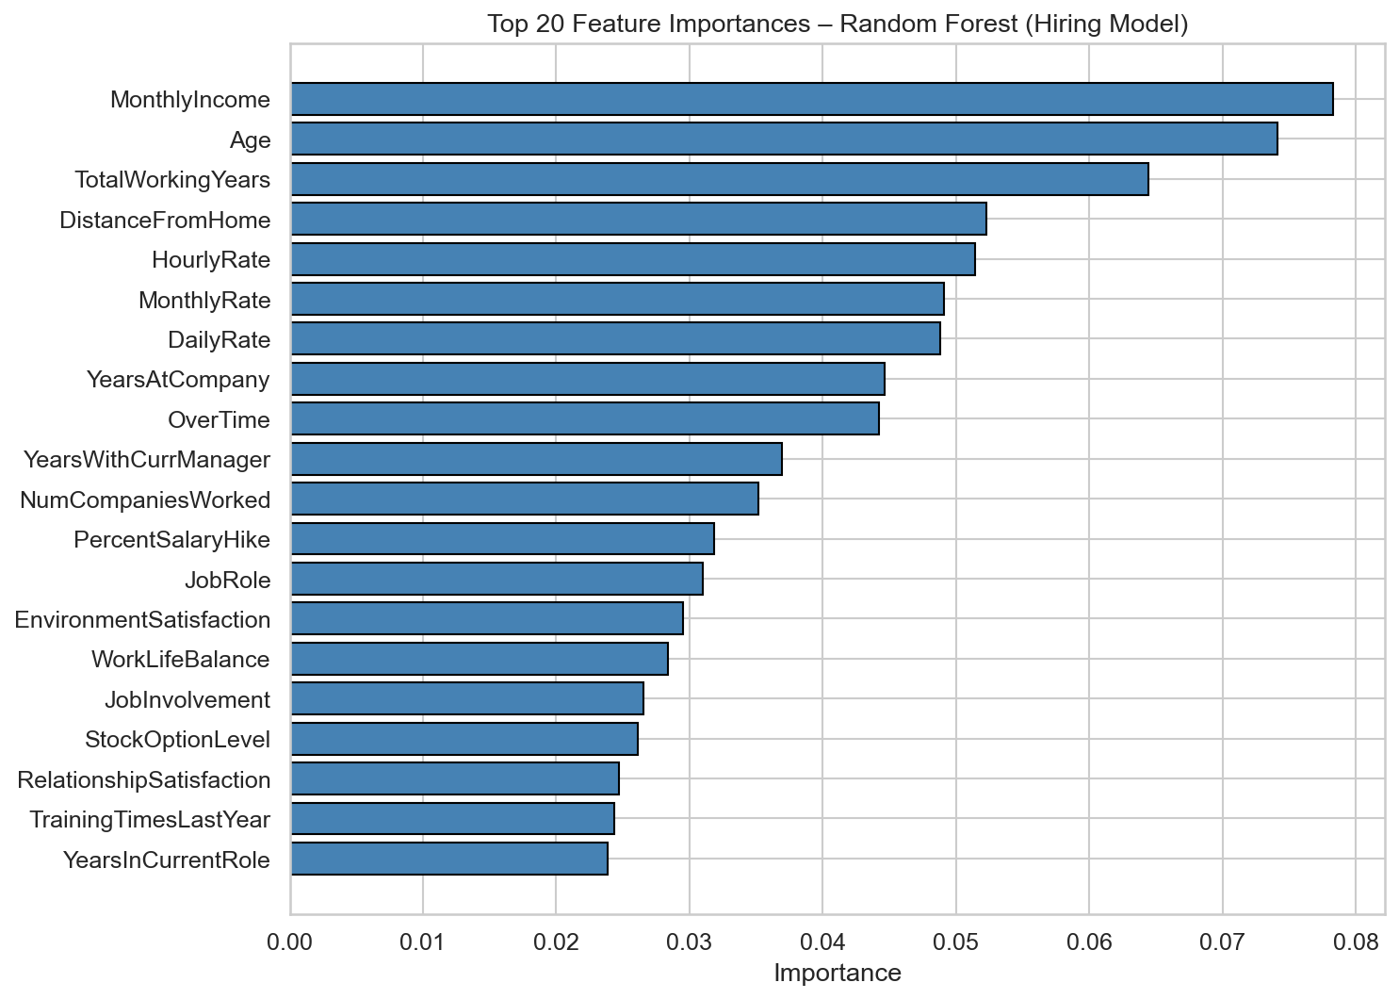
Interpretability & Explainability (Unit 3)
Two categories of explainability:
Two categories of explainability:
A. Intrinsic Methods (built-in interpretability):
• Decision Tree – directly readable rules
• Logistic Regression – feature coefficients
B. Post-hoc Methods (explain after training):
• SHAP (SHapley Additive exPlanations)
→ Game-theoretic feature attribution
• Feature Importance (Random Forest)
→ Gini / permutation importance
• Partial Dependence Plots
→ Marginal effect of each feature
Why it matters:
• GDPR Article 22: right to explanation
• Candidates deserve to know WHY

Slide 13
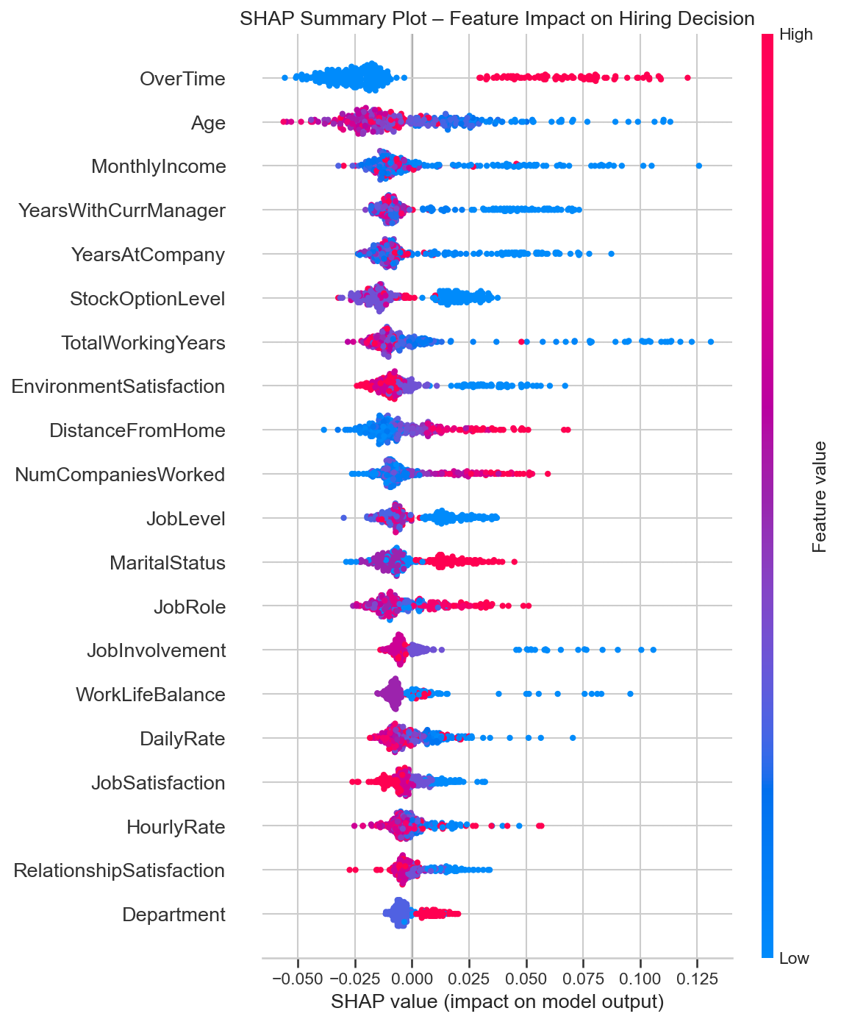
SHAP Summary Plot – Feature Impact
Each point = one employee. Color = feature value. X-axis = impact on prediction

Slide 14
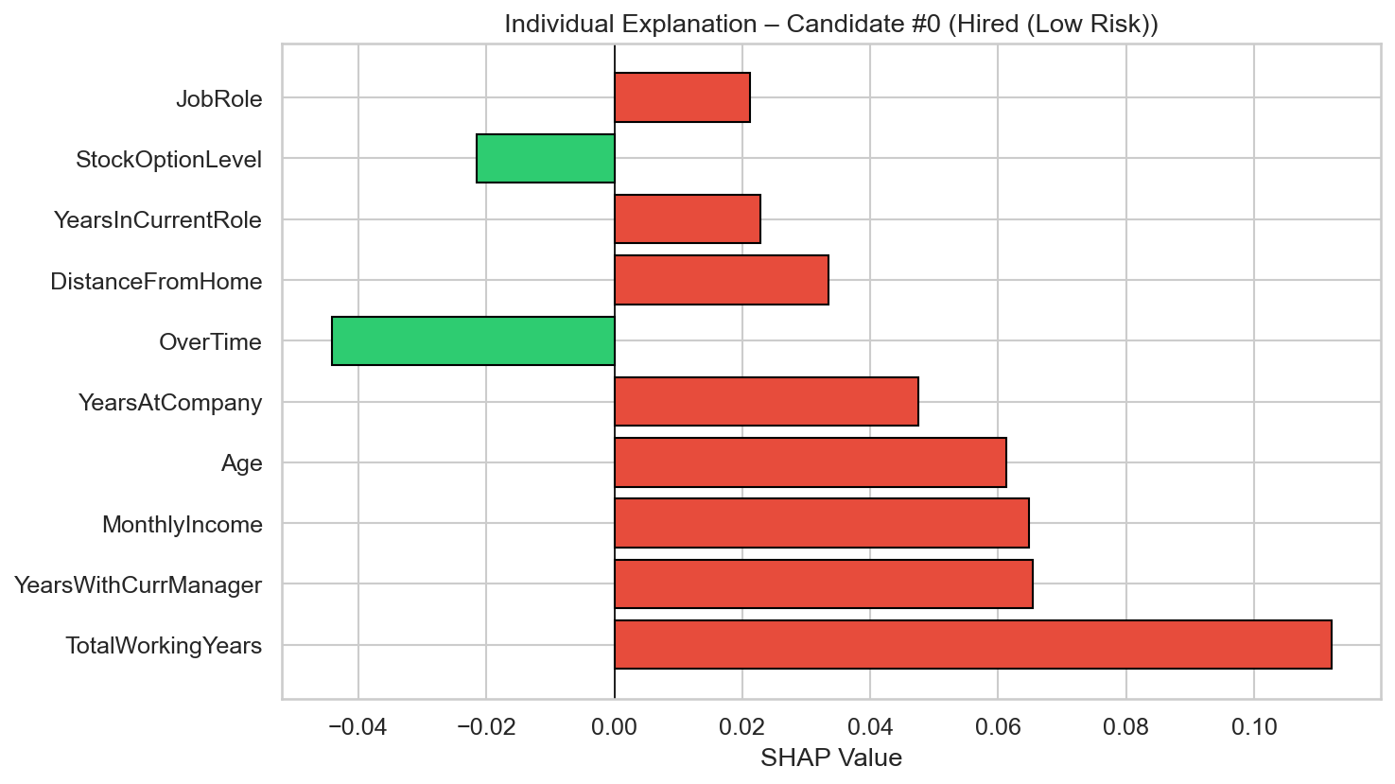
Individual Candidate Explanation
For each candidate, SHAP explains:
For each candidate, SHAP explains:
→ Which features pushed toward 'Hired'
→ Which features pushed toward 'Not Hired'
Example: Candidate #0
• OverTime → strong push toward Not Hired
• MonthlyIncome → push toward Hired
• TotalWorkingYears → push toward Hired
This provides:
✓ Transparency for the candidate
✓ Actionable feedback
✓ Audit trail for the organization

Slide 15
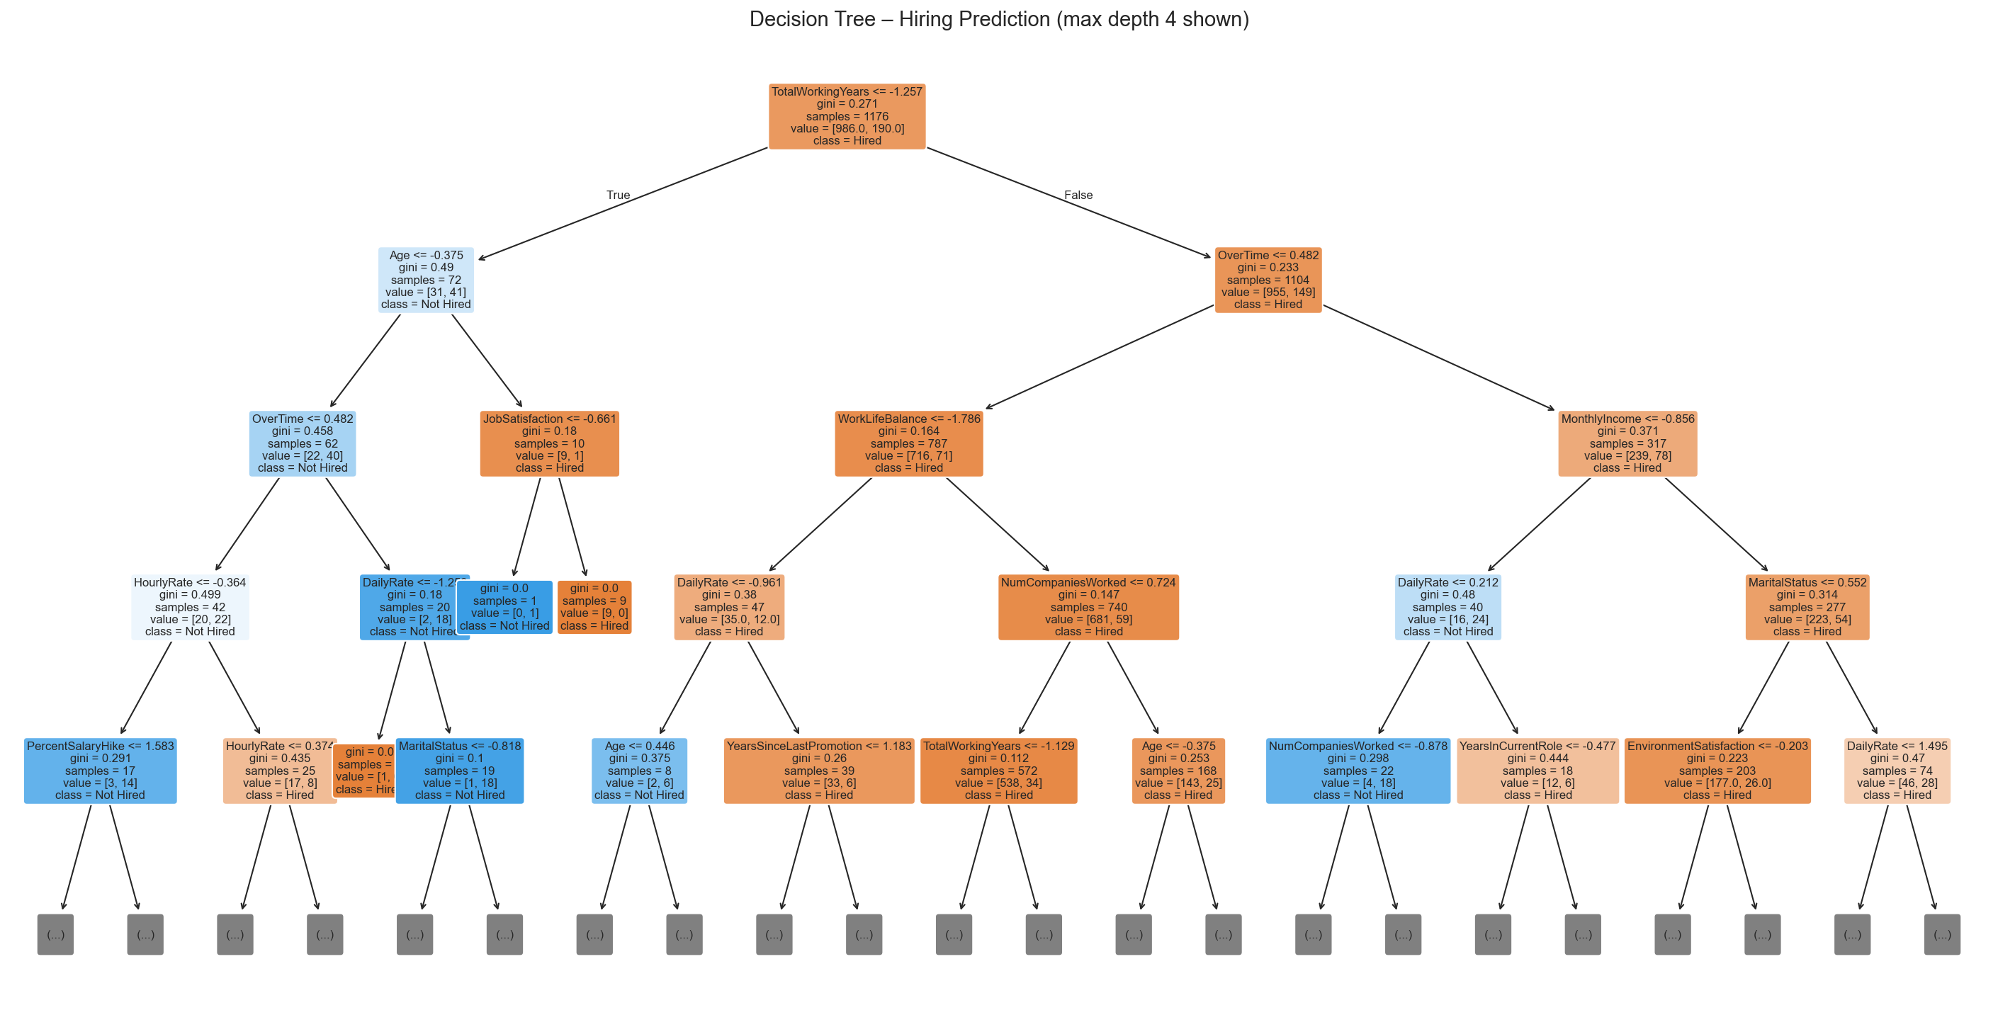
Decision Tree Visualization (Intrinsic)
The Decision Tree model is inherently interpretable – each path is a hiring rule

Slide 16
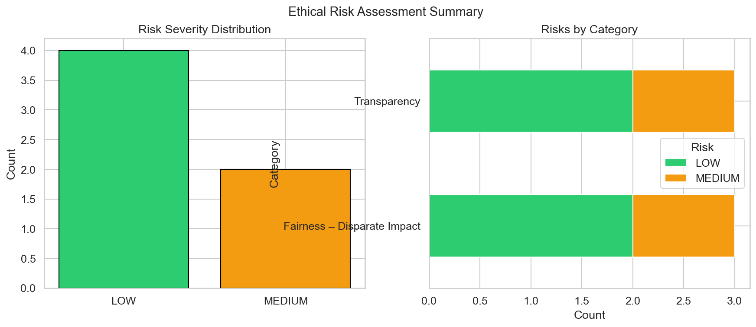
Ethics & Accountability Audit (Unit 4)
Automated AI Audit Report includes:
Automated AI Audit Report includes:
1. Bias findings across all models
2. Ethical risk severity (HIGH / MEDIUM / LOW)
3. Model transparency assessment
4. Regulatory compliance notes
5. Actionable recommendations
Ethical Principles evaluated:
• Fairness • Transparency
• Accountability • Privacy
• Beneficence • Non-maleficence
Risk Summary: 0 HIGH, 2 MEDIUM, 4 LOW

Slide 17
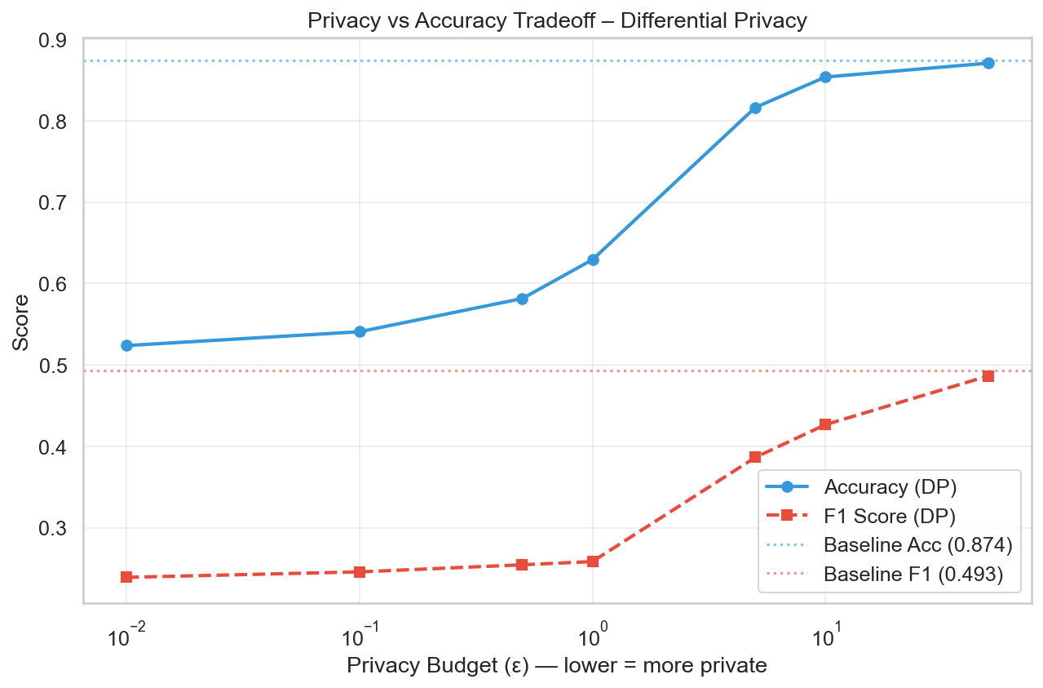
Privacy Preservation (Unit 5)
Technique: Differential Privacy (ε-DP)
Technique: Differential Privacy (ε-DP)
• Adds calibrated noise to model training
• Privacy budget ε controls the tradeoff:
→ Low ε = strong privacy, lower accuracy
→ High ε = weak privacy, higher accuracy
Implementation: IBM diffprivlib
• DP Logistic Regression at ε = 0.01 to 50
Baseline: Acc=0.8741, F1=0.4932
Best DP: ε=50.0, Acc=0.8707
Most Private: ε=0.01, Acc=0.5238

Slide 18
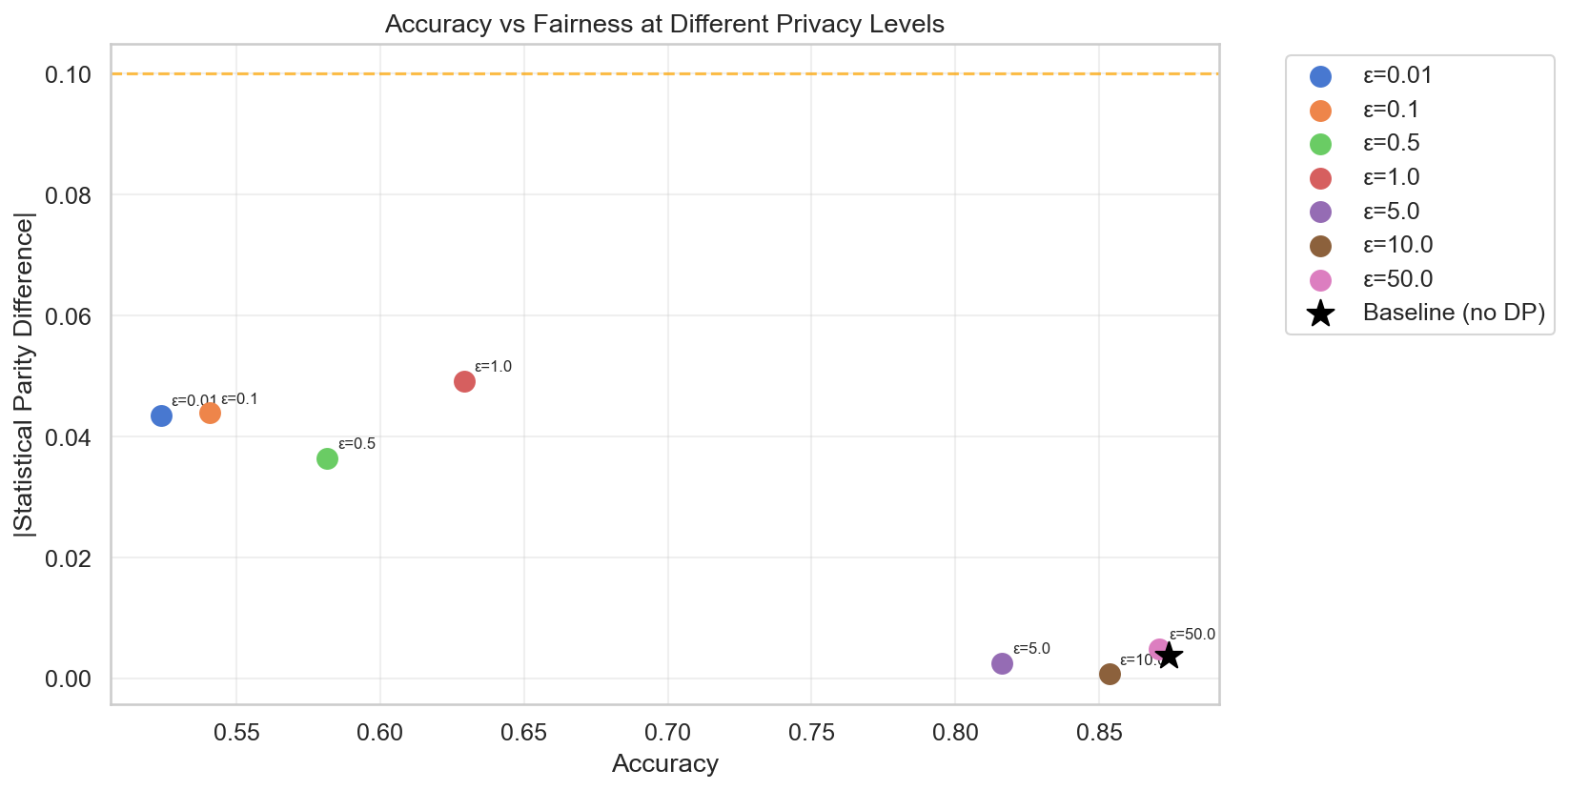
Accuracy vs Fairness at Different Privacy Levels
Each point = a DP model at different ε. Star = baseline without privacy

Slide 19
Responsible AI Dashboard
Interactive Streamlit Dashboard features:
📊 Dataset Overview:
• Employee statistics, distributions, demographics
🤖 Model Performance:
• Side-by-side metric comparison
• Confusion matrices
⚖️ Fairness & Bias:
• Interactive fairness metric tables
• Bias heatmaps and comparison charts
🔍 Explainability:
• SHAP plots, feature importance, PDP
📋 Ethics Audit:
• Full audit report with risk table
🔗 Correlation & Causation:
• Correlation matrix, proxy variables, Simpson's Paradox
🎯 Nudge Theory:
• Threshold nudging, counterfactual explanations
🔒 Privacy Analysis:
• DP comparison tables and tradeoff plots
Run: streamlit run dashboard.py

Slide 20
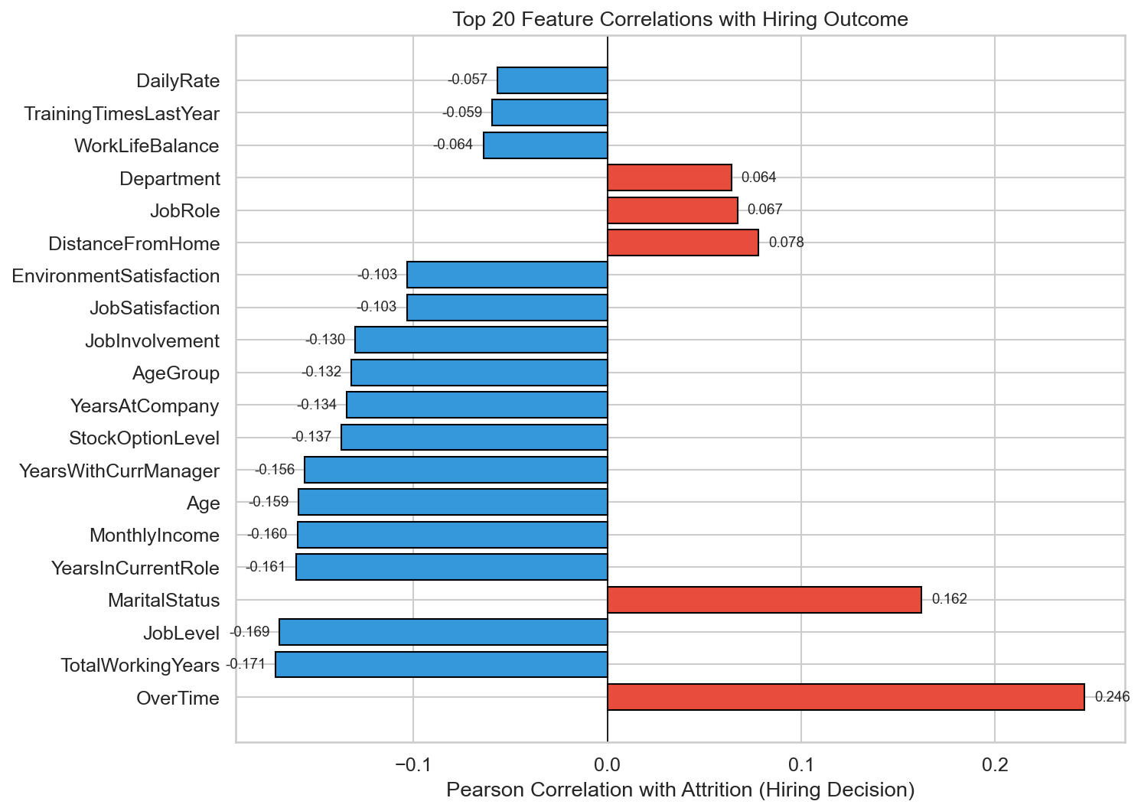
Correlation vs Causation Analysis
Correlation ≠ Causation in AI Hiring:
Correlation ≠ Causation in AI Hiring:
Correlation Analysis:
• Full feature correlation matrix computed
• Identified top features correlated with Attrition
• VIF analysis to detect multicollinearity
Causation Analysis:
• Simpson's Paradox detection across subgroups
• Proxy variable identification (features correlated
with protected attributes like Gender, Age)
• Confounding variable analysis using partial correlations
Key Finding:
Many features that correlate with attrition also correlate
with protected attributes → potential indirect discrimination
Proxy variables found: Gender, TotalWorkingYears, JobLevel, MonthlyIncome, YearsAtCompany

Slide 21
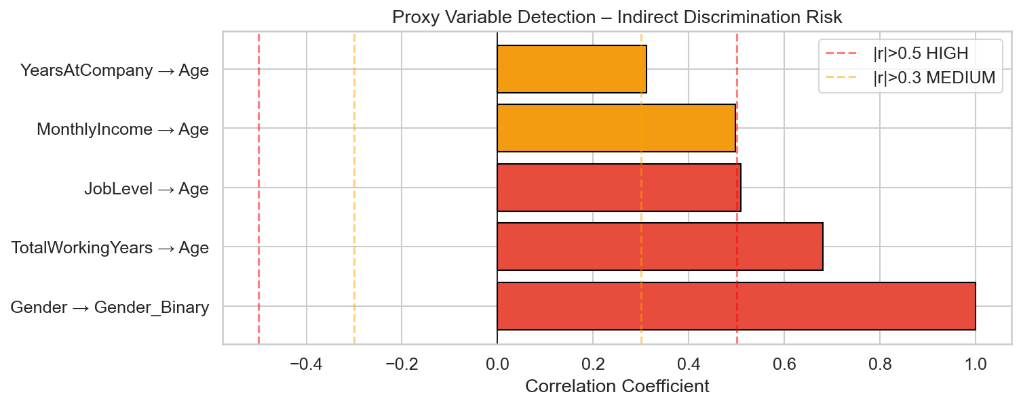
Simpson's Paradox & Proxy Variable Detection
Proxy variables can transmit bias from protected attributes to model predictions

Slide 22
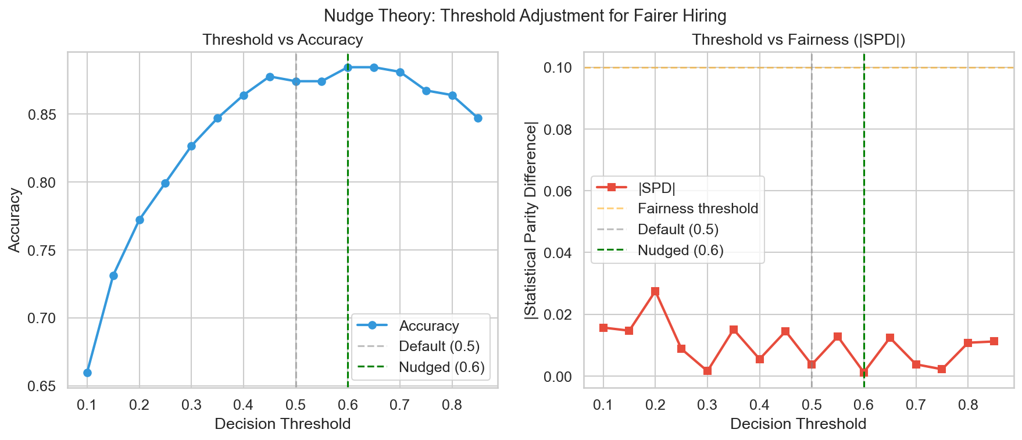
Nudge Theory & Counterfactual Explanations
Nudge Theory (Thaler & Sunstein, 2008):
Nudge Theory (Thaler & Sunstein, 2008):
Small design changes guide better decisions
without restricting freedom of choice.
Applied to AI Hiring:
1. Threshold Nudging:
• Default threshold = 0.5 may be unfair
• Optimized threshold balances accuracy & fairness
• Small shift → significant fairness improvement
2. Counterfactual Explanations:
• 'What minimal change would flip the decision?'
• Provides actionable feedback to candidates
• Ensures transparency & right to explanation

Slide 23
Conclusion & Key Takeaways
✓ Built a complete Responsible AI pipeline for hiring
✓ Detected measurable bias across Gender and Age groups
✓ Provided model explanations using SHAP & Decision Trees
✓ Generated automated ethics audit with risk assessment
✓ Demonstrated privacy–accuracy–fairness tradeoffs
✓ Analyzed correlation vs causation & proxy variables
✓ Applied nudge theory & counterfactual explanations
✓ Created interactive dashboard for stakeholder review
Key Insight: Responsible AI is not optional –
it is essential for trustworthy AI deployment.

