Slide 1

GROUP 3 FINAL PROJECT PRESENTATION BURIAL RECORD OPTICAL CHARACTER RECOGNITION EAI6010 APPLICATIONS OF ARTIFICIAL INTELLIGENCE CRN: 72021
Done By
Anish Nitin Somaiah
Pratibha Sridhar Iyengar
Ankit Arvind Khatavkar
Siddhant Sanjiv Sapte,
Srinivasu Narahari
Instructor: Mr. Sergiy Shevchenko

Slide 2
INTRODUCTION
Optical Character Recognition is defined as the process of scanning text into an image from an image/form/paper and translating the images obtained into a system manipulatable form.
This is highly useful in applications where an archive of form data has to be manipulated and features in these forms are to be extracted and stored into a data frame.
On an extension such OCR can be used in financial institutions to analyze cheques, credit cards, in healthcare providing systems to maintain patient databases from forms and so on.

Slide 3
PROJECT OBJECTIVE AND DATASET DESCRIPTION
To perform Optical Character Recognition over forms given and extract necessary features such as Name, Age and so on from the image.
Dataset is obtained from an organization named “Plural Point” that has burial forms of 120 deceased patients provided to us as .jpg images.
The forms contain essential attributes such as
Name: name of the deceased person.
Age: age at which person deceased.
Date of Burial: date of burial.
LOT-TER: Section of burial ground of the deceased person etc.

Slide 4
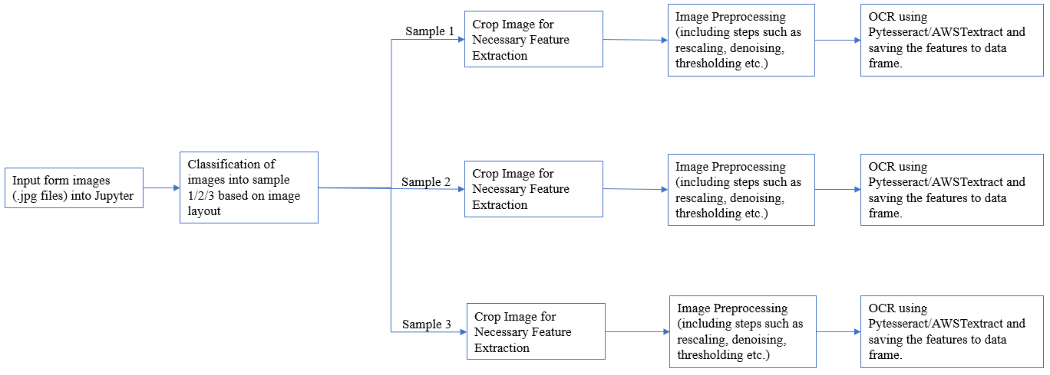
GENERAL WORKFLOW

Slide 5
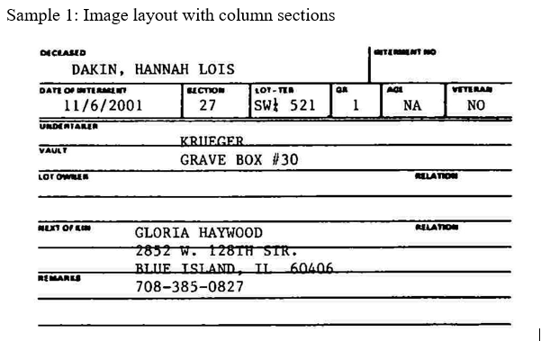
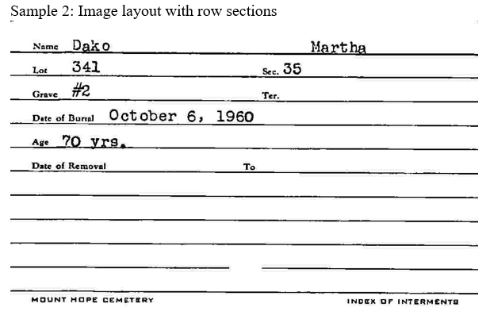
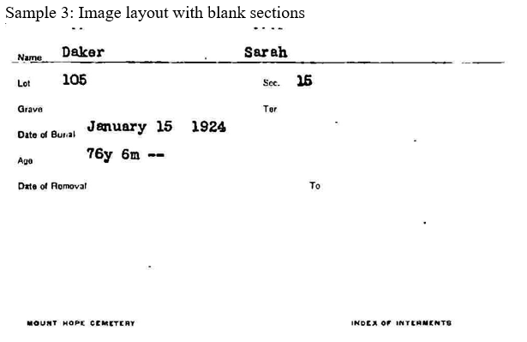
SAMPLE IMAGES

Slide 6
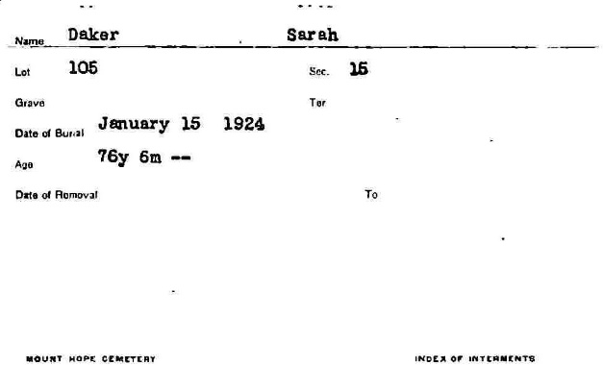
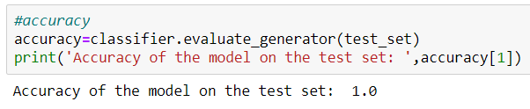
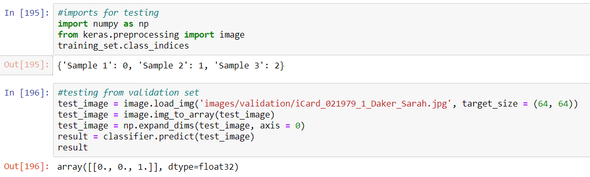
IMAGE CLASSIFICATION USING CNN

Slide 7
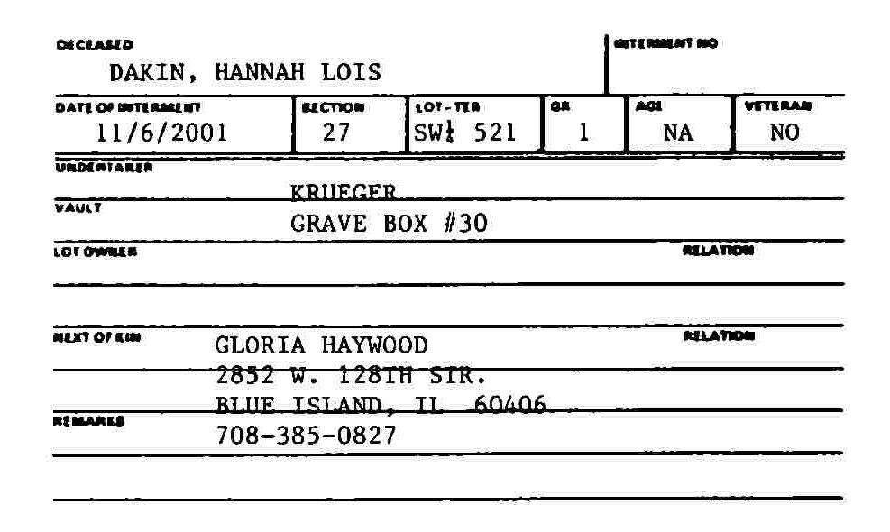
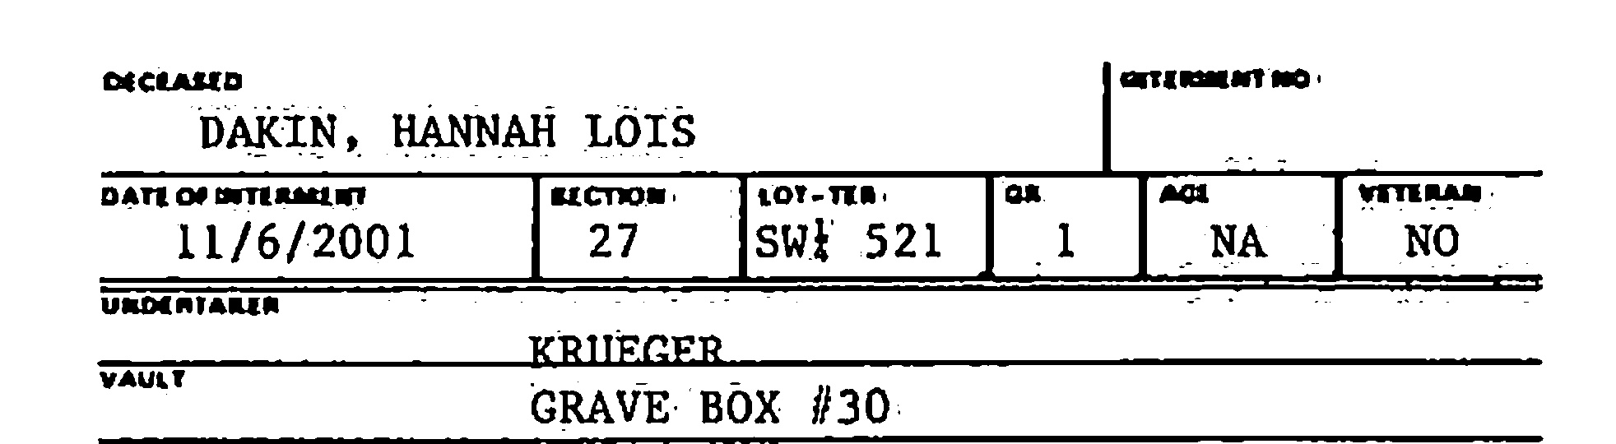
IMAGE PREPROCESSING
Cropping an image: to remove unwanted parts of the image containing insignificant information
Grayscale conversion: to reduce color complexity that the image gives while processing.
Rescaling: to improve visibility of smaller characters, the image is rescaled to a larger value.
Denoising: reduce noise in image output from scanners/cameras to retain image features such as edges, sharp structures etc.
Dilation and erosion: Addition and removal of pixels to boundaries to further reduce noise in image
Thresholding: Gaussian blurring is done in this method to remove outlier pixels and it acts as a low pass filter to provide definite boundaries for the image that is considered for OCR.

Slide 8

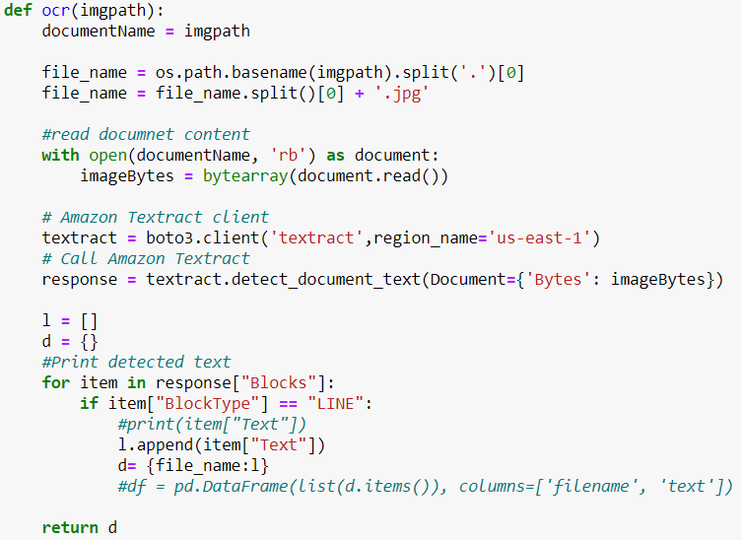
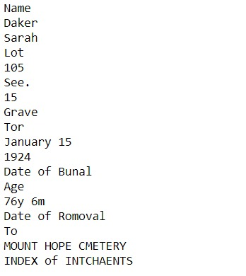
OPTICAL CHARACTER RECOGNITION

Slide 9
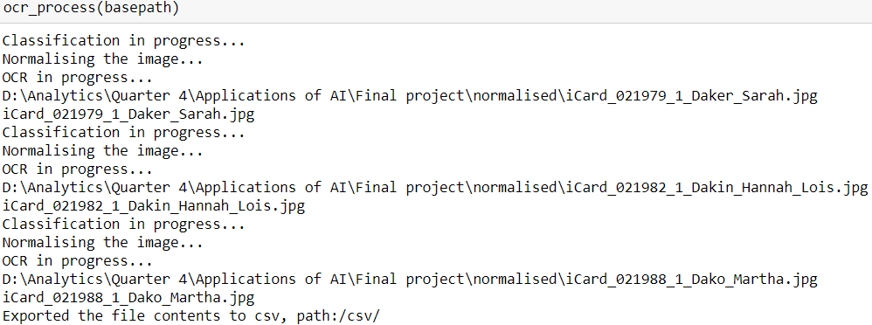
COMPLETE WORKFLOW

Slide 10
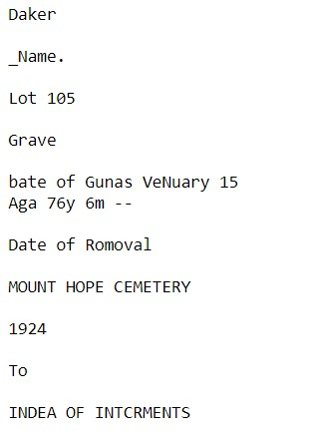
COMPARISON OF AWS TEXTERACT AND PYTESSERACT
AWS TEXTERACT OUTPUT
PYTESSERACT OUTPUT

Slide 11
REFERENCE
AWS(n.d), Installing the AWS CLI, Documentation Retrieved from https://docs.aws.amazon.com/cli/latest/userguide/cli-chap-install.html
UB-Mannheim(n.d), Tesseract at UB Mannheim, Documentation Retrieved from https://github.com/UB-Mannheim/tesseract/wiki
Prince Canuma(Oct 2018), Image Pre-Processing, Retrieved from https://towardsdatascience.com/image-pre-processing-c1aec0be3edf
TensorScience.com(Dec 2018), Optical Character Recognition (OCR) with Python and Tesseract 4, Retrieved from https://www.tensorscience.com/ocr/optical-character-recognition-ocr-with-python-and-tesseract-4-an-introduction
Zain Sajjad(Sept 2019), Amazon Textract — Going beyond optical character recognition (OCR), Retrieved from https://heartbeat.fritz.ai/amazon-textract-going-beyond-optical-character-recognition-ocr-202cf270a0ba

Slide 12
THANK YOU

