Slide 1
Viacom Facebook watch Window
Prepared by Srinivasu Narahari
Professor : Matt Goodwin, Ph.D.
FINAL Submission
Date 09/01/2019

Slide 2
Overview
Viacom is a media entertainment company. It created content and deliverer most of that in the tv channels.
Some content is created for social media like face book and others
Some revenue from the Facebook watch window.
Planning to extend it is business of preparing content for telecasting over social media like Facebook watch window.

Slide 3
Goal of the Project
Viacom can invest on social media like watch media ?
Factors to be considered
Performance
Number of views attained
Engagement
Ad Supported
Viewership and views ship engagement
Investment
Revenue Generated

Slide 4
Executive summary
Viacom extend the business by telecasting videos to Social media like Facebook.
Analyzing current available data. Planning to build analytic model with current data. Based on the model want decide it is feasible to invest in social media.
Preparing the data and looking for possible stakeholders.
This presentation uses Random forest trees algorithm for building the model based on the current data telecasting to social media. By using that model measuring the possibility of business extension.

Slide 5
Available Data
Video Retention Data
This data set provides details like how many people watched the predefined percent of video. We can say like 1000 people watched full video and 2000 people watched half video etc.
Metadata of Each Video
This Data sent contains details regarding the video like name, duration, time
Performance details of related Video Quality
This data set contains information regarding the total views, total recordings, total videos auto played, total videos clicked
Performance Details based on age and gender
This data set displays various age group watching in groups like 13-17,18-24 etc.

Slide 6
Description of key fields of data
hID : Unique id of the video in all data sets. Used to join the data sets for creating unique data set.
Is episode : this filed is used to differentiate between videos telecasted in regular channels and Facebook watch window.
Name : Name of the Video.
Created Time, update time : Created and performance date
Length : Length of the video
Total Video views: How many viewers watched the video. Need to consider if watched the video more than once.
Total video view auto played: How many videos auto played

Slide 7
Data Preparation
Created Three data Sets:
Both face book and TV cannel video data
only face book video telecasted data
Other than face book telecasted data.

Slide 8
Analysis approach
Step1 Join the meta data set master and video insights by using hid column.
Separate the data into two parts. One part contains details regarding the Facebook watch window videos. Second set contains video details, telecasting in the tv channels.
.Model should be build with face book data. By using that model we need to pass the tv cannel data to the model and predict about future of the investment.

Slide 9
Algorithm and building procedure insight data
Dependent variable: Total_video_views_unique is considered as dependent variable for the following list of the dependent variable
Independent Variable: total_video_views_unique, total_video_views_autoplayed, total_video_views,total_video_views_paid,total_video_views_sound_on,total_video_play_count,total_video_stories_by_action_type.like,total_video_reactions_by_type_total.like
Build the model by using random forest algorithm by using video data created for face book. Next step is predicting by passing tv channel data in r.

Slide 10
Model build with Facebook insight data
model2 = randomForest(total_video_views_unique ~ ., data=TrainSet, nTree = 500, mTry = 6 , importance = TRUE) model2
## ## Call: ## randomForest(formula = total_video_views_unique ~ ., data = TrainSet, nTree = 500, mTry = 6, importance = TRUE) ## Type of random forest: regression ## Number of trees: 500 ## No. of variables tried at each split: 3 ## ## Mean of squared residuals: 1.975511e+12 ## % Var explained: 89.8 Effectiveness of this model ia 89.8

Slide 11
Algorithm and building procedure AGE data
Dependent Variable : U.35.44
Independent Variable U.55.64, F.25.34 ,M.18.24, M.55.64
Data used for Building Model : Videos telecasted on Facebook related to age.
Prediction : By using model build predicted the number of videos watched.

Slide 12
Model build in r with age Facebook data
model2 = randomForest(U.35.44 ~ ., data=TrainSet, nTree = 500, mTry = 6 , importance = TRUE) model2
## ## Call: ## randomForest(formula = U.35.44 ~ ., data = TrainSet, nTree = 500, mTry = 6, importance = TRUE) ## Type of random forest: regression ## Number of trees: 500 ## No. of variables tried at each split: 2 ## ## Mean of squared residuals: 3.795456e+15 ## % Var explained: 87.27
Model effectiveness is 83.37

Slide 13
Repetition
Repeat the analysis for all data sets.
The steps listed for building model for insight and age should be followed for retention data.
By doing above approach on age, retention, insight data we can find the demand of the face book videos.

Slide 14
Tableau reports
In this section presented comparison and trend analysis for few variables by using tableau.
used data created for Facebook watched videos and TV watched videos.
Created trends analysis comparison between facebook data and other tv channels data

Slide 15
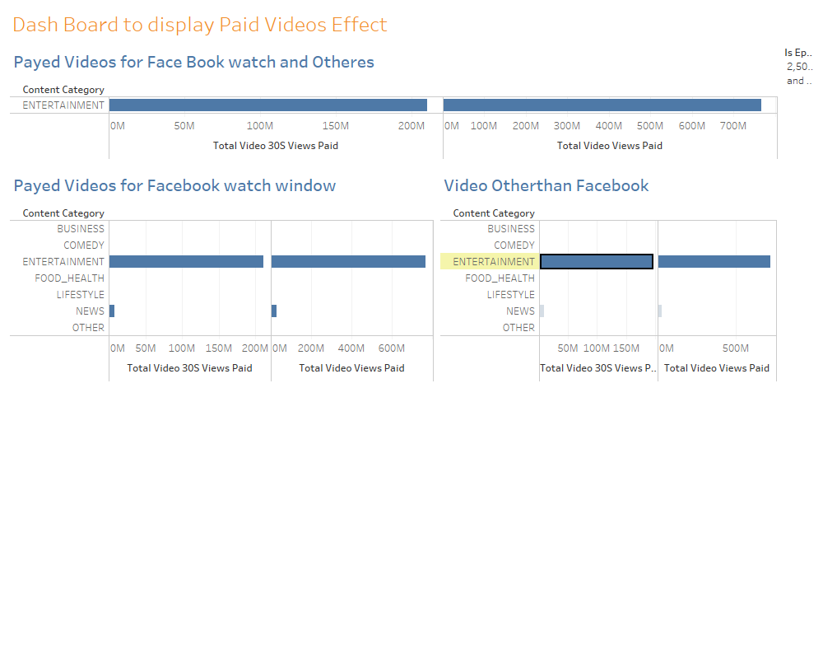
Paid Video

Slide 16
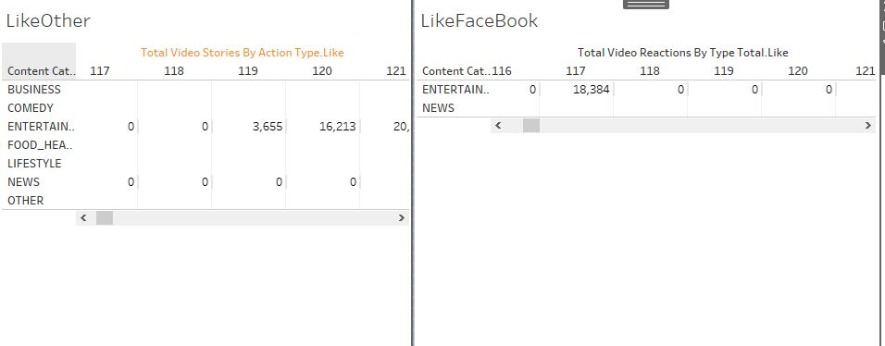
Liked Videos

Slide 17
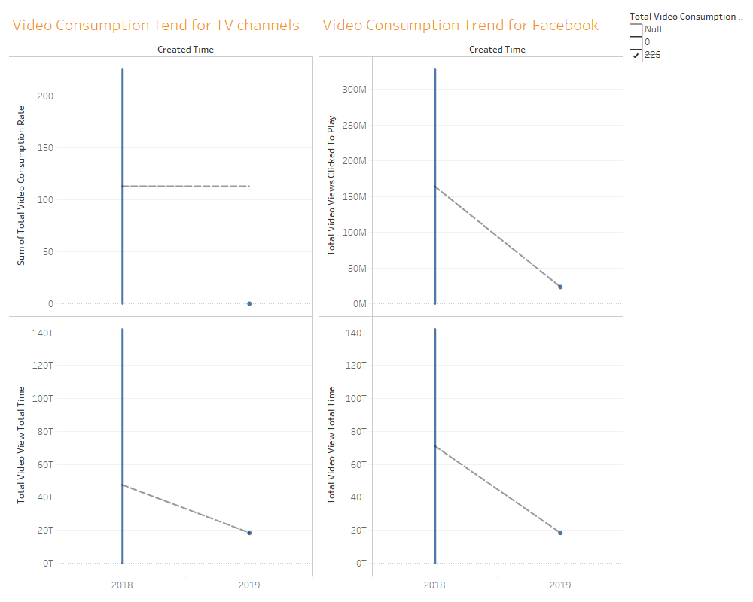
Trend graphs for video Consumption and Total video view time

Slide 18
Conclusion
Entertainment paid videos for Facebook watch window are 210 Millions
Entertainment paid videos for other tv- channels is 194 Millions.
The paid videos for Facebook watch window is little more than tv telecast videos
In the same manner liked videos are almost equal.
Total_video_30s_views_paid are more for Facebook watch window then tv-channel
Based on the data provided trends are not encouraging towards spending more money om Facebook watch window.
Model build with Facebook insight data effectiveness is 89.8
. Model build in r with age Facebook data effectiveness is 83.8

Slide 19
Recommendations
Models are encouraging in expanding business towards Facebook watch window.
Tableau graphs on insight data are encouraging base on Entertainment paid videos .
Discouraging based on the Total_video_30s_views_paid data.
Tend graphs are not encouraging much.
Based on the analysis Viacom can invest money on social media. Bur few years they cannot expect much profits on that investment.

Slide 20
References:
ViaCom. (2019). NEU-2019-facebook-watch. Retrieved from https://drive.google.com/drive/folders/1-zdF41JNvEUESqNI9W5twrnpX0bWSr84
Matt Goodwin, P. (2019, 08). NEU Viacom Facebook watch Window. (NEU, Ed.) Retrieved from https://northeastern.blackboard.com/webapps/blackboard/content/listContent.jsp?course_id=_2586907_1&content_id=_21189698_1
Matt Goodwin, P. (2019, 08). NEU Viacom Facebook watch Window. (NEU, Ed.) Retrieved from https://northeastern.blackboard.com/webapps/blackboard/content/listContent.jsp?course_id=_2586907_1&content_id=_21189698_1
ViaCom. (2019). NEU-2019-facebook-watch. Retrieved from https://drive.google.com/drive/folders/1-zdF41JNvEUESqNI9W5twrnpX0bWSr84
EliteDataScience. (2016 -2019). EliteDataScience. Retrieved from https://elitedatascience.com/data-cleaning
https://www.r-bloggers.com/how-to-implement-random-forests-in-r/

