Slide 1
BIKE RENTAL SYSTEM
Mini Project | Java + JDBC + MySQL (XAMPP)
Subject: Programming with Java
Course Code: 202044502
Department: AI & DS
TEAM MEMBERS
Vasu Kheni
Rushit Kacha
Dhruv Prajapati
12502120603010
12402120601071
12502120603001

Slide 2
Introduction & Objectives
About the Project
Objectives
The Bike Rental System is a console-based Java application that manages bikes, customers and rentals using a MySQL database. It replaces manual paper records with a fast, accurate and organized digital system, including automatic bill calculation.
Store bike and customer data in a database
Track which bikes are available or rented
Automate renting and returning of bikes
Generate the rental bill automatically
Maintain a complete rental history
Bike Rental System | Programming with Java
2 / 8

Slide 3
Technology Stack & Features
Java
JDBC
MySQL
XAMPP
Core language, console UI
Java-to-database link
Stores all records
Local MySQL server
Key Features
Add and view bikes
Add and view customers
View available bikes only
Rent a bike (status auto-updates)
Return a bike with auto bill
Full rental history report
Bike Rental System | Programming with Java
3 / 8

Slide 4
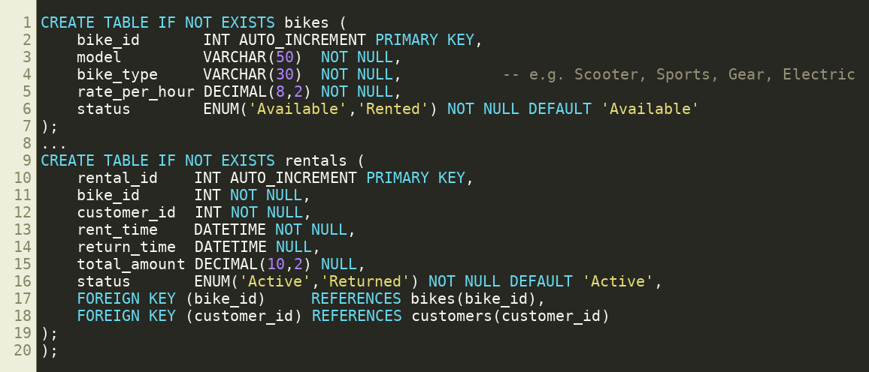
Database Design (bike_rental)
bikes
bike_id, model, bike_type, rate_per_hour, status
customers
customer_id, name, phone, license_no
rentals
rental_id, bike_id, customer_id, rent_time, return_time, total_amount, status
rentals links bikes and customers using foreign keys.
Bike Rental System | Programming with Java
4 / 8

Slide 5
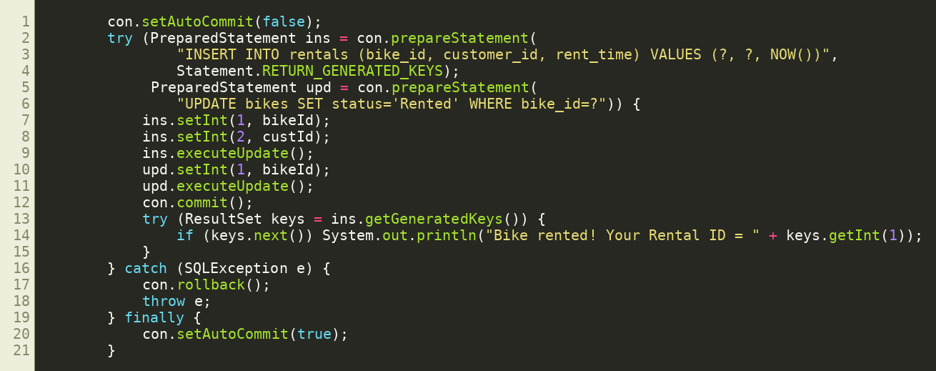
Code: Renting a Bike
How it works
Checks bike is Available and customer exists
Inserts a new rental with NOW()
Sets bike status to Rented
Uses commit / rollback so both updates succeed together
Bike Rental System | Programming with Java
5 / 8

Slide 6
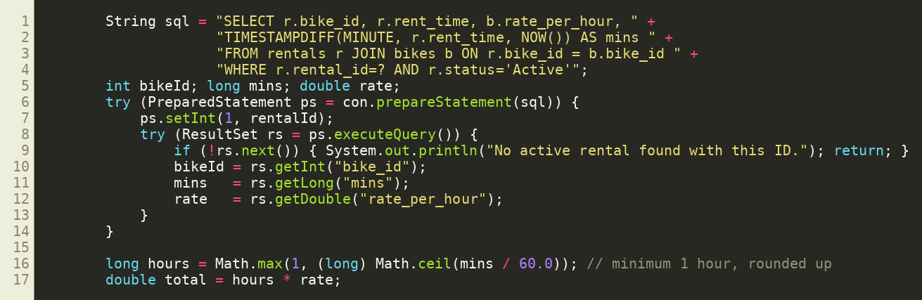
Code: Returning & Billing
Billing logic
Finds the active rental by Rental ID
Time is calculated in minutes using TIMESTAMPDIFF
Rounded up to the next full hour
Example: 70 min at Rs. 100/hr = 2 hrs = Rs. 200
Bike becomes Available again
Total = hours (rounded up, min 1) x rate per hour
Bike Rental System | Programming with Java
6 / 8

Slide 7
Conclusion & Future Scope
Conclusion
Future Scope
The system shows how Java and JDBC connect to a MySQL database to build a practical application. It reduces manual work, avoids double booking of bikes and gives accurate bills with a clear rental record.
GUI using Java Swing / JavaFX
Admin and user login system
Late return fee and discounts
Search and filter bikes
Export bills as PDF
Bike Rental System | Programming with Java
7 / 8

Slide 8
Thank You
Vasu Kheni | Rushit Kacha | Dhruv Prajapati
Bike Rental System | Programming with Java (202044502)

