Slide 1

NAME
ENROLLMENT NUMBER
CampusPass
Vasu Kheni
12502120603010
Pal Gardhariya
12502120603005
College Event Registration System
Dhruv Prajapati
12502120603001
Department
AI & DS
Subject
Web Development (WD)
Subject code
202044505
Division
5AI
Batch
D12
Notes:
Introduce the team: Vasu Kheni (12502120603010), Pal Gardhariya (12502120603005) and Dhruv Prajapati (12502120603001). Department AIDS, Division 5AI, Batch D12. Topic: College Event Registration System for the Web Development (202044505) mini project.

Slide 2




Outline
01
02
03
04
Introduction
Modules of Project
Snapshot related to Project
Conclusion
Notes:
The presentation has four parts: Introduction, Modules of Project, Snapshots and Conclusion.

Slide 3





Introduction
What it is
Technologies used
A web application where students view upcoming college events and register for them online.
HTML5
Page structure and forms
Why it is needed
CSS3
Styling, animations, responsive layout
It replaces paper sign-up sheets and scattered messages with one form and one central list.
JavaScript
Form validation and small animations
How it is built
PHP
Server-side form processing
Made for the Web Development course using HTML5, CSS3, JavaScript, PHP and MySQL.
MySQL
Stores the registrations
Notes:
CampusPass lets students browse events and register online. It replaces paper sheets and chat messages. Front end: HTML5, CSS3, JavaScript. Back end: PHP and MySQL.

Slide 4




Modules of Project
Home Module
Events Module
index.php
events.php
Landing page with the next-event ticket, featured events, how it works and FAQ.
All events as cards with a category filter and a season schedule table.
Registration Module
Registered List Module
register.php
registrations.php
Form with JavaScript validation; PHP saves the data to MySQL.
Shows all registrations from MySQL in a table, with a session page-view counter.
Shared by all pages: header.php | footer.php | db.php | style.css | script.js
Notes:
Four modules, one per page. All pages share the header, footer, database connection, stylesheet and script file.

Slide 5
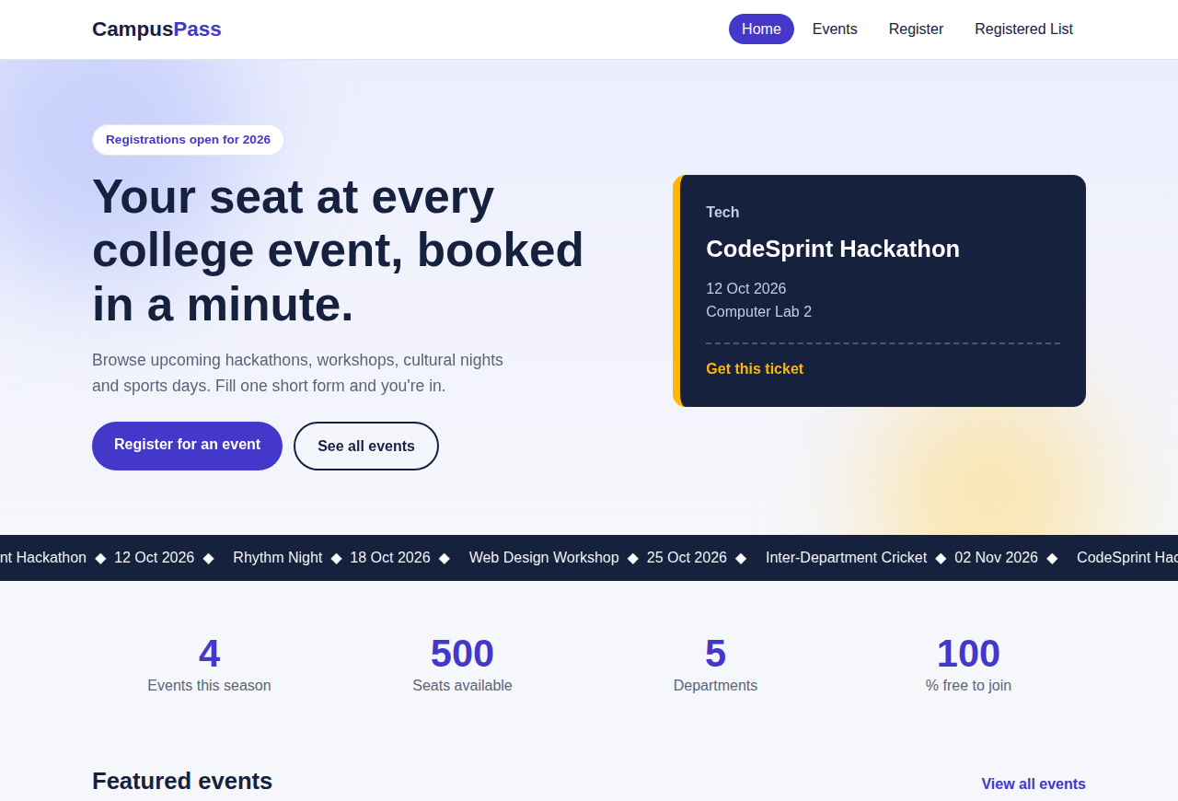
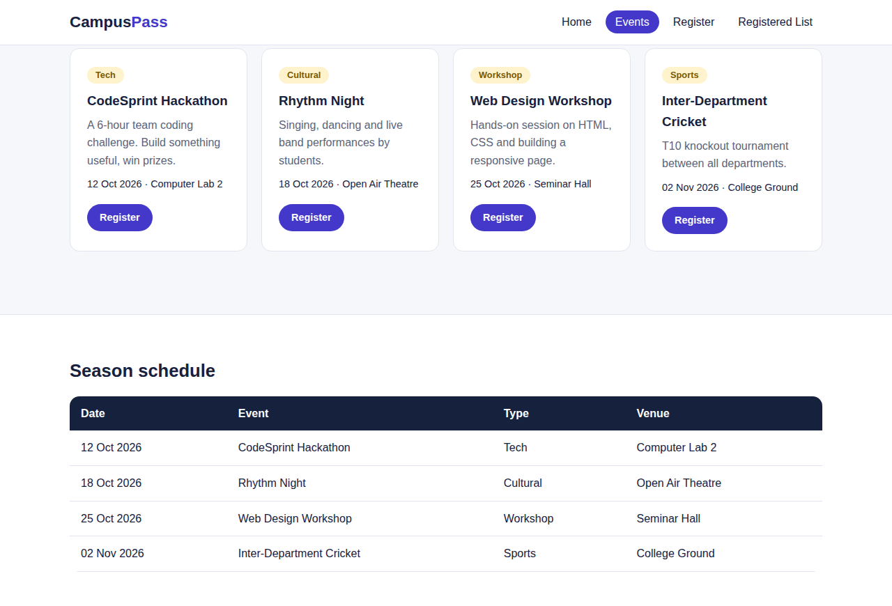
Snapshot related to Project
1-2 of 4 pages
localhost/college-events/index.php
localhost/college-events/events.php
1. Home Page index.php
2. Events Page events.php
Notes:
Home page shows the next event ticket, scrolling event ticker and stats. Events page lists events with a filter.

Slide 6
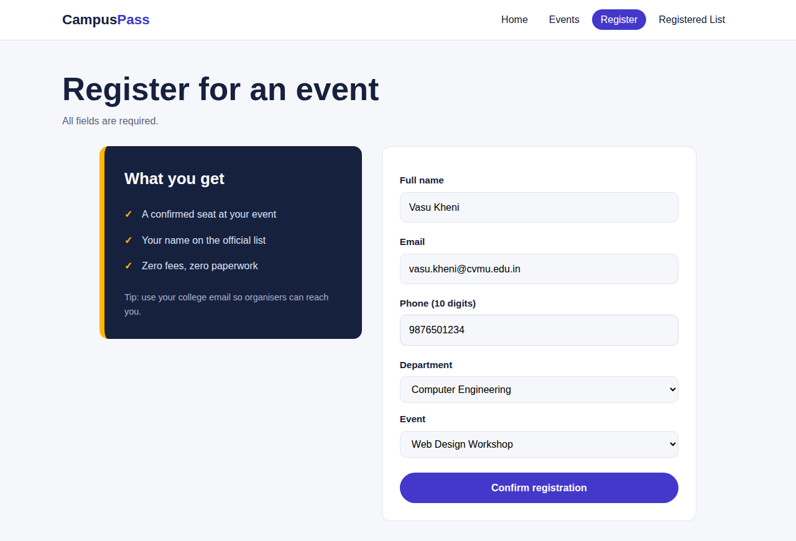
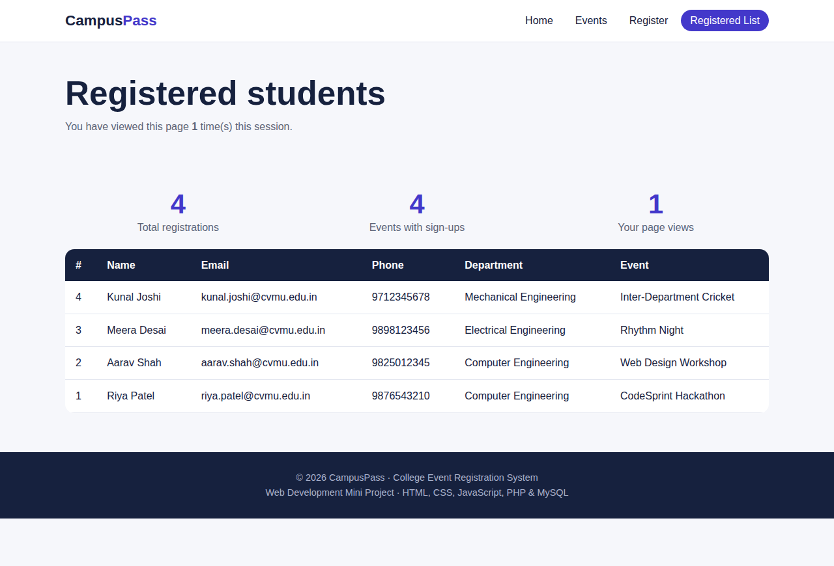
Snapshot related to Project
3-4 of 4 pages
localhost/college-events/register.php
localhost/college-events/registrations.php
3. Register Page register.php
4. Registered List Page registrations.php
Notes:
Register page has the validated form. Registered List shows all saved registrations from the MySQL table.

Slide 7


Conclusion
A working College Event Registration System with 4 pages: Home, Events, Register and Registered List.
4
Pages
Front end built with HTML5, CSS3 and JavaScript; back end built with PHP and MySQL.
5
Technologies
Data is validated in the browser and in PHP, then saved to MySQL using prepared statements.
1
Database table
Uses course topics: forms, CSS3 animations, responsive design, regular expressions, sessions and database connectivity.
GitHub Repository
https://github.com/your-username/college-event-registration
Notes:
Summarise the project. Replace the GitHub link with your real repository URL before presenting.

Slide 8
PHP & MySQL Prepared Statements
1
Browser
register.php
The student fills the form. JavaScript validates it first.
$stmt = $conn->prepare(
"INSERT INTO registrations
(name, email, phone, department, event)
VALUES (?, ?, ?, ?, ?)");
$stmt->bind_param("sssss",
$name, $email, $phone, $dept, $event);
$stmt->execute();
2
PHP
register.php checks the data again and prepares the SQL.
3
MySQL
The query runs with the bound values and the row is saved.
Why use prepared statements?
4
Response
The ? placeholders keep user input separate from the SQL.
bind_param() sends the values as data (s = string).
This prevents SQL injection.
A confirmation message is shown to the student.
Notes:
Topic from the syllabus: PHP and database connectivity with prepared statements. Explain the 4-step flow, then the three code lines, then why this stops SQL injection.

Slide 9
Thank You
College Event Registration System
Notes:
Thank the audience and invite questions.

