Slide 1
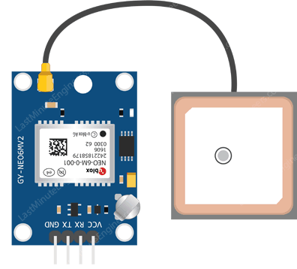
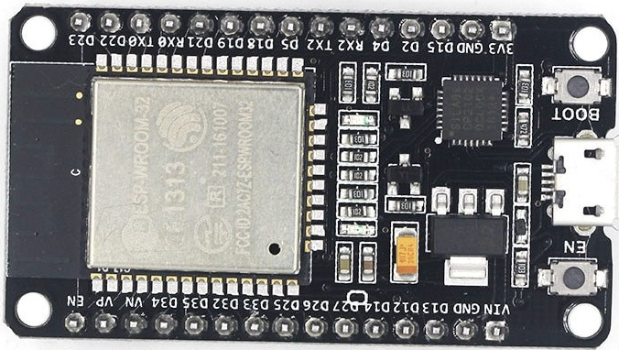
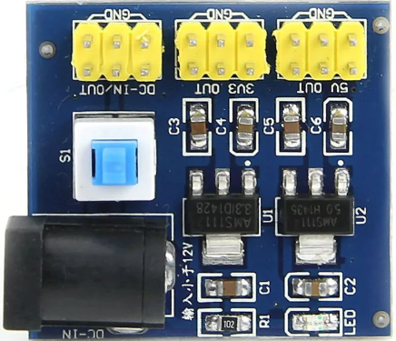
ESP 32 DevKit
GPS NEO-6M
DC - DC
- Ground (GND)
- Input (VCC)
- GPS (TX) – ESP D4
- GPS (RX) – ESP D2

