Slide 1

Smart Shelves for Retail Stores
Presented
by
Ms. K Vasuki, 1RV14MCA42
Under the Guidance
of
Internal Guide External Guide
Dr. S. Anupama Kumar, Mr. Muthukumar M (Manager),
Associate Professor Mr. Chethan M (IT Architect)
Date:22 March ’2017 Department of MCA,RVCE 1 /18

Slide 2
Agenda
Introduction
General Description
Functional Requirements
Non Functional Requirements
Design Constraints
System Architecture
System Models
References
Date:22 March ’2017 Department of MCA,RVCE 2 /18

Slide 3
Introduction
Problem description
Eliminating “out of stock challenge” in retail store.
Monitoring the misplaced items in retail store.
Communication system to replenish the stock
in store/warehouse
Expected deliverables
Inventory automation
Remote monitoring provision
Date:22 March ’2017 Department of MCA,RVCE 3 /18

Slide 4
Introduction
Objectives and Scope
Scalable and compatible REST based architechture.
Portable/Integrate easily with POS, Store and Warehouse.
Ease of data addition to the system.
Date:22 March ’2017 Department of MCA,RVCE 4 /18

Slide 5
General Description
Product Perspective
Responsible for inventory automation
Responsible for remote monitoring process.
Product Functions
Reduction of ‘out-of-stock’ products
Locate products easy and fast
Better optimization of in-store operations
Store space optimization
Control and monitor the usage of high value items
Date:22 March ’2017 Department of MCA,RVCE 5 /18

Slide 6
General Description
User Characteristics
Two classes of users
store manager
stock clerks
General Constraints
RFID tags must be attached with the stocks.
Assumptions
Stock clerks own mobile phone.
RFID tags are conjoined with stock.
Date:22 March ’2017 Department of MCA,RVCE 6 /18

Slide 7
Functional Requirements
NAME | INTRODUCTION | INPUT | PROCESS | OUTPUT
Inventory Distribution | Assets count in terms of location | Valid user ID and password | Filters applied on the basis of location, type or category | User view of available options
Asset Status | Asset information | Asset ID | Search based on Asset ID | User view for requested asset
Stock Notification | Out of stock notification | Generated by the shelf | Sms alert | Sms alert to store keeper and stock clerk
Misplaced notification | Misplaced items notified | Generated by the shelf | Sms alert | Sms alert to store keeper and stock clerk
Date:22 March ’2017 Department of MCA,RVCE 7 /18

Slide 8
Non-Functional Requirements
Security: Integrity such that there is no harm to the users and data by any means.
Portability: With the minimum requirements the application must be compatible and capable of working on any platform.
Reliability: Front end- Back end updating
Usability: well-structured user manuals, well-formed GUI‟s for the users to learn how to operate the system.
Date:22 March ’2017 Department of MCA,RVCE 8 /18

Slide 9
Design Constraints
Stock clerks must be equipped with resources like mobile phone.
Indivisible RFID tags.
RFID Antennas must not intercede
Date:22 March ’2017 Department of MCA,RVCE 9 /18

Slide 10
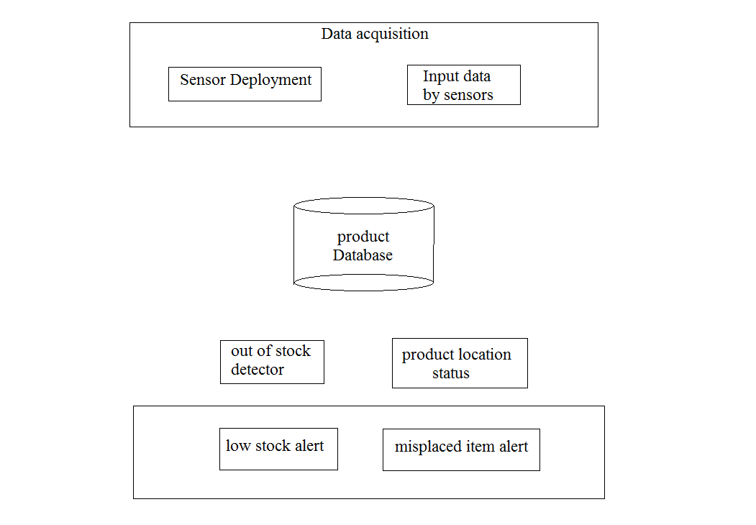
System Architecture
Alert messages
Date:22 March ’2017 Department of MCA,RVCE 10 /18

Slide 11
System Models
Contextual Model
Alert on
out of stock
Store keeper
customers
Request
stock details
Alert on
misplaced
item
Return
stock details
Pick items
Misplaced
items
Smart Shelves in retail store
Update
stock details
Data storage
Put back
misplaced
Replenish new stock
Alert on out of stock
Stock clerk
Alert on misplaced item
Date:22 March ’2017 Department of MCA,RVCE 11/18

Slide 12
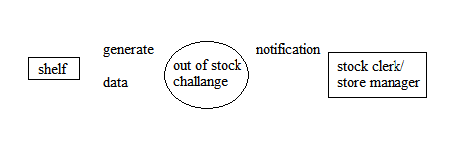
System Models
0-level DFD
Out of stock process
Date:22 March ’2017 Department of MCA,RVCE 12/18

Slide 13
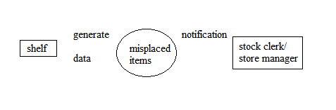
System Models
0-level DFD
Misplaced item identification
Date:22 March ’2017 Department of MCA,RVCE 13/18

Slide 14
System Models
Data Definition / Dictionary
Event table
Field name | Type
UUID | VARCHAR2(35 BYTE)
READER | VARCHAR2(30 BYTE)
ANTENNA | VARCHAR2(20 BYTE)
READ_TIME | NUMBER
LOC_ID | VARCHAR2(10 BYTE)
PREV_READ_TIME | NUMBER
PREV_LOC_ID | VARCHAR2(10 BYTE)
Date:22 March ’2017 Department of MCA,RVCE 14 /18

Slide 15
System Models
Item Table
Field name | Type
ITEM_ID | VARCHAR2(20 BYTE)
ITEM_NAME | VARCHAR2(20 BYTE)
ITEM_CATEGORY | VARCHAR2(40 BYTE)
ITEM_TYPE | VARCHAR2(40 BYTE)
BASE_LOC_ID | VARCHAR2(20 BYTE)
LOC_ID | VARCHAR2(20 BYTE)
STATUS | VARCHAR2(20 BYTE)
Location table, tag table, appliance table
Date:22 March ’2017 Department of MCA,RVCE 15 /18

Slide 16
Literature Survey
Sl No | Author | Title | Outcome
1 | Xianming Qing | Multiloop antenna for High Frequency RFID smart shelf Application | The proposed antenna prototype has been able to generate magnetic field with uniform magnitude for a larger interrogation region.
2 | Carla R. Medeiros Jorge R. Costa Carlos A. Fernandes | RFID Smart Shelf With Confined Detection Volume at UHF | The working frequency band covers simultaneously the three world assigned RFID subbands at ultrahigh frequency (UHF).
3 | Khan Nishiyama | A smart shelf, an efficient object identification system with battery less passive low frequency RFID tag | describes a system that uses an RFID module to harvest energy from an incoming radio signal both to power the circuitry in order to identify the object and to power an indicator LED.
Date:22 March ’2017 Department of MCA,RVCE 16 /18

Slide 17
Literature Survey
Sl No | Author | Title | Outcome
4 | D'Alessandro A. Buffi P. Nepa G. Isola | RFID-Based Smart Shelving Storage Systems | A RFID-Based Smart Shelving Storage System in UHF band is presented for localization of tagged items with specific reference to a pharmacy drawer for drug storage
5 | Soheyl Soodmand Tim W. C. Brown Alexander Gluhak | Evaluation of HF band NFC/RFID antennas for smart shelf applications | a new theoretical approach is presented to increase bandwidth of RFID reader antennas operating at HF band to improve the reception of the backscattered RFID response
6 | Andrey S. Andrenko | Optimized near-field antenna for UHF RFID smart shelf applications | The proposed antenna demonstrates excellent ability to provide strong and uniform E-field distribution at the distances up to 50 cm form the antenna surface.
Date:22 March ’2017 Department of MCA,RVCE 17 /18

Slide 18
Thank You
Date:22 March ’2017 Department of MCA,RVCE 18/18

