Slide 1

Smart Shelves for Retail Stores
Presented
by
Ms. K Vasuki, 1RV14MCA42
Under the Guidance
of
Internal Guide External Guide
Dr. S. Anupama Kumar, Mr. Muthukumar M (Manager),
Associate Professor Mr. Chethan M (IT Architect)
Date:22 March ’2017 Department of MCA,RVCE 1 / 18

Slide 2
Agenda
Introduction
General Description
Functional Requirements
Non Functional Requirements
Design Constraints
System Architecture
System Models
References
Date:22 March ’2017 Department of MCA,RVCE 2/18

Slide 3
Introduction
Problem description
    Eliminating “out of stock challenge” in retail store.
    Monitoring the misplaced items in retail store.
    Communication system to replenish the stock
    in store/warehouse
Expected deliverables
    Inventory automation
    Remote monitoring provision
Date:22 March ’2017 Department of MCA,RVCE 3/18

Slide 4
Introduction
Objectives and Scope
    Scalable and compatible REST based architechture.
    Compatible UHF and HF technology
    Portable/Integrate easily with POS, Store and Warehouse.
    Ease of data addition to the system.
Date:22 March ’2017 Department of MCA,RVCE 4/18

Slide 5
General Description
Product Perspective
      Responsible for inventory automation
      Responsible for remote monitoring process.
Product Functions
      Reduction of ‘out-of-stock’ products
      Locate products easy and fast
      Better optimization of in-store operations
      Store space optimization
      Control and monitor the usage of high value items
Date:22 March ’2017 Department of MCA,RVCE 5/18

Slide 6
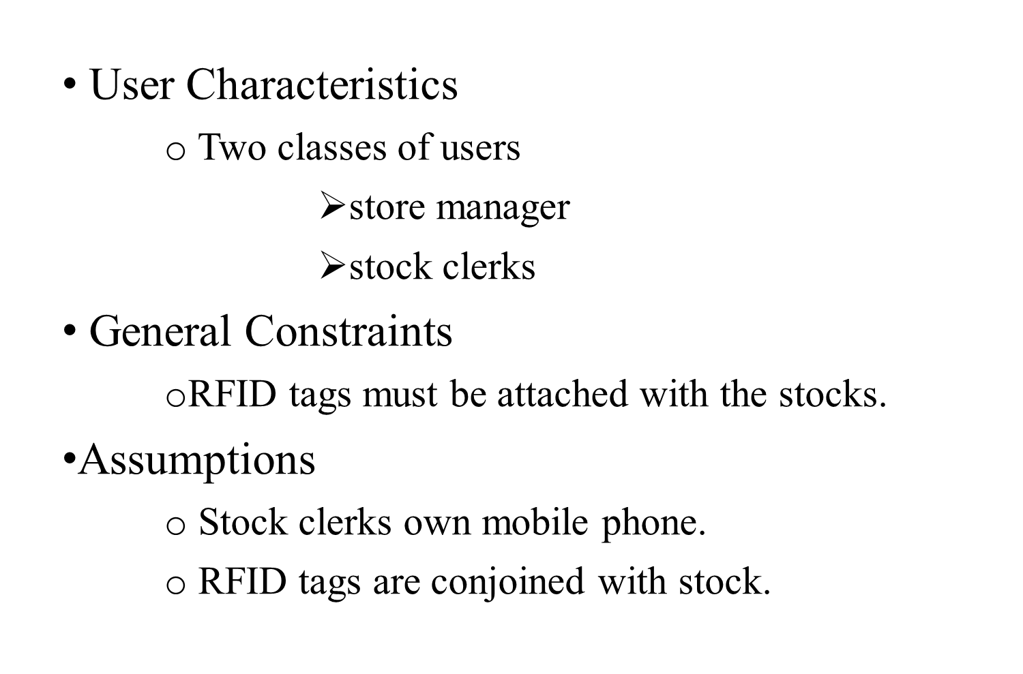
General Description
Date:22 March ’2017 Department of MCA,RVCE 6/18

Slide 7
Functional Requirements
NAME | INTRODUCTION | INPUT | PROCESS | OUTPUT
Inventory Distribution | Assets count in terms of location | Valid user ID and password | Filters applied on the basis of location, type or category | User view of available options
Asset Status | Asset information | Asset ID | Search based on Asset ID | User view for requested asset
Stock Notification | Out of stock notification | Generated by the shelf | Sms alert | Sms alert to store keeper and stock clerk
Misplaced notification | Misplaced items notified | Generated by the shelf | Sms alert | Sms alert to store keeper and stock clerk
Date:22 March ’2017 Department of MCA,RVCE 7/18

Slide 8
Non-Functional Requirements
Security: Integrity such that there is no harm to the users and data by any means.
Portability: With the minimum requirements the application must be compatible and capable of working on any platform.
Reliability: Front end- Back end updating
Usability: well-structured user manuals, well-formed GUI‟s for the users to learn how to operate the system.
Date:22 March ’2017 Department of MCA,RVCE 8/18

Slide 9
Design Constraints
Stock clerks must be equipped with resources like mobile phone.
Indivisible RFID tags.
RFID Antennas must not intercede
Date:22 March ’2017 Department of MCA,RVCE 9/18

Slide 10
System Architecture
Date:22 March ’2017 Department of MCA,RVCE

Slide 11
System Models
Functionality of the system and models related to the project
Contextual Model
Process Model (Activity Model)
Behavioral Model (DFD)
Data Definition / Dictionary
Date:22 March ’2017 Department of MCA,RVCE

Slide 12
References
Date:22 March ’2017 Department of MCA,RVCE

Slide 13
Thank You
Date:22 March ’2017 Department of MCA,RVCE

