Slide 1

DEPARTMENT OF ARTIFICIAL INTELLIGENCE AND DATA SCIENCE ACADEMIC YEAR 2025 - 2026 SEMESTER III ARTIFICIAL INTELLIGENCE LABORATORY MINI PROJECT REVIEW <AI Treasure Hunt using A* Search Algorithm>
REGISTER NUMBER | 2117240070342
NAME | VASUKI K
YEAR | 2
SECTION | AI&DS - F
FACULTY IN-CHARGE | Mrs. M. Divya

Slide 2
PROBLEM STATEMENT
Artificial Intelligence (AI) enables systems to simulate human-like decision-making in problem-solving environments. In this project, an AI agent navigates a grid-based environment to find hidden treasure while avoiding traps.
The system applies AI search algorithms to simulate intelligent behavior within a constrained environment.
The goal is to demonstrate how an agent can autonomously find an optimal path to a target using heuristic search, representing an application of AI in pathfinding and decision-making.

Slide 3
THEORETICAL BACKGROUND
Artificial Intelligence (AI) is the science of creating systems capable of performing tasks requiring human-like intelligence.
In grid-based pathfinding problems, AI uses search algorithms to explore the environment efficiently.
This project uses the A* (A-star) algorithm, a popular AI pathfinding technique that combines the advantages of Dijkstra’s algorithm and Greedy Best-First Search.
A* uses a heuristic function to estimate the cost of reaching the goal, allowing the agent to find the shortest and safest path to the treasure while avoiding obstacles.

Slide 4
IMPLEMENTATION AND CODE
Link to code in Git-hub Repository
List | Git-hub Repository Links
Implementation of Code Link | https://github.com/vasukik24/AI-Miniproject
Word Document Report Link | https://docs.google.com/spreadsheets/d/1jUNpg0ZJjOfW03nAPWbVE6cxmrmbslgz/edit?usp=drivesdk&ouid=116503242688954787115&rtpof=true&sd=true
PPT Link

Slide 5
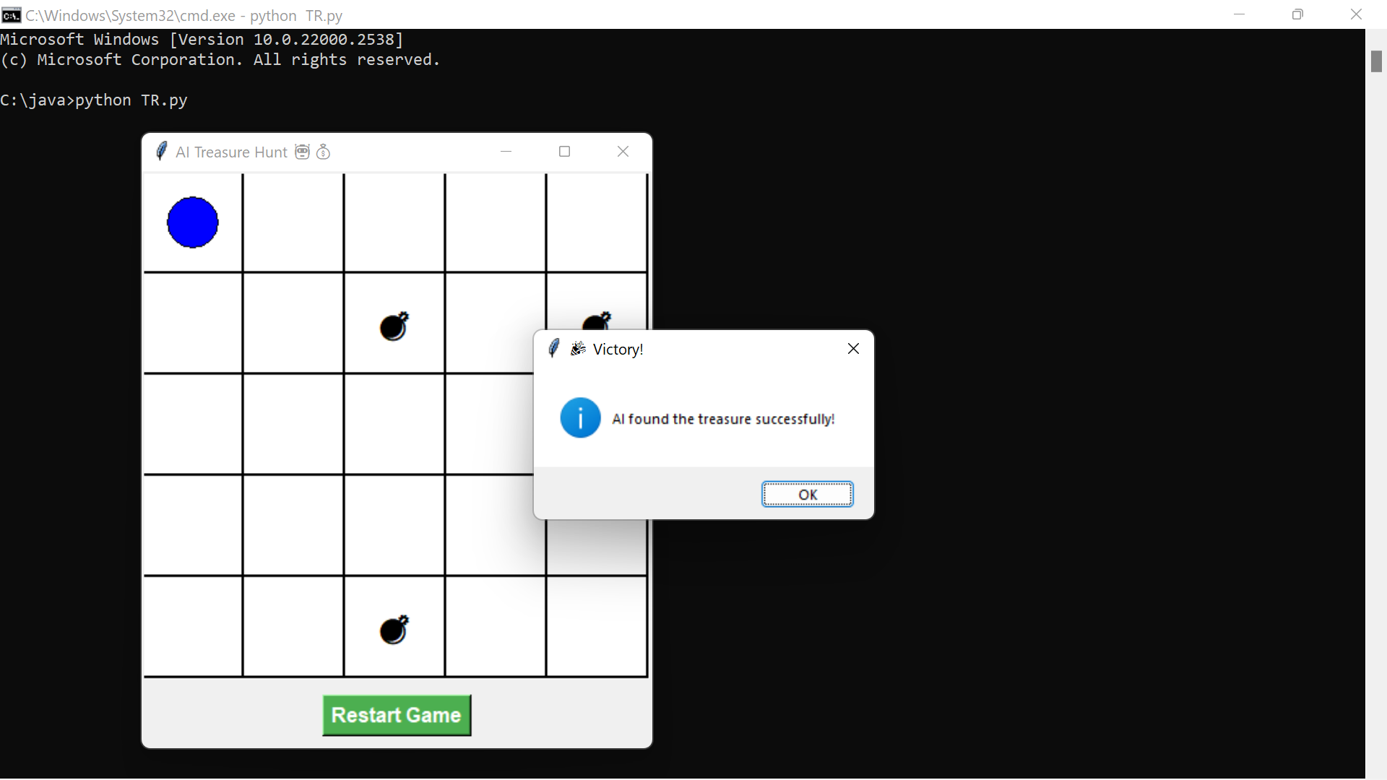
OUTPUT AND RESULTS

Slide 6
REFERENCES
1. Russell, S., & Norvig, P. (2021). Artificial Intelligence: A Modern Approach. Pearson.
2. Amit Patel, 'Introduction to the A* Algorithm', Red Blob Games
3. Python Tkinter Documentation(https://www.redblobgames.com/pathfinding/a-star/)
4. AI Pathfinding Examples on GitHub – Open Source Educational Projects.https://docs.python.org/3/library/tkinter.html

