Slide 1

COGNITIVE RADIO CHANNEL SELECTION
UNDER HOSTILE JAMMING
Software Demonstration for Senior Defence Scientists
Sense · Decide · Act — Interference Capture · Hybrid ML Safety · Cognitive Adaptive Frequency Hopping
eAge Innovations | Defence SDR & Electronic Warfare Lab | September 2026

Slide 2
1. Presentation Agenda
1.1 Objective for this demonstration
1.2 Closed-loop system architecture (block diagram)
1.3 Live modular UI — Jammer, Receiver, Transmitter + ML
1.4 How interference is captured (ES sensing)
1.5 Hybrid ML decision with deterministic safety gate
1.6 Dynamic frequency hopping based on cognitive decisions
1.7 Recommended live demo sequence and closing
eAge Innovations | Cognitive Radio Simulation | Defence Scientific Briefing
2 / 12

Slide 3
2. What This Demonstration Proves
2.1 Present the modular look-and-feel of the Cognitive Radio closed loop.
2.2 Show capturing interference through Electronic Support (ES) sensing and FREE / DEGRADED / BLOCKED classification.
2.3 Show cognitive decisions using RULES / ML / HYBRID, with HYBRID preferred for mission assurance.
2.4 Show dynamic frequency hopping that updates the hop pool from live cognitive decisions.
2.5 Keep every claim tied to observable screen evidence and an explainability trace.
2.6 Position this as a software decision twin ready for later eADM / SDR integration.
eAge Innovations | Cognitive Radio Simulation | Defence Scientific Briefing
3 / 12

Slide 4
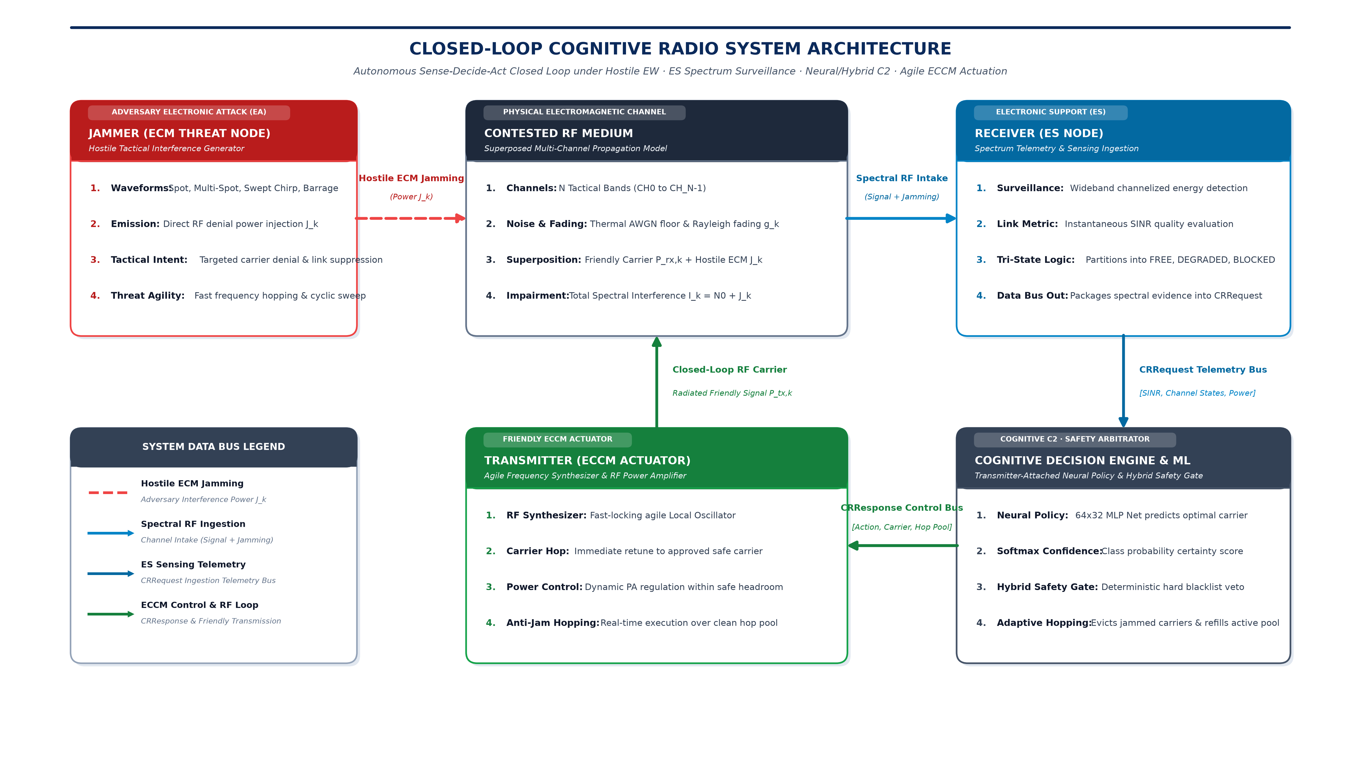
3. Closed-Loop System Architecture
Figure 1 — Sense–Decide–Act under Electronic Attack
eAge Innovations | Cognitive Radio Simulation | Defence Scientific Briefing
4 / 12

Slide 5
4. Architecture — Numbered Explanation
4.1 Jammer (Red): adversary ECM — Spot, Multi-Spot, Sweep, Barrage.
4.2 Contested RF Medium: friendly signal + jammer power + noise/fading.
4.3 Receiver / ES Node (Blue): measures SINR and packages CRRequest telemetry.
4.4 Cognitive Decision Engine & ML (Slate): 64×32 MLP proposal + Hybrid Safety Gate + adaptive hop synthesis.
4.5 Transmitter / ECCM Actuator (Green): retunes carrier, regulates power, executes hop pool.
4.6 Closed loop: radiated friendly carrier returns to the contested medium.
4.7 Key message: Sense → Decide → Act, with explainable safety containment of ML.
eAge Innovations | Cognitive Radio Simulation | Defence Scientific Briefing
5 / 12

Slide 6
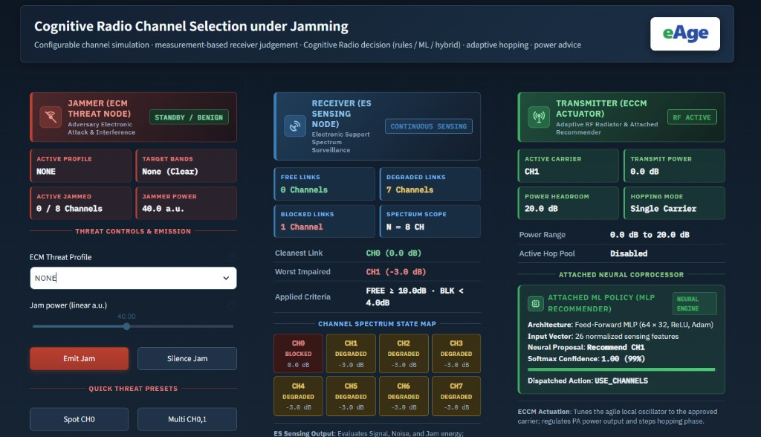
5. Live Software UI — Modular Node View
Figure 2 — Jammer · Receiver · Transmitter with Attached ML Policy
eAge Innovations | Cognitive Radio Simulation | Defence Scientific Briefing
6 / 12

Slide 7
6. How to Read the Live UI
6.1 JAMMER (Red)
6.2 RECEIVER (Blue)
6.3 TRANSMITTER (Green)
1. ECM threat profile control
2. Jam power and emit / silence
3. Quick presets: Spot / Multi
4. Shows adversary activity state
1. FREE / DEGRADED / BLOCKED counts
2. Channel Spectrum State Map
3. Cleanest vs worst impaired link
4. This is interference capture
1. Active carrier and TX power
2. Hopping mode / hop pool
3. Attached MLP recommender
4. Proposal, confidence, action
eAge Innovations | Cognitive Radio Simulation | Defence Scientific Briefing
7 / 12

Slide 8
7. Interference Capture & Cognitive Dynamic FH
7.1 Capturing interference: Receiver measures jam power and SINR per channel.
7.2 Classification: FREE (≥10 dB), DEGRADED (3–10 dB), BLOCKED (<3 dB).
7.3 Decisions use measured evidence only — no oracle jammer identity.
7.4 Dynamic FH: when hopping is enabled, adapt_hop_set rebuilds the hop pool.
7.5 Threatened (BLOCKED) hop members are evicted; clean usable channels are filled in.
7.6 Result: hopping follows cognitive decisions, not a blind fixed PRFH list.
eAge Innovations | Cognitive Radio Simulation | Defence Scientific Briefing
8 / 12

Slide 9
8. Machine Learning in This Simulation
Advisory recommender inside a hybrid safety architecture
8.1 Model: supervised MLP classifier (64 × 32), ReLU, Adam.
8.2 Input: 3N+2 feature vector (for N=8 → 26 features: SINR, state, jam, power, headroom).
8.3 Output: recommended channel or INCREASE_POWER, with Softmax confidence.
8.4 Modes: RULES · ML · HYBRID (preferred for defence review).
8.5 Safety Gate: veto BLOCKED proposals and out-of-headroom power increases.
8.6 Assurance message: ML advises; deterministic rules contain; every override is logged.
eAge Innovations | Cognitive Radio Simulation | Defence Scientific Briefing
9 / 12

Slide 10
9. Recommended Live Demo Sequence
9.1 Opening: state Sense–Decide–Act and the three proofs.
9.2 Walk the architecture diagram (Figure 1), then show the live UI (Figure 2).
9.3 Benign baseline — all FREE, status OK.
9.4 Spot jam on active carrier — show BLOCKED capture and HYBRID alternate channel.
9.5 Enable cognitive hopping — jam a hop-set member — show eviction and refill.
9.6 Barrage — show INCREASE_POWER within headroom.
9.7 Close with explainability Stages 2–3 and invite questions.
eAge Innovations | Cognitive Radio Simulation | Defence Scientific Briefing
10 / 12

Slide 11
10. Preferred Speaking Points
10.1 Sense–Decide–Act closed loop under Electronic Attack.
10.2 Interference capture through Electronic Support sensing.
10.3 Hybrid safety-gated machine learning recommender.
10.4 Cognitive adaptive frequency hopping / dynamic hop-pool management.
10.5 Mission assurance with a human-readable audit trail.
10.6 Software decision twin prepared for later eADM / SDR integration.
10.7 Avoid claiming airborne certification or absolute jam-proof performance.
eAge Innovations | Cognitive Radio Simulation | Defence Scientific Briefing
11 / 12

Slide 12
Closing Summary for the Panel
1. Agreed look-and-feel is presented in modular architecture and live UI.
2. Interference is captured by ES sensing and channel-state classification.
3. Decisions use hybrid ML under a deterministic safety gate.
4. Frequency hopping updates dynamically from cognitive decisions.
5. We request guidance on priorities for the next eADM laboratory step.
Thank you, Sir. We are ready for questions.

