Slide 1
01 | BUSINESS PROBLEM
Where is revenue concentrated - and where should management focus?
The analysis looks at four practical questions:
Management question
When does demand peak, and what should we plan around?
How do we protect the revenue we already have while making the next growth move more targeted?
Which markets and customers carry the business?
Where is customer retention weakest?
How much revenue leaks through cancellations?
Online Retail II | Data Analyst Assessment

Slide 2
02 | DATA & METHOD
Data & methodology
Source
UCI Machine Learning Repository - Online Retail II
1,067,371 raw transaction rows | 8 fields | 01-Dec-2009 to 09-Dec-2011
Processing
Deduplicate → separate cancellations → remove service/test codes → enforce positive quantity/price → create SalesValue → segment customers
Analysis
Revenue trend • country mix • product concentration • RFM • cohort retention • returns • Pareto
Important caveat
December 2011 is only a partial month, and missing Customer IDs are not usable for customer-level analysis.
Source: https://archive.ics.uci.edu/dataset/502/online+retail+ii
Online Retail II | Data Analyst Assessment

Slide 3
03 | KEY FINDINGS
Four findings management should remember
85.5%
£1.45M
69.2%
21%
UK revenue share
Nov-2011 peak
Revenue from Champions
Average month-1 repeat
The story is not “sales are low”. The story is concentration: in market, customers and timing.
Returns are ~3.65% of revenue, which makes targeted SKU/process fixes more sensible than a blanket policy change.
Online Retail II | Data Analyst Assessment

Slide 4
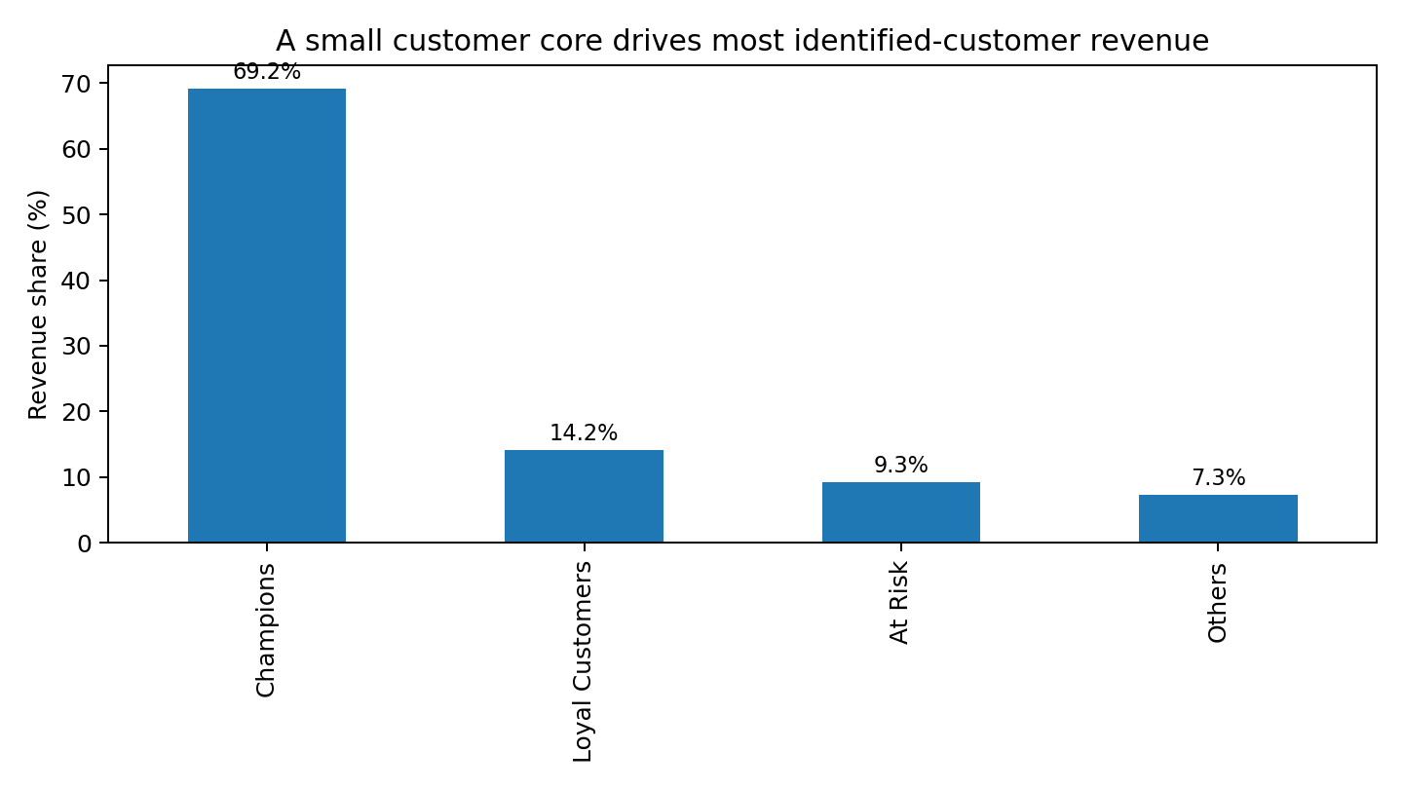
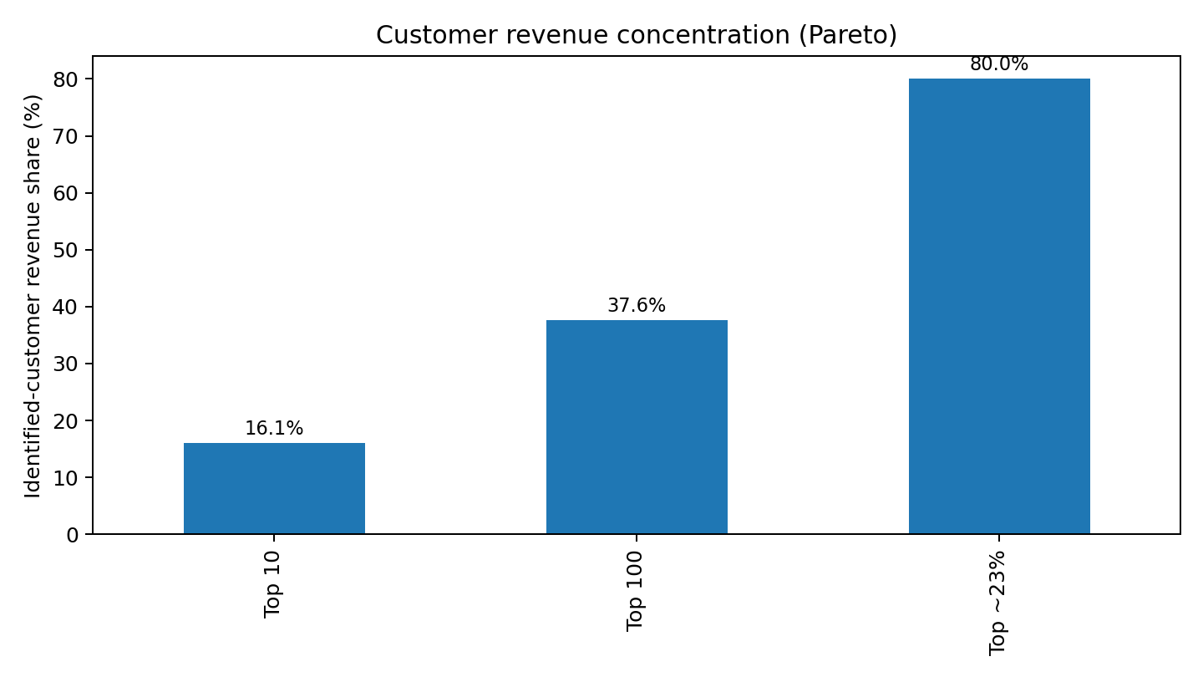
04 | DEEP DIVE
Deep dive: a small customer core drives most value
Champions = 25.2% of customers but 69.2% of revenue. Top ~23% of identified customers generate ~80% of revenue.
Online Retail II | Data Analyst Assessment

Slide 5
05 | RECOMMENDATIONS
Three actions, in priority order
1
Protect high-value customers
Champions + Loyal are ~46% of customers and ~83% of revenue.
CRM / Customer Success
2
Win back proven buyers
At Risk is 14.1% of customers and 9.3% of identified-customer revenue.
CRM / Marketing
3
Improve the second purchase
Month-1 repeat is ~21%; use a structured post-purchase journey and peak-season readiness.
Marketing / Merchandising / Ops
Online Retail II | Data Analyst Assessment

Slide 6
06 | EXPECTED IMPACT
What success would look like
Measure the recommendations as operating experiments, not one-off ideas.
Retention
Win-back
30-day second-order rate
Reactivation rate
Repeat rate / revenue per customer
Incremental revenue / offer cost
Seasonality
Returns
November revenue + readiness
Return revenue rate
Stock-outs / cancellations during peak
Rate by SKU + process reason
The goal is not just to “increase sales”. It is to improve the quality and durability of revenue.
Online Retail II | Data Analyst Assessment

Slide 7
07 | CAUTION & NEXT
Limitations & next steps
The final month is partial, so end-of-period comparisons need care.
About 22.6% of the clean sales snapshot has no CustomerID, limiting customer analytics.
There is no marketing cost, acquisition channel or product margin, so CAC/ROAS/true contribution margin cannot be calculated.
The data supports patterns and prioritization, not causal claims.
Join customer/order data with campaign cost, margin, product return reason and channel data; then test the three recommendations as measurable experiments.
Next step
Online Retail II | Data Analyst Assessment

