Slide 1
Acoustic Scene Classification ML - EE2802 EE19BTECH11006
Acoustic Scene Classification:
The goal of the acoustic scene classification is to classify the given test data into one of the predefined acoustic scene classes which characterizes the environment of the test data.
For this Project , Acoustic scene Classes are:
1) airport
2) Bus stop
3) Metro
4) park
5) public square
6) shopping mall
7) street traffic

Slide 2
Audio dataset:
The audio data set consists voice recordings of 10 different places from 4 different devices in 10 different cities. This data is collected by Tampere university.
Link - https://zenodo.org/record/3819968#.YnRASiRBy-o
For this project , I have trimmed the train data into 714 sample data points , where each class consists of 102 samples of data.

Slide 3
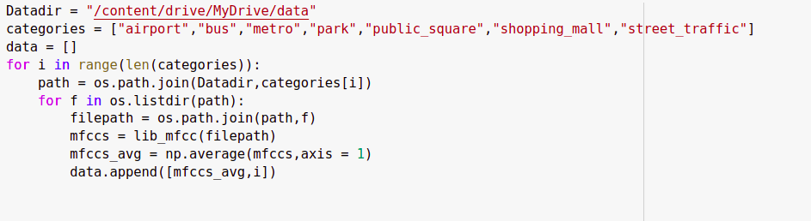
Implementation:
Step 1: I need to map the files to their respective classes.
The above program , iterates through every file in the folder("data") and maps it to the respective classes and appends it to the list data.
Here the "filepath" is a .wav file and we are converting it into array of numeric data by using lib_mfcc() and avg of this array along axis = 1 , is mapped.

Slide 4
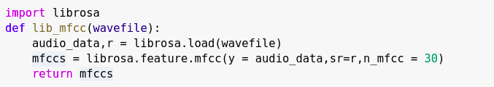
Step2: Converting the .wav file into array of numeric data , by using MFCC.
Librosa.load() gives audio_data and sample rate
Librosa.feature has inbuilt function "mfcc" , which takes this audio data and sample rate along with n_mfcc and the output is (30,431) size array.
Averaging the output along axis = 1 , give an array of size (30,1)

Slide 5
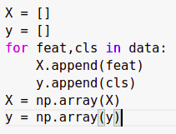

Step3: Using above function we collect X_train and Y_train .
We do one hot encoding for y , since we use softmax Activation function for output in our model.
And the shape of our train data are:

Slide 6
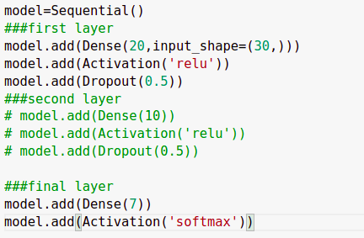
Step4: Building model to train.
The model consists of 1 hidden layer , 1 output layer and input_size = (30,1).
Hidden layer is a dense layer with 20 node and "relu" as activation function and final layer is a dense layer with 7 node and "softmax" as Activation function.
The output here is of size 7.

Slide 7


Training :
Predicting:
The Test data Accuracy is 0.72

