Slide 1
Identify Car
Wash Services
By Team Bolt:
Arti Kale(888228)
Pradipta Sen(888457)
Ruchira Chavan(888229)
Sayali Sawant(888281)
Vasundhara Agarwal (888569)

Slide 2
TABLE OF CONTENTS
01
04
About Project
Sneak Peek
02
05
Project Description
Project Code
03
06
Tools
Extent Report

Slide 3
ABOUT PROJECT
SELENIUM JAVA
Explore the Innovative Implementations.
Implement Best practices such as creating Smoke and Regression suite.
Implement Maven on the created automation test scripts
Explore Jenkins to execute the test scripts periodically on Selenium Grid.
Explore Selenium Grid to run test scripts on different platforms and against different browsers.
Integrate Jenkins with version controller (GIT) and scheduled builds to run automatically.

Slide 4
PROJECT DESCRIPTION
Open Website www.Justdial.com
1. Display 5 Car washing services name and phone numbers, near your location with highest rating (more than 4) on top & Customer Votes more than 20
2. Try to register for Free Listing, fill the form with any one input invalid (example: phone); Capture the error message & display
3. From Fitness, go to Gym and retrieve all sub-menu items and store in a List; Display the same

Slide 5
FIRST DESCRIPTION
1.Open Website www.Justdial.com
2. Display 5 Car washing services name and phone numbers, near your location with highest rating (more than 4) on top & Customer Votes more than 20

Slide 6
FIRST DESCRIPTION
SELENIUM JAVA
1. "www.justdial.com/" should open
2. Search Textbox should be selected
3. "Car washing services" should be read and written
4. "Mumbai" should be selected as default
5. Search Button should be clicked
6. "Car Wash Services At Home near me" button should be selected
7. Filter "Ratings" should be selected
8. Services should be selected where ratings are greater than four star
9. Votes should be greater than 20

Slide 7
SECOND DESCRIPTION
2. Try to register for Free Listing, fill the form with any one input invalid (example: phone);
Capture the error message & display

Slide 8
SECOND
DESCRIPTION
SELENIUM JAVA
1. User should navigate back to home page
2. User should be redirected to "Free Listing" page
3. User should be able to put values in all placeholders
4. If user gives incorrect values, then error message
should be displayed.

Slide 9
THIRD DESCRIPTION
3. From Fitness, go to Gym and retrieve all sub-menu items and store in a List; Display the same

Slide 10
THIRD
DESCRIPTION
SELENIUM JAVA
1. Hamburger menu should be clicked
2. User should scroll down for options
3. Fitness option should be clicked
4. Menu items should be displayed
5. Gym option should be clicked
6. Sub-menu items should be displayed
7. Sub-menu items should be send to excel

Slide 11










TOOLS
Selenium
Extent Report
Maven
MS Excel
Jenkins
Eclipse
TestNG
Git
Java
Selenium Grid

Slide 12
SNEAK PEEK

Slide 13
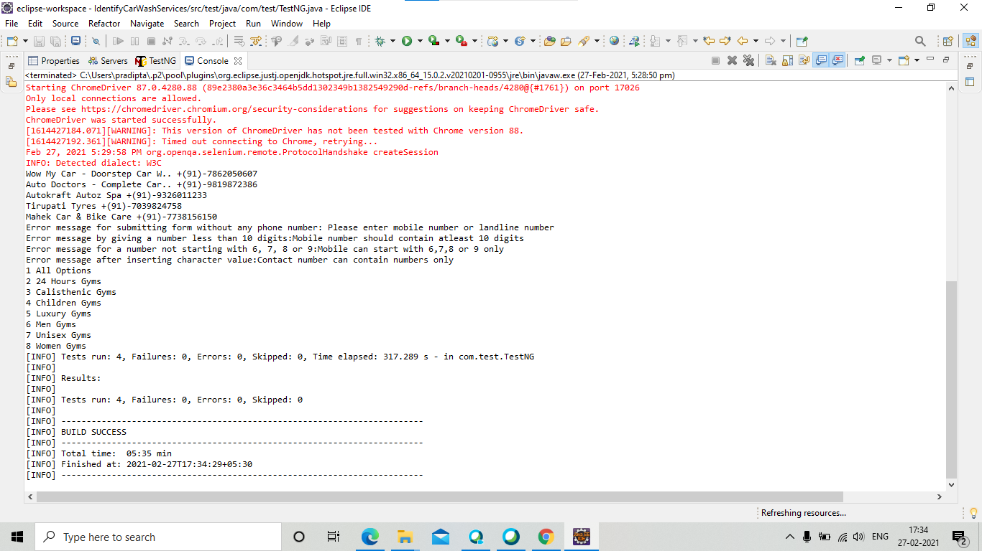
MAVEN IMPLEMENTATION
Console Output after Maven Implementation(BUILD SUCCESS)

Slide 14
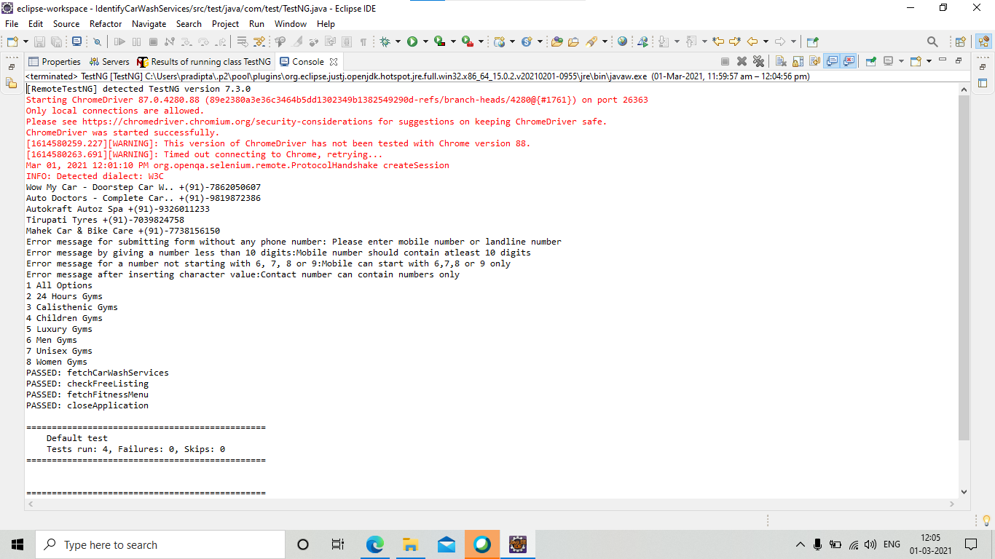
TESTNG IMPLEMENTATION

Slide 15
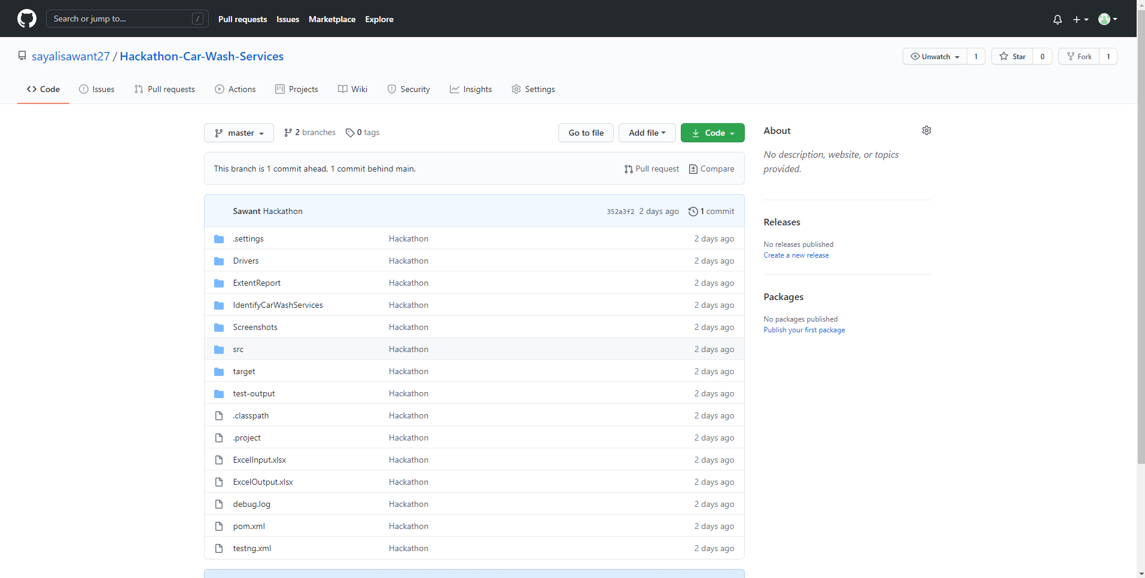
GIT IMPLEMENTATION
Link: https://github.com/

Slide 16
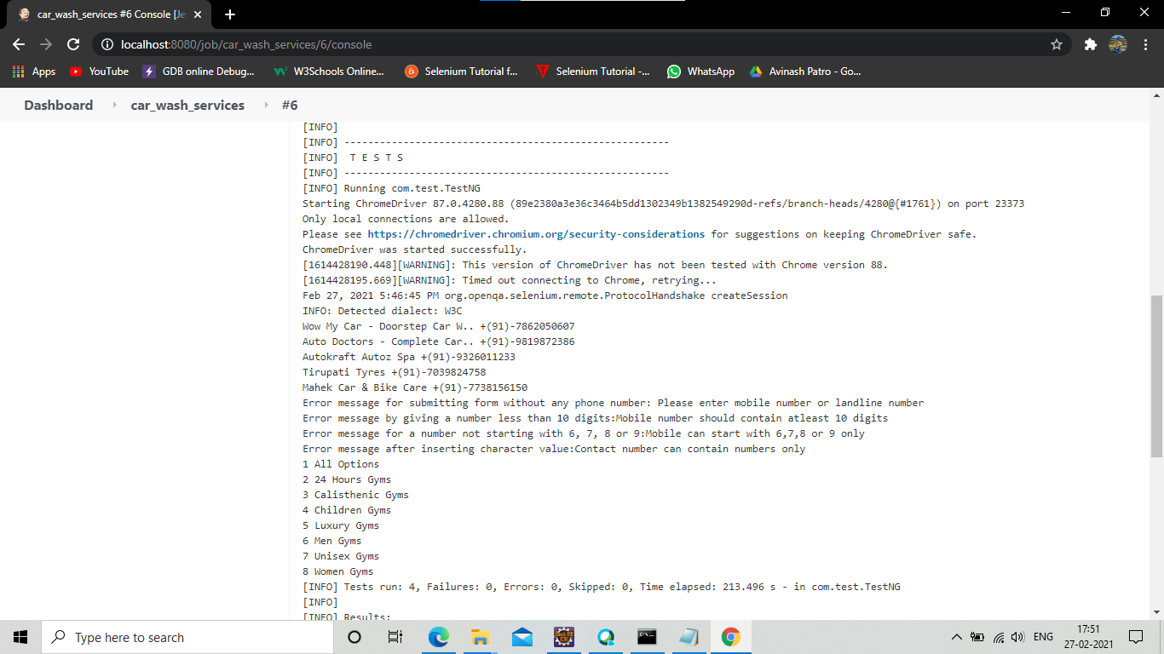
JENKINS IMPLEMENTATION WITH MAVEN

Slide 17
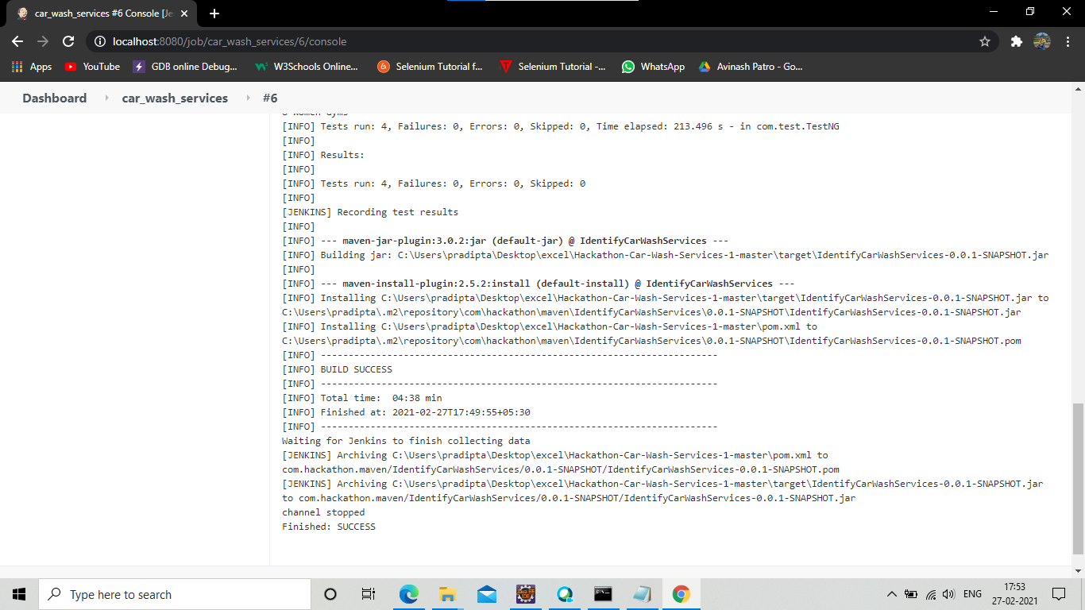

Slide 18
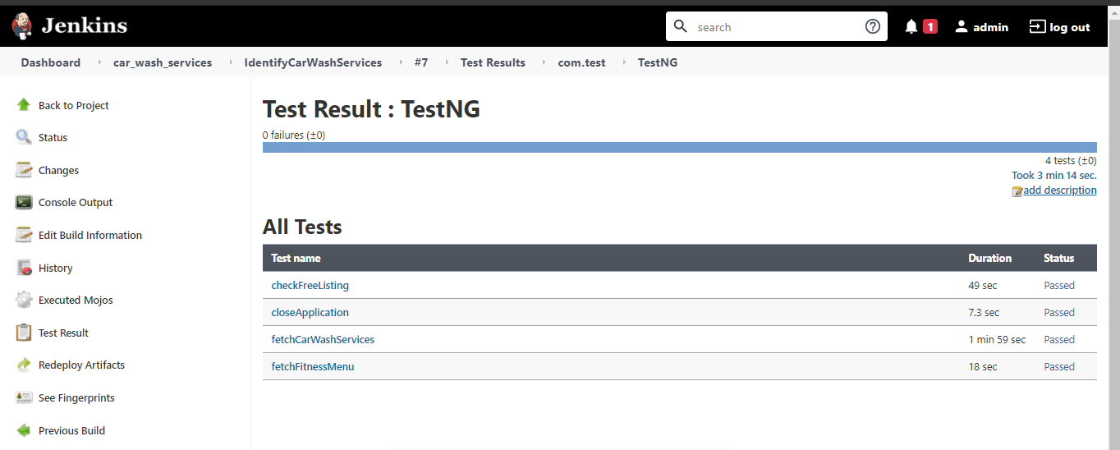
JENKINS IMPLEMENTATION WITH TESTNG

Slide 19
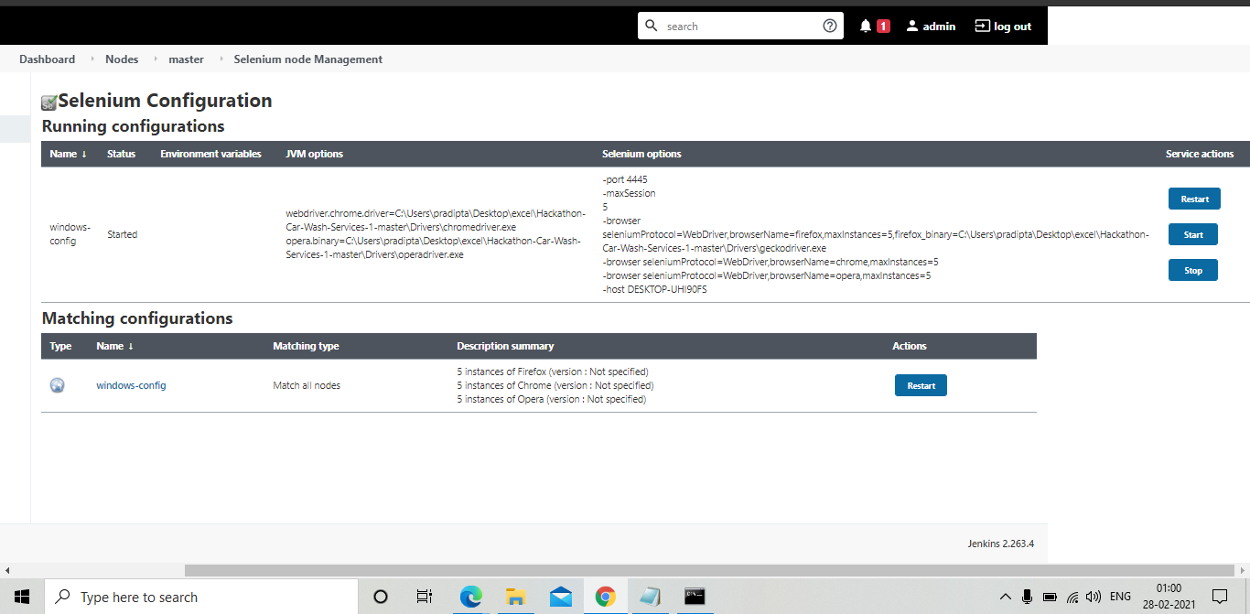
JENKINS IMPLEMENTATION WITH
SELENIUM GRID

Slide 20
OUR TIMELINE
WEEK 1
WEEK 3
START
FINAL
WEEK 2
WEEK 4
Formation of Test Cases
Integration of modules and implementation of testNG and Extent Report
Division of work in three modules and code implementation
Implementation of Jenkins and Completion of documentation

Slide 21
RESOURCES
Following are all the weblinks we used for reference.
WEBSITES:
https://udemy.com/course/selenium-webdriver-web-based-automation-testing/
www.stackoverflow.com
www.guru99.com
www.w3schools.com
TestNG: https://www.techbeamers.com/generate-reports-selenium-webdriver/
YOUTUBE LINKS
Selenium: https://youtu.be/25U-KUpWd1c
Selenium: https://youtu.be/M4Ye3SKT46g
Excel: https://youtu.be/FEIfL1skR8o
Excel: https://youtu.be/gVvlbTv2TME
GIT: https://youtu.be/8JJ101D3knE
Jenkins: https://youtu.be/FX322RVNGj4
Maven and Jenkins: https://youtu.be/-5tA3hZTVfA
Maven and Jenkins: https://youtu.be/A4Z1F7gJvkY

Slide 22
Thank
You!

