Slide 1
DETECTING BOT-LIKE
YOUTUBE CHANNELS
An Unsupervised Anomaly Detection Approach Using Autoencoders
Class Presentation | Exploratory Data Analysis & Deep Learning
1

Slide 2
Project Objective
1
Explore & Clean
Understand 15,830 YouTube channels and resolve missing / invalid values
Not every subscriber or view on YouTube is genuine. This project builds an unsupervised model to flag channels whose statistics look artificially inflated or inconsistent — potential bot or fraud-driven activity.
2
Engineer Features
Derive ratios such as views per subscriber and uploads per year
3
Model Normal Behavior
Train an Autoencoder to learn what a typical channel looks like
4
Flag Anomalies
Use reconstruction error to surface likely bot-driven channels
2

Slide 3
Dataset Overview
15,830
17
9
Channels
Raw Columns
Numerical Features Used
Key Columns
Data Quality Gaps
channel_name, channel_id, category, country
view_count, subscriber_count, video_count
videos_last_30_days, views_last_30_days
created_date → engineered into channel_age
defaultLanguage — 90% missing (dropped signal, kept as category)
country — ~1,800 missing, filled as “Not Provided”
description, category — minor gaps, filled
custom_url, last_10_video_ids — dropped (not useful)
3

Slide 4
Cleaning & Feature Engineering
Data Cleaning Steps
Engineered Features
views_per_subscriber
Parsed created_date and derived channel_age (years)
Filled missing description, country, category, defaultLanguage
Dropped unusable columns: custom_url, last_10_video_ids
Removed 0 residual nulls before feature engineering
view_count / subscriber_count
views_per_video
view_count / video_count
video_per_year
video_count / channel_age
4

Slide 5
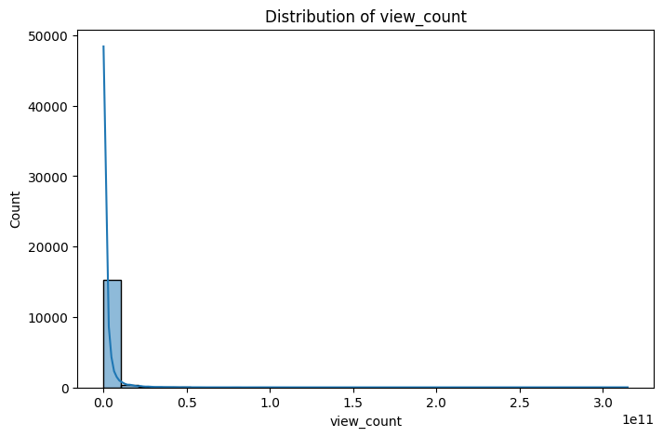
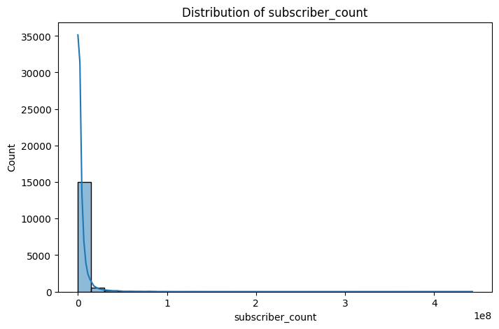
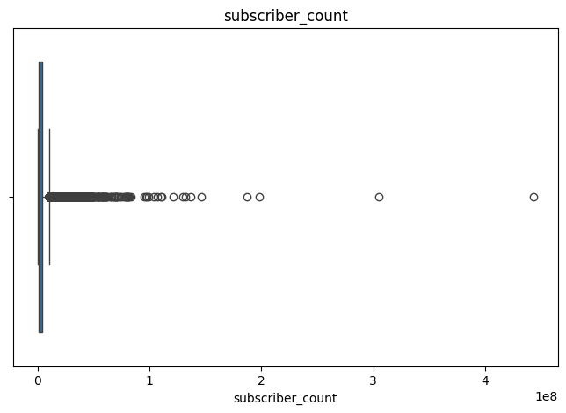
EDA: Skewed Distributions
Observation
Every numerical feature — view_count, subscriber_count, video_count, and derived ratios — is heavily right-skewed. Most channels cluster at low values, with a long tail of a few extremely large channels (e.g. Blackpink, MrBeast). Boxplots confirm this: a narrow interquartile range with many extreme high-value outliers, which are genuine, not data errors.
5

Slide 6
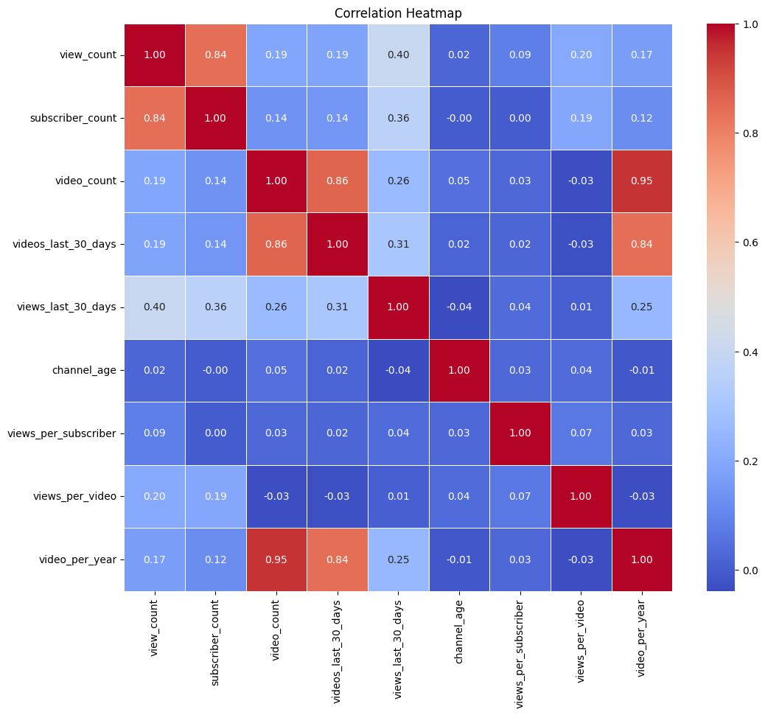
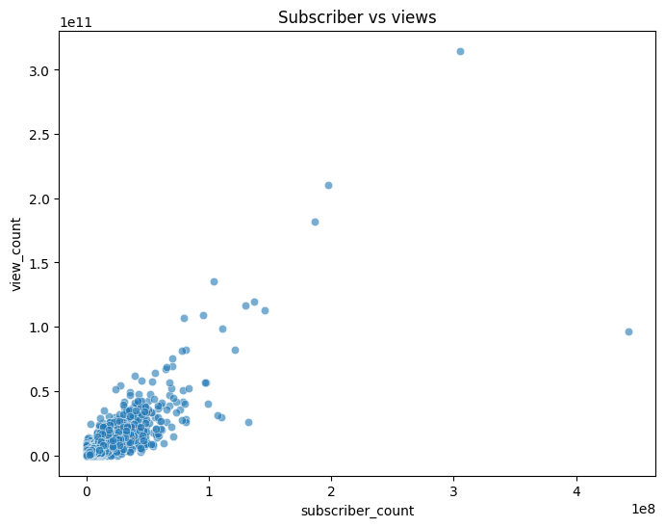
Correlation & Relationships
Subscriber count and view count are strongly positively correlated
Video count has only a weak link to subscribers and total views
views_per_subscriber carries several extreme outliers
6

Slide 7
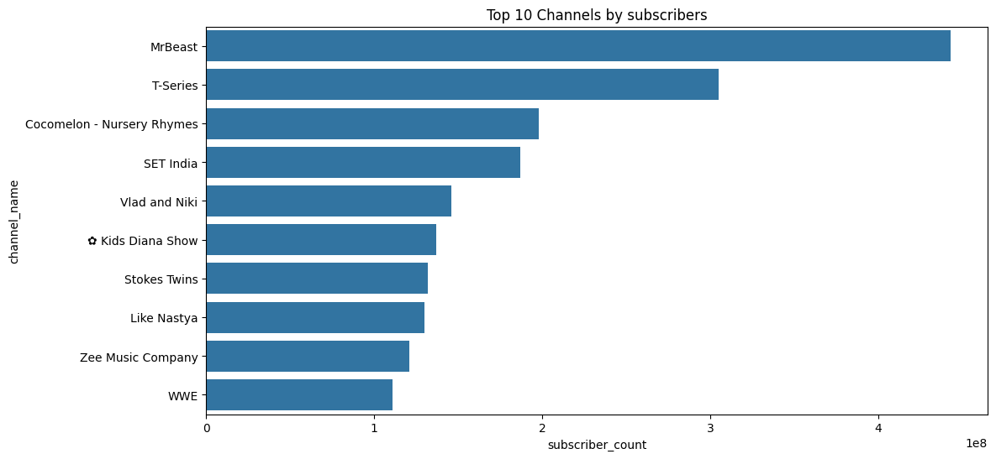
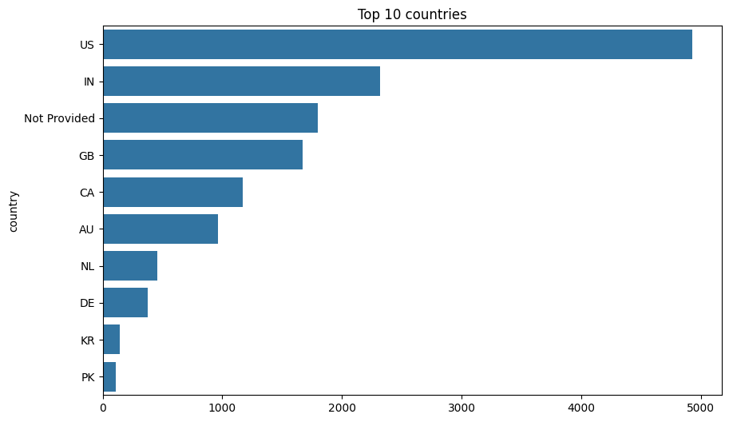
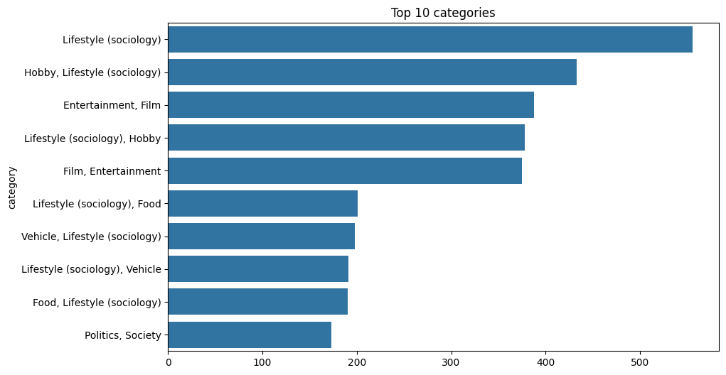
Who Dominates the Platform?
Takeaway
A handful of mega-channels dominate subscriber and view counts, the US and India lead by channel volume, and Entertainment / Music-style categories are most common — the same long-tail pattern seen in the distributions.
7

Slide 8
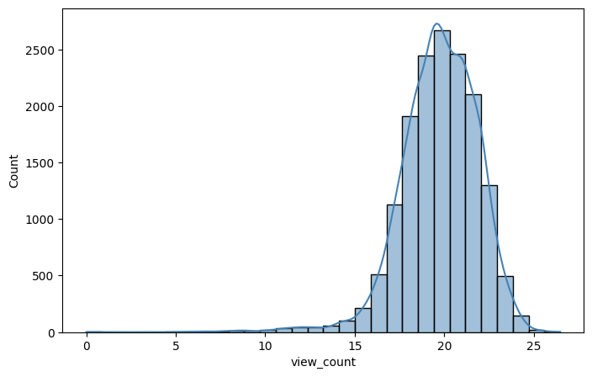
Fixing Skew: Log Transformation
A log1p transform was applied to the eight most skewed features before scaling, sharply reducing skewness:
Feature | Before (skew) | After log1p
view_count | 18.02 | -0.99
subscriber_count | 14.87 | -0.08
Log transformation pulls extreme high values inward, producing distributions far more suitable for standardization and neural-network training.
Distribution after log1p (example feature)
8

Slide 9
Model: Autoencoder Architecture
An Autoencoder compresses each channel’s 8 scaled features into a 2-dimensional bottleneck, then reconstructs them. Channels the network struggles to reconstruct are the anomalies.
8
8
4
4
2
Input
Dense
Bottleneck
Dense
Output
Hidden activation: ReLU
Output activation: Linear
Loss: MSE • Optimizer: Adam
Total trainable params: 241
9

Slide 10
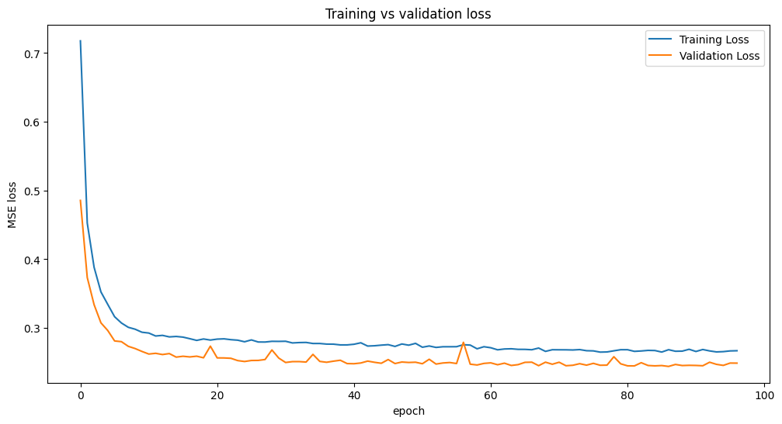
Training the Autoencoder
394 / 32
Batches / Batch size
EarlyStopping
patience = 5, on val_loss
Training and validation loss dropped quickly and converged together — no overfitting, no gap between the two curves. EarlyStopping halted training once validation loss stopped improving, restoring the best-performing weights automatically.
10

Slide 11
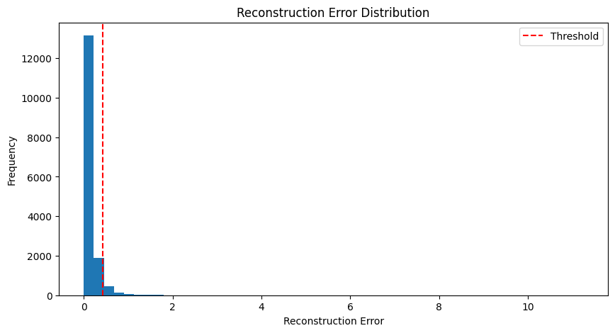
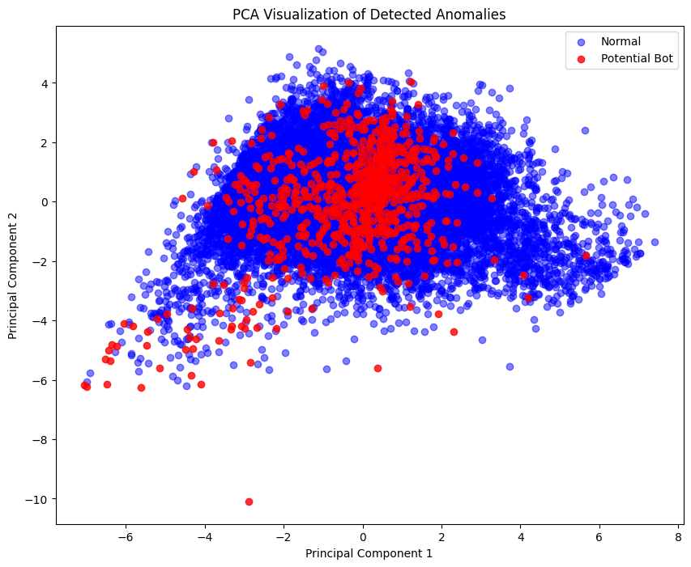
Flagging the Anomalies
95th percentile threshold
Reconstruction error = 0.428. Channels above this line reconstruct poorly — their feature patterns don't match the norm.
14,968
Normal channels
788
Flagged as bot-like
11

Slide 12
Conclusion & Key Takeaways
Real-world data is messy — and skewed
Missing values, log transforms, and outlier handling shaped every downstream step.
Autoencoders learn “normal” without labels
No bot/human labels existed; reconstruction error alone reveals unusual channels.
~5% of channels look anomalous
788 of 15,830 channels reconstruct poorly — candidates for deeper fraud review.
PCA confirms visual separation
Flagged channels cluster distinctly apart from the normal population in 2D.
Thank you — questions welcome
12

