Slide 1
DIABETES PREDICTIVE EXPERIMENT DIABATONIC
-BY
TROJAN
AAYUSHI SINGH AND VASUNDHRA SINGH

Slide 2
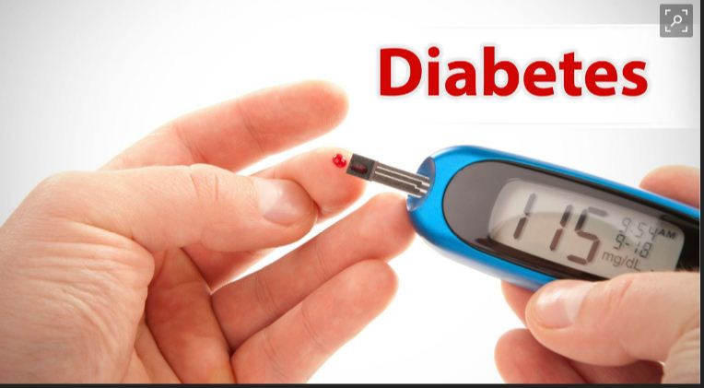
PURPOSE
This app-Diabatonic aims at predicting whether the patient has diabetes or not based upon the input parameters and thus predicting the probability of diabetes that can exist in a certain age group.

Slide 3
DATASET DESCRIPTION
This dataset is originally from the National Institute of Diabetes and Digestive and Kidney Diseases.
The objective of the dataset is to diagnostically predict whether or not a patient has diabetes, based on certain diagnostic measurements included in the dataset.
The datasets consists predictor variables includes the number of pregnancies the patient has had, their BMI, insulin level, age, and so on and target variable-OUTCOME

Slide 4
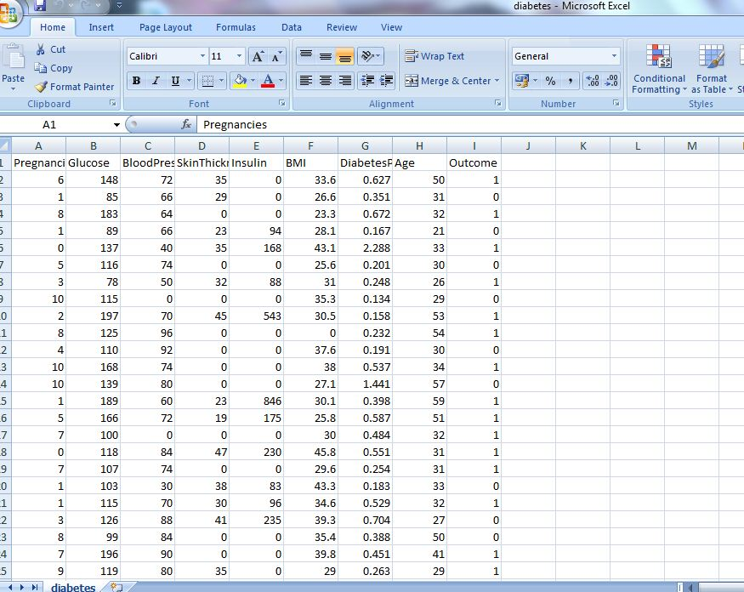
Dataset Overview

Slide 5
BASIC REQUIREMENT
Foremost requirement after getting the dataset is creating an experiment with the available dataset on Microsoft Azure Machine Learning Studio.

Slide 6
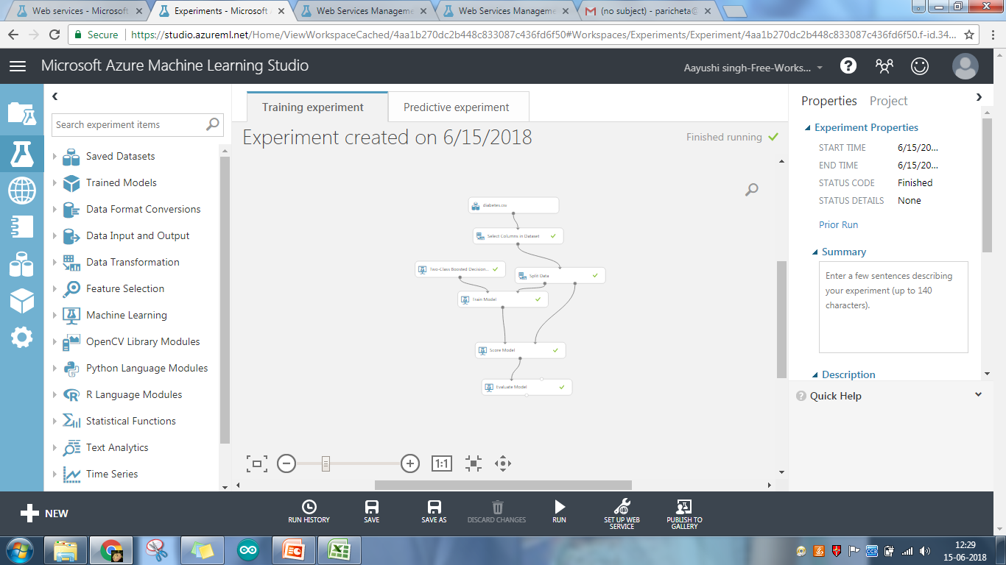
TRAINING EXPERIMENT

Slide 7
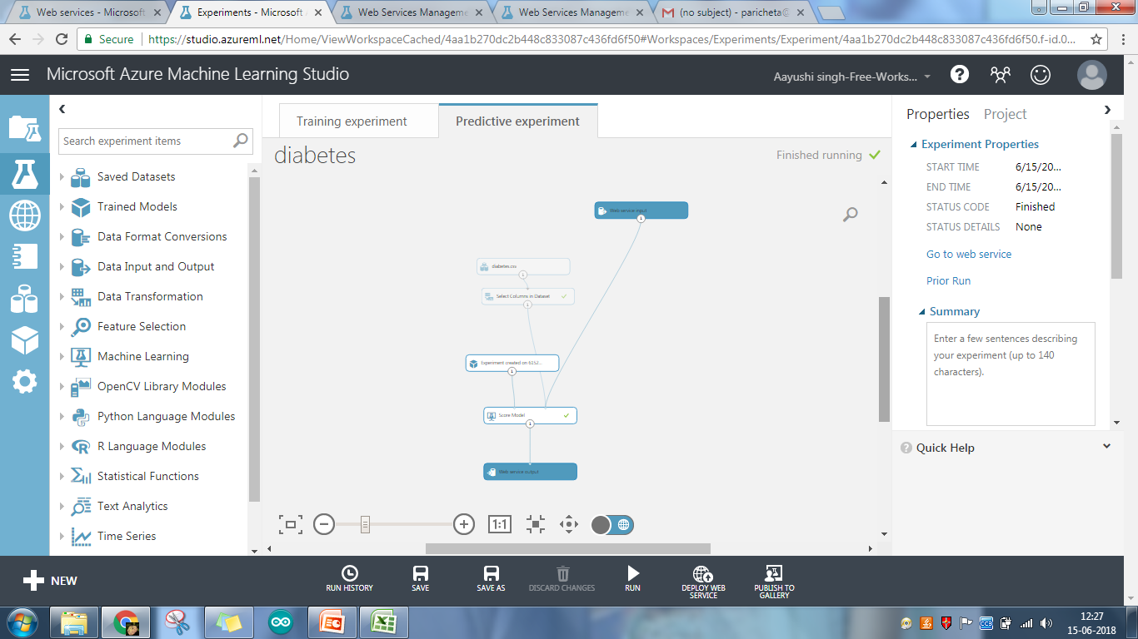
PREDICTIVE FLOWCHART

Slide 8
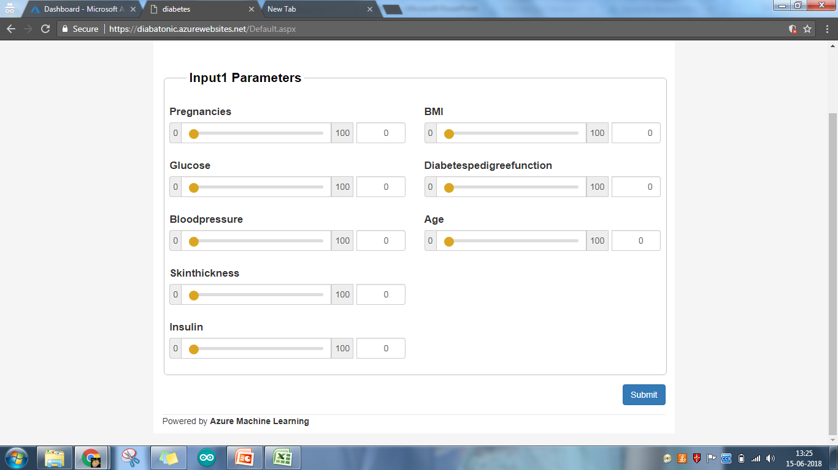
OUR WEB APP

Slide 9
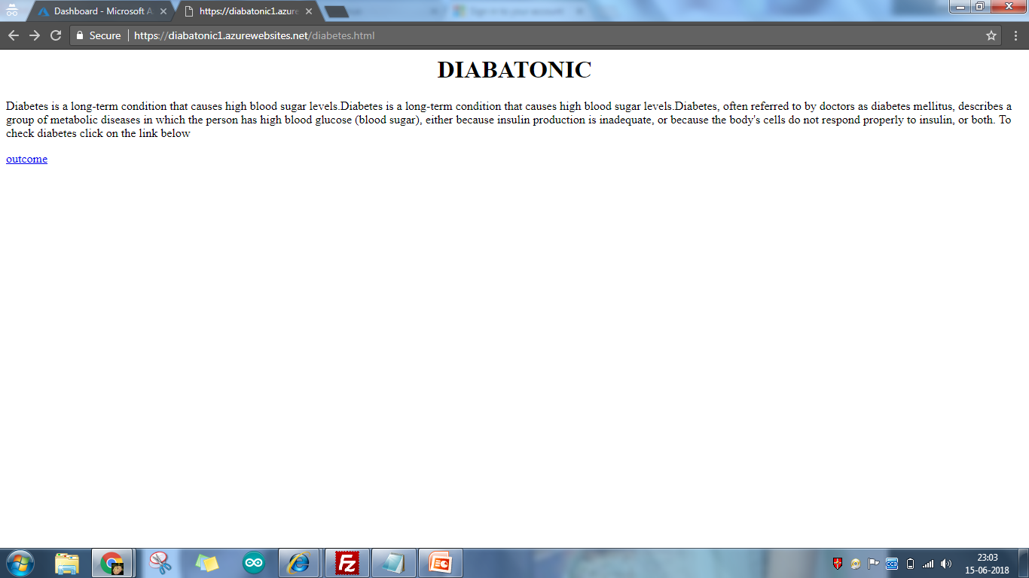
WEB SERVICE

Slide 10
ADVANTAGES
Self-management is very important for patients with diabetes, and health care provided via mobile applications (apps) has a great advantage when applied to patients with diabetes; the adherence to activities for the management of diabetes such as regular medication and insulin injection, self-monitoring of blood

Slide 11
LIMITATIONS
There can be limitations in technology’s ability to collect some of the most meaningful data and to make treatment decisions that take into consideration how dramatically patient responses can vary in seemingly identical situations.
People today suffer poor health because of a lack of information rather than an inability to force themselves to make healthy choices. The evidence, to date, is mixed.

Slide 12
THANKYOU

