Slide 1

Pen&Paper
Pitch Deck

Slide 2
Pen and paper team always made decision based on data and strategies which is very resource saving move as our venture is on mission to regrow the greens on the land.
We have gone through many conversations and debates regarding saving environment and stop letting down rainforest for human comfort use.
Our founding team is well balanced with responsibilities as pen and paper team have expert skills with their role.
The proposed application provide an easy way for alternating the use of wood pulp paper into reusable paper.
As the population is increasing in the metropolitan cities, the usage of Daily suppliance got increased , Such as paper ( specifically Notebooks ) damaging our environment by cutting down forest , thus there is a need to alternate the use of wood paper into reusable paper which anyone can use again and again , which also protect the rainforest.
The market use of the product is very huge as ever individual uses this product on the daily basis why don’t we make it reusable , and it also have attractive market size of $ 1.4 billion
The competitive market of this product is very less and we can create the monopoly through huge marketing and make this product scalable

Slide 3
Problem Statement
CONTEXT As the population is increasing in the metropolitan cities, the usage of Daily suppliance got increased , Such as paper ( specifically Notebooks ) | PROBLEM It starts off with a tree being cut down and ends its life by being burned – emitting carbon dioxide in the atmosphere .When paper rots, it emits methane, a greenhouse gas, When it is burned or composted, carbon dioxide. | ALTERNATIVES . Cotton extracted from used fabrics , Some conventional papers contain powdered minerals , Fruit skin , Peel and Stones .,Plants other than trees . Seaweed , leftovers from leather manufacturing
CUSTOMERS The proposed application provide an easy way for alternating the use of wood pulp paper into reusable paper. | EMOTIONALIMPACT User's life will become more organized , as they don't have to purchase more and more books QUANTIFIABLE IMPACT Are the service provide satisfying? • 70% Yes • 20% Need improvement • 10% No | ALTERNATIVE SHORTCOME People finds uneven surface, Tearing of paper, overvalued products in the market , changed in colour of paper which leads to more stress on eyes , Products are not easily available in the market

Slide 4
Customer Interviews And Surveys
Details of the survey | Results
Number of Costumer interviewed by us | 78
How many of them agree this is a problem that needs to be solved? | 52
How many of them said they can already solve this problem and don't need a new solution? | 26

Slide 5
Problem Definition
Clear & Succinct Problem Definition:
As the population is increasing in the metropolitan cities, the usage of Daily suppliance got increased , Such as paper ( specifically Notebooks ) damaging our environment by cutting down forest , thus there is a need to alternate the use of wood paper into reusable paper which anyone can use again and again , which also protect the rainforest
Steps of Problem Definition:
• In today’s digital age, businesses are introducing several eco-friendly and smart solutions to cater to the needs of an eco-conscious market. Reusable notebooks are revolutionary notebooks that allow users to erase and use a page again
• Trees are an integral part of our ecological part, whereas notebooks are essential for everyday stationery. Schools and learners can reduce their carbon footprint is by using reusable notebooks.
• The market is continuously evolving to meet the changing needs of the consumer base. Reusable notebooks allow learners to enjoy the incredible pen and paper experience while decreasing their carbon footprint.

Slide 6
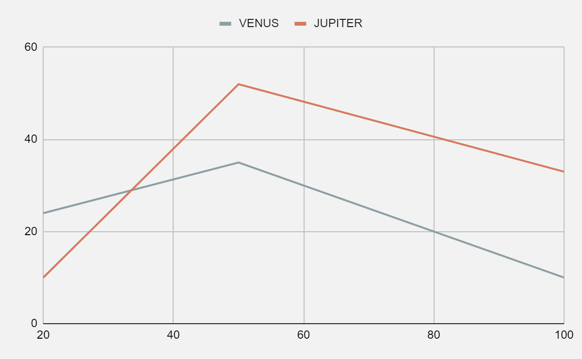
Market Analysis
1. Key Players
Digital notebooks combine cloud computing with recycling factors to provide you with an innovative solution. Reusable notebooks eliminate the need to restock supplies, lower the rate of trees cut annually, and help increase the lifespan of our planet.
2. Recent Innovations
We are under the research and development for our upcoming products regarding E-pen . In this you can write anywhere without using ink and store it to the word file so you can read it later
3. Sales Cycles
SALES - 1500 Piece sold per month
REVENUE - 50 Piece per day * 100 = 5000 , Per month = 5000 * 30 = 1,50,000
PROFIT - 35 % of total REVENUE – operational cost
4. Adoption Rates
Is the solution provided relevant and satisfying ?
Yes 79%
Need improvement 16% & No 5%

Slide 7
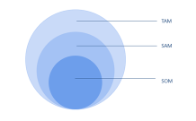
Market Sizing
TAM
$1.9 Bn
Market
Top-Down Approach
1. Forecast economic condition
2.Determine market potential
3.Estimate market share
4.Forecast sales
SAM
$ 532 M
Market
2.Add individual estimates to get total forecast
1.Estimate demand in market segments or from organizational units in the company
Bottom-Up Approach
SOM
$ 10.1 M
Market

Slide 8
Solution
Solution description:
We offer a This state-of-the-art technology is perfect for people who have trouble staying organized. Say goodbye to hundreds of sticky notes and reminders by creating your everyday schedule in reusable notebooks.
Our solution offers customers the benefit of Digital notebooks combine cloud computing with recycling factors to provide you with an innovative solution. Reusable notebooks eliminate the need to restock supplies, lower the rate of trees cut annually, and help increase the lifespan of our planet.
The details of our offering consist of:
1. Compatible price All the services available online 24*7 customer service Verified Application and website easily accessible Book or order online , Give the correct details of delivery location
2.Offers and discount coupons 5 points on every parking Feedback and implementation Pre orders within a given area through application or website , Money refund on cancellation
3.We provide a complete service to purchase our product , instant delivery within a radius of 200m or as chosen, Cancelling the booking, GPS tracking.

Slide 9
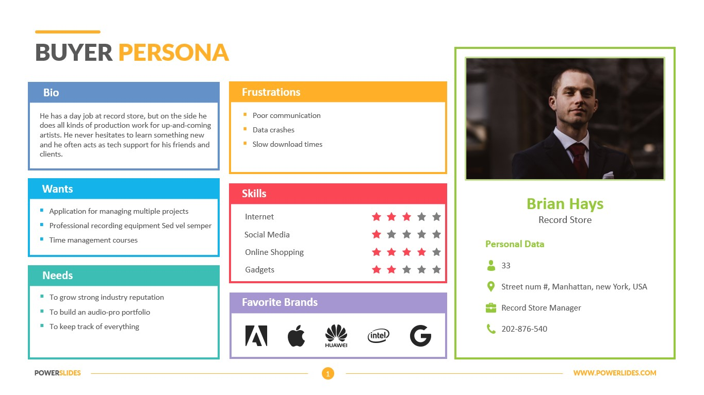
Customer Persona Template

Slide 10

Value Proposition Canvas
GAIN CREATORS
Offers and discount coupons 5 points on every purchase Feedback and implementation
CUSTOMER GAINS
Verified Product purchase Instant purchase Application and website easily accessible
PRODUCTS &
SERVICES
Purchase or product within a given area through application or website Advance and current booking option available Money refund on cancellation
CUSTOMER JOBS
Purchase a product Keep their navigation on Know the details of customer
PAIN RELIEVERS Compatible price All the services available online 24*7 customer service
CUSTOMER PAINS
Do not want to incure high expenses Unable to find a valid porduct in the radius Unable to use the application

Slide 11
Competition Analysis
DIRECT COMPETITORS
myPAPERCLIP
SECONDARY COMPETITORS
GoofyBookstore
INDIRECT COMPETITORS
Botianical notebook
Product- App to find books
UVP - Finds nearby stores
Branding (partner + Clients) - Google ads
Market Review - Engaging
Product- App to find books with reading online
UVP -Anyone can read books easily online
Branding (partner + Clients) - Kindel
Market Review -Good
Product- Personal app
UVP - Checks availability of notebooks
Branding (partner + Clients) - Advertisements
Market Review - Fairly good

Slide 12
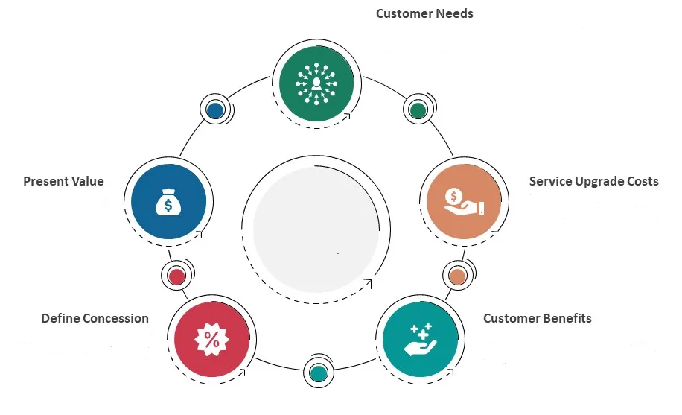
Customer Value Statement
Costumer Needs
Service Upgrade Cost
Present value
Equipment cost of Rs 75000 and net cash flow of Rs 800000 per year
Instant purchase Application and website easily accessible
Define Concession
Do not want to incure high expenses Unable to find a valid porduct in the radius
Website and app maintenance and upgrade = 10,00/month
Server maintenance and upgrade = 20,00/month
Costumer Benefits
We provide a complete service to purchase our product , instant delivery within a radius of 200m or as chosen, Cancelling the booking, GPS tracking.

Slide 13
What competitive advantages will you build to keep the promise of your Unique Value Proposition?
Offers and discount coupons 5 points on every purchase Feedback and implementation
How will you defend your competitive advantage?
Purchase or product within a given area through application or website Advance and current booking option available Money refund on cancellation

Slide 14
Financial Feasibility Template
⋄ Investment
Documentation and company registration, office space and other initial investment | 5,00,000
⋄ One time capital cost
Website development and App development | 4,50,000
Server hosting , domain buying and other IT support and Marketing budget under projection | 2,00,000
⋄ RECCURING AND ONGOING COST
IT team | 2,50,000
Customer support team | 50,000
Admin team | 25,000
⋄ Fixed Cost
Website and app maintenance | 10,000/month
Server maintenance | 20,000/month
Office maintenance | 5000/ month

Slide 15
Pen and paper team always made decision based on data and strategies which is very resource saving move as our venture is on mission to regrow the greens on the land.
The proposed application provide an easy way for alternating the use of wood pulp paper into reusable paper.
Our founding team is well balanced with responsibilities as pen and paper team have expert skills with their role.
The market use of the product is very huge as ever individual uses this product on the daily basis why don’t we make it reusable , and it also have attractive market size of $ 1.4 billion
As the population is increasing in the metropolitan cities, the usage of Daily suppliance got increased , Such as paper ( specifically Notebooks ) damaging our environment by cutting down forest , thus there is a need to alternate the use of wood paper into reusable paper which anyone can use again and again , which also protect the rainforest.
The competitive market of this product is very less and we can create the monopoly through huge marketing and make this product scalable
We are growing for more than 3 years and giving customers what they need .
We also keep customers preference first which helps a lot to make pen and paper profitable business .
Services offered to early customers included = Rs. 100 as an discounted price.
We interviewed College / School going Students / Business / Corporate place / People who are doing jobs / Banks / Daily user of note book as they are our early adopters.
We have gone through many conversations and debates regarding saving environment and stop letting down rainforest for human comfort use.

Slide 16
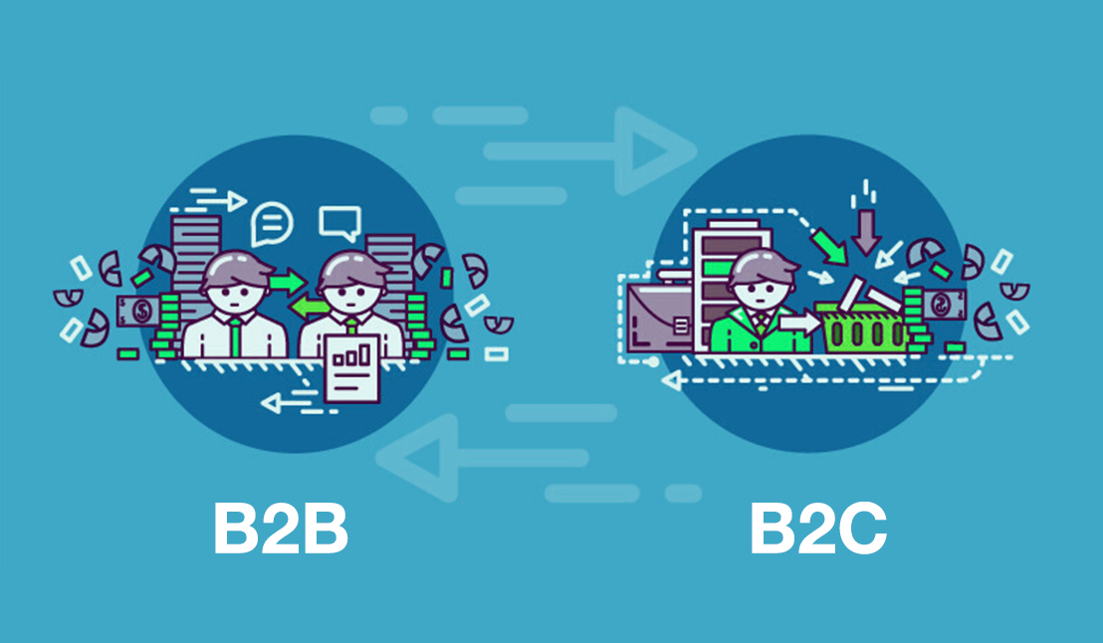
Business Model Canvas
KEY PARTNERS
Transport providers
Component suppliers
Mentors and Guru
Industry Associations
Tech. suppliers
Cloud software providers
Remote VOIP telephony
IT remote support providers
KEY ACTIVITIES
Production
Sales
Billing
Packaging
Logistics
Procurement
Maintenance
Management
Marketing
Accounting
3rd party logistics
VALUE PROPOSITION
Latest Products
Best designs
Brand status
Quick service
Quick delivery
Accessible location
Exclusive products
Digital payments
digital bill delivery
Online queries
3D printing to order
Video conference to customers
COSTUMER RELATIONSHIP
In premises one to one
Shows
Trade shows
Phone contact
In store demonstration
Customer website interactions
Social media
interactions
COSTUMERS SEGMENST
Mass market
Manufacture
Buyer not always end user
Help costumer Complete Jobs
Business to business segment
Global wholesale sales
Global manufacture sales
eBay/Amazon etc. market sales
BUSINESS MODEL
PEN AND PAPER
Sells their products
Through supply chain
As well as direct to
Costumers which makes
Us more scalable and
Also make trust worthy
company
KEY RESOURCES
People
Factory
Warehouse
Trucks
Communications
Othe Utilities
Sales Data
Custome Data
Efficient processes
Automation systems
Industry analytics
CHANNELS
Direct mail list
Sponsored groups
Website
Email Marketing
Digital marketing
Online videos
Internet text search
Internet image search
Internet map search
Web page product
EARLY ADOPTERS
College / School going Students / Business /
Corporate place
COST STRUCTURE
Labour
Taxes
Building expense
Equipment
REVENUE STREAMS
Product sales
Project fulfilment
Advertising
Logistics
Communications
Insurance
Wate removal
Web hosting
Email marketing
Content creation
Renewable energy creation
Digital products

Slide 17
Testing Risky Assumption
Hypothesis 1
We have provide free samples to the students as well as teachers for marketing purpose and also we are collecting feedback after they use the product , to check the adaption. Which concluded in the positive result and the adaption rate is 53% which is more than our team expected
Hypothesis 3
We also sold our product into IT cities such as Hyderabad , Bangalore , Pune etc. To check the response of the corporate system weather our products are made for corporate offices or not. And the response was quite disproves as they believe to store data on machine as they are working on huge data number and our products gives them limitation
Hypothesis 2
We have also provide free delivery to the costumers on our e- commerce website to increase more traffic on our web page and also to collect the costumers data for further strategies to be applies in future . And the results was very impressive as people are more interested into home delivery facility
Hypothesis 4
We gave the costumer discount as they found our product expensive . To check the costumer response after discount we provide them our product at Rs 100 . And the results was much higher than our exception which also increase our sales and more number of new costumers purchased our product .

Slide 18
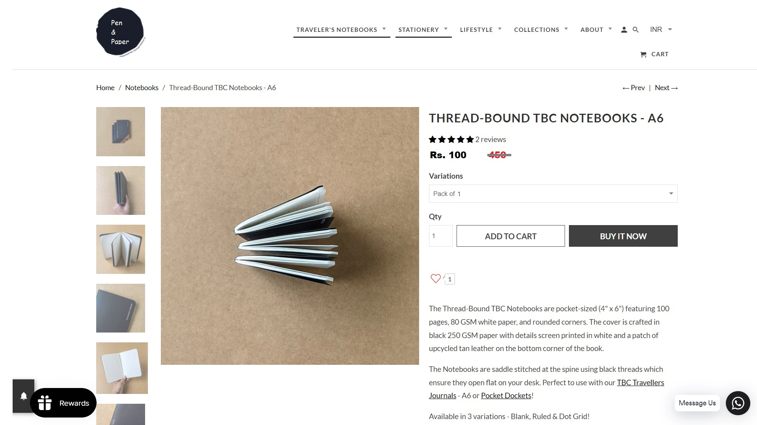
MVP Full product / service description
www.pen&paper.in
Our product pricing is Rs.450 without applying any coupons or Discount scheme
Pen and paper provides reusable notebooks
Benefits of using pen and paper reusable notebooks are : he/she can use notebook infinite times by simply using erasing process below , it can also prevent cutting down rain forest , fully utilization of resources
You can reuse the note book simply by erasing the ink through water and wipe the page with the cloth , as pen and paper reusable notebook are made from special material so we can use the whole notebook multiple time

Slide 19
MVP Validation
Our MVP
Our MVP is to provide reusable notebooks at affordable price
Who is our target audience for the test ?
College / School going Students / Business / Corporate / place
How will we get to that audience ?
We will advertise on social media using strategies and targeting specific age group who is working on daily bases , Arrange seminars on school and colleges , provide display products
Did costumers recommend our product to other about it ?
Yes costumers do recommend our product to other people and we also provide referral code special scheme for such loyal costumers
Did costumers come back or show interest in doing so ?
Yes we do have repeated costumer more than 50 % which proves our research study to be revolutionary and giving good influenced change into our costumers
Did enough customers buy?
Yes costumers do buy our products because this product is very unique
And resourceful
Did costumers pay the price we expected ?
At the first place costumers aren't buying our products as costumers found our product expensive , so we came up with the discounts and costumers coupons
Conclusion
Persevere
Pivot
Not conclusive
Realization
Now with the modification in app. Customers need to register their mail only once, i.e., at the time of signup. Maximum of the people interviewed validated these updates.

Slide 20
Sales Plan (one year)
In Stores | In Online | Wholesale
Product and services
Projected sales
Distribution strategies
Proposed deadline
Pen and paper books are available at all size | Pen and paper books are available at all size | Pen and paper books are available only in large and medium size
5000 unit | 9000 unit | 7000 unit
Promote costumer service experience in stores only promotion | Keyword search SEO optimization link building responsive costumer service | Event sponsorship
March 2023 | March 2023 | March 2023

Slide 21
COSTUMER SALES FUNNEL
Target Market : Students, Corporate employees , Teachers etc..
Leads : reusable infinite times
Opportunities : Advertisement opportunities
Costumer : Age group betn. 10 - 70

Slide 22
Customer Acquisition Plan Template
1. | 2. | 3. | 4. | 5.
Target Customer Segment (Type) | Target Customer Segment (Number) | Channels to be used to attract the target customer segment | Estimated number of leads | Estimated cost to convert these leads to actual customers
Demographic | 9 | 1. Social Media Marketing (SMM) 2. Referral Marketing 3. Advertisement | 9000 | 9,00,000

Slide 23
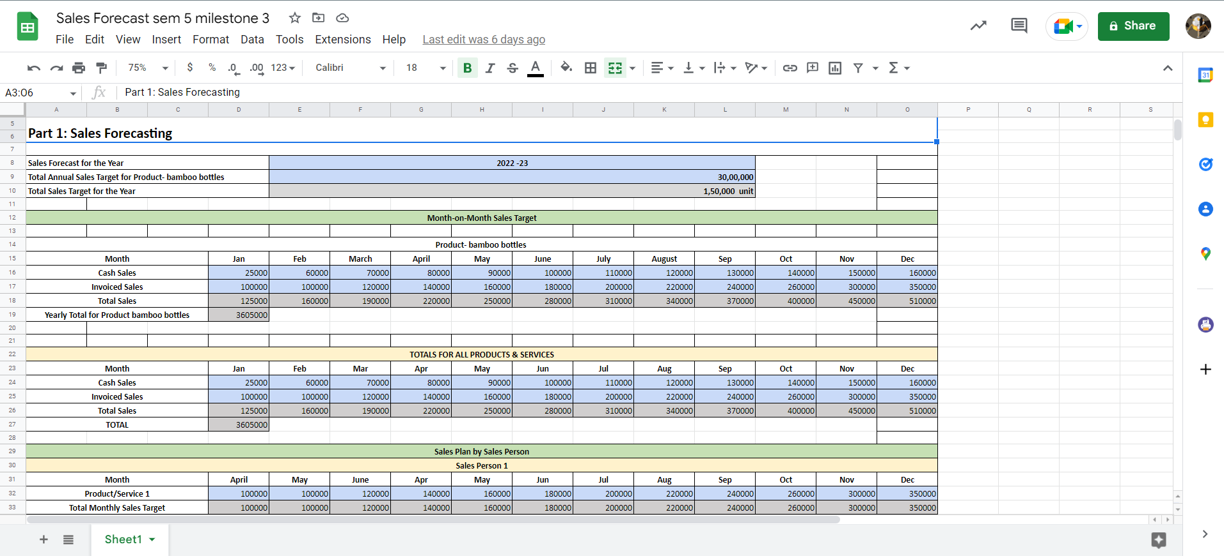

Slide 24
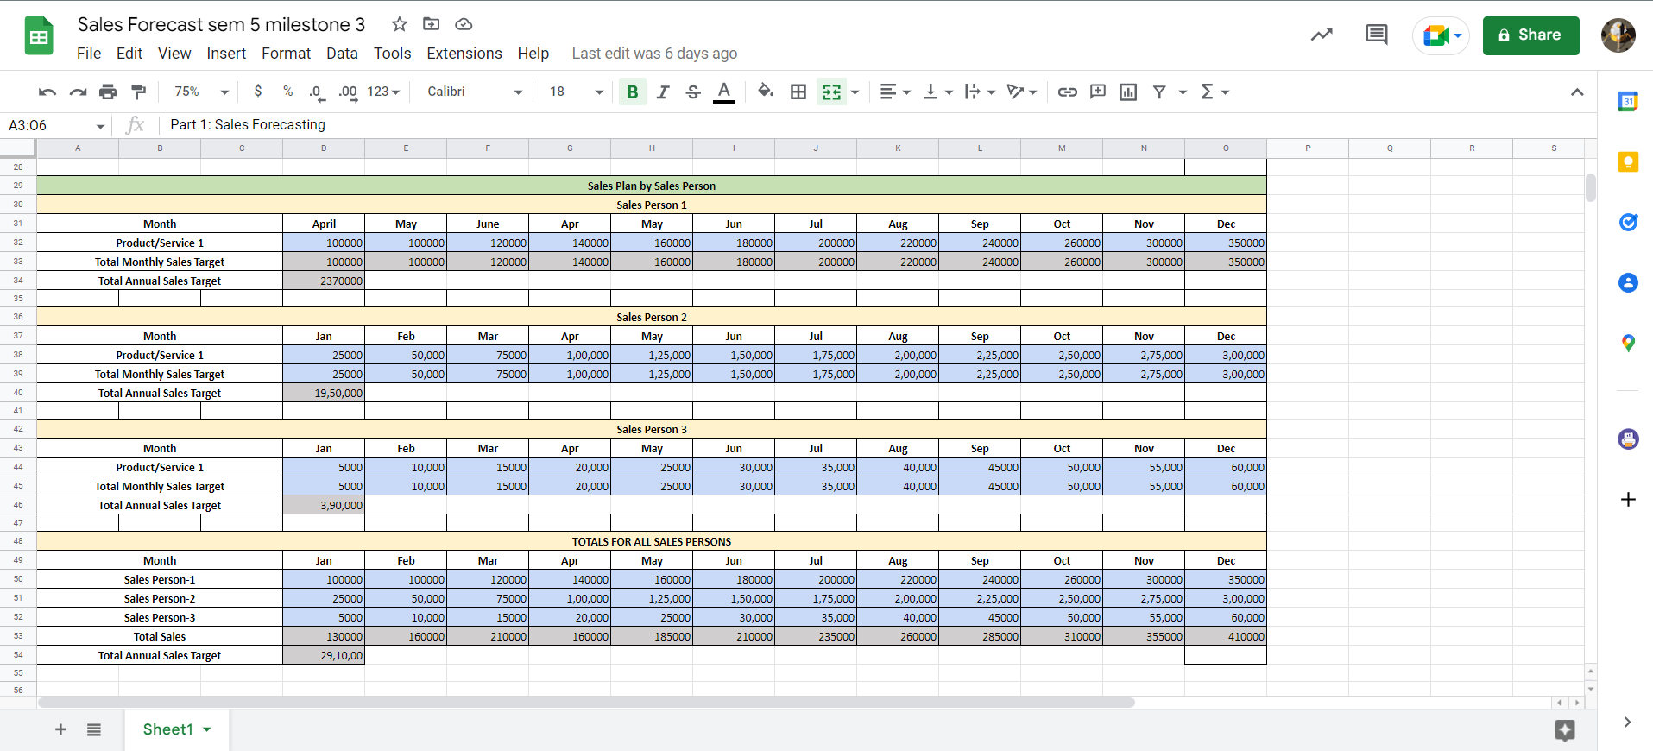

Slide 25
Unit Economics Template
UNT ECONOMIC MODEL
1,50,000 UNIT
DEPEND ON CUSTOMERS
Contribution margin
LTV : CAC RATIO
Payback on CAC

Slide 26
Brand Framework
Vision | What does my organization aspire to become? | Our vision is to make notebooks reusable , used worldwide by everyone
Mission | What does my organization stand for and what do we value? | Our mission is to prevent cutting down rain forest
Promise | What do we promise to customers at the most fundamental level? | Pen and Paper provides best quality products which last for long tern duration and can use infinite times
Brand Values | What are the core values your brand believes in and stands for? | We believe in making eco-friendly notebooks and Pen and Paper successfully complete this mission
Brand Personality | What are the human characteristics associated with your brand? | Pen and Paper is like unique, caring, funny, trustworthy, creative, straightforward
Attributes | What makes us distinctly valuable to our customers? How do we achieve over and over? | aspects like quality, popularity, accessibility, convenience and longevity . 80% of customers state positive customer experience
Emotion | What does it feel like to engage with us? | ultimate goal of engagement is to build an emotional connection with the brand

Slide 27
Branding, Positioning & Channels
Brand Name : Pan&Paper
why you chose them
Market segment | Channels | Why this channel?
Early adopters School/college students , corporate employees, teachers , | Social Media Marketing , Advertisement | We can attract and reach to maximum number of costumer through this channel
Positioning Statement : Pen&Paper is all over the country with the huge manufacturing capacity at large scale.

Slide 28
Funding Plan
How much fund required to reach to the next level of the venture? -
10 Lakh
How much have been bootstrapped if not , why?
5 Lakh
How much can be bootstrapped?
3-4Lakh
How much external required if not, why?
2-5 Lakh
Funds utilization Strategy
Raw Material
Work place
Warehouse
Machinery
Employers and workers salary
Marketing and advertisement
Packaging
Reserve fund
Transportation
Insurance

Slide 29
Valuation
Valuation methods used | Company valuation (in dollars) | How did you arrive at your company's? On what basis
Market capitalization | $ 50,000 (Approx) | Share of stock price , goodwill
Book value | $ 40,000 (Approx) | Assets , Liabilities

Slide 30


Thank you !
Address
Mumbai, India
Company Number
+91-11-23978046
E-mail
pen&paper@email.com
Facebook
www.facebook.com/pen&paper

