Slide 1



G-Charm : An Adaptive Runtime System for Message-Driven Parallel Applications on Hybrid Systems
Vasudevan Rengasamy*, Sathish Vadhiyar*, Laxmikant V. Kalé#
*Indian Institute Of Science, Bangalore
# University Of Illinois at Urbana-Champaign, Urbana, IL, USA
Notes:
Reduce logo size, good templ

Slide 2
Outline
Introduction
Charm++ and Existing GPU Framework
G-Charm Architecture
Optimization Strategies
Dynamic Scheduling
Data management
Combining kernels
Experiments and Results
2D Stencil computation
Cholesky factorization
2D Molecular dynamics
Related works
Conclusion and future work

Slide 3
Introduction
GPU application performance depends on
Asynchronous use of heterogeneous resources
GPU idle time
CPU-GPU memory transfers
Occupancy of GPU Kernels
Data transfer – Kernel execution overlap
Extent to which CUDA kernels are optimized
Drawbacks of hand optimization
Considerable programming overhead
Different applications require different optimization techniques

Slide 4
Introduction: Framework for Message-Driven Parallel Applications on Hybrid Systems
Message driven languages enable communication-computation overlap
Perform useful computation on the messages already received rather than waiting for non-arrived messages
CHARM++ improves application performance by hiding communication latencies
Some applications include NAMD, ChaNGa etc
Objective
A generic runtime framework that optimizes different classes of applications with minimum user overhead
Perform optimizations like dynamic scheduling, data management, data reuse and combining kernels
Extend benefits of CHARM++ to GPU environment

Slide 5
Background – CHARM++
Charm++ is a message-driven object oriented programming language
The application domain is divided among migratable objects called Chares
Application execution starts with Mainchare on PE₀ which creates other chares distributed over all available PEs
Chares invoke methods of remote chares called entry methods
One runtime system instance runs on each PE and has a Message Queue
C[2].hello()
PE 0
MC
C[0]
Runtime
PE 1
Runtime
C[1]
C[2]
entry void hello();

Slide 6
CHARM++
C[2].hello()
Each entry in Message Queue corresponds to an entry method invocation
Runtime system processes messages from this queue and invokes corresponding chares’ entry methods
Overlaps message arrival for a chare with entry method execution of another chare
Performs dynamic load balancing by migrating chares among PEs
PE 0
MC
C[0]
Runtime
PE 1
Runtime
C[1]
C[2]
entry void hello();

Slide 7
HybridAPI: An existing framework
PE 0
MC
C1
Chares create workRequest objects and enqueue in workRequest Queue
workRequest object specifies CUDA kernel, data to be transferred and callback function to be invoked after GPU processing completion
workRequest objects are executed in a pipelined manner overlapping data transfer and kernel execution
Callback function is called after a workRequest completes on GPU
C2
C3
Runtime
HybridAPI
wr3
wr2
wr1
wr1
wr2
wr3
wr1
wr2
wr3
wr1
wr2
wr3
Data in
Kernel
Data out

Slide 8
G-Charm
Architecture and Optimization Strategies

Slide 9
G-Charm Architecture
PE 0
Processes each workRequest object
Decides if a workRequest object has to be assigned to CPU or GPU for execution
G-Charm maintains a chare table for information about location of buffers present in GPU device memory
Creates larger workRequest object called workRequestCombined by combining multiple workRequest objects and enqueues into workGroupList
workRequestCombined objects are scheduled in GPU
MC
C0
Converse 0
G-Charm
Data Reuse
Chare table
CombineKernels
workGroup
List

Slide 10
Optimization Strategies
Dynamic Scheduling
Deciding if a workRequest has to be executed on CPU or GPU
Memory Management
Managing data on GPU to facilitate reuse and combining kernels
Optimizing data transfer
Avoiding redundant data transfer to GPU
Combining kernels
Combining multiple workRequest objects to invoke a single GPU kernel to improve occupancy
Notes:
Don’t go into details

Slide 11
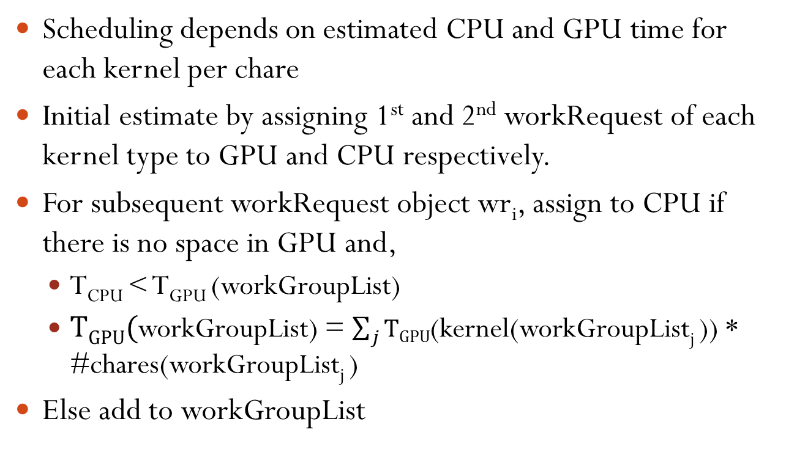
Dynamic Scheduling
Scheduling depends on estimated CPU and GPU time for each kernel per chare
Initial estimate by assigning 1st and 2nd workRequest of each kernel type to GPU and CPU respectively.
For subsequent workRequest object wr_{i}, assign to CPU if there is no space in GPU and,
T_{CPU} < T_{GPU} (workGroupList)
$TGPU($workGroupList) = $\sum_{j}{TGPU}$(kernel(workGroupList_{j} )) * #chares(workGroupList_{j} )
Else add to workGroupList

Slide 12
Memory Management
GPU memory divided into N_{buf} buffer pools, N_{buf} is the number of buffers used by the application (N_{buf} = 2)
Each buffer pool divided into slots, slot size = chare buffer size
A hash function assigns adjacent slots to adjacent chares’ buffers
This helps in invoking a single kernel on multiple chares since data are contiguous in GPU
Chare table – Stores slot numbers occupied by each chare
CPU
CPU Chares
0,0 | 0,1 | 0,2 | 0,3
1,0 | 1,1 | 1,2 | 1,3
2,0 | 2,1 | 2,2 | 2,3
3,0 | 3,1 | 3,2 | 3,3
GPU Memory
Buffer Pool 0 (12 Slots)
0 0,0 | 1 | 2 | 3 3,3
4 1,0 | 5 | 6 1,2 | 7 1,3
8 2,0 | 9 2,1 | 10 | 11
Chare Table
Chare | Buffer0 | Buffer 1
0,0 0,1 0,2 0,3 1,0 1,1 1,2 1,3 2,0 2,1 2,2 2,3 3,0 3,1 3,2 3,3 | Slot 0 - - - Slot 4 - Slot 6 Slot 7 Slot 8 Slot 9 - - - - - Slot 3 | Slot 0 - - - Slot 4 - Slot 10 Slot 11 Slot 8 Slot 9 - - - - - Slot 3
Buffer Pool 1 (12 Slots)
0 0,0 | 1 | 2 | 3 3,3
4 1,0 | 5 | 6 | 7
8 2,0 | 9 2,1 | 10 1,2 | 11 1,3
Application with 2 buffers
Notes:
-mention greyed area
-buffer, buff pool – introduce in detail
-y mem mgmt, what is buff
- inp/out param

Slide 13
Minimizing Data Transfer
G-Charm cross-references the chare table to check if data for a new kernel already located in GPU
Avoids redundant transfers
LRU policy for data replacement in GPU and migration to CPU
Maximizes reuse of data
Notes:
read

Slide 14
Combining Kernels
G-Charm automatically analyses dependencies between kernels at runtime
workRequest objects with no dependencies among the buffers and invoking the same kernel are combined
Improves Occupancy
Shared memory
Data regions of adjacent chares are contiguous in CPU memory
Hence these data regions can be transferred in a single call
Reduces kernel invocations

Slide 15
Experiments and Results
Experiments done on
Tesla Cluster – 3 nodes
Each node has 4 quad core AMD Opteron 8378 cores +1 Tesla S1070 GPU card
Tesla S1070 GPU card has 4 GPUs, each GPU having 240 cores
Fermi Cluster – 4 nodes
Each node has a 4 core Intel XEON W3550 processor and one Tesla C2070 GPU with 448 GPU cores
3 Applications
2D Stencil computation
Cholesky factorization
2D Molecular dynamics
All experiments performed using single GPU and CPU

Slide 16
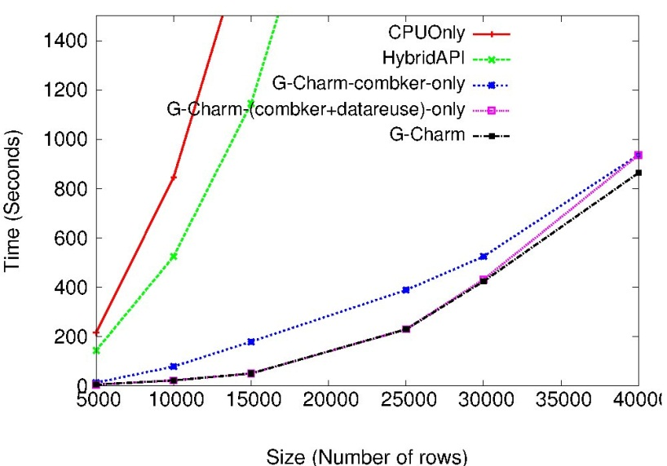
2D Stencil Computation
Combining kernels alone gives 10X improvement over HybridAPI
Combining kernels along with data reuse gives 16X improvement
Asynchronous CPU utilization provides another 6% improvement

Slide 17
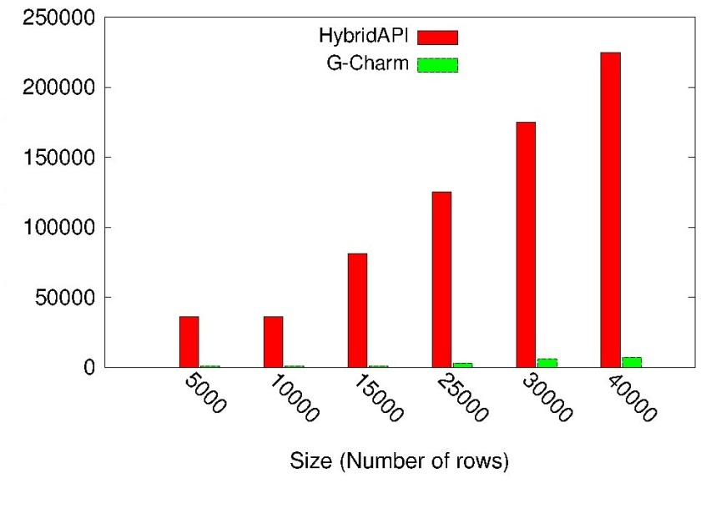
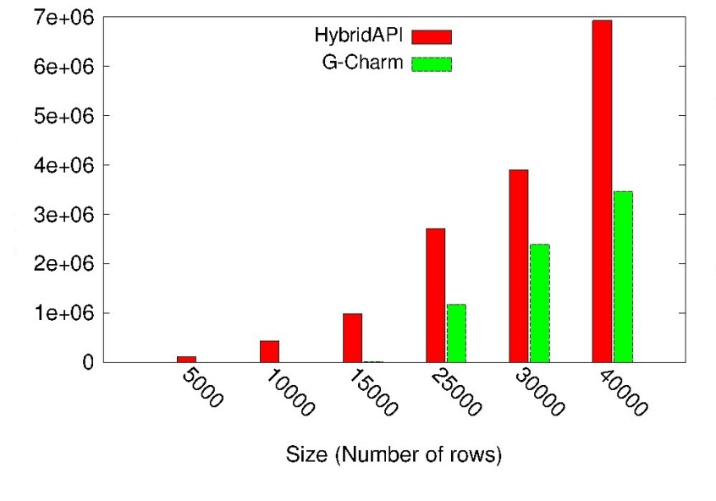
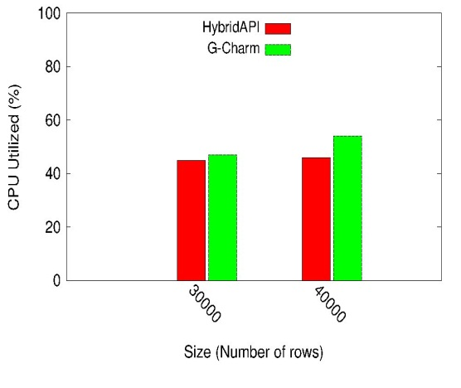
Execution Statistics
Number of kernels
Transfer size (MB)
Number of kernel invocations
Amount of CPU-GPU data transfer
G-Charm invokes 30X fewer kernels, transfers half the data and achieves 5% increased CPU utilization
CPU utilization

Slide 18
Cholesky Factorization
Factorizes a real symmetric positive definite matrix A = LL^{T}
Matrix is divided across 2D chare array
Each block column undergoes 3 stages of operation
Cmod – update a column block using all previous columns
Factorization of diagonal block
Cdiv – update the blocks along the same column as factorized block
Comparison with MAGMA and StarPU
MAGMA: a highly tuned dense linear algebra library for GPUs
StarPU: a runtime framework that performs dynamic work scheduling
A
B
D
C
E
F
Column 1
1. Factorize A
2. Cdiv
B=BA^{-T}
C=CA^{-T}
Column 2
1. Cmod
D=D-BB^{T}
E=E-CB^{T}
2. Factorize D
3. Cdiv
E=ED^{-T}
Column 3
1. Cmod
F=F-CC^{T}-EE^{T}
Factorize F

Slide 19
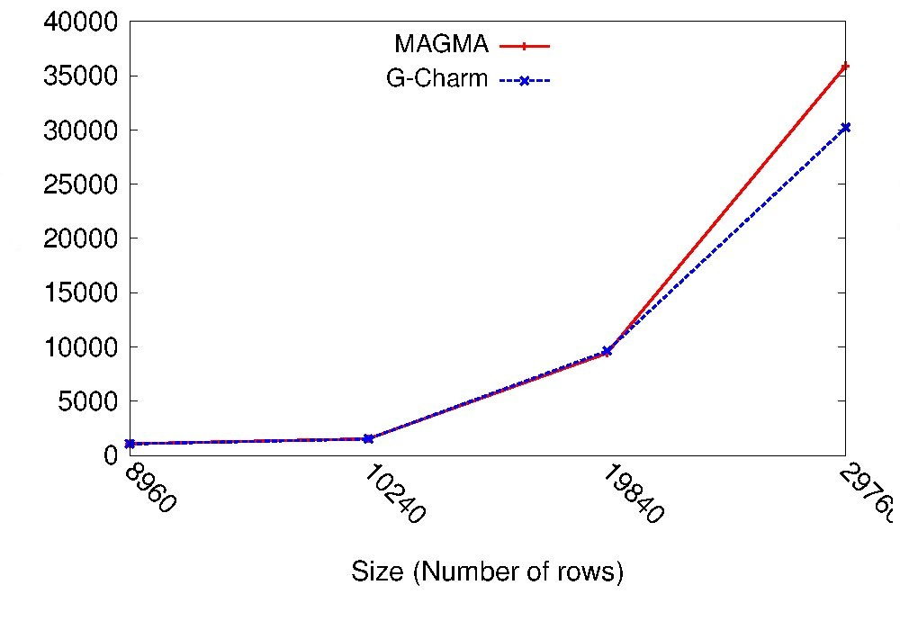
Time(ms)
For larger matrices, upto 14% improvement over MAGMA due to efficient data management
G-Charm transfers 3X less data than MAGMA, invokes 2.5X less kernels
For matrix size 29760×29760 double precision,
StarPU – 137 seconds
MAGMA – 34.7 seconds
G-Charm – 31.8 seconds
StarPU invokes a kernel for each block whereas G-Charm and MAGMA invokes fewer kernels

Slide 20
Molecular dynamics
Irregular application, distributed memory implementation
Particle space partitioned among 2D patches
Compute objects calculate force between pairs of patches and send the force vectors to the source patches
Patches add force vectors received from all compute objects to get the total force acting on each particle due to neighboring particles
Particle coordinates are updated using force calculated
Particles are migrated to appropriate patches after each iteration
Patch 0
Patch 2
Patch 1
Patch 3
Compute object

Slide 21
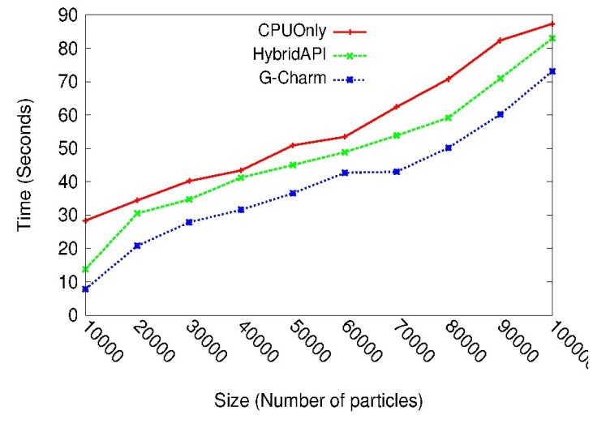
Molecular Dynamics Execution Time
33% improvement in execution time over CPU execution and 21% over HybridAPI
20% less kernel invocation, 30% less data transfer and 2.5 to 5 times increased CPU utilization

Slide 22
Summary of Results
Combining kernels also reduces latency of data transfer for shared memory implementation
Data management and reuse provide significant benefits for large problem sizes
Performance due to asynchronous CPU execution depends on ratio of CPU-GPU performance and application characteristics
8X and 10X improvement for Jacobi and Cholesky applications and 21% for Molecular dynamics over HybridAPI
Notes:
Why diff performance for diff apps?

Slide 23
Related Work
Unified Programming Model [Kunzman et al. Journal on Scientific Programming 2011]
generic abstraction for accelerators
Explicit data management
Automatic Memory Management [Sreepathi et al. PACT ‘12]
Avoids unnecessary data transfers automatically by compiler analysis
G-Charm performs scheduling and kernel agglomeration along with data reuse to improve performance
G-Charm is the only framework
Extends the advantages of message driven programming model to GPU
Performs optimizations such as dynamic scheduling, memory management and data reuse and combining kernels

Slide 24
Conclusion
G-Charm reduces CPU-GPU memory transfer, performs dynamic scheduling, improves occupancy by combining kernels
1.3 to 15 times improvement for 2D Stencil computation
14% improvement for Cholesky factorization over MAGMA
21% improvement over HybridAPI for Molecular Dynamics application because of distributed memory implementation
Future Work
Extend G-Charm to multi-GPU systems
Improvement in programming abstractions
Experimenting with large-scale applications
Notes:
Elaborate on future work

Slide 25
Thank you
Questions?

