Slide 1
THEORY OF COMPUTATION
Technical Presentation
Course Outcome CO1 — Finite Automata, Determinism and Mathematical Induction
Presented by: K Vasu Deva Reddy Register No: 192411256 Course: Theory of Computation (TOC)

Slide 2
What This Presentation Covers
Four questions on automata theory and mathematical proof, explained in simple technical terms
NFA to DFA Conversion
1
Subset construction, and the challenges of removing non-determinism
Mathematical Induction
2
Proving the sum-of-squares formula for all positive integers
Epsilon (ε) Transitions
3
Their purpose, and how to remove them from an ε-NFA
ε-NFA to DFA (ε-Closure)
4
Computing ε-closures and building the final DFA
Theory of Computation | CO1 Technical Presentation
2

Slide 3
1
QUESTION 1 · NON-DETERMINISTIC TO DETERMINISTIC AUTOMATA
Converting an NFA into an Equivalent DFA
Why conversion is possible
An NFA can be in several states at once for the same input symbol. A DFA must always be in exactly one state. Every NFA has an equivalent DFA because any set of NFA states can be treated as a single “combined” DFA state.
Key Challenges
State explosion
In the worst case the DFA needs 2ⁿ states for an n-state NFA, since every subset of states is a candidate.
Unreachable states
Subset (powerset) construction method
Many of those subsets are never actually reached from the start state and must be discarded.
Start with the NFA's start state as the DFA's start state.
For each DFA state (a set of NFA states) and each input symbol, find the union of all NFA states reachable — this union becomes a new DFA state.
Repeat until no new state-sets appear.
Any DFA state whose set contains an NFA final state becomes a final state.
Tracking multiple paths
Every symbol must be checked against every state in the current subset, not just one state.
Epsilon transitions
If the NFA has ε-moves, ε-closures must be computed first before applying subset construction.
Theory of Computation | CO1 Technical Presentation
3

Slide 4
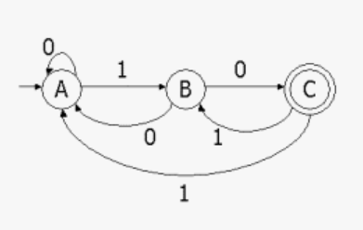
1
QUESTION 1 · APPLYING SUBSET CONSTRUCTION TO THE GIVEN NFA
Given NFA over Σ = {0, 1}
How to build the DFA from this NFA
Take the NFA start state alone as DFA state A = {start state}.
For state A, read symbol 0: collect every state the NFA can reach — this set becomes DFA state B.
For state A, read symbol 1: collect the reachable set — this becomes DFA state C (or reuses B if identical).
Repeat the same 0/1 check for B, C, and every new set that appears, until no new set is produced.
Mark a DFA state as final if its set includes the NFA's final state.
Draw the resulting DFA: one circle per unique set, with a single 0-arrow and a single 1-arrow leaving each circle.
Given NFA diagram (as provided in the assessment)
Theory of Computation | CO1 Technical Presentation
4

Slide 5
2
QUESTION 2 · PROOF TECHNIQUE USED IN AUTOMATA THEORY
Mathematical Induction
Induction proves a statement is true for every positive integer n by proving just two things:
1
2
3
Base Case
Inductive Hypothesis
Inductive Step
Show the statement is true for the smallest value (usually n = 1).
Assume the statement is true for some general value n = k.
Use that assumption to prove it must also be true for n = k + 1.
Why automata theory needs it
Induction is the standard way to prove facts that must hold for strings or languages of every possible length — for example, proving a DFA accepts exactly the language it was designed for, or proving a formula about string counts is correct for all n.
Theory of Computation | CO1 Technical Presentation
5

Slide 6
2
QUESTION 2 · WORKED PROOF
Prove: Σ i² = n(n+1)(2n+1) / 6
for all positive integers n, where the sum runs from i = 1 to n
Step 1 — Base Case (n = 1)
Left side: 1² = 1. Right side: 1(1+1)(2·1+1)/6 = 1·2·3/6 = 1. Both sides match, so the formula holds for n = 1.
Step 2 — Inductive Hypothesis
Assume the formula is true for n = k, that is:
1² + 2² + ... + k² = k(k+1)(2k+1) / 6
Step 3 — Inductive Step (show it for n = k+1)
Add (k+1)² to both sides:
1²+...+k²+(k+1)² = k(k+1)(2k+1)/6 + (k+1)²
Step 4 — Simplify the right side
Factor out (k+1): = (k+1) [ k(2k+1)/6 + (k+1) ] = (k+1)(2k²+7k+6)/6 = (k+1)(k+2)(2k+3)/6
Step 5 — Conclusion
This is exactly the original formula with n = k+1 substituted in. Since it holds for n=1, and truth at n=k forces truth at n=k+1, by induction it is true for every positive integer n.
Theory of Computation | CO1 Technical Presentation
6

Slide 7
3
QUESTION 3 · ROLE OF EPSILON MOVES IN FINITE AUTOMATA
What Epsilon (ε) Transitions Do
An ε-transition lets an automaton move from one state to another without reading any input symbol at all.
Combining smaller machines
ε-moves make it easy to join automata for union (OR), concatenation, and Kleene star (repetition) without redesigning each piece.
Simplifying design
A designer can build simple automaton fragments separately and link them with ε-edges instead of merging states manually.
No extra language power
ε-NFAs do not accept any language a plain NFA or DFA could not accept — they only make construction easier.
Removing ε-transitions: for every state, compute its ε-closure (every state reachable using only ε-moves), then add a direct transition on symbol 'a' to whatever the closure can reach on 'a'. Delete the ε-edges afterward.
Theory of Computation | CO1 Technical Presentation
7

Slide 8
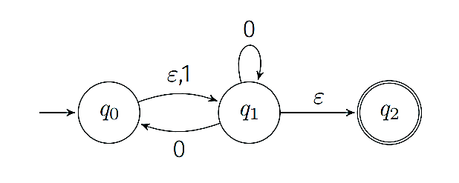
3
QUESTION 3 · BUILDING THE EQUIVALENT NFA (NO EPSILON)
Given ε-NFA to Convert
Steps to remove ε-transitions
Compute the ε-closure of every state (the set of states reachable by following only ε-edges, including the state itself).
For each state q and each real input symbol, find every state reachable from the ε-closure of q on that symbol, then take the ε-closure of that result.
Add these as the new direct transitions of q — this removes the need for the ε-edge.
A state becomes final in the new NFA if its ε-closure contains any original final state.
Draw the transition table using only the real alphabet symbols, and mark the initial state and all final states clearly.
Given ε-NFA diagram (as provided in the assessment)
Theory of Computation | CO1 Technical Presentation
8

Slide 9
4
QUESTION 4 · FROM AN ε-NFA STRAIGHT TO A DFA
ε-Closure and DFA Construction
What is an ε-closure?
The ε-closure of a state q is the complete set of states reachable from q using zero or more ε-transitions (q itself is always included). It answers the question: “which states could the automaton silently be in, without reading anything?”
Why this differs from Question 1
Question 1 converts an NFA that already has no ε-transitions. Here, the NFA includes ε-moves, so ε-closures must be computed first and folded into every subset before applying the same subset-construction logic.
Building the DFA (combined procedure)
Deliverable required
Compute the ε-closure of the NFA start state — this set is the DFA start state.
For each DFA state and each real symbol, move on that symbol from every state in the set, then take the ε-closure of the result — this gives the next DFA state.
Repeat for every new state-set produced, until no new sets appear.
Any DFA state whose set contains an original final state is marked final.
ε-closure listed for every state, the resulting DFA transition table, and clear marking of the initial and final states.
Theory of Computation | CO1 Technical Presentation
9

Slide 10
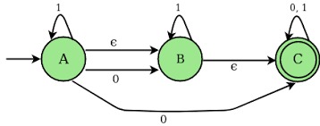
4
QUESTION 4 · GIVEN ε-NFA
Given NFA with ε-transitions
Given ε-NFA diagram (as provided in the assessment) — apply the ε-closure and subset-construction steps from the previous slide to build its transition table.
Theory of Computation | CO1 Technical Presentation
10

Slide 11
Summary
1
NFA → DFA
Subset construction removes non-determinism; the trade-off is a possible exponential rise in state count.
2
Mathematical Induction
A base case plus an inductive step proves a formula true for every positive integer, and underlies many automata-theory proofs.
3
Epsilon Transitions
Useful for building automata modularly; removed by folding ε-closures into direct transitions.
4
ε-Closure to DFA
Combines ε-closure computation with subset construction to go directly from an ε-NFA to a DFA.
K Vasu Deva Reddy | Reg No: 192411256 | Theory of Computation

