Slide 1
Bangalore Bizwiz
Ankam VVS rajKUMAR
Raj thiluk
Senthil KumarAN SubbaiYA
Vasudevan surendran
Venoth Kumar GNANAMANI

Slide 2
Steps
Reduced the data based on aggregation technique
Entire data is reduced to 237 rows x n columns based on grouping and aggregation
Clustering based on R&D investment as a ratio over sales
Decide number of clusters based on elbow curve
For each cluster identify the industry name with SIC
Find commonalities between industries to identify pattern

Slide 3
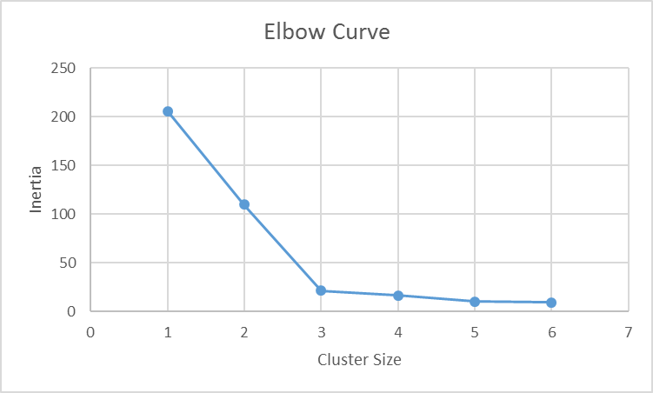
Commodity vs boutique market
The data from patents is clustered using R&D investment, infact ratio of R&D over Sales for all 3 years
Based on elbow curve, 3 clusters were decided
 | R&D Expense Ratio
Cluster ID | 2003 | 2004 | 2005 | Cluster_Size
1 | 1.95 | 0.91 | 8.03 | 2
2 | 0.14 | 0.03 | 0.88 | 36
3 | -0.14 | -0.11 | -0.31 | 154
Cluster 1 is high end research segment
In-Vitro and In-Vivo Diagnostic substance
Commercial Physical and Biological research

Slide 4
Boutique market’s dilemma
R&D expense over sales is high for boutique market compared to commodity market
Boutique Commodity
R&D Expense ratio - 2003 16.9 % 2.35%
R&D Expense ratio - 2004 14.1% 2.15%
R&D Expense ratio - 2005 12.6% 1.94%
Mean Net Income is less compared to commodity market
Boutique Commodity
Mean net income – 2003 -107 -114
Mean net income – 2004 308 529
Mean net income – 2005 494 681

Slide 5
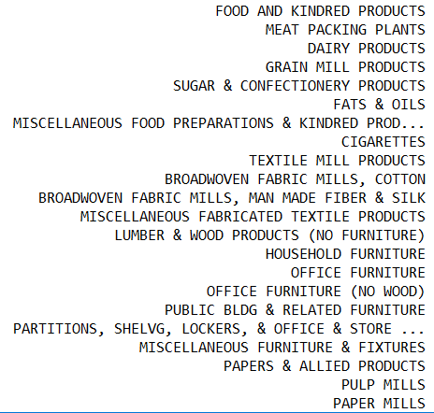
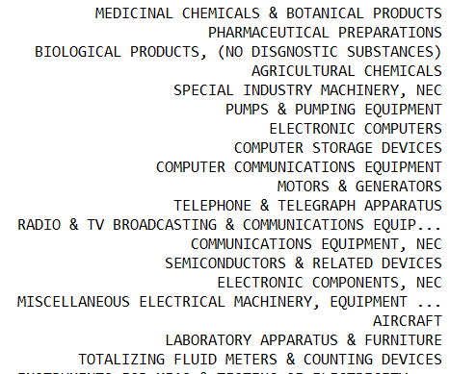
But… Enjoys premium pricing
Net margin is high for boutique products compared to commodity… it also suffers more when market suffers
Boutique Commodity
R&D Expense ratio - 2003 -2.7 % -1.02%
R&D Expense ratio - 2004 7.23% 4.34%
R&D Expense ratio - 2005 10.14% 5.01%
Cluster Size 154
Total Patents: 20748
Cluster Size 36
Total Patents: 20127

Slide 6
Business insights
For industries dealing with commodity focus need to be on increasing volume
For industries dealing with boutique focus need to be on product differentiation

Slide 7
About DAta
Only 40442/42498 observations were complete
Total of 237 unique SIC found
668 unique ICL Class found
1644 unique gvkey found

