Slide 1
The Vital Role of Remote Learning in Modern Education

Slide 2


Introduction
The Vital Role of Remote Learning in modern education is undeniable. This presentation will explore the beneﬁts and challenges of this educational approach.

Slide 3



Accessibility and ﬂexibility
Remote learning offers ﬂexibility for students to learn at their own pace and accessibility to education for those in remote areas or with physical limitations.

Slide 4


Technology Integration
The integration of technology in remote learning enhances engagement and provides interactive learning experiences, preparing students for the digital age.

Slide 5
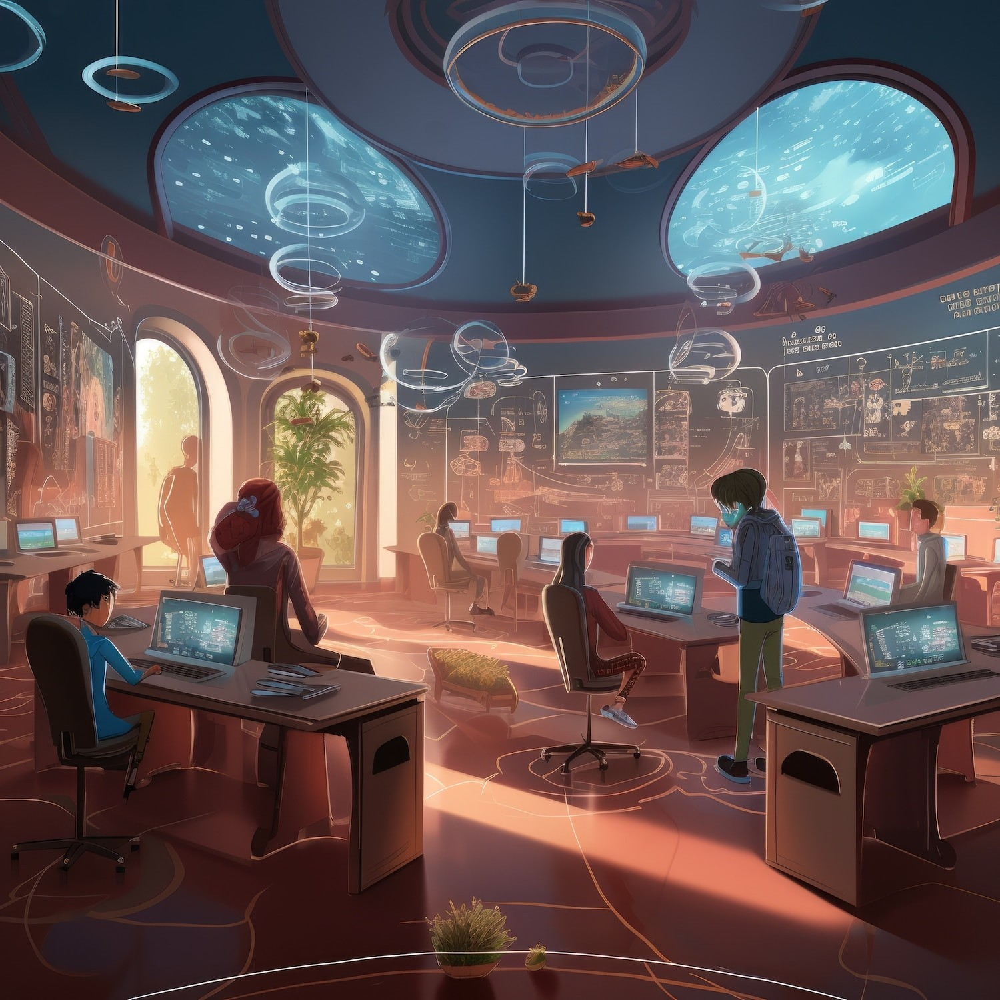


Challenges and Solutions
Challenges such as digital divide and social isolation require innovative solutions to ensure equitable access and foster a sense of community in remote learning environments.

Slide 6


Empowering Educators
Remote learning empowers educators to explore diverse teaching methods and utilize digital tools to create engaging and personalized learning experiences for students.

Slide 7




Conclusion
Remote learning has become an integral part of modern education, offering ﬂexibility, accessibility, and opportunities for innovation. Embracing its potential while addressing its challenges is crucial for the future of education.

Slide 8
Thanks!

