Slide 1
EDA CASE STUDY - BANK LOAN DATASET
Submitted by
Vasu Teotia & Vignesh M

Slide 2
Understanding of the background
We have been provided Loan.csv dataset from a consumer finance company. The primary attributes captured in data are
Loans given by the institution
Loan status which captures type of client (defaulter / fully paid / current ) based on behaviour of payment
Various other variable which are collected at time of loan sanction
Understanding of the problem
Given the above context , and based on the data collected, our team feels
ultimate task is to be able t devise a model which can, based on data collected at the time of application, help us in determining if the applicant
can be good candidate od defaulter in future
Setting up the problem statement
Given the understanding . We will try to figure out the variable which are the best predictors for defaulting behaviour from the given dataset.

Slide 3
Goals of Data Analysis
The main objective is to be able to identify these risky loan applicants, then such loans can be reduced thereby cutting down the amount of credit loss. Identification of such applicants using EDA is the aim of this case study.
Perform an analysis to understand the driving factors (or driver variables) behind loan default, i.e.the variables that are strong indicators of default.
The company can utilize this knowledge for its portfolio and risk assessment.

Slide 4
Importing libraries
import numpy as np
import matplotlib.pyplot as plt
import seaborn as sns
Loading Loan.csv to variable lcs
lcs = pd.read_csv(r"C:\LendingCaseStudy\loan.csv")
lcs.shape
Data Cleaning
After load we have 111 columns in lcs data frame variable
Remove Null values from variable lcs
lcs.dropna(axis = 1, how = 'all', inplace = True)
lcs.shape
After cleaning we have 57 columns in lcs

Slide 5
Drop additional columns we don't need these as these are mostly nulls.
lcs.drop(["id", "member_id", "url", "title", "emp_title", "zip_code",
"last_credit_pull_d", "addr_state","out_prncp_inv","total_pymnt_inv",
"funded_amnt", "delinq_2yrs", "revol_bal", "out_prncp", "total_pymnt",
"total_rec_prncp", "total_rec_int", "total_rec_late_fee", "recoveries",
"collection_recovery_fee", "last_pymnt_d", "last_pymnt_amnt",
"chargeoff_within_12_mths"], axis = 1, inplace = True)
lcs.shape
After cleaning we have 23 columns for Data Analysis
lcs.columns
Index(['loan_amnt', 'funded_amnt_inv', 'term', 'int_rate', 'installment', 'grade',
'sub_grade', 'emp_length', 'home_ownership', 'annual_inc', 'verification_status',
'issue_d', 'loan_status', 'desc', 'purpose', 'dti', 'earliest_cr_line', 'inq_last_6mths',
'mths_since_last_delinq', 'open_acc', 'pub_rec', 'revol_util', 'total_acc'],
dtype='object')

Slide 6
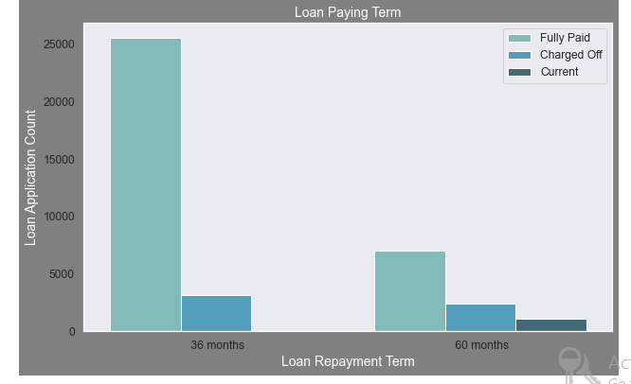
Univariate Analysis
plt.figure(figsize=(10,6),facecolor='grey')
ax=sns.countplot(x="term",data=lcs,hue='loan_status',palette='GnBu_d')
ax.set_title('Loan Paying Term',fontsize=14,color='w') ax.set_xlabel('Loan Repayment Term',fontsize=14,color = 'w') ax.set_ylabel('Loan Application Count',fontsize=14,color = 'w') ax.legend(bbox_to_anchor=(1, 1))
plt.show()

Slide 7
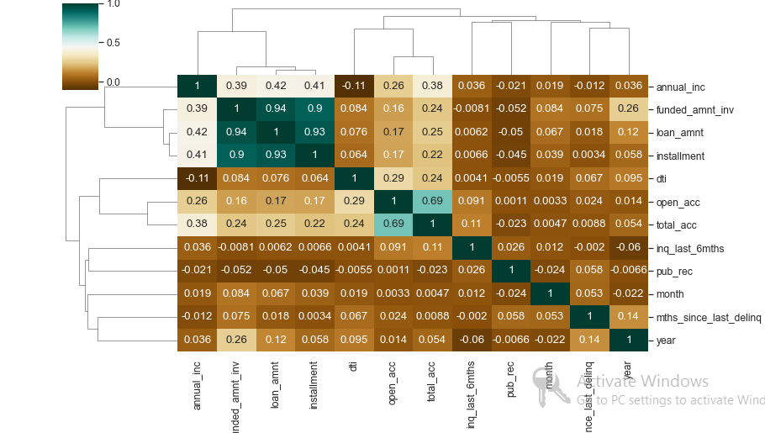
Bivariate Analysis
loan_correlation = lcs.corr()
sns.set(font_scale=1.1)
sns.clustermap(loan_correlation,annot=True,figsize=(12, 8),cmap="BrBG")
plt.show()

Slide 8
