Slide 1
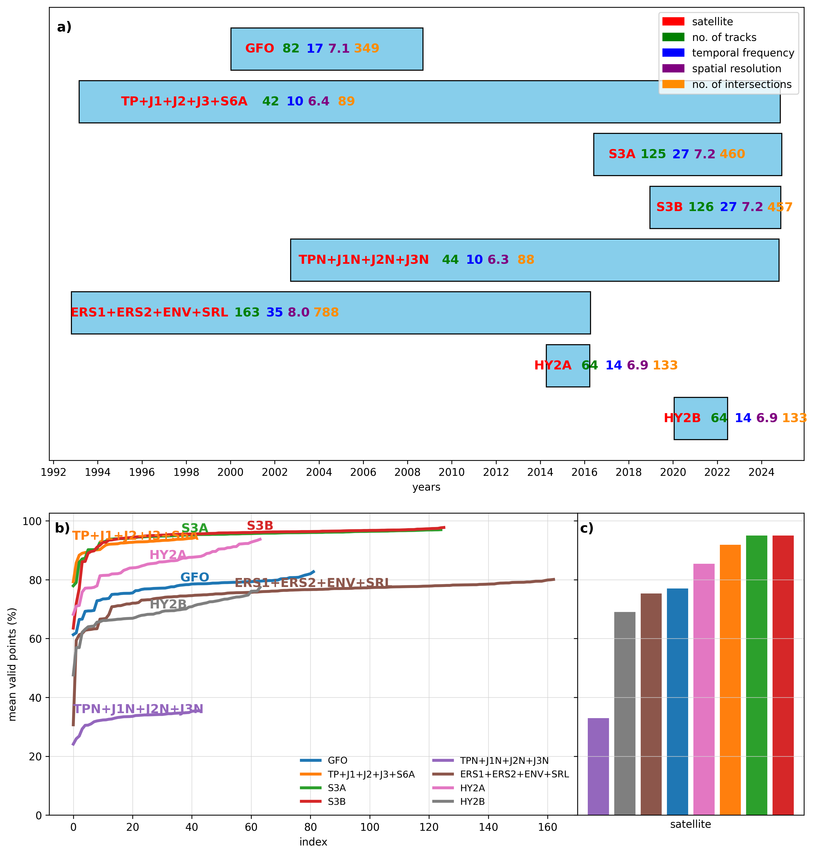
XTRACK (A Coastal Altimetry Algorithm) product consists of ...
Composite overview of mission coverage and data validity across altimeter satellites. (a) Mission timelines showing each satellite’s observation period, annotated with number of tracks, temporal sampling frequency, and spatial sampling resolution. (b) Track-wise mean valid-point percentage for each satellite, with colored curves indicating within-mission variability. (c) Satellite-level mean of valid-point percentage, summarizing overall data-validity performance across missions. Panel colors are consistent between (b) and (c).

Slide 2
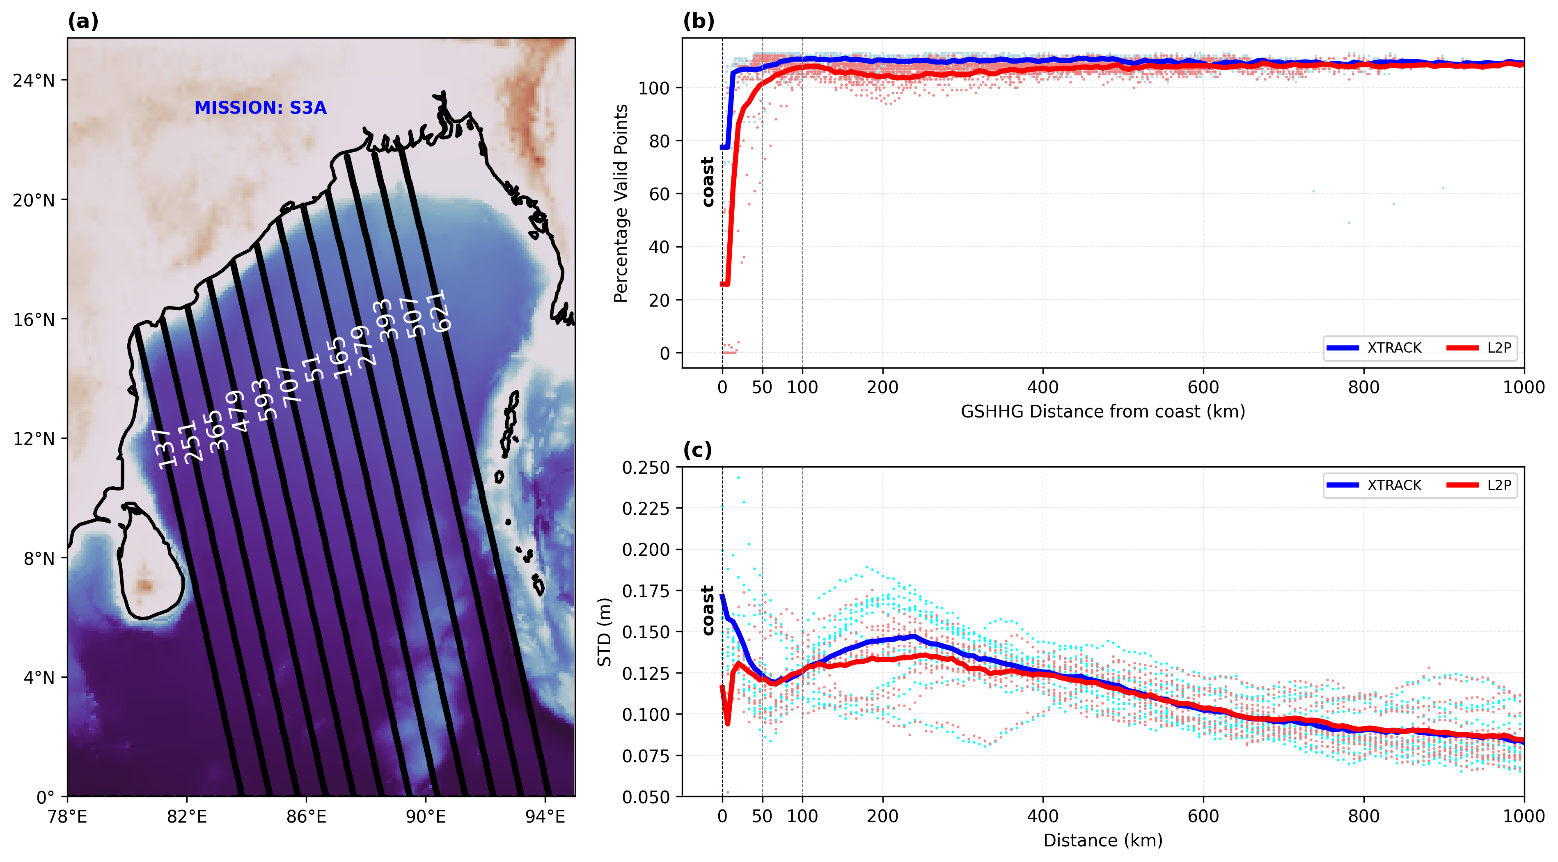
More SLA data and variability captured near the coast in XTRACK ...
Comparison of Sentinel-3A (S3A) sea level anomaly (SLA) data between X-TRACK and along-track Level-2+ (L2P) products for common ground tracks that are meeting the east coast of India. (a) Selected common S3A tracks plotted (black) over ETOPO5 bathymetry, with track numbers annotated in white. (b) Percentage of valid SLA observations available along-track plotted against GSHHG coastline distance, showing X-TRACK (blue) and L2P (red) individual track values (dots) and multi-track means (solid lines). The dashed vertical line in (b) and (c) marks the coastline. (c) Temporal standard deviation of SLA as a function of distance from coast for individual tracks (dots) and their multi-track mean (solid lines) from X-TRACK (blue) and L2P (red) products.

Slide 3
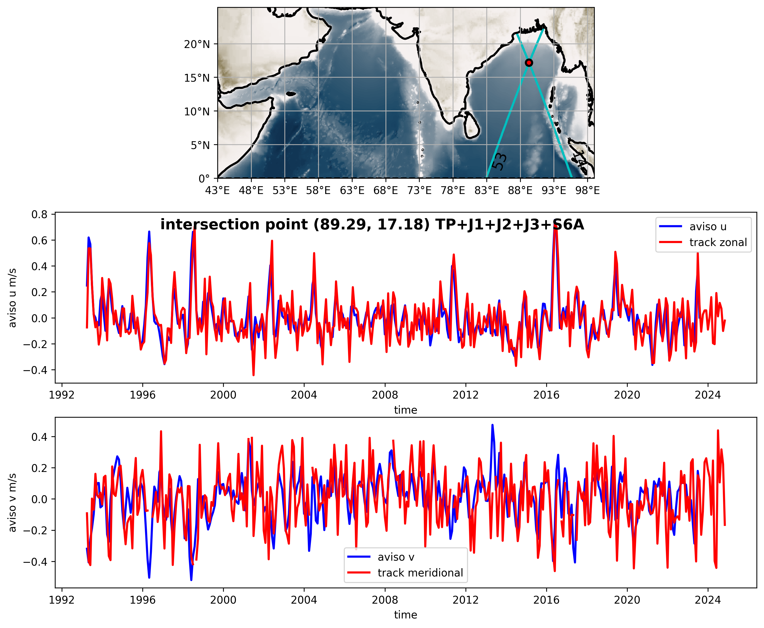

In the open ocean, AVISO currents and XTRACK derived currents are mostly same
This indicated robustness of methodology used (smoothing techniques, maths)
where gc1 and gc2 are cross-track geostrophic velocities of the intersecting tracks
Here α1 and α2 are the heading angles (counter clockwise to the positive x-axis) of
the intersecting tracks

Slide 4
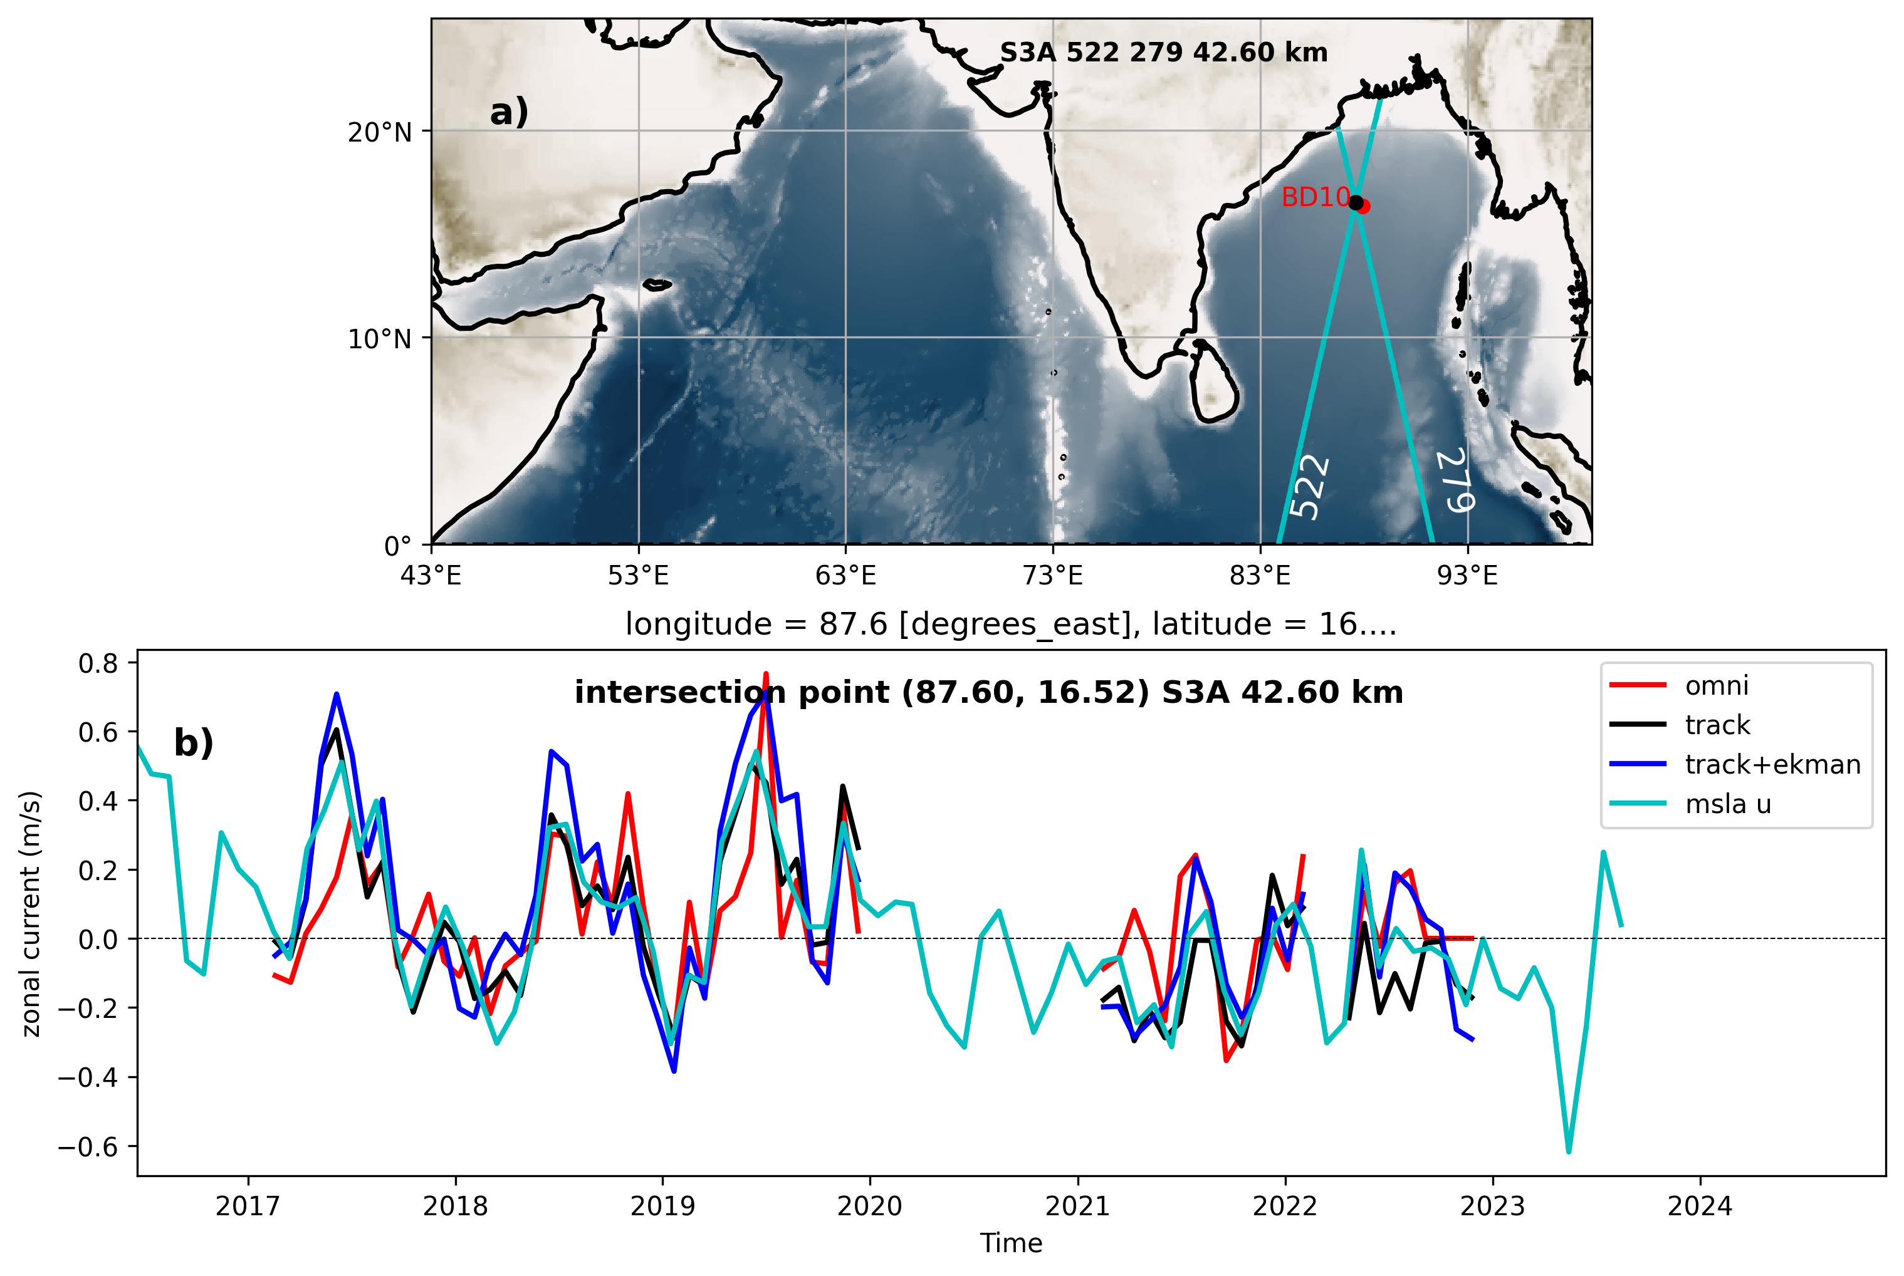
An example of comparison of computed gu, corrected gu with observation ...
b) Time series of geostrophic zonal component (black) derived at an intersection point (of track numbers 522 and 279 of S3A satellite mission) which is close to an OMNI buoy (BD10) overlied with buoy's zonal current(red). Timeseries of gu corrected with ekman u component(blue) and AVISO msla_uv at the intersection point(cyan) also added. a) Shows the intersection point(black) of the tracks and the close by bouy(red). It is rougly half a degree away from the intersection point.

Slide 5
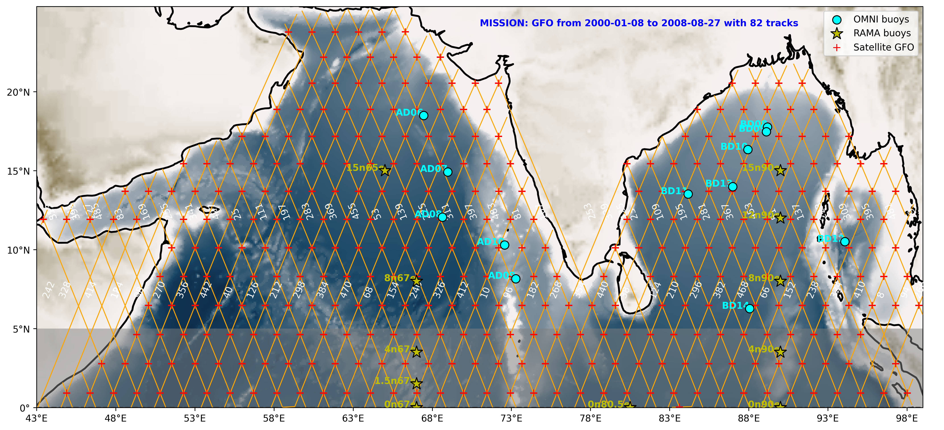

Slide 6
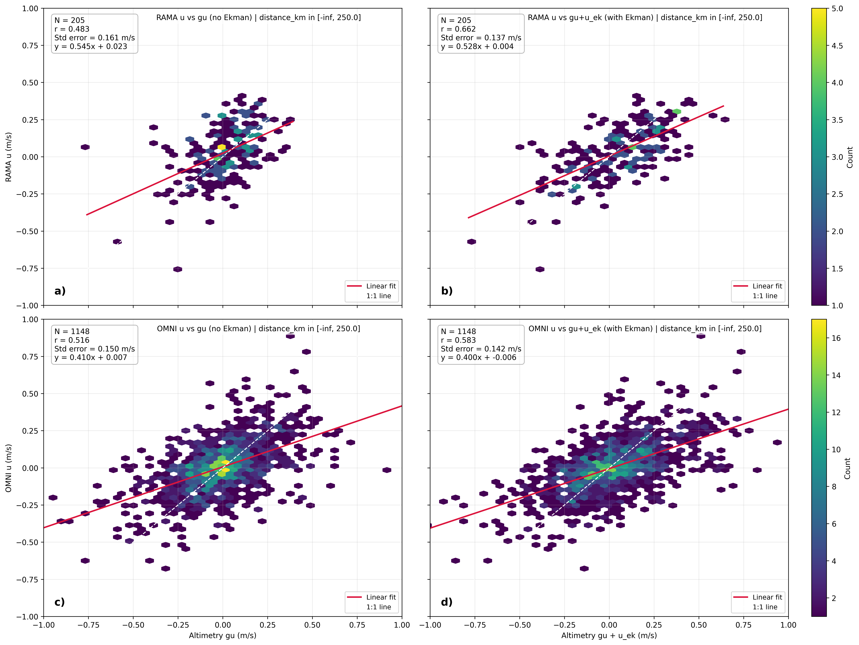
Title: An all point comparison at intersection points with RAMA and OMNI
Ekman correction explains
An additional variance of
~7%. RMSE and BIAS are
Not significantly improved.
a) Scatter plot of rama buoys' zonal currents(y-axis) versus altimetry derived zonal currents(x-axis) at nearby intersection points. b) Shows scatter plot with altimetry derived currents corrected with ekman zonal currents. c) and d) show scatter plots of OMNI currents with and without Ekman correction against altimetry zonal currents. The colorbar shows density of points in the scatter plot in terms of count. A redline passing through the points indicates linear fit and white dashed line represents perfect fit as a reference. The number of points, correlations and standard errors are show in boxes in the upper left corner.

Slide 7
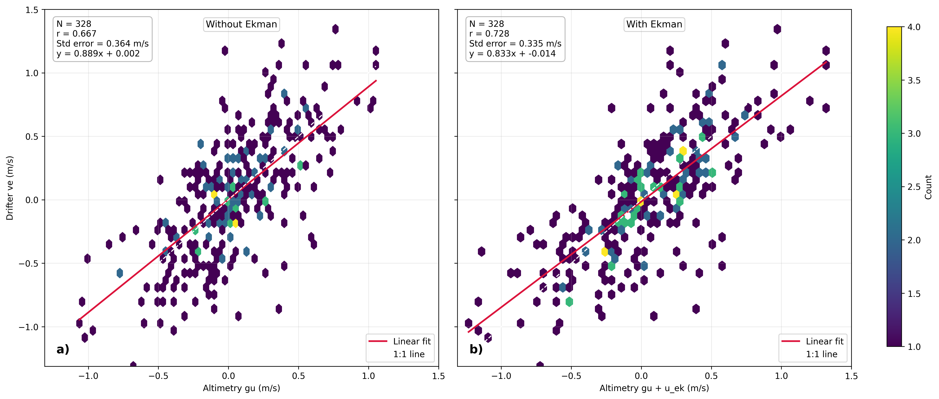
An all point comparison at intersection points with drifter buoys < 100km of coast
a) Scatter plot of drifters' zonal velocities versus altimetry derived velocities within 100km inshore of the coast for the satellite mission TP+J1+J2+J3+S6A. b) shows scatter plot with altimetry derived velocities corrected with ekman zonal velocities. The colorbar shows density of points in the scatter plot in terms of count. A redline passing through the points indicates linear fit and white dashed line represents perfect fit as a reference. The number of points, correlations and standard errors are shown in boxes in the upper left corner.

Slide 8
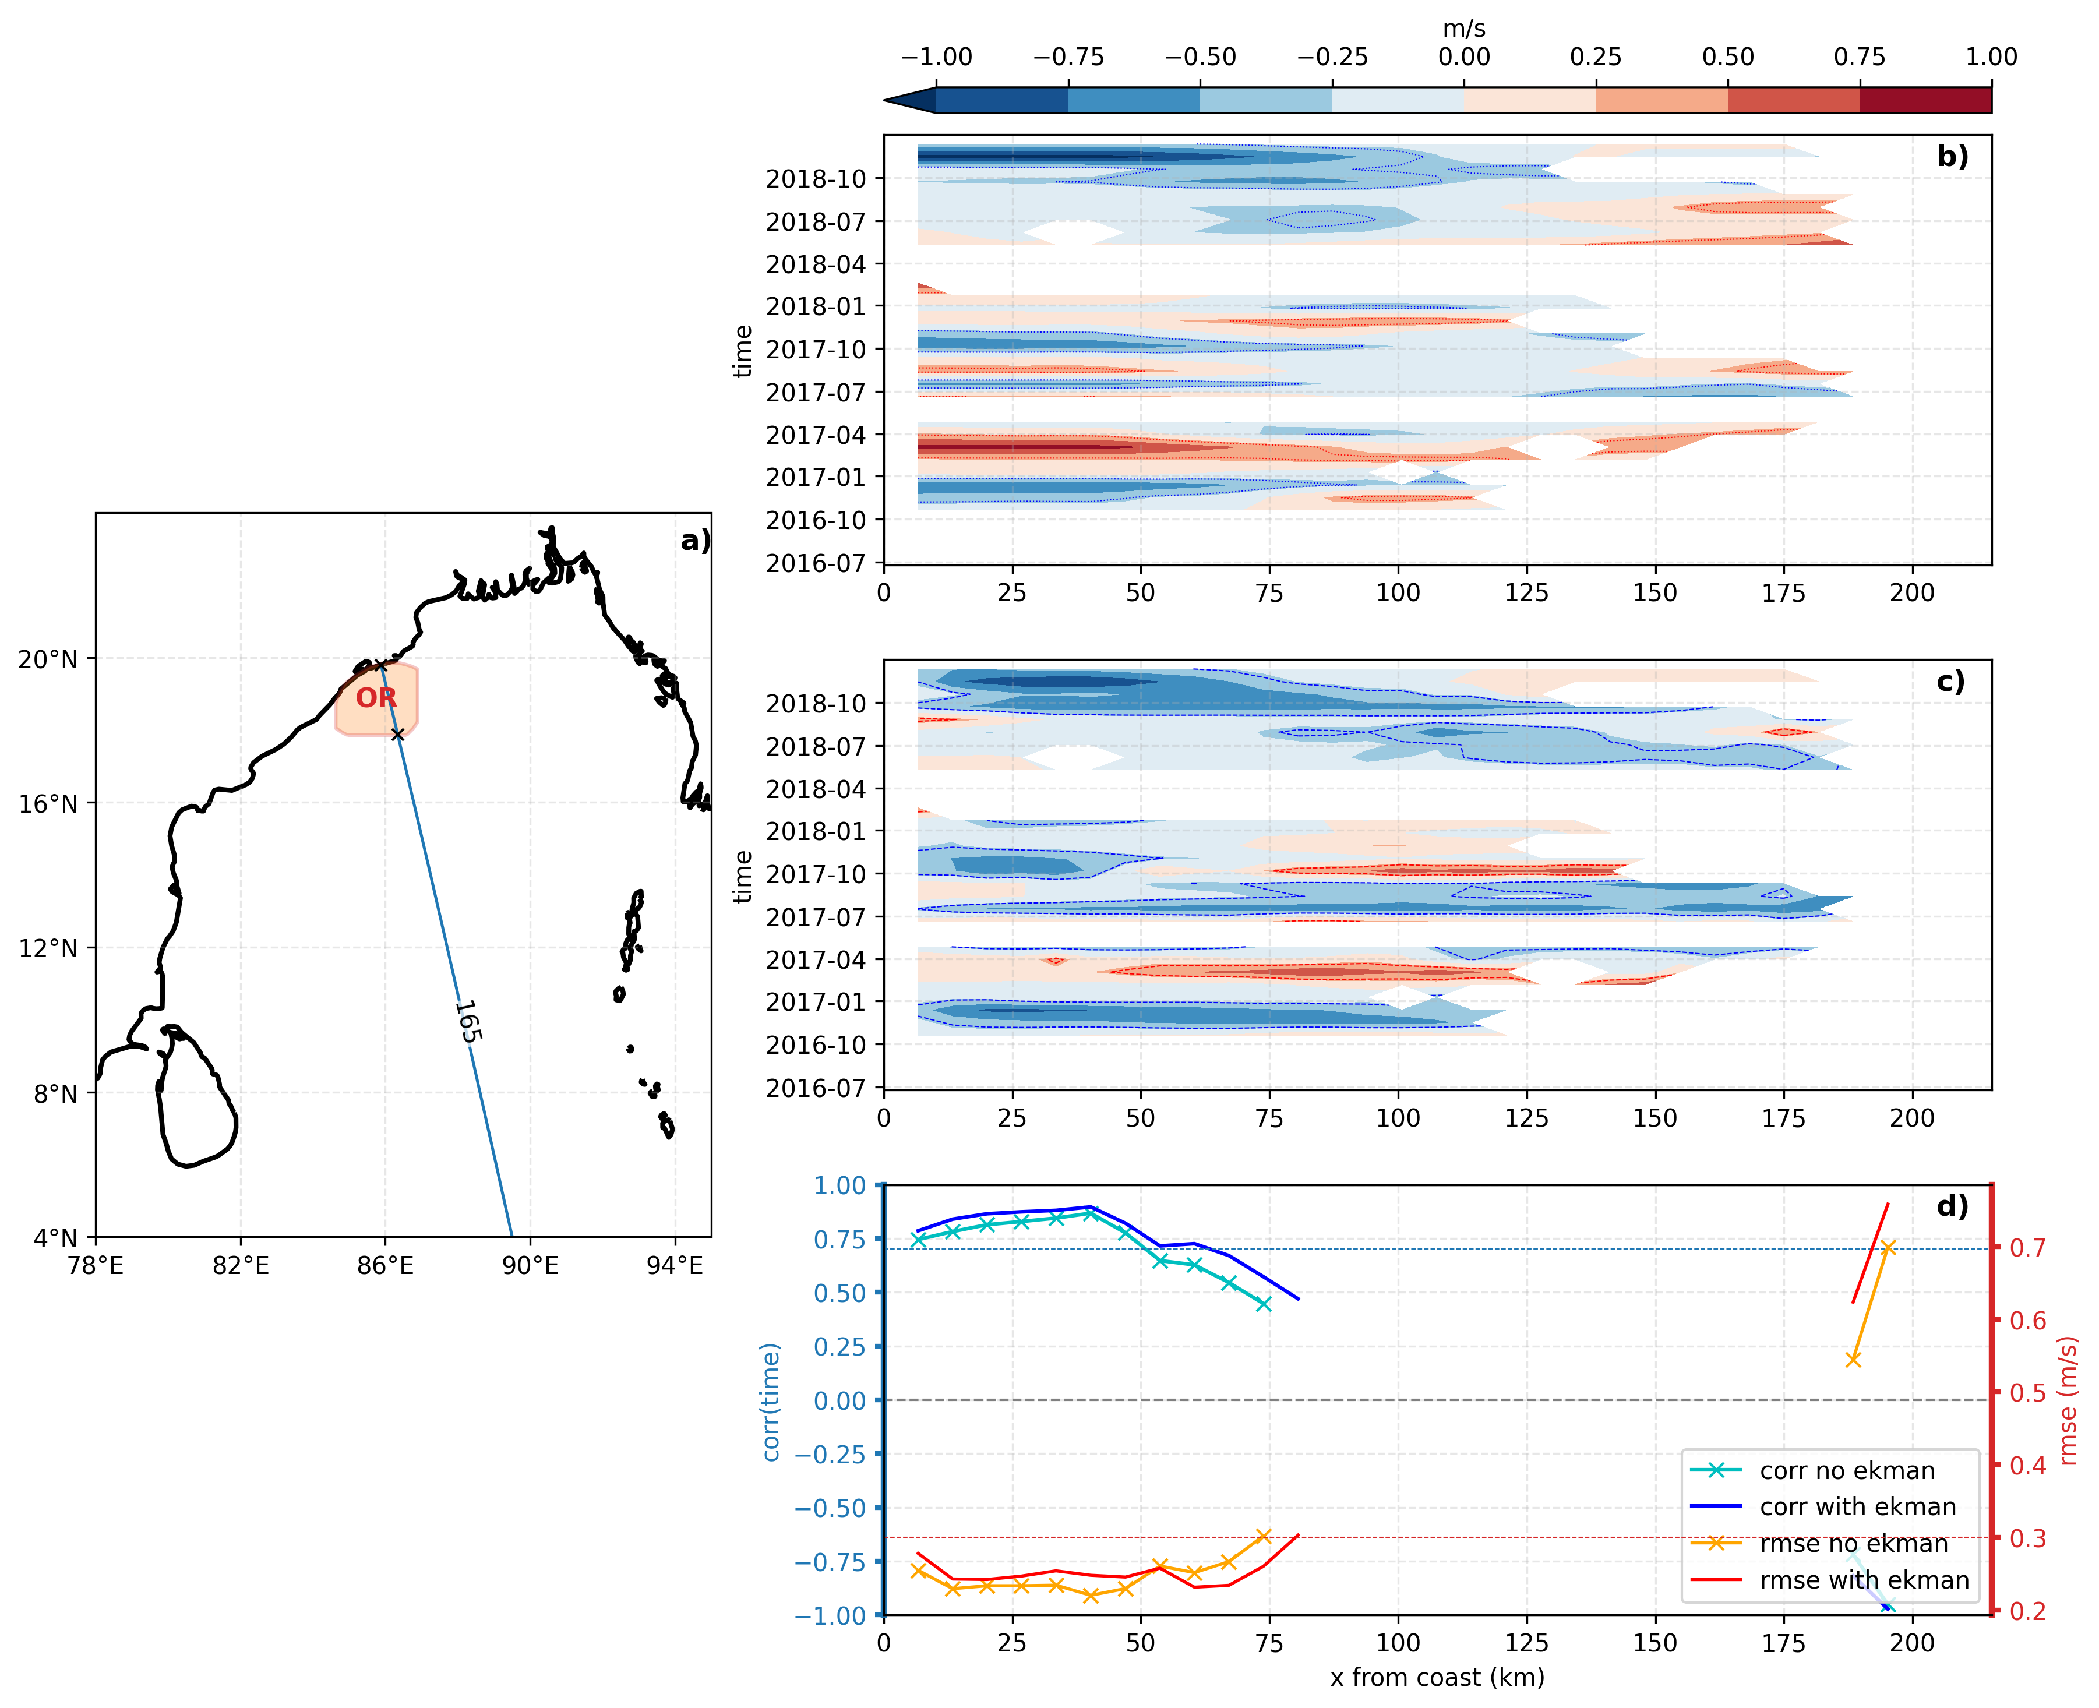
Near shore currents validation extend to radars ...
Comparison of along-track cross-track velocity structure for the selected OR radar–altimeter intersection (track 165, S3A). (a) Map of the Bay of Bengal showing the selected Odisha radar region (OR) as polygon (shaded), satellite track segment, and intersection limits, with distance x measured from coast. (b) Time–distance section of geostrophic current plus Ekman component, (gc+uk). (c) Time–distance section of radar-derived velocity(rotated to cross track direction). (d) Skill metrics versus offshore distance: correlation (left axis; blue) and RMSE (right axis; red), each shown for cases without Ekman correction and with Ekman correction (legend). Only statistically significant correlations ((p<0.05)) are retained.

Slide 9
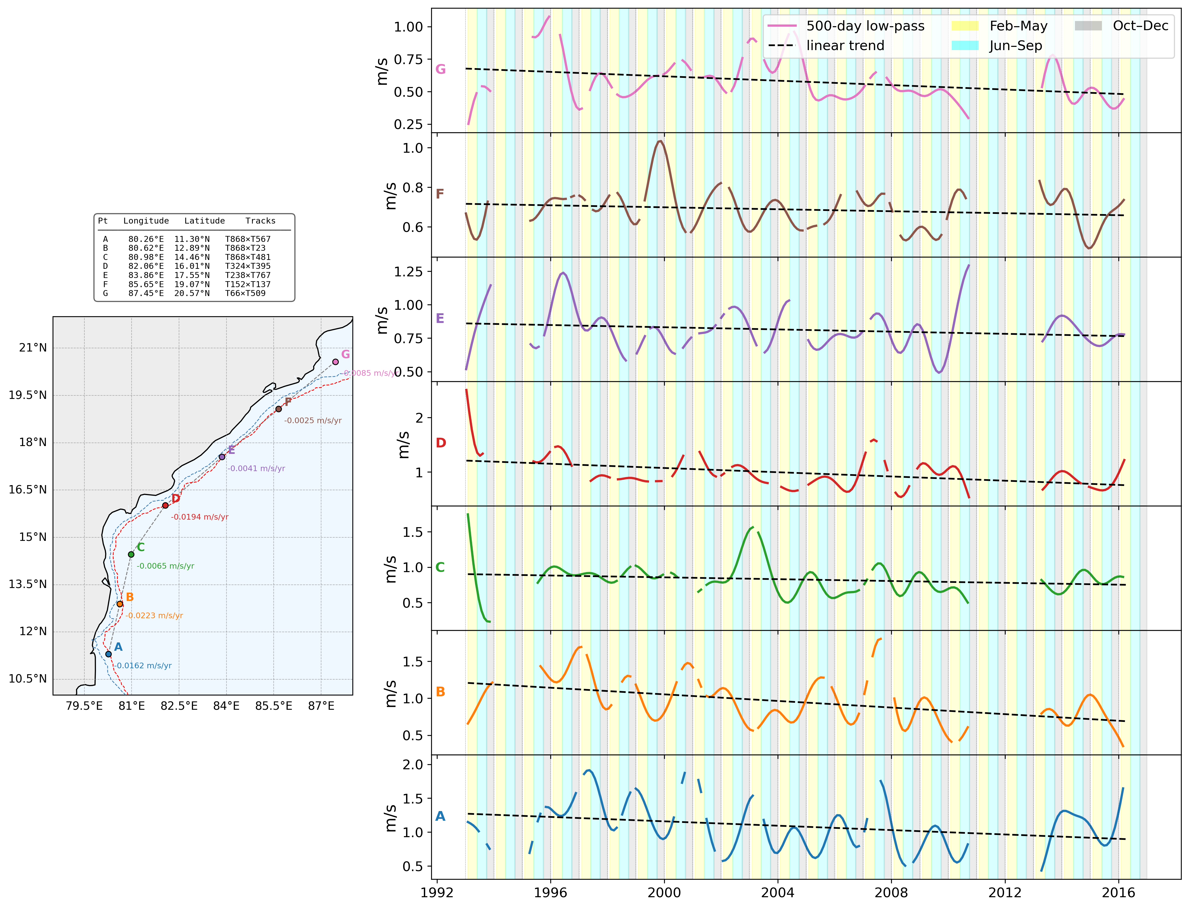
EICC speed is decreasing
Long-term variability and linear trends of Ekman corrected geostrophic current speed at seven crossover points of the East India Coastal Current (EICC) derived from ERS-1/2, Envisat, and SARAL/AltiKa altimetry. (Left) Locations of the seven crossover points (A–G, south to north) along the eastern boundary of the Bay of Bengal (10°–22°N, 78°–88°E). Each point is colour-coded by its label; the annotated value is the linear trend in m s⁻¹ yr⁻¹ (greyed out where the trend is not significant at the 95% confidence level, p ≥ 0.05). Isobaths of 200m(skyblue) and 1000m(red) are added. (Right) 500-day low-pass filtered current speed (coloured line) and its linear trend fit (black dashed line) at each point. Background shading indicates the spring inter-monsoon (February–May, yellow), summer monsoon (June–September, cyan), and post-monsoon/early winter (October–December, grey) seasons. Point coordinates and contributing ground-track pairs are: A (80.26°E, 11.30°N; T868×T567), B (80.62°E, 12.89°N; T868×T23), C (80.98°E, 14.46°N; T868×T481), D (82.06°E, 16.01°N; T324×T395), E (83.86°E, 17.55°N; T238×T767), F (85.65°E, 19.07°N; T152×T137), and G (87.45°E, 20.57°N; T66×T509).

Slide 10
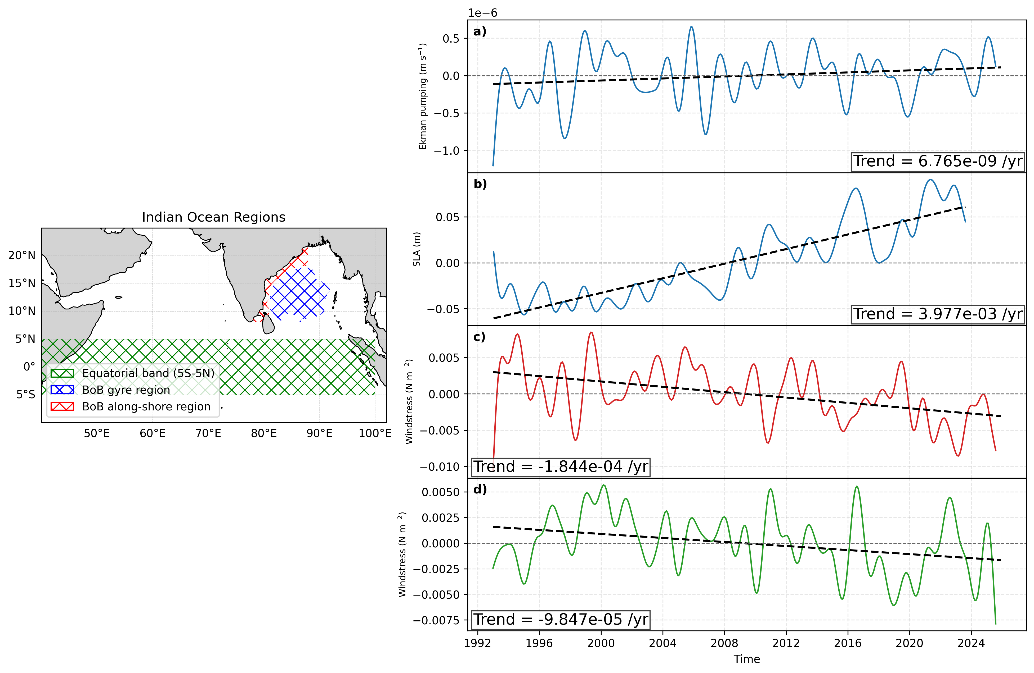
Trends of driving forces aka Windstress curl and SLA over Bay of Bengal gyre region
, Windstress(along shore and equatorial).
Regional context and low-pass filtered variability of Bay of Bengal and equatorial Indian Ocean forcing/response. Left panel shows the analysis masks over the Indian Ocean: equatorial band (5°S-5°N, green hatch), Bay of Bengal gyre region (blue hatch), and Bay of Bengal along-shore region (red hatch). Right panels (a-d) show monthly area-averaged time series after applying a 500-day low-pass filter, with linear trend lines (black dashed): (a) Ekman pumping over the Bay of Bengal gyre mask, (b) sea-level anomaly over the Bay of Bengal gyre mask, (c) windstress magnitude over the Bay of Bengal along-shore mask, and (d) windstress magnitude over the equatorial band. Spatial means are cosine-latitude weighted, and Bay of Bengal masks are interpolated to each dataset grid before averaging.

Slide 11
Ideas:
Data related:
High-Density "Virtual Tide Gauge" Networks: We can use this data to QC and extend the INCOIS Tide Guage data.
Assimilation into Coastal Ocean State Forecasting: Instead of regular AVISO L2P products, We can assimliate XTRACK data to see how sea level and currents get improved near the coast. Its a great project data assimilation people.
Quantifying Storm Surge height statistics using long XTRACK data.
Research Related:
Is EICC widening?
Trends of efolding width of the EICC?

Slide 12
What I wanted to do:
Data related:
Creating a high resolution 1/12 degree gridded SLA (and thus u, v) product
close to the east and west coast of India. It takes AVISO monthly gridded 0.25 as the basis,
improve it near the coast with XTRACK data using statistical/AI/ML methods
Start with simple Optimal Interpolation method.
Transitioning to more robust AI/ML methods.
Physics-Informed Neural Networks (PINNs):
With a custom loss function that penalizes deviations from geostrophic balance.
I will make a draft detailing all the statistical/AI/ML techniques that can used for this purpose.
Research related:
Thoroughly quantify the speed deceleration in terms of forcing mechanisms.
1. Rough estimation of transport using windstress curl, how efolding width of EICC changing,
And rough depth of EICC, we deduce the speed change.
2. Multilinear correlation of driving forces (lead-lag corrected) and identify the domninant
Forcing for this deceleration.

Slide 13
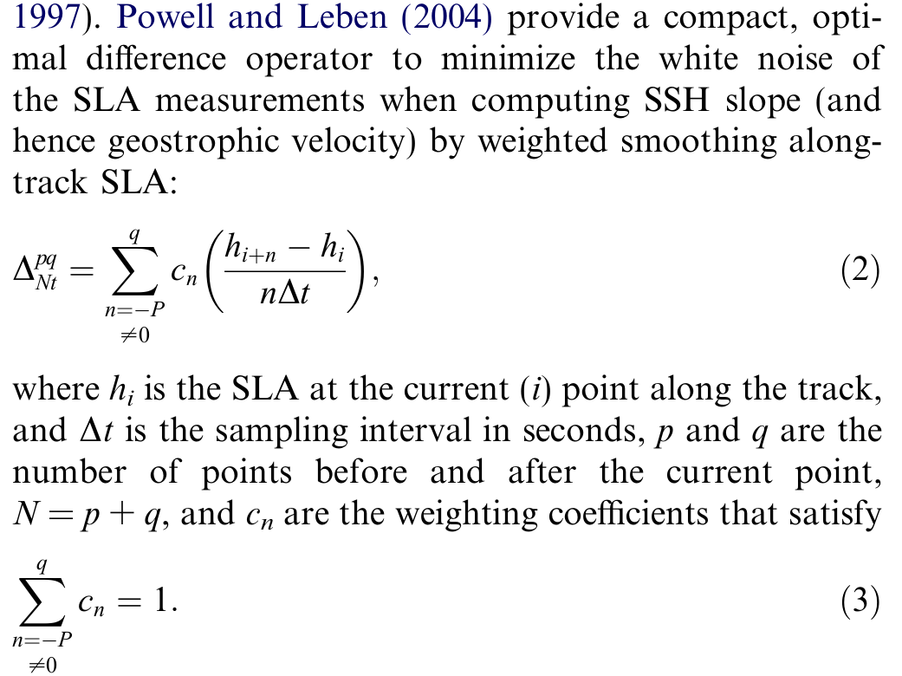
Along track data has to be smoothed properly before computing geostrophic currents. Otherwise, it will give huge gradients due to noise and hence huge and unreliable currents.
Powel and Leben (2004) proposed a filter to minimize white noise.
Results of using several smoothing techniques described in the draft

Slide 14
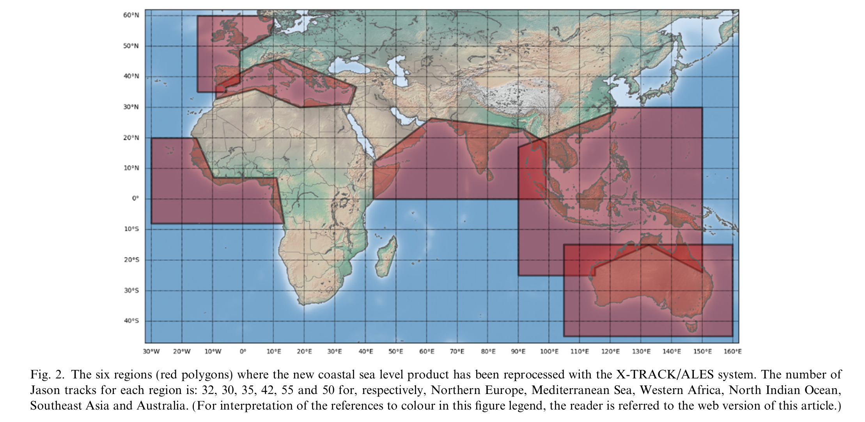
Coastal Altimeter products are available for these regions (Birol et al. 2021)

Slide 15
So, How do coastal altimetry algorithms like X-TRACK (Roblou et al. 2007) to tackle these problems?
1. Using state of the art high resolution regional models to better filter out tides and meteorologically induced signals.
2. Employing new waveform models for retracking of coastal waveforms (ALES, i.e.,
Advanced Leading Edge Subwaveform retracker).
3. Screen multiple along track altimeter data together.
4. Sophisticated vertical reference frame with updated MSS.
Most of the earlier studies focused on open ocean currents derived from gridded altimeter
Data from AVISO. Very few studies focused on coastal current systems.

Slide 16
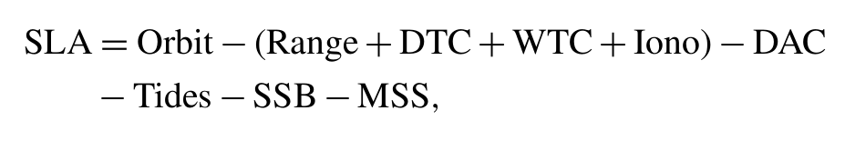
Problems with alimetry in coastal regions:
1. Signals are contaminated by land and inland water reflections, thus effecting the shape of the waveform.
2. Temporal and spatial sampling of current altimetry not enough to capture coastal variability (Chelton 2001). Also, Many assumption of altimetry data processing are valid for only open ocean.
3. Inaccurate tidal representation by global tidal models near to coastal and shelf regions.
4. Ocean response to atmospheric forcing(like inverse barometric affects) is not adequetly modelled in global coarse region models.
5. Reference Mean Sea Surface (MSS) is not accurate in the coastal regions because of the lack of sufficient data.
6. The gridding procedure smooths out coastal variability.
Because of all these limitations, the data near coast is mostly rejected by altimeter processing algorithms.
WTC - Wet Trophosperic Correction
DTC - Dry Trophosperic Corretion
Ion - Ionspheric path delay
DAC - Dynamic Atmopheric Correction
SSB - Sea State Bias
MSS - Mean Sea Surface
MSS = GEOID + MDT
MDT = Mean Dynamic Topography
(Quartly et al. 2017)

Slide 17
Glimpse of Coastal Altimetry
Coastal altimetry represents a significant leap forward from conventional open-ocean satellite altimetry.
Traditional altimetry data is often flagged and discarded within 50 km of the coast due to land contamination in the radar footprint and complex, rapidly changing coastal dynamics that degrade the signal quality.
Coastal altimetry utilizes specialized processing techniques to recover valuable sea level information right up to the coastline, overcoming these limitations.
It overcomes open-ocean altimetry limitations near coasts by using specialized processing (e.g., X-TRACK/ALES) to recover reliable sea level and tidal harmonics within a few kilometers of land, enabling robust coastal trend and variability assessment.
Coastal altimetry creates virtual tide-gauge “stations” where satellite tracks intersect the shoreline, complementing sparse in situ gauges with absolute sea level time series at high along-track resolution.
Virtual coastal stations provide multidecadal sea level anomalies and trends at hundreds of sites globally, supporting nearshore sea level change studies and offering a geocentric reference that complements relative tide gauges subject to vertical land motion.
The along-track sea surface height gradients derived from coastal altimetry can be used to estimate surface currents at a high spatial resolution, acting as a network of virtual surface current meters. This provides unprecedented insight into complex coastal circulation patterns.
For Indian coasts, integrating virtual stations with INCOIS services (ocean state forecasts, hazard advisories) aligns with the mission to deliver accurate, impact-based ocean information to society and maritime stakeholders
References: Cazenave et al., 2022 (virtual coastal stations); AVISO/CTOH X-TRACK tidal constants (coastal tidal harmonics and uses); INCOIS vision/mission pages (alignment with institute objectives).

