Slide 1
SPAM DETECTION USING NLP AND RENDER DEPLOYMENT
PRESENTED BY:
P.M. BENSON MANSINGH
G.GAYATHRI
Y.SIRITEJA
S.VASU VAMSI KRISHNA
D.KARTHIK RAJA

Slide 2
ABSTRACT:
Problem Statement:
Spam messages are a significant issue in digital communication, leading to phishing attacks, fraud, and user inconvenience. Traditional spam filters often fail to balance accuracy and efficiency. This project aims to develop an optimized machine learning model for SMS spam detection, improving accuracy and minimizing misclassification.
Objective:
Build an SMS spam detection system using natural language processing (NLP) and machine learning techniques.
Focus on accuracy, efficiency, and real-time detection.
Significance:
Enhanced Security: Helps users avoid phishing scams and fraudulent messages.
Improved Communication: Reduces spam messages, ensuring important messages are not lost.

Slide 3
PROPOSED SOLUTION:
01
Data Collection and Preprocessing
02
Feature Engineering
03
Model Selection
04
Model Training
05
Evaluation and Deployment

Slide 4
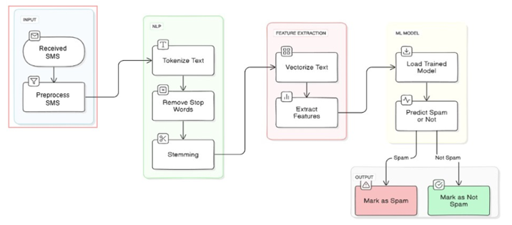
System Architecture:

Slide 5
PROJECT PLANNING AND DATA PREPARATION
Part 1 (Planning and Preparation) | Details
Define the Problem & Objectives | Outline the problem and do proper literature on it.
Set Success Metrics | Define KPIs (accuracy, precision, recall).
Gather Requirements | Identify hardware, software, and resource needs.
Part 2 (Data Acquisition & Pre-processing) | Details
Collect Data | Gather from datasets, APIs, web scraping, or experiments.
Clean Data | Remove errors, duplicates, handle missing values.
Transform Data | Convert data (e.g., text vectorization)
Feature Engineering & Data Split | Create features, split data into training, validation, test sets

Slide 6
MODEL DEVELOPMENT & DEPLOYMENT
Part 3 (Model Building & Evaluation) | Details
Select Models | Choose algorithms (e.g., Logistic Regression, Support Vector Machines (SVM), k-Nearest Neighbors (k-NN), Naive Bayes, Decision Trees etc)
Train Models | Train with optimization and hyperparameter tuning.
Evaluate Models | Use validation metrics like accuracy or RMSE.
Refine Models | Adjust hyperparameters or try different algorithms.
Part 4: Deployment & Monitoring
Deploy Models | Use platforms like Render,Streamlit, Flask, or cloud services.
Test & Monitor | Ensure performance, track accuracy, and latency in production.
Maintain & Update | Retrain models with new data, keep improving performance
Document Results | Record steps, insights, and future improvements and submit Project Documentation

Slide 7
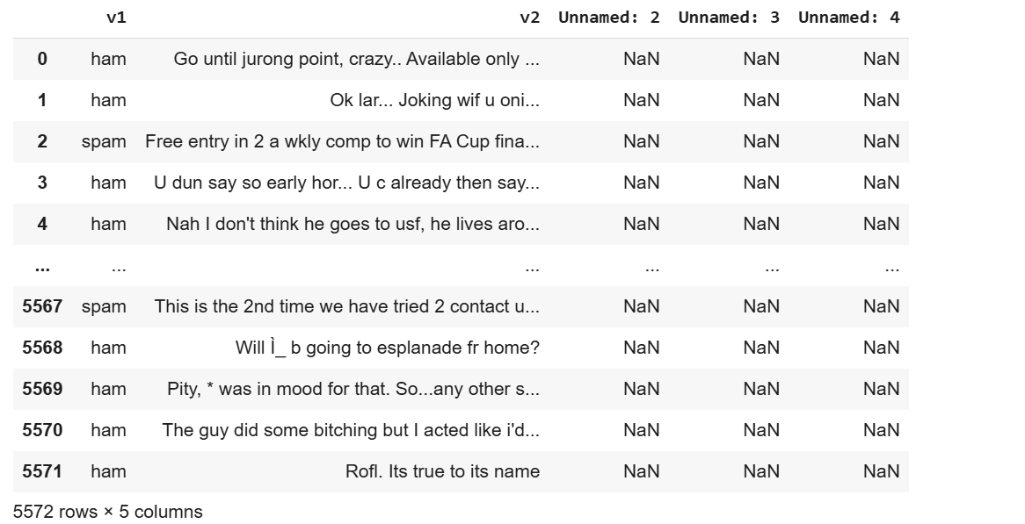
DATA SET
Source: Kaggle (SMS SPAM Prediction Dataset)
Size: 5574 messages
Target Variable: Spam (Spam, ham)
Imbalance: 747 spam, 4827 ham

Slide 8
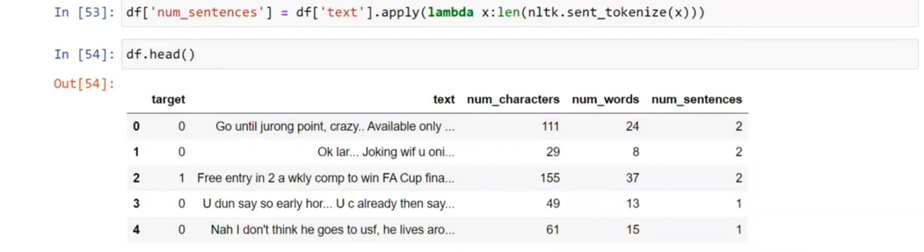
DATA CLEANING:
Data after cleaning:
Removing null values
Encoding ham and spam
Removing duplicate values

Slide 9
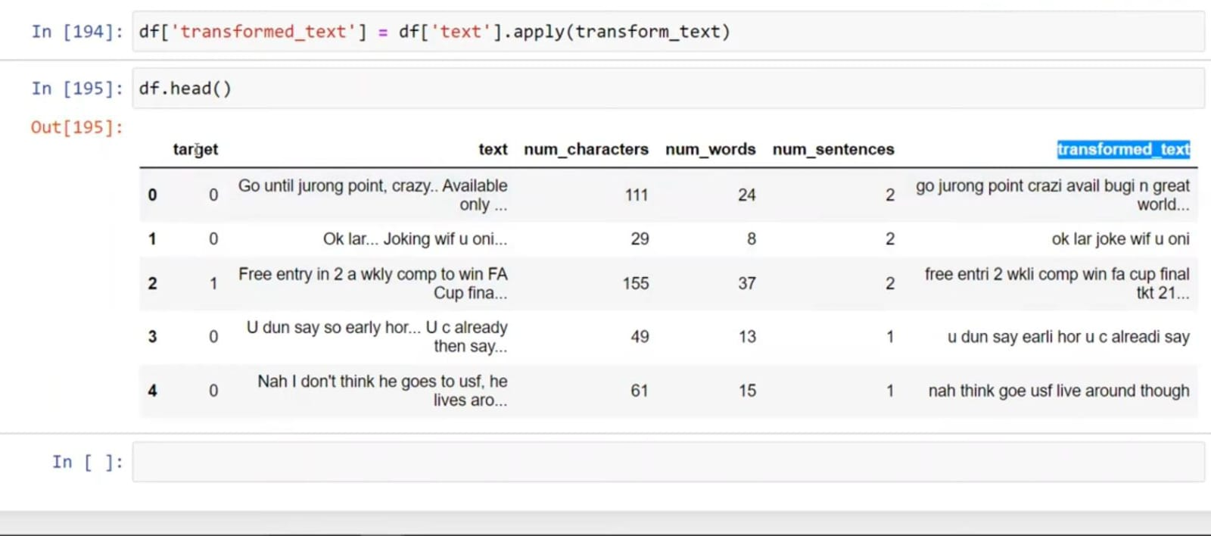
PREPROCESSING :
Text Cleaning:
Lowercasing: Converted all text to lowercase for uniformity.
Tokenization: Split sentences into individual words.
Removing Special Characters: Retained only alphanumeric words.
Stopword Removal: Eliminated common words (e.g., "the", "is") using NLTK.
Stemming: Used PorterStemmer to reduce words to their root form (e.g., "running" → "run").
Feature Engineering:
TF-IDF Vectorization: Converted processed text into numerical format for model training.

Slide 10
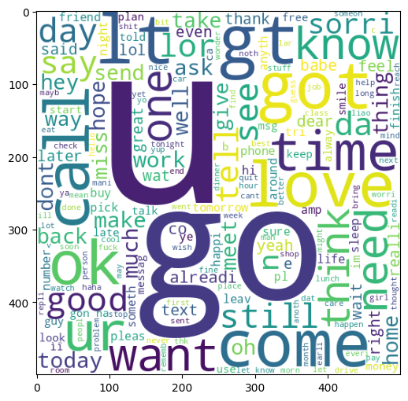
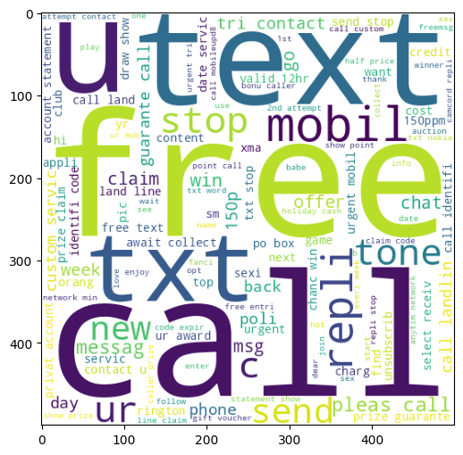
Word cloud images for ham and spam

Slide 11
MODEL TRAINING AND DEVELOPMENT
Model Training and Development
1. Bernoulli Naïve Bayes (BNB) - Best Performing Model
Purpose: Works well for text classification when features are binary (word presence/absence).
Strength: High accuracy, efficient for spam detection.
Result: Accuracy of 96.42%, with precision of 94.54%.
2. Multinomial Naïve Bayes (MNB) - Alternative Model
Purpose: Uses word frequency for classification, suitable for NLP tasks.
Strength: High precision (100%) but more false negatives (missed spam messages).
Result: Accuracy of 95.74%, with 100% precision.
3. Gaussian Naïve Bayes (GNB) - Least Effective
Purpose: Based on normal distribution, less suited for text classification.
Weakness: Lower precision (47.89%), leading to misclassification.
Result: Accuracy of 85.98%, not ideal for spam detection.
Final Choice: BernoulliNB for best accuracy and balanced performance.

Slide 12
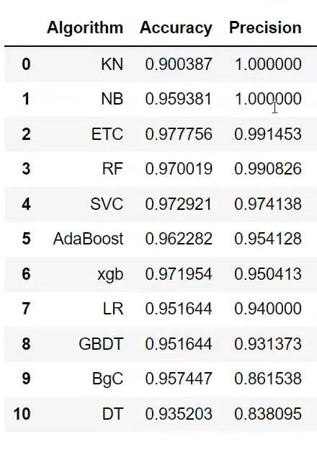
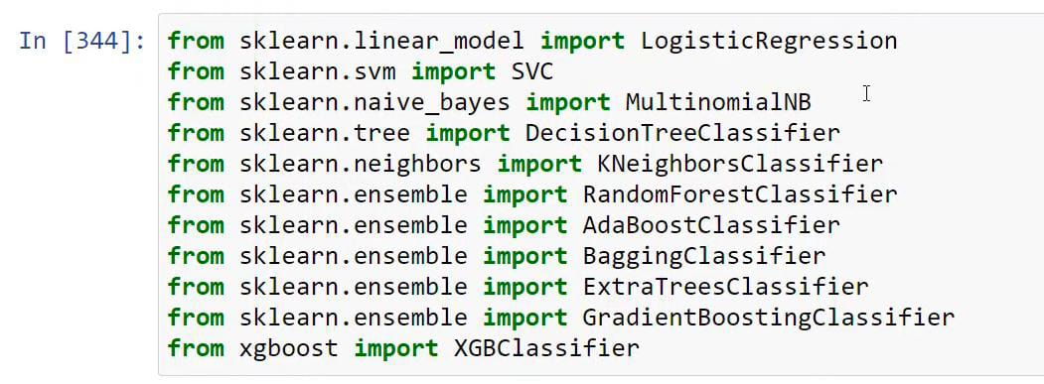
MODEL TRAINING AND DEVELOPMENT USING DIFFERENT ALGORITHMS:

Slide 13
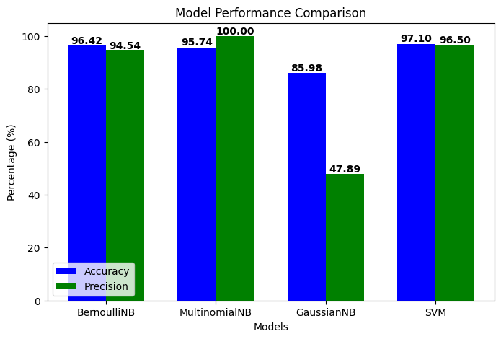
RESULT AND ANALYSIS

Slide 14
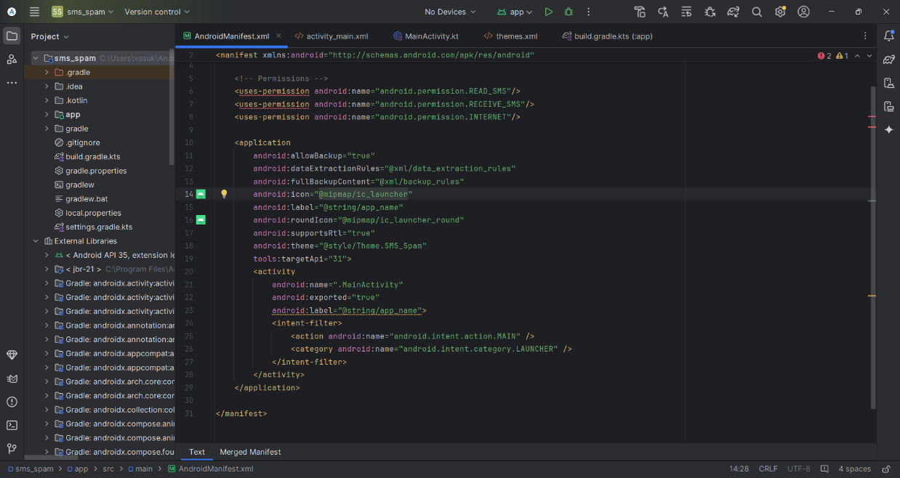
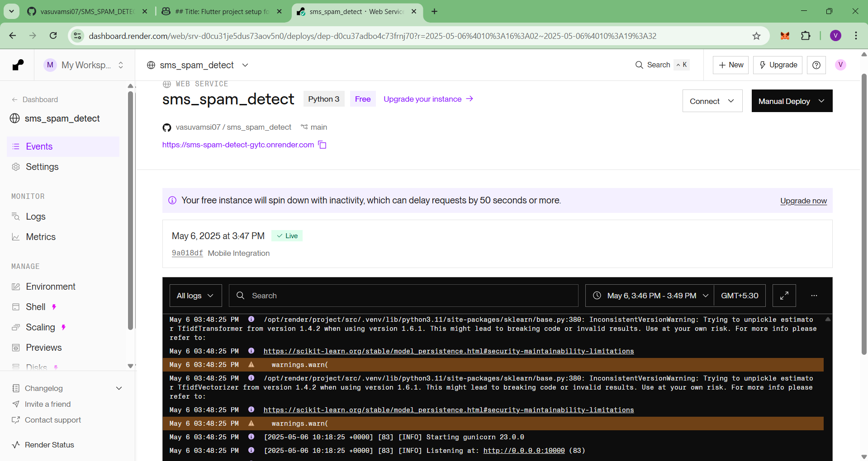
DEPLOYMENT:
i. RENDER DEPLOYMENT
ii. Android studios deployment

Slide 15

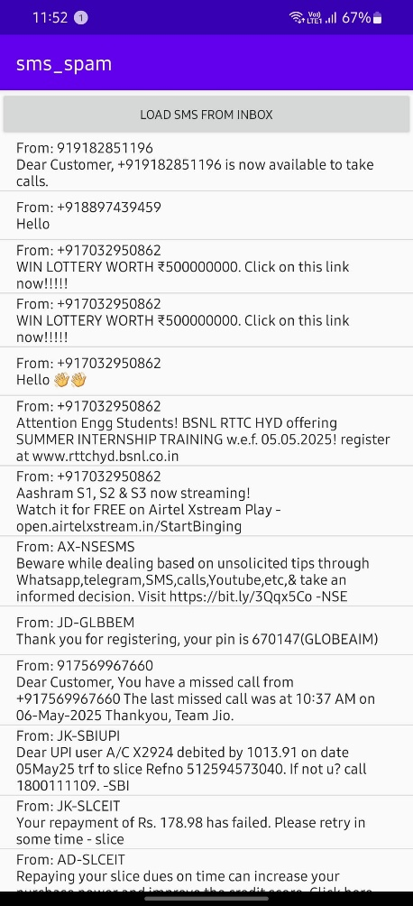
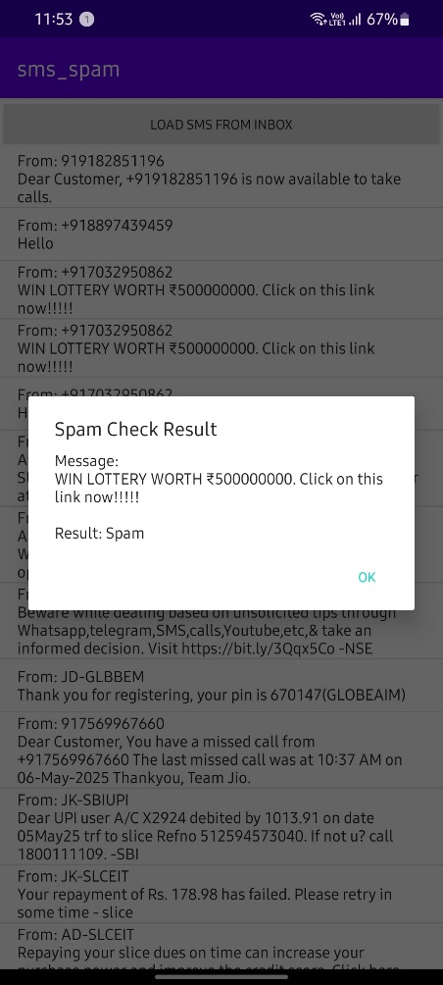
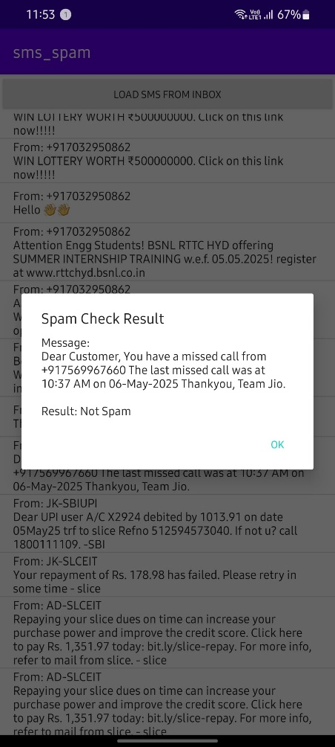
BUILDING APP IN MOBILE:
APP
MESSAGES
SPAM
HAM

Slide 16

CONCLUSION
Developed an SMS Spam Detection model using NLP and machine learning to classify messages accurately.
Data preprocessing (cleaning, tokenization, and stopword removal) improved model efficiency.
Achieved 96.5% accuracy with Naïve Bayes, the best-performing model.
Integrated Flask web application for real-time spam detection.

Slide 17
REFERENCES:
[1] T. A. Almeida, J. M. G. Hidalgo, and A. Yamakami, ”Contributions to the study of SMS spam filtering: New collection and results,” in Proceedings of the 11th ACM Symposium on Document Engineering, 2011, pp. 259-262.
[2] J. L. Gomez Hidalgo, G. C. Bringas, E. P. Sanz, and F. C. Garc ´ ´ıa, ”Content based SMS spam filtering,” in Proceedings of the 2006 ACM Symposium on Document Engineering, 2006, pp. 107-114. [3] S. J. Delany, M. Buckley, and D. Greene, ”SMS spam filtering: Methods and data,” Expert Systems with Applications, vol. 39, no. 10, pp. 9899- 9908, 2012.
[4] M. R. Islam, M. M. Rahman, and M. A. H. Akhand, ”Machine learning based SMS spam detection on large datasets,” in Proceedings of the International Conference on Machine Learning and Data Engineering (iCMLDE), 2017, pp. 144-149.
[5] A. K. Uysal and S. Gunal, ”The impact of preprocessing on text classification,” Information Processing Management, vol. 50, no. 1, pp. 104-112, 2014.
[6] Z. Chen, H. Xu, and B. Liu, ”Detecting SMS spam using deep learning techniques,” Neural Networks, vol. 121, pp. 33-50, 2020.
[7] Ionx Solutions, ”Verisys File Integrity Monitoring,” [Online]. Available: https://www.ionx.co.uk/products/verisys. [Accessed: Jan. 2021].
[8] J. Brownlee, ”Text classification with deep learning in Python,” [Online]. Available: https://machinelearningmastery.com. [Accessed: Mar. 2022].
[9] W. Wang, Y. Zhang, and L. Liu, ”A hybrid approach for SMS spam detection using deep learning and NLP techniques,” Journal of Artificial Intelligence Research, vol. 75, pp. 233-248, 2022.

Slide 18
REFERENCES:
[10] R. Gupta and S. Sharma, ”Enhancing SMS spam detection with transformers and contextual embeddings,” ACM Transactions on Knowledge Discovery from Data, vol. 17, no. 3, pp. 1-24, 2023.
[11] J. Li, H. Sun, and X. Zhou, ”An ensemble learning approach to SMS spam detection,” IEEE Transactions on Information Forensics and Security, vol. 15, pp. 2896-2909, 2020.
[12] D. Patel and A. Mehta, ”Feature engineering for improving SMS spam detection accuracy,” in Proceedings of the International Conference on Big Data Analytics, 2019, pp. 99-110.
[13] L. Xiao and T. Wang, ”A comparative study of machine learning algorithms for SMS spam filtering,” Journal of Computer Science and Technology, vol. 33, no. 4, pp. 763-776, 2018.
[14] X. Zhang, J. Luo, and P. Yu, ”Deep learning-based SMS spam detection with attention mechanisms,” Pattern Recognition Letters, vol. 98, pp. 12-19, 2016.
[15] Y. Liu, K. Kim, and M. Park, ”Real-time SMS spam classification using lightweight neural networks,” Applied Intelligence, vol. 51, no. 5, pp. 3102-3115, 2021.

Slide 19
THANK YOU!

