Slide 1

Data Science :: Bank Marketing(Campaign)

Slide 2
Name : Vasu Sharma Email : vasu.vs45@gmail.com College : Indiana University Bloomington Country : United States of America
GitHub Repository : https://github.com/vasuvs45/Project

Slide 3
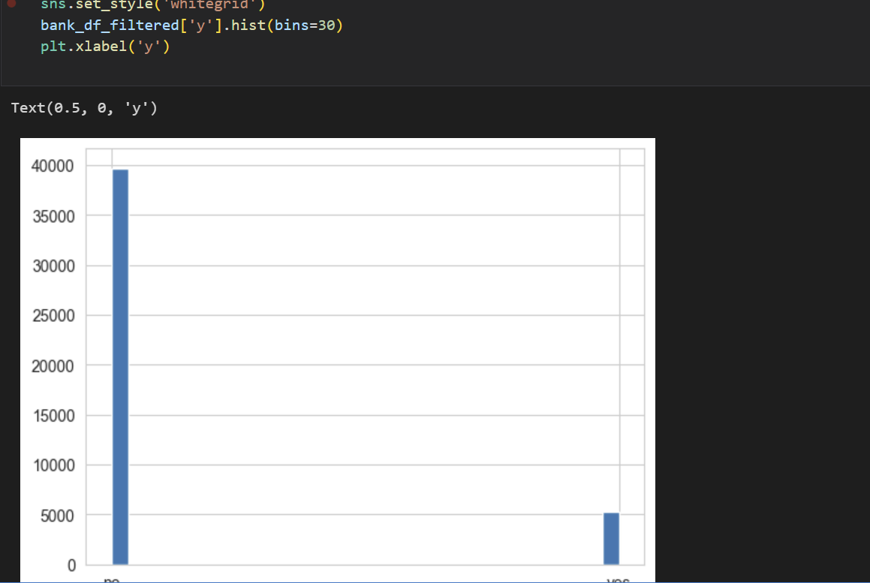
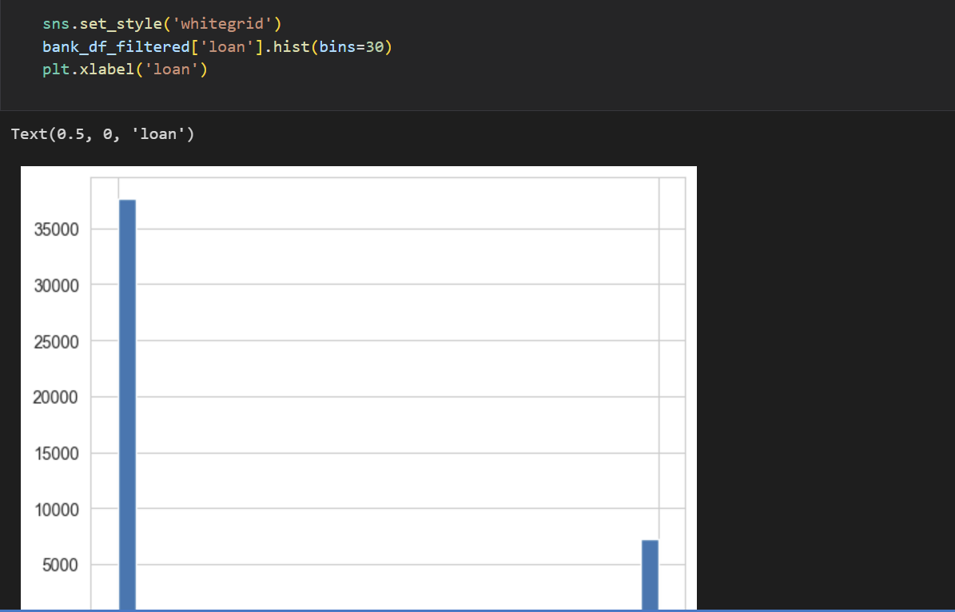
The EDA that’s performed on the provided data sets are as follows:

Slide 4
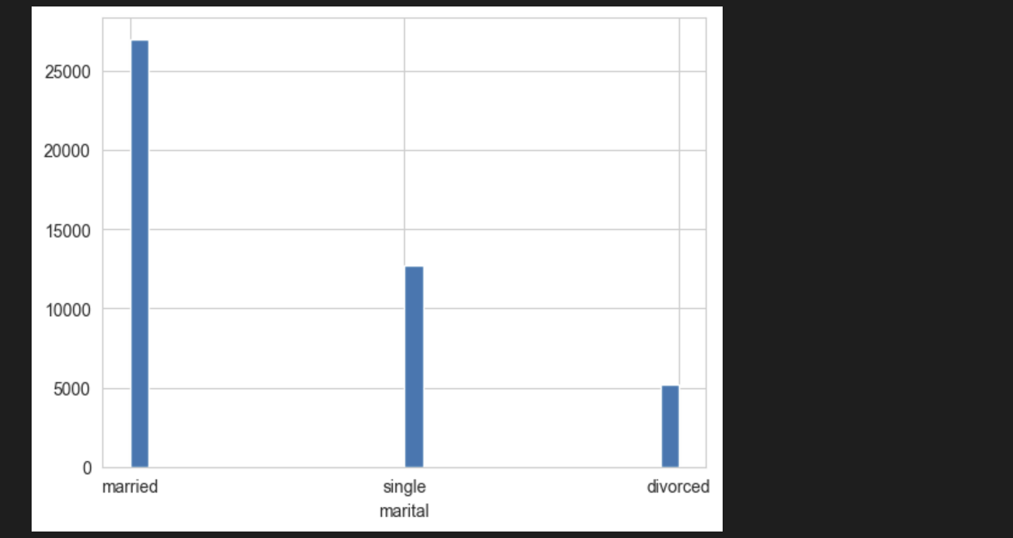
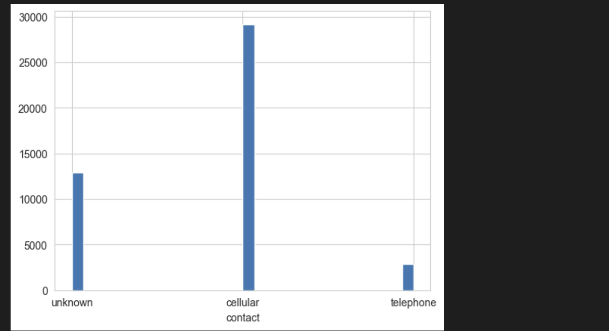

Slide 5
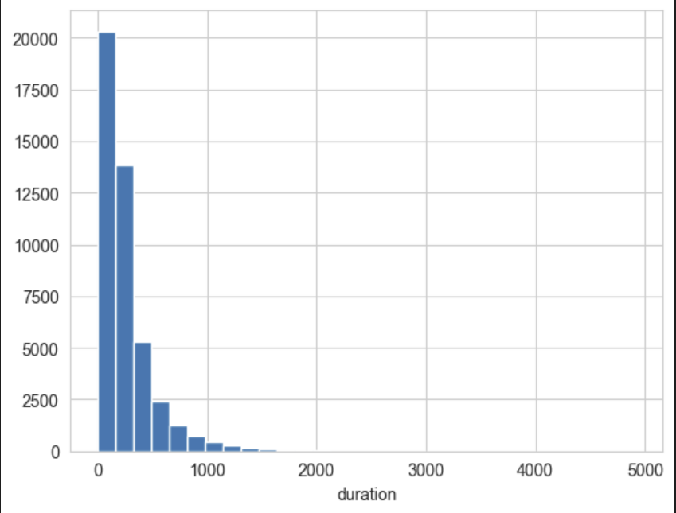
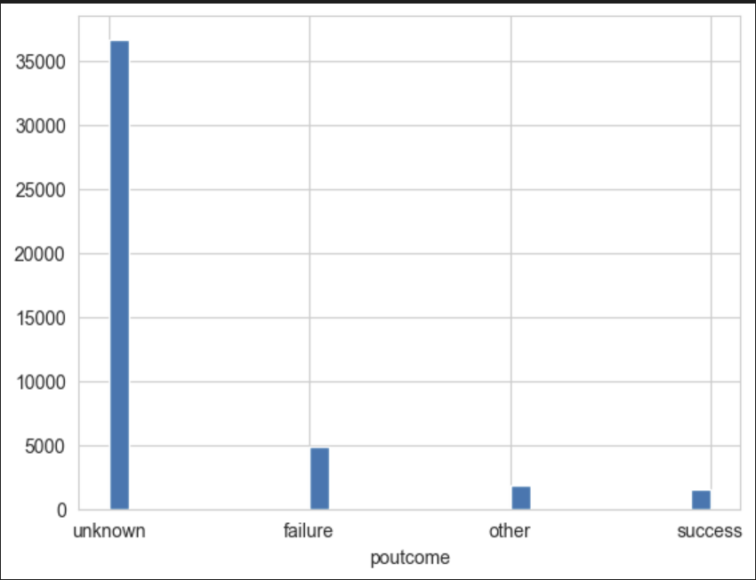

Slide 6
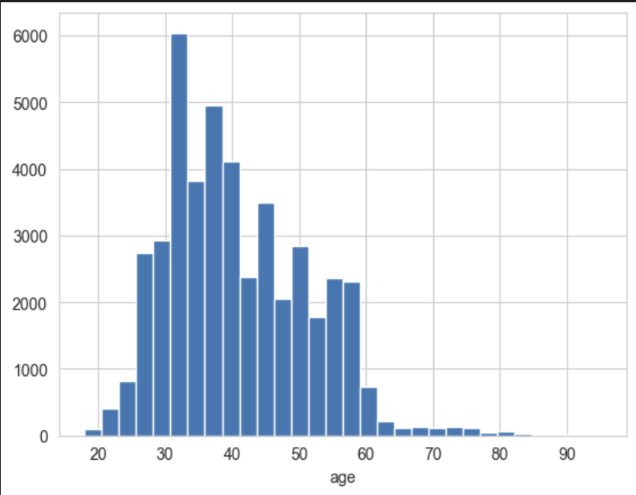
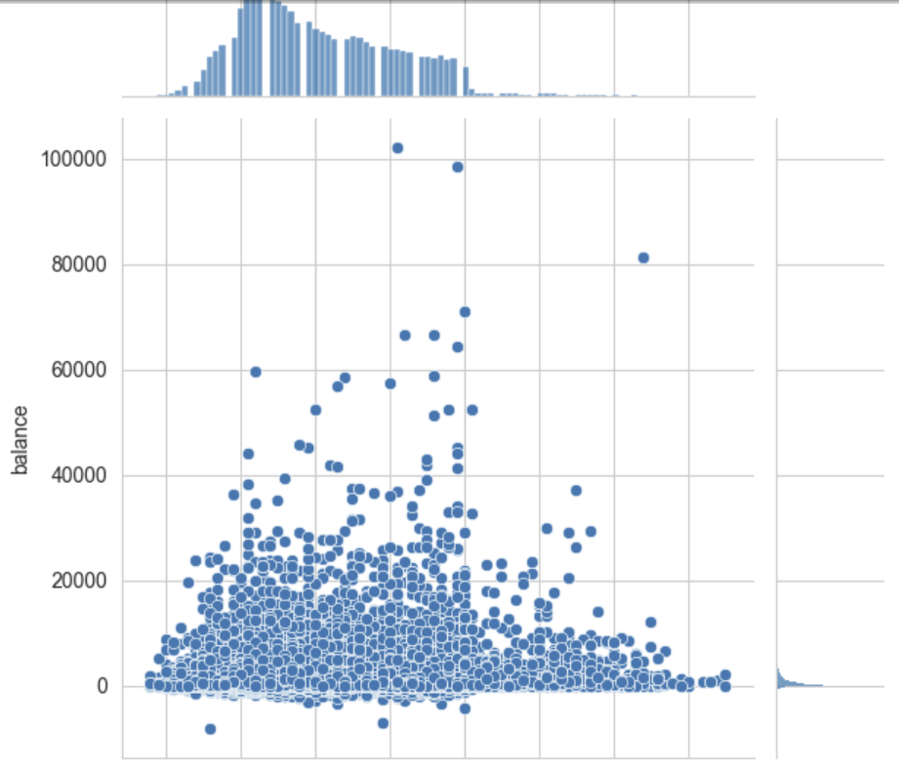

Slide 7
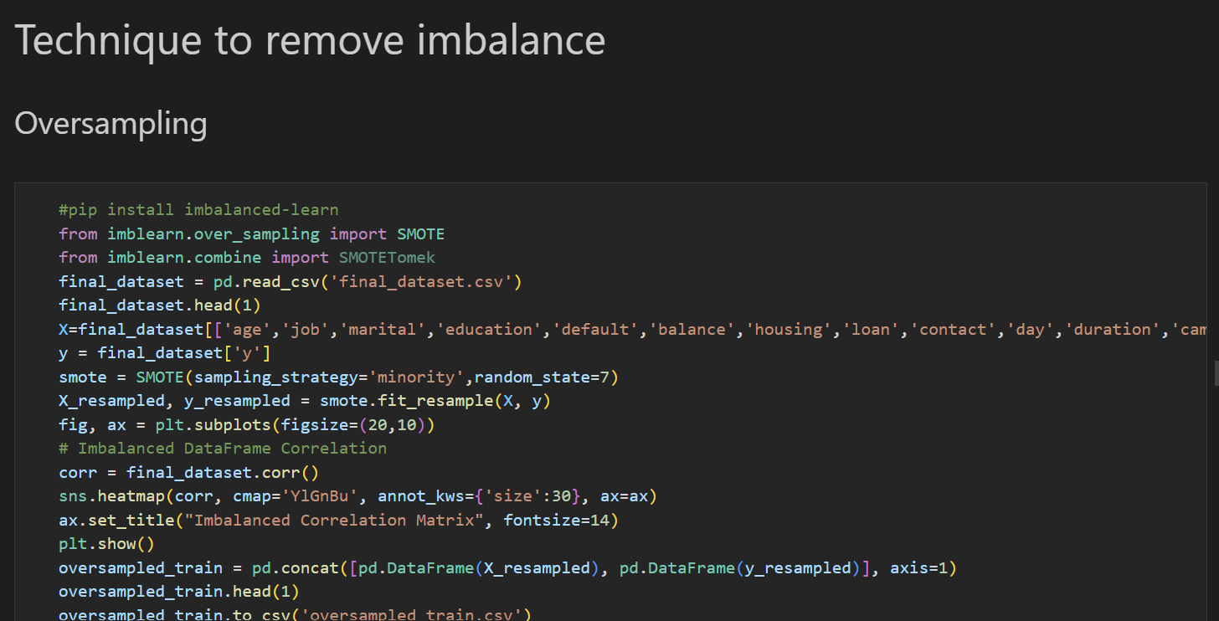

Slide 8

Tthe Website that has been creted and ML algorithms that are created are as follows:

Slide 9
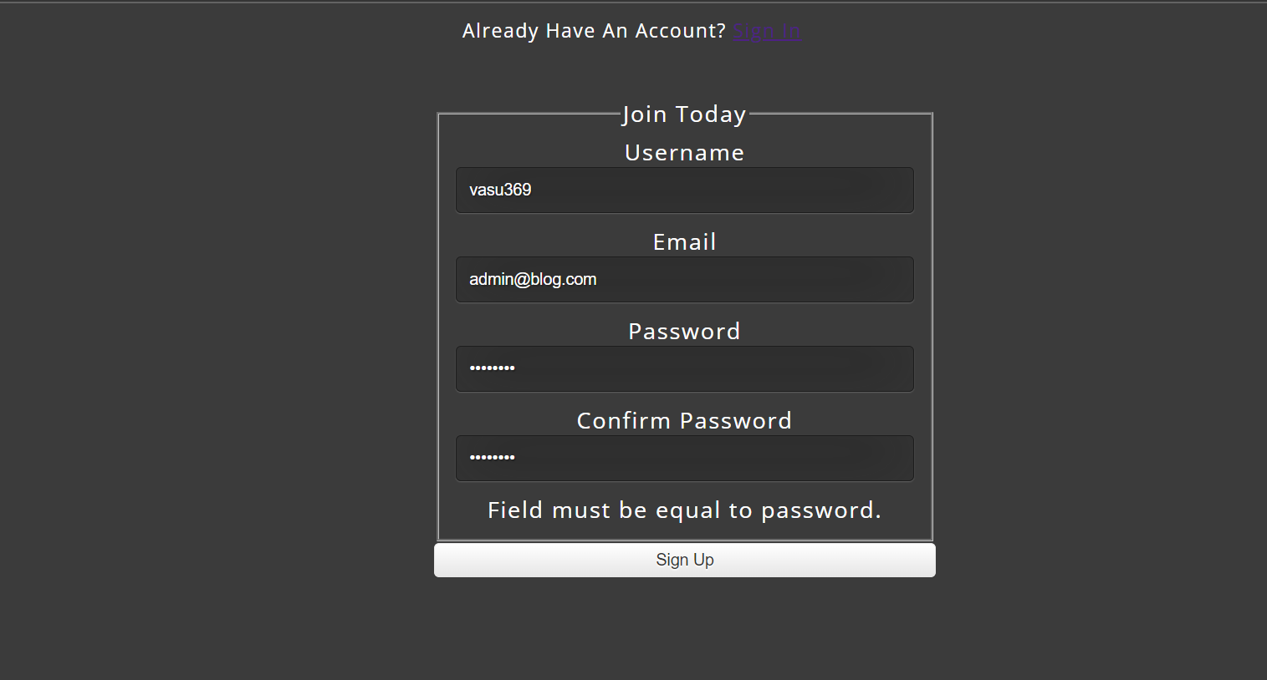

Slide 10
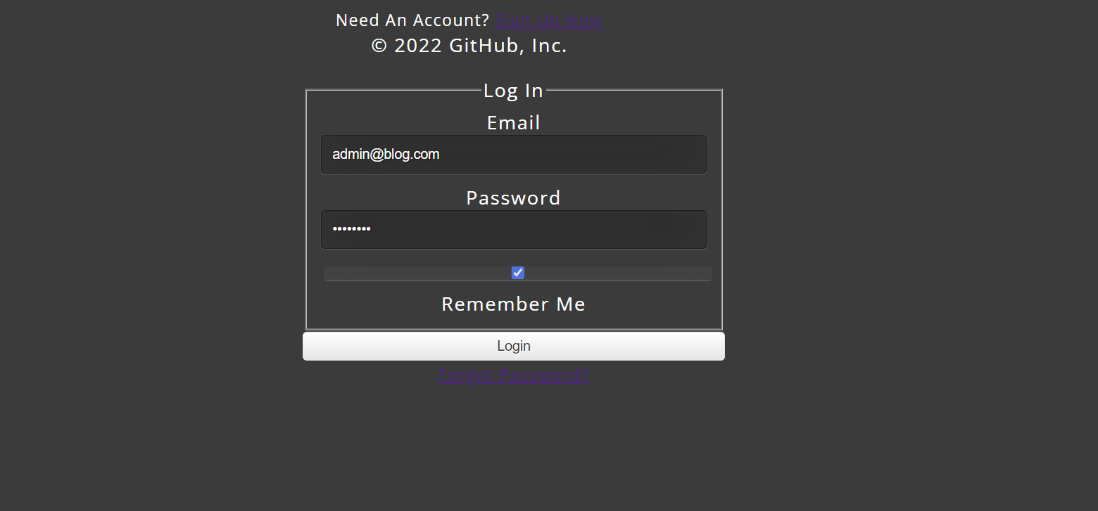

Slide 11
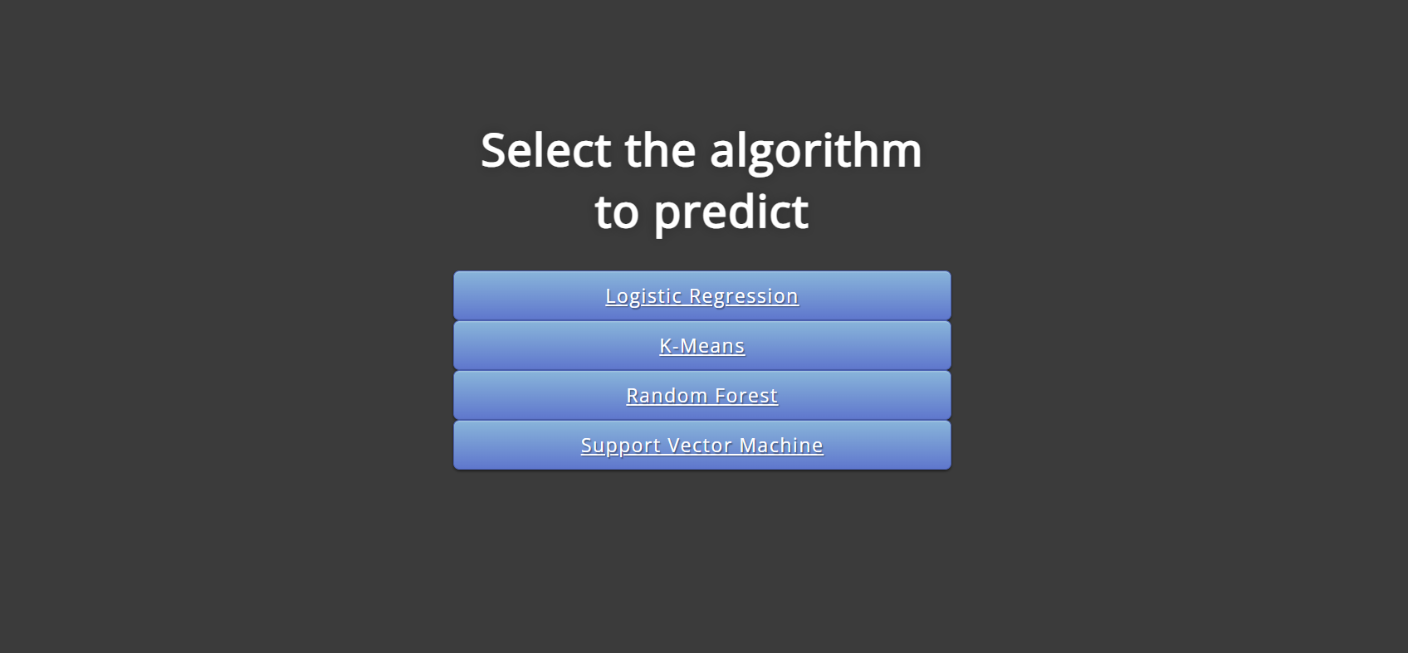

Slide 12
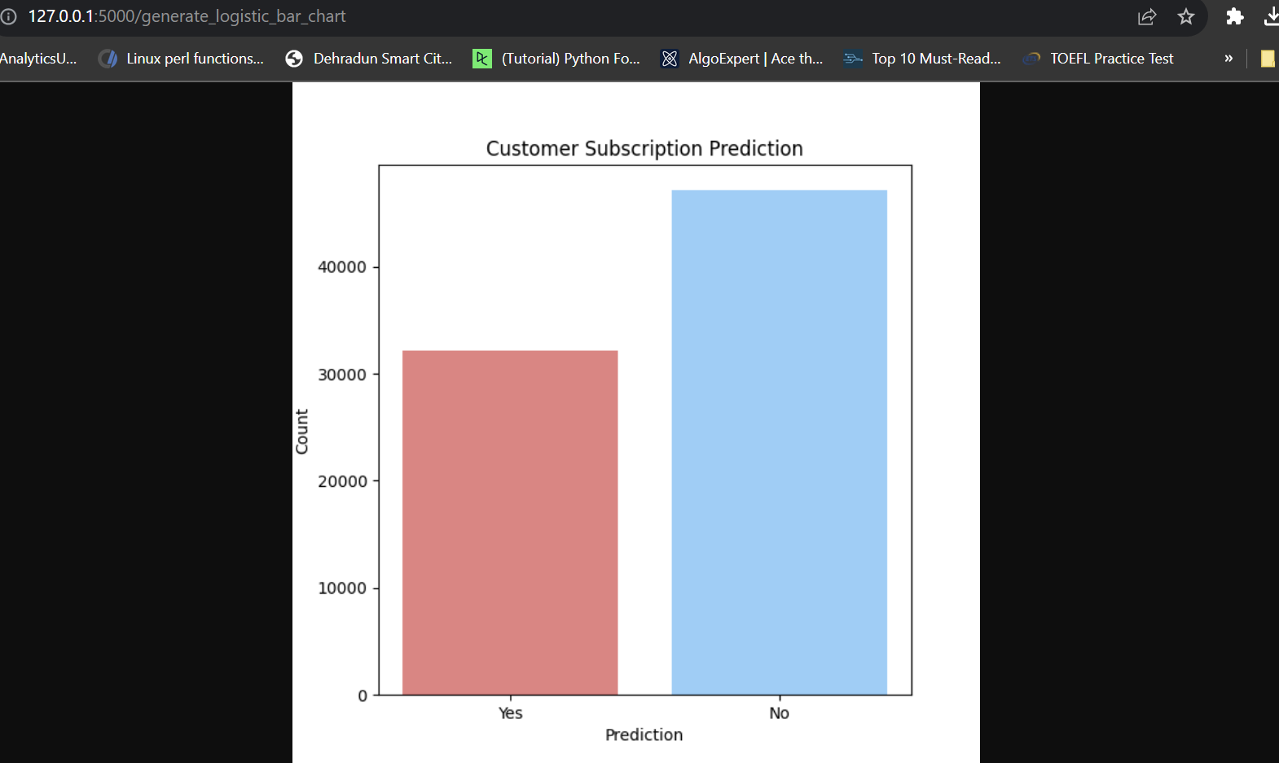
Logistic Regression

Slide 13
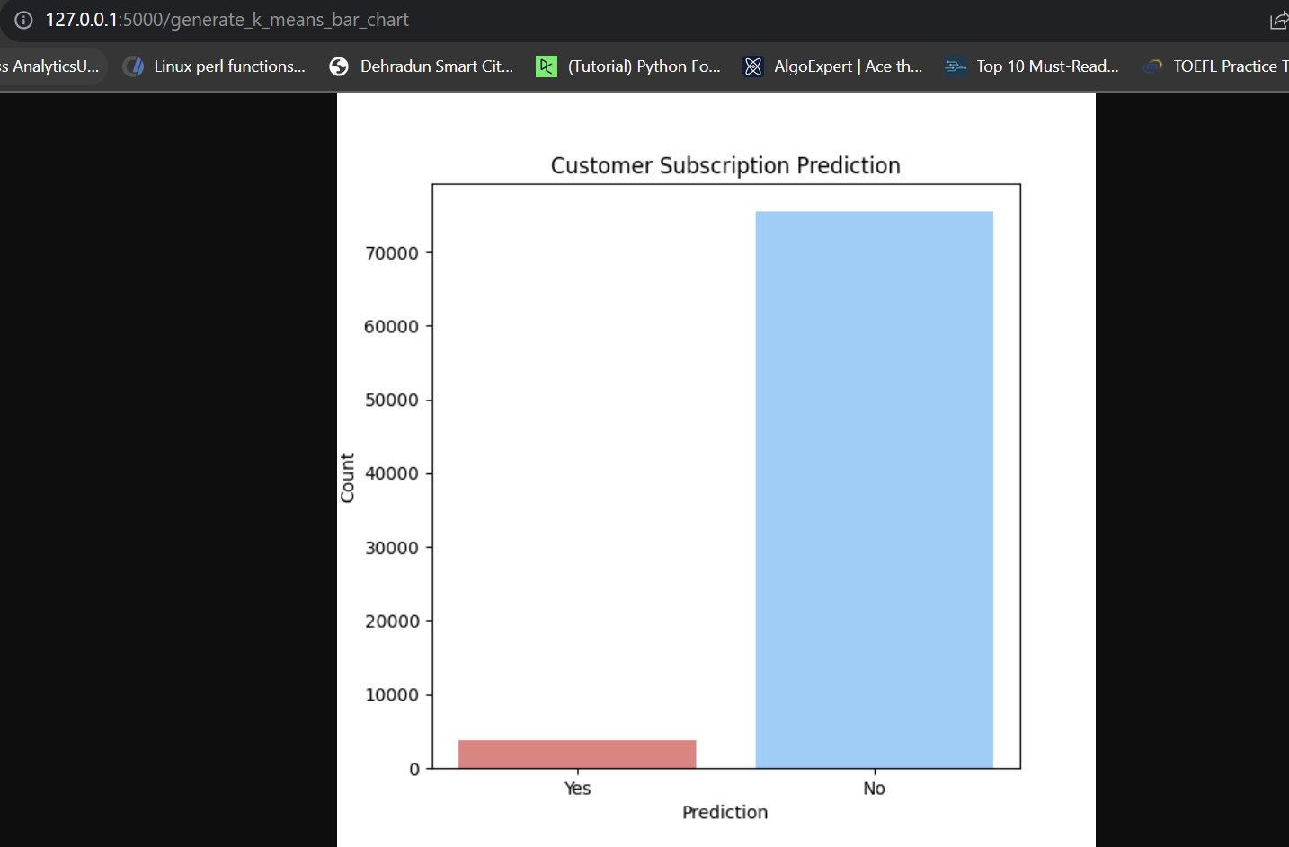
K-Means Algorithm

Slide 14
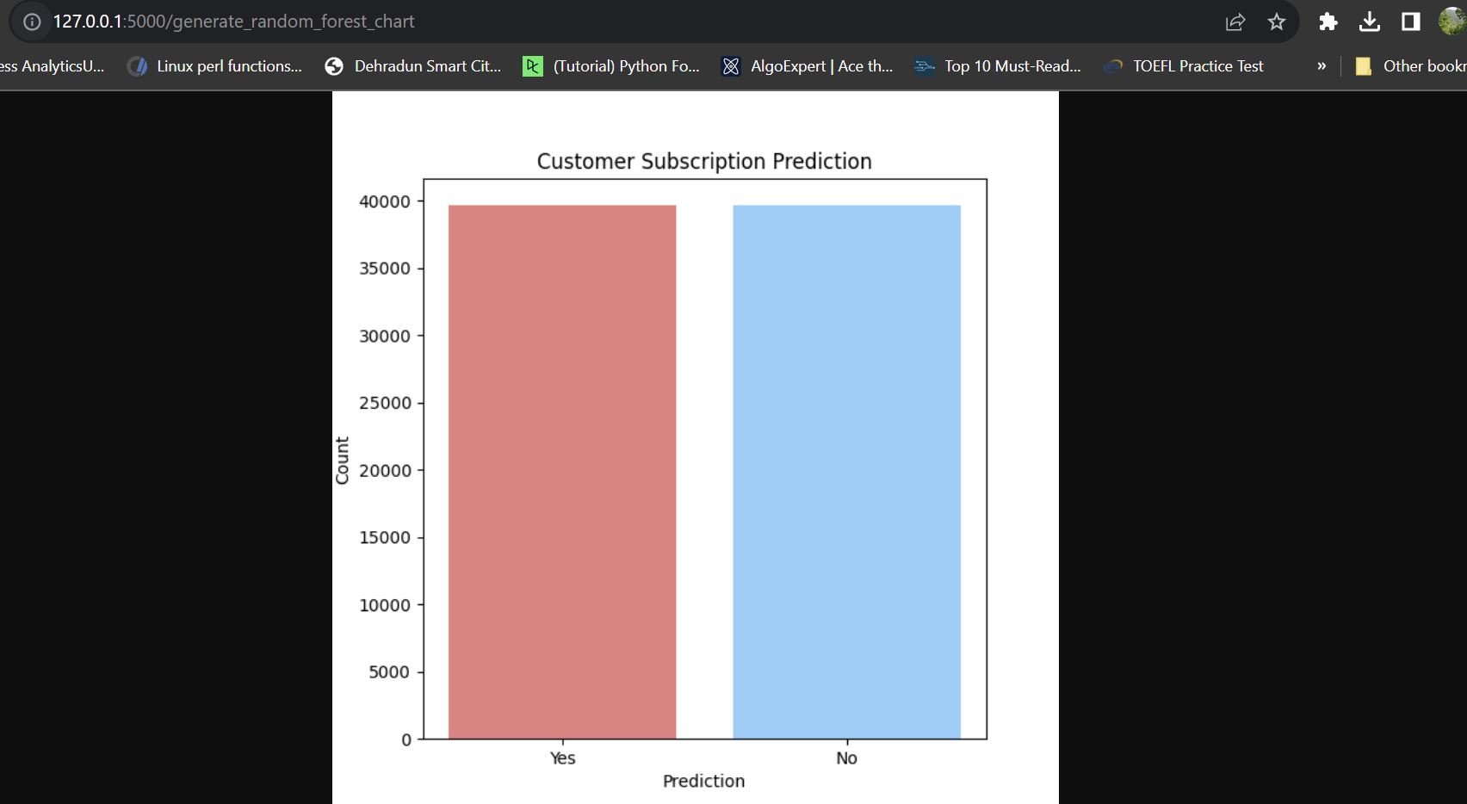
Random Forest

Slide 15
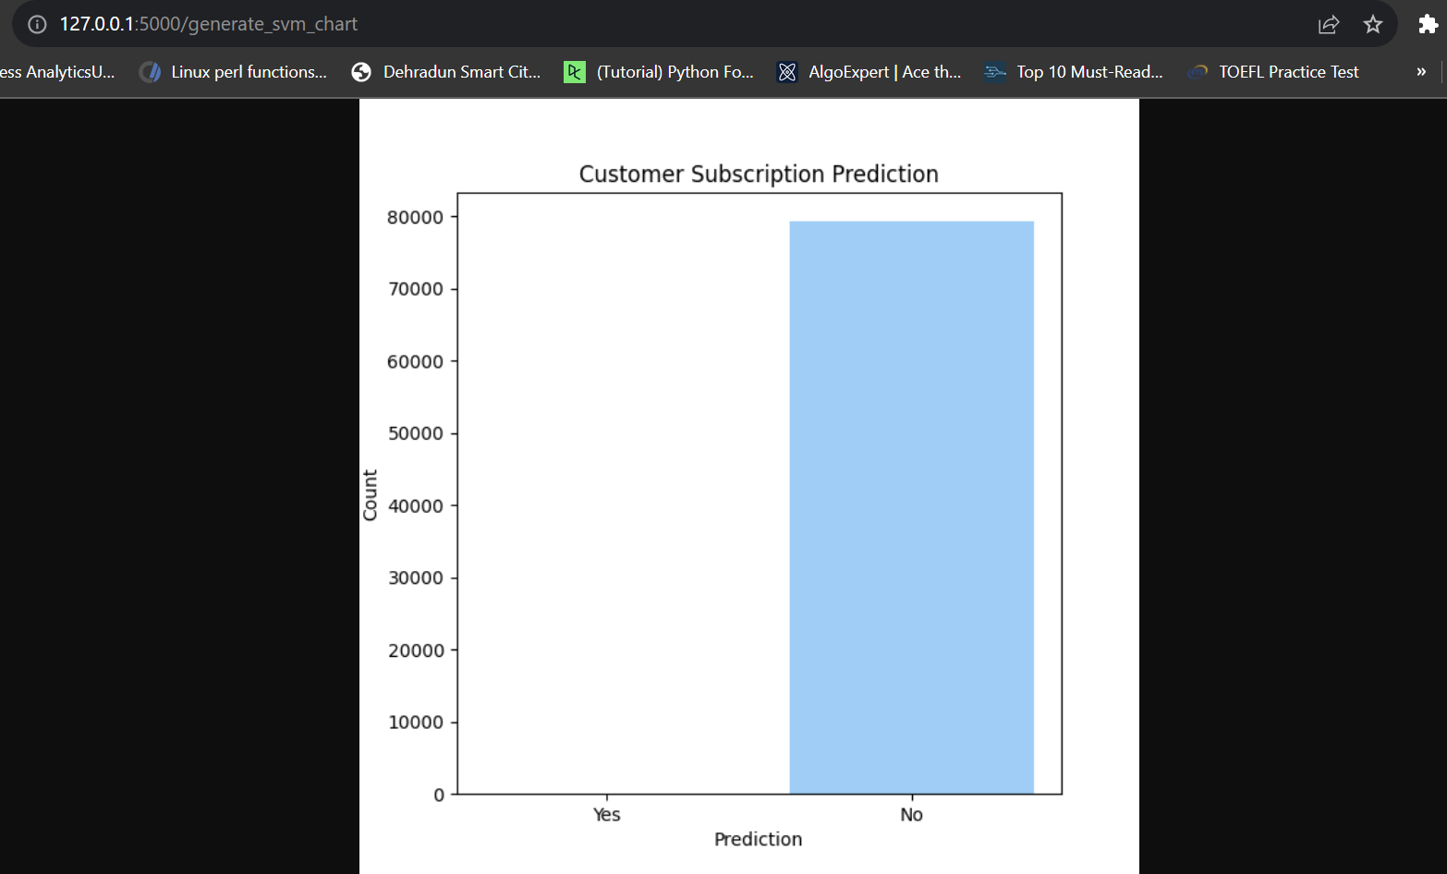
Support Vector Machine

Slide 16
In the end, I would suggest using either Logistic Regression or K-Means would be the best choice as the visualization and decisions made based on these algorithms seems more logical. Also Logistic Regression provides more accurate results as compared to other ML algorithms. Hence I would suggest using either Logistic Regression or K-Means ML algorithms.

