Slide 1

Data Science :: Bank Marketing(Campaign)

Slide 2
Name : Vasu Sharma Email : vasu.vs45@gmail.com College : Indiana University Bloomington Country : United States of America
GitHub Repository : https://github.com/vasuvs45/Project

Slide 3
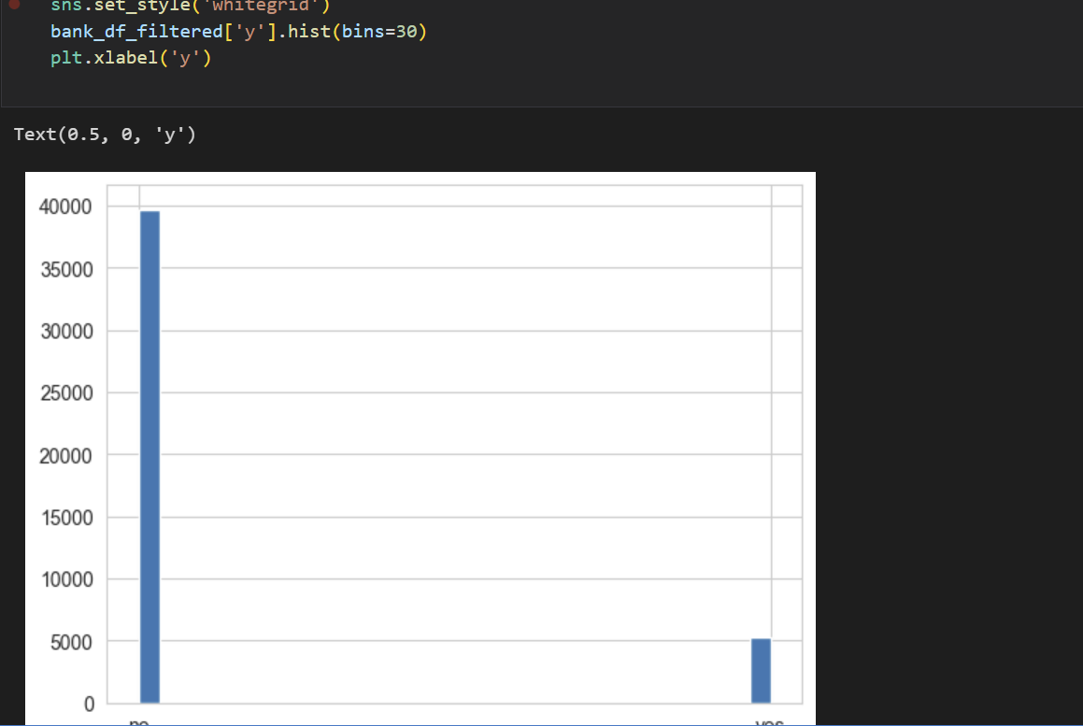
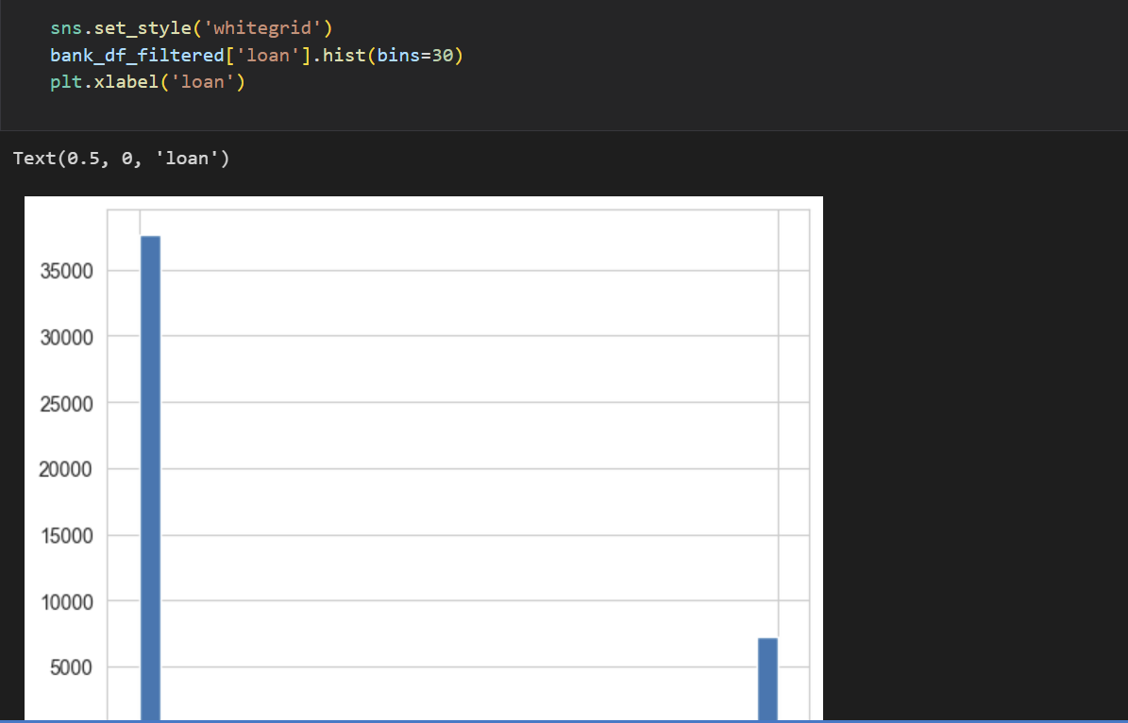
The EDA that’s performed on the provided data sets are as follows:

Slide 4
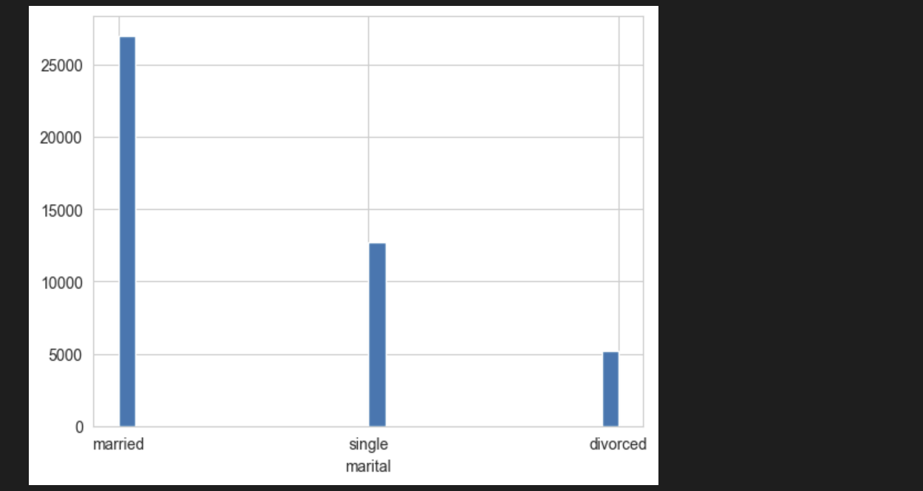
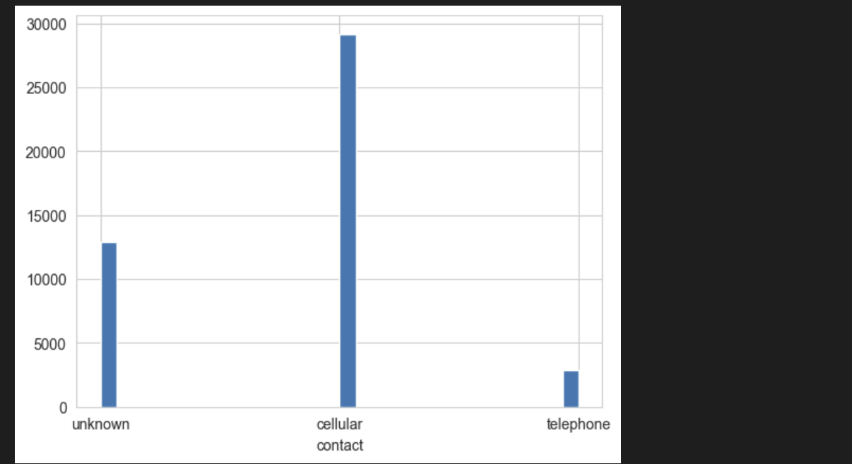

Slide 5
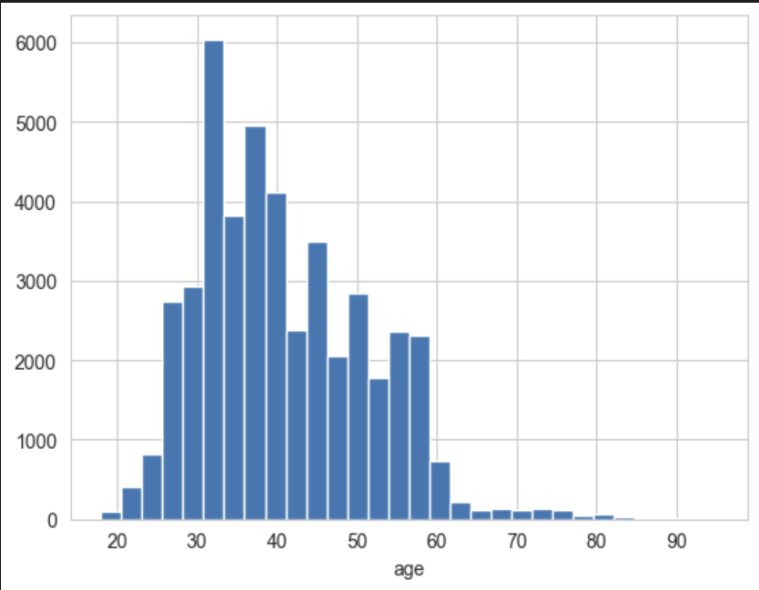
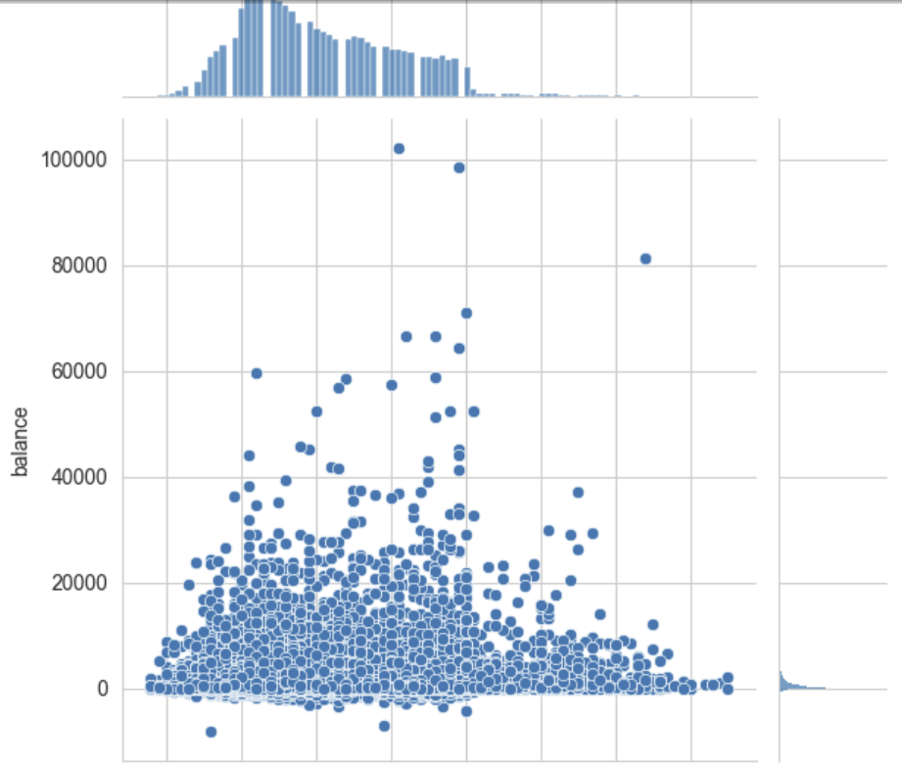

Slide 6
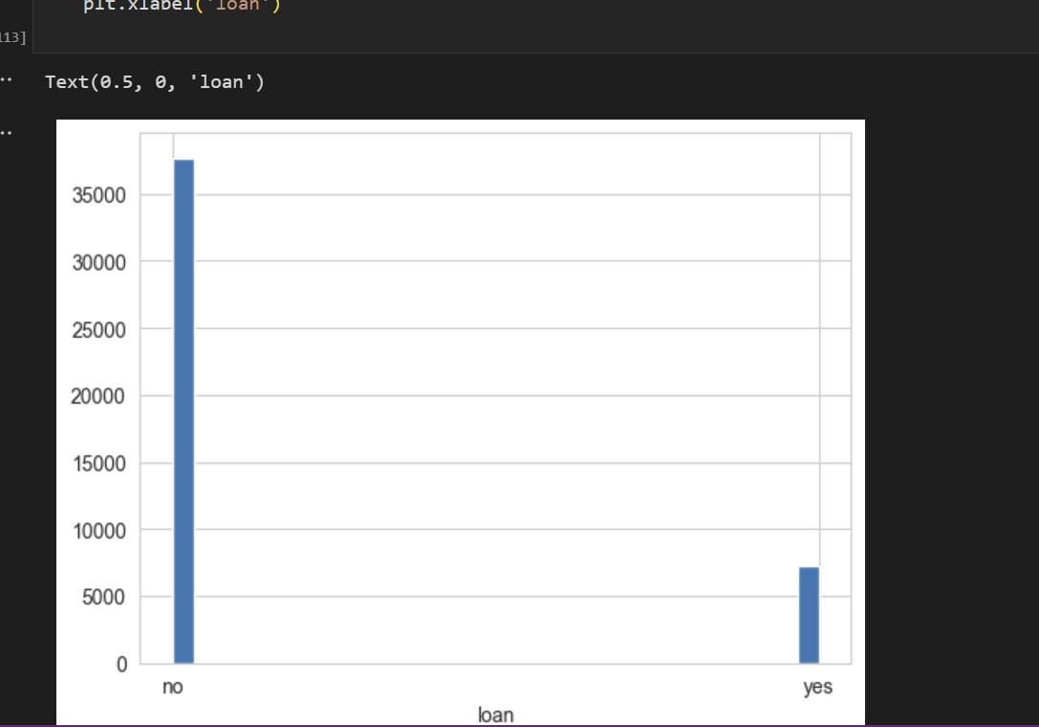
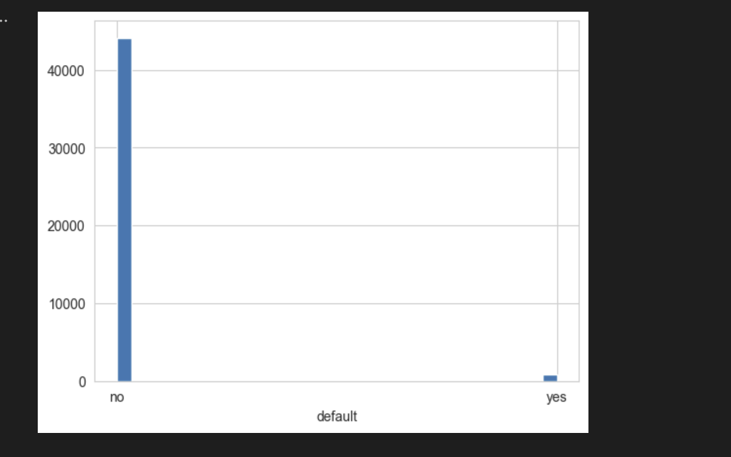

Slide 7
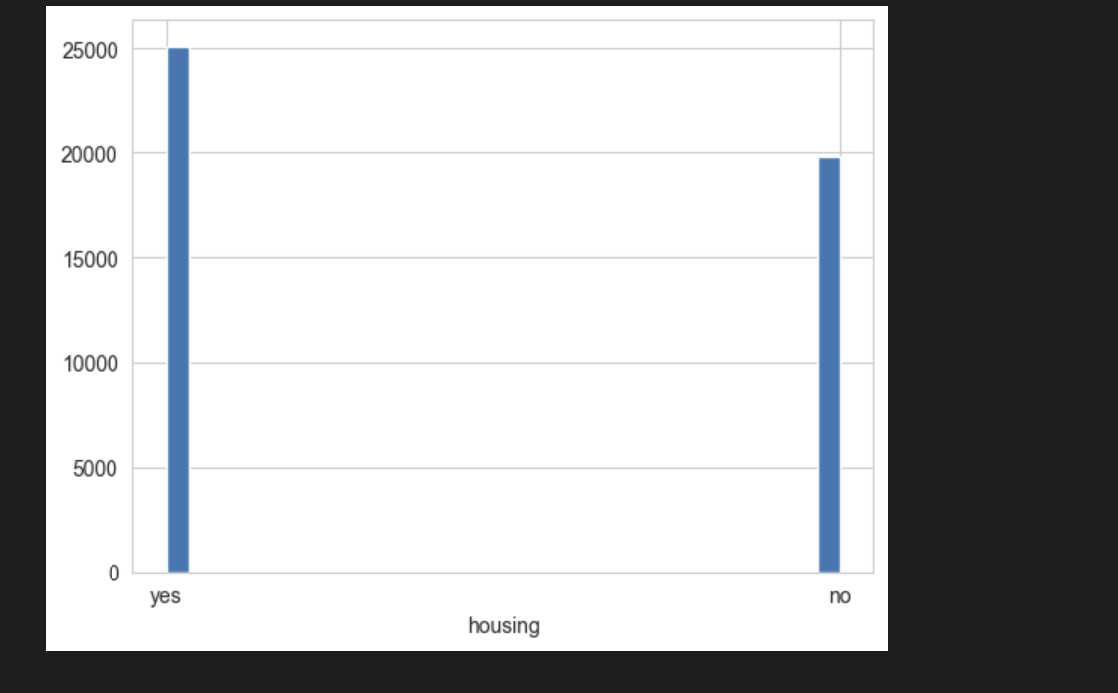
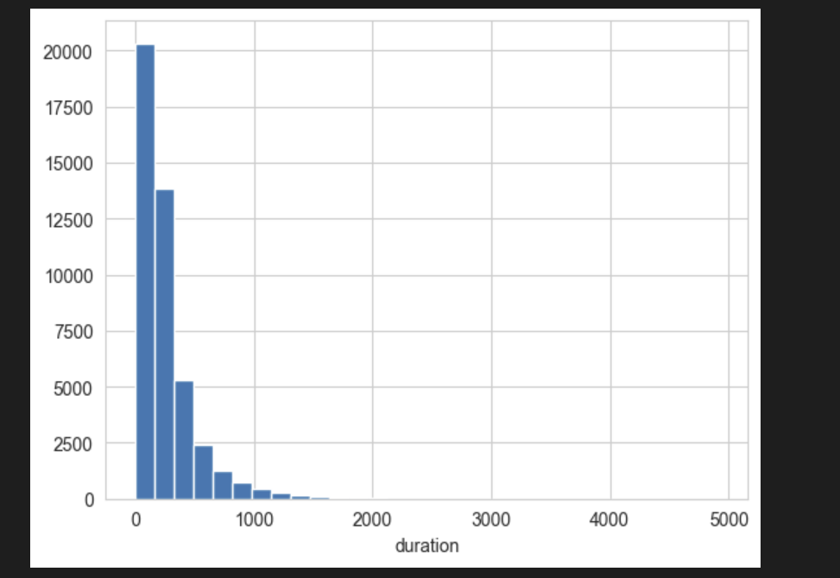

Slide 8
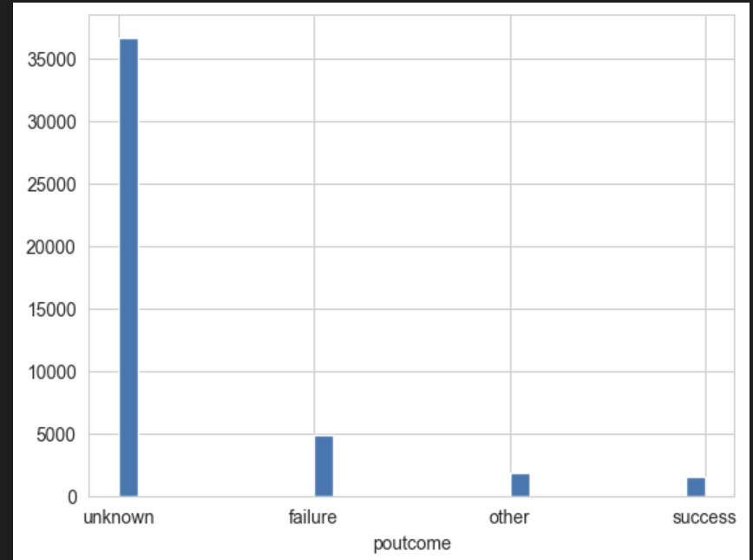
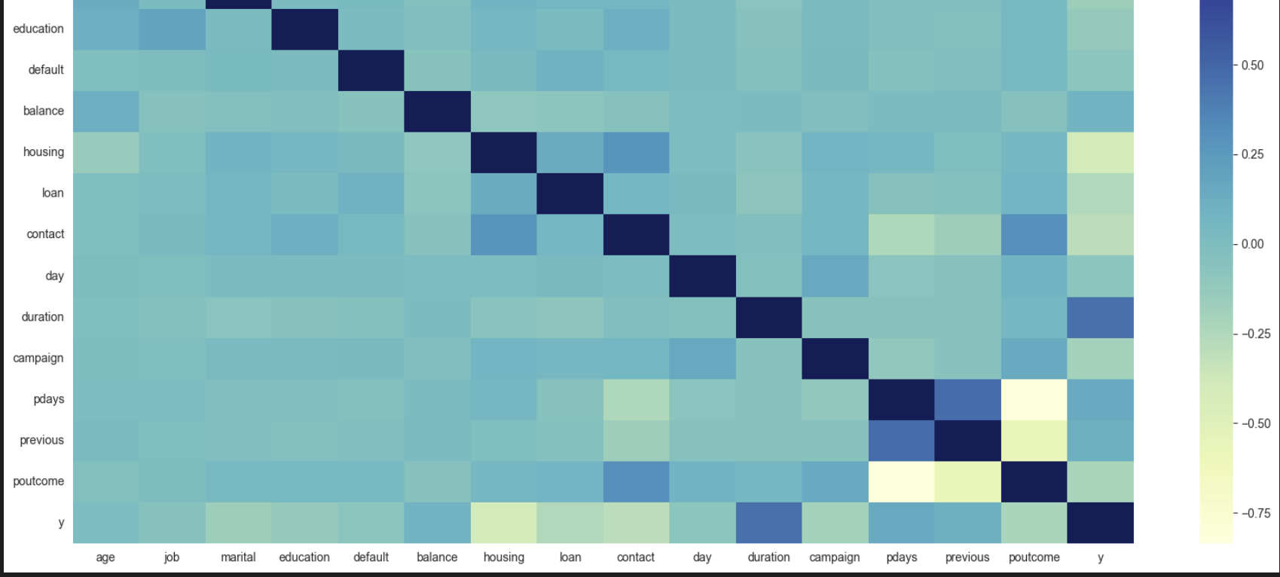

Slide 9
We have performed EDA using various parameters. After performing exhaustive search, we come to the realization that performing K-means, SVM, Random Forest and Logistic Regression is the best way to move forward. This is because the output of the prediction is in form of 0 and 1. i.e. yes or no for customers to buy the new product generated by the bank will be bought by customers or not.

