Slide 1


APPLIED DATABASE TECHNOLOGIES PROJECT FALL 2023

Slide 2
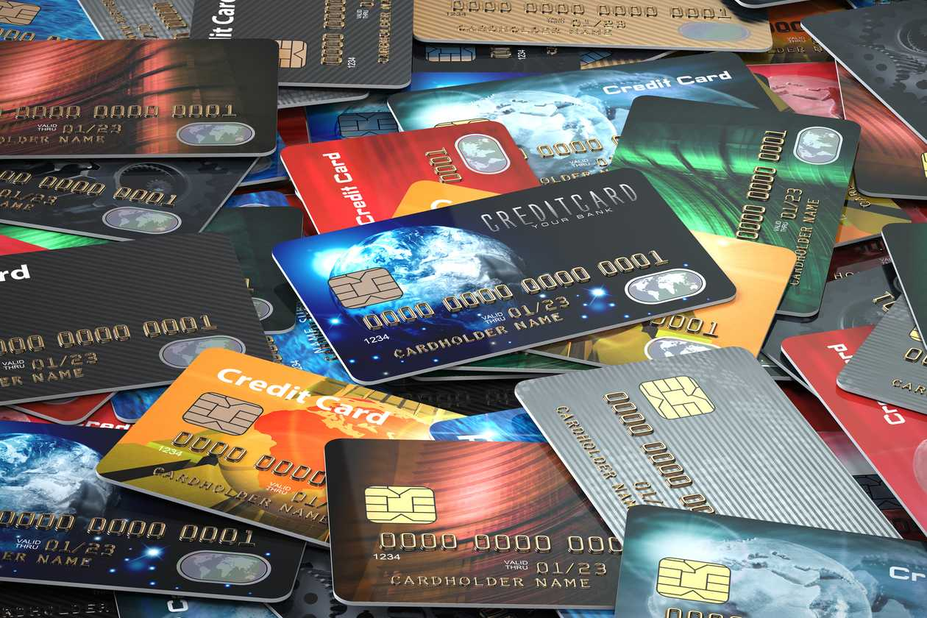
CREDIT CARD APPROVAL ASSESSOR

Slide 3
CONTENTS:
Overview
Motivation
Tools Used
Dataset and Exploratory Data Analysis(EDA)
Front End
Results
Future Scope
C

Slide 4



GROUP PRESENTATION:
TEAM MEMBERS:
Vasu Sharma
Harsha Gade
Siddhesh Sheth

Slide 5

OVERVIEW AND THE GOAL
To build a credit card approval system, define creditworthiness criteria like credit score and income. Collect and preprocess user data, rather than having a model at the backend we would initially for the project purpose hard code the values and if a person meets a threshold for a particular card, he will be eligible for it. Prioritize compliance with regulations and ethical considerations, safeguarding user privacy and data security throughout the process.
The goal is to categorize users as Excellent, Good, Moderate, or Bad credit risks, providing a transparent and trustworthy estimation of their approval odds. Our system also helps a customer to get an overall idea on eligibility which won’t further hamper their credit score.

Slide 6

MOTIVATION
This project is driven by the desire to democratize financial opportunities. By automating the credit card approval process, the system provides individuals with swift and transparent assessments of their creditworthiness, fostering financial inclusivity. The streamlined application experience not only accelerates decision-making but also promotes financial literacy, helping users comprehend the factors influencing their approval chances. The model's objective evaluation minimizes human biases, ensuring fairness and consistency in decision-making for financial institutions. Through this initiative, the aim is to make credit more accessible to a wider demographic, empowering users to make informed financial decisions and contributing to a more equitable and inclusive financial landscape.

Slide 7



TOOLS AND TECHNOLOGIES USED
1. Python
2. Streamlit
3. PostgreSQL

Slide 8
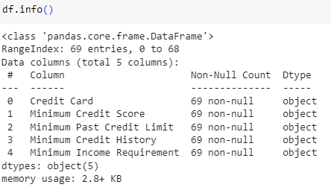
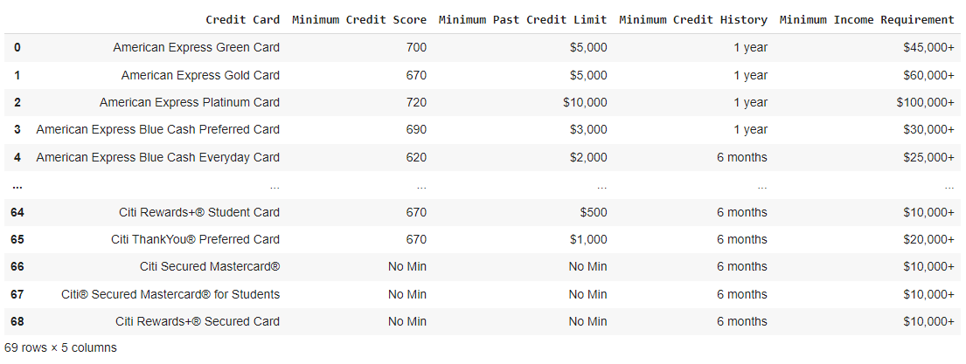
DATASET
We have collected data from various sources and merged together to manually create the dataset. The dataset which we were looking for precisely wasn’t available and we thus merged some datasets.
It comprises of :
5 Rows
69 Columns

Slide 9


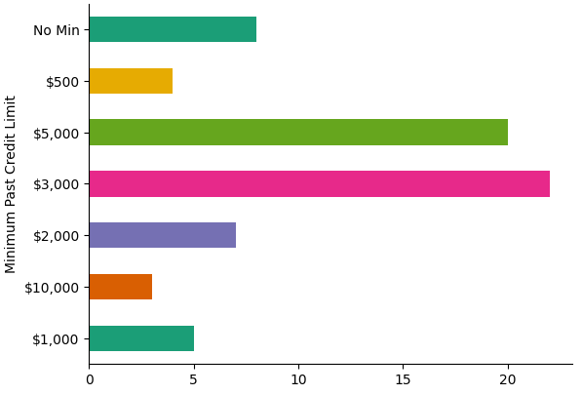
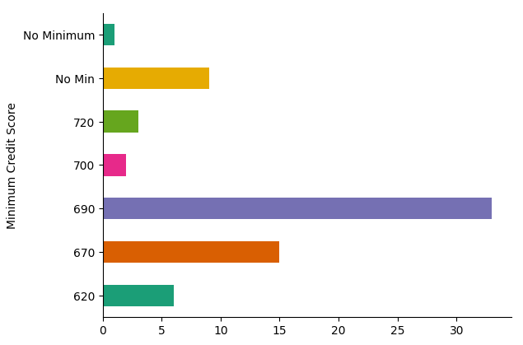
EXPLORATORY DATA ANALYSIS

Slide 10
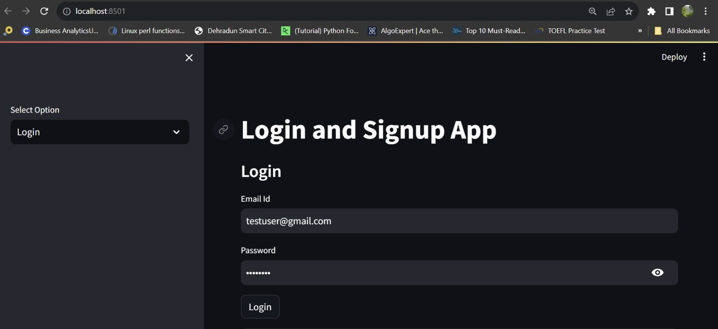
FRONTEND SNAPSHOTS
Login and Signup Page

Slide 11
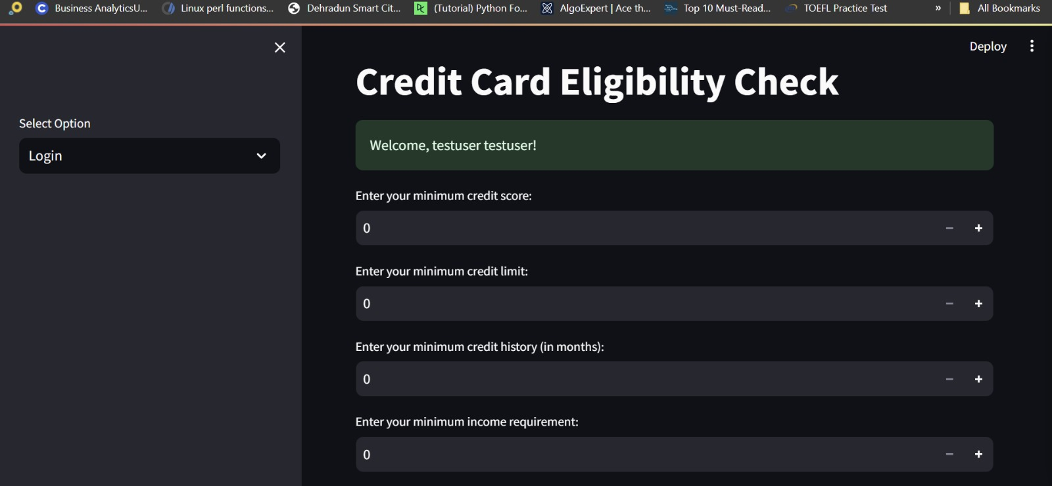
Card eligibility check Page

