Slide 1

Exploratory Data Analysis
G2M Case Study for Cab Investment
21/June/2023

Slide 2

Agenda
Executive Summary
Problem Statement
Approach
EDA
EDA Summary
Recommendations

Slide 3
Problem Statement
There has been remarkable growth in the cab market in last few years. To make profit from this market, XYZ company is planning to make investment in this sector.
Before making substantial investment in this sector, XYZ wants to analyze this market properly before making final decisions regarding investment.
Mission : Our purpose has been to provide recommendation to XYZ company to make their investment in a right company to maximize their profit.
The analysis has been divided into 4 parts:
1. Data Analysis
2. Exploratory Data Analysis
3. Graphical Representation
4. Most profitable company
5. Recommendation

Slide 4
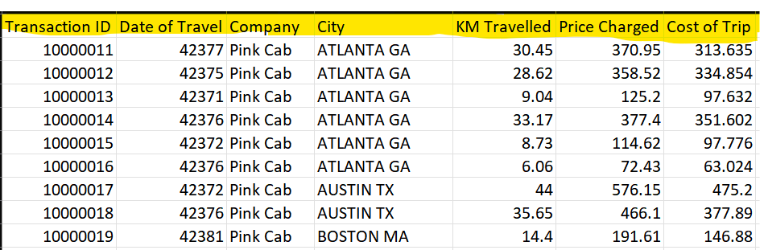
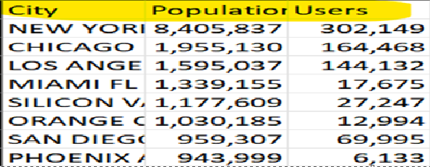
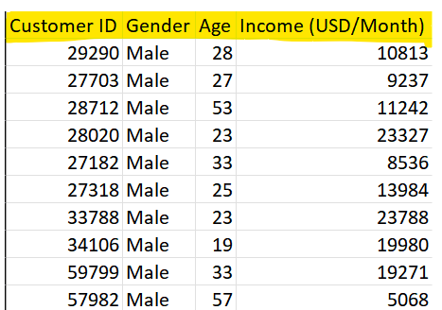
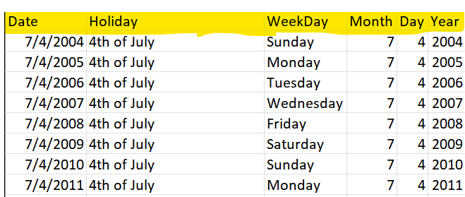
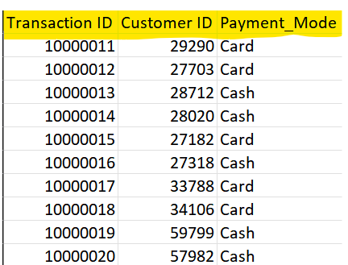
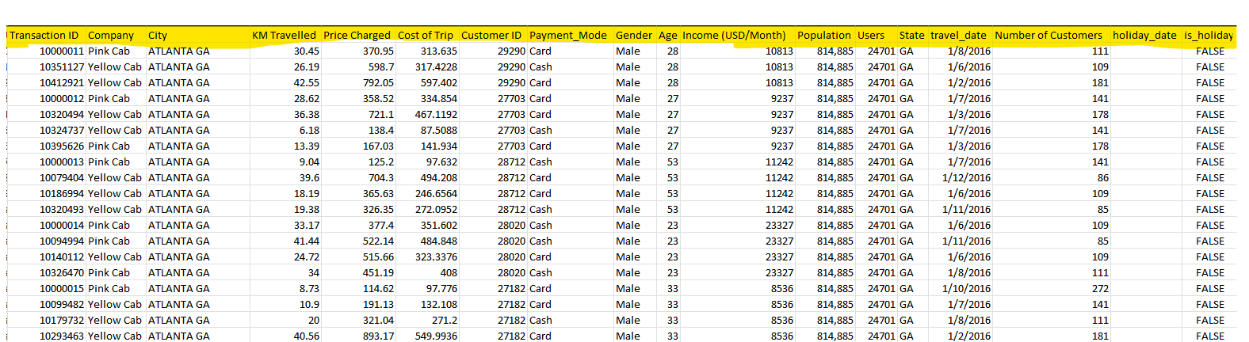
Data Analysis
Cab Data
City Data
Customer ID Data
US Holidays Data
Transaction ID Data
Final DataSet

Slide 5
Column description
Transaction ID : User’s Transaction ID
Company : Cab Company used by User
City : City of User
KM Travelled : Cab booked for KM
Price Charged : Price Charged by User
Cost of Trip : Cost of Trip done by User
Customer ID : ID of User
Payment Mode : Mode of Payment used by User
Gender : User’s Gender
Age : Age of User
Income (USD/Month) : Income of User
Population : Population of City
Users : Number of Users of Cab company in that particular city
State : State of Usr
Travel date : travel date of User
New Columns Derived from Existing Columns
Number of Customers : Number of Customers of that particular cab company on a particular date
Holiday date : Hoiday Date as per USA calender.
is_holiday : Determines if a particular date is holiday or not

Slide 6
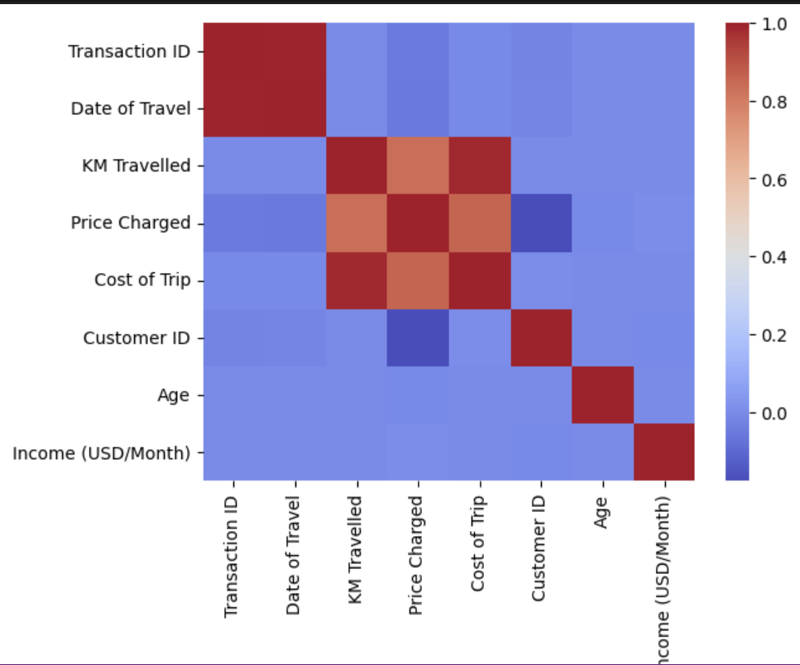
Exploratory Data Analysis

Slide 7
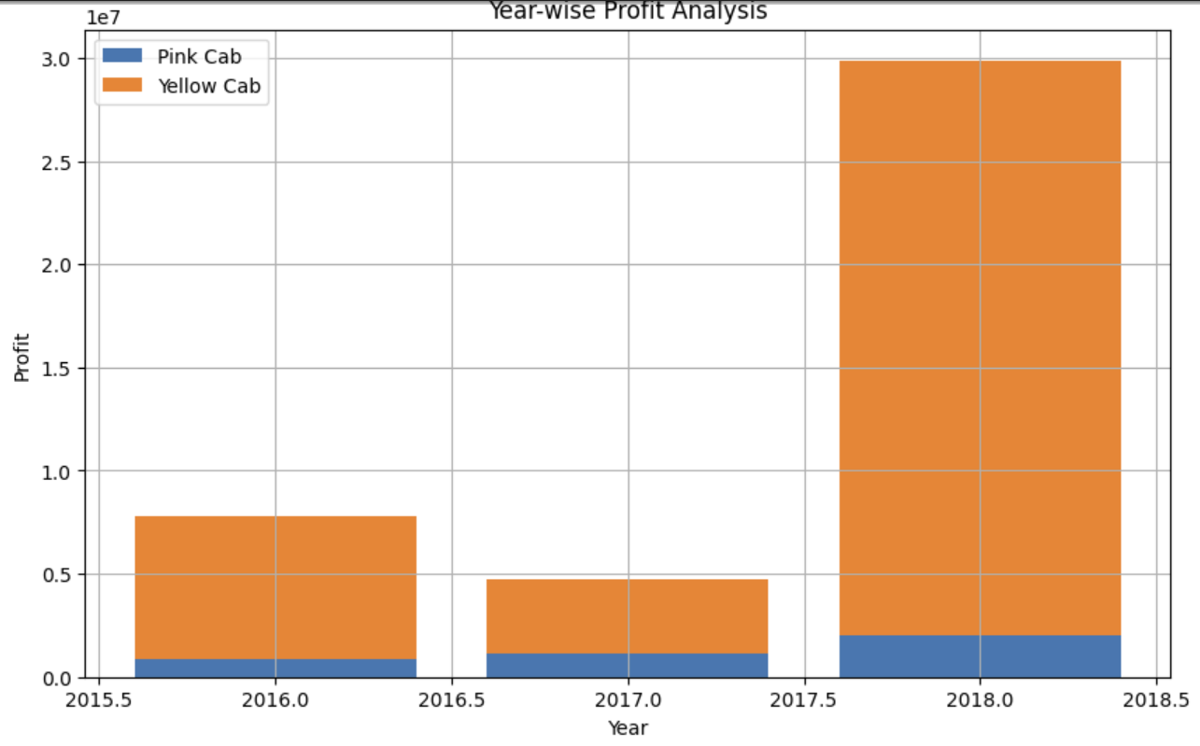

Slide 8
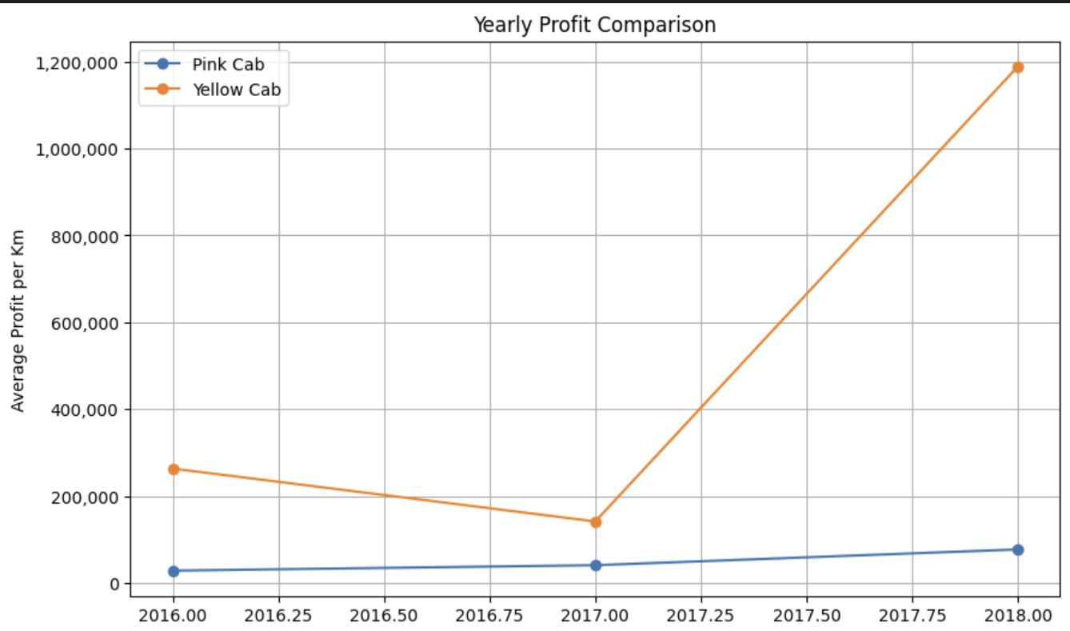

Slide 9
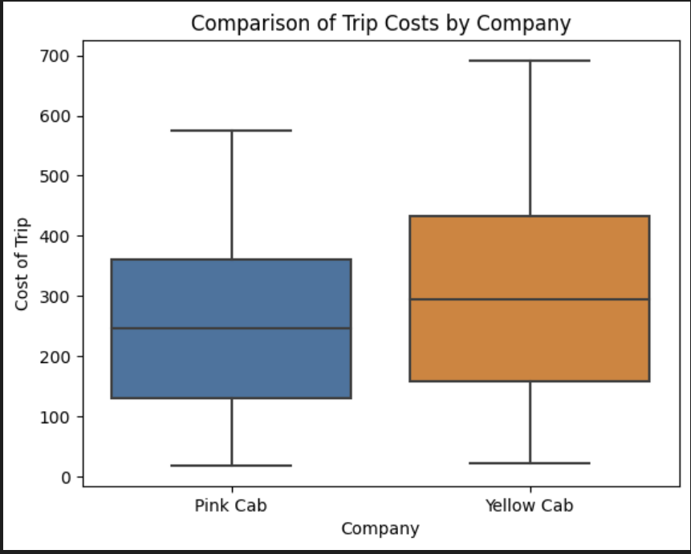
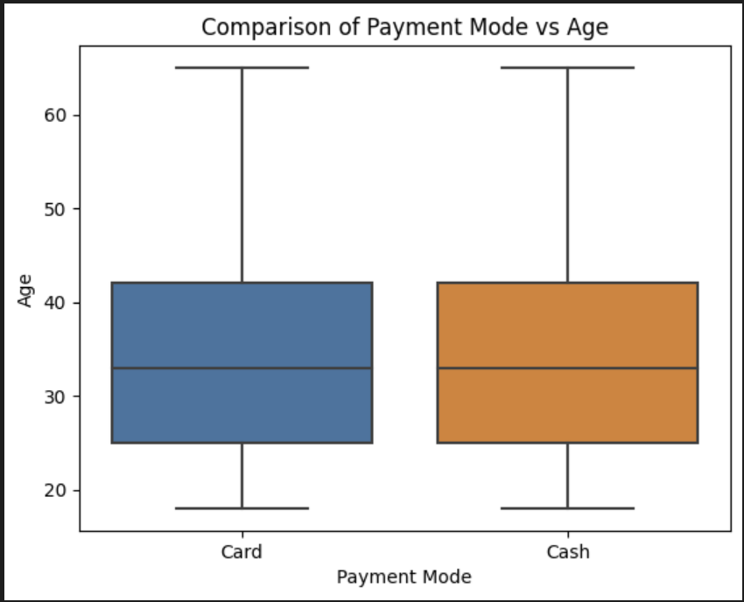

Slide 10
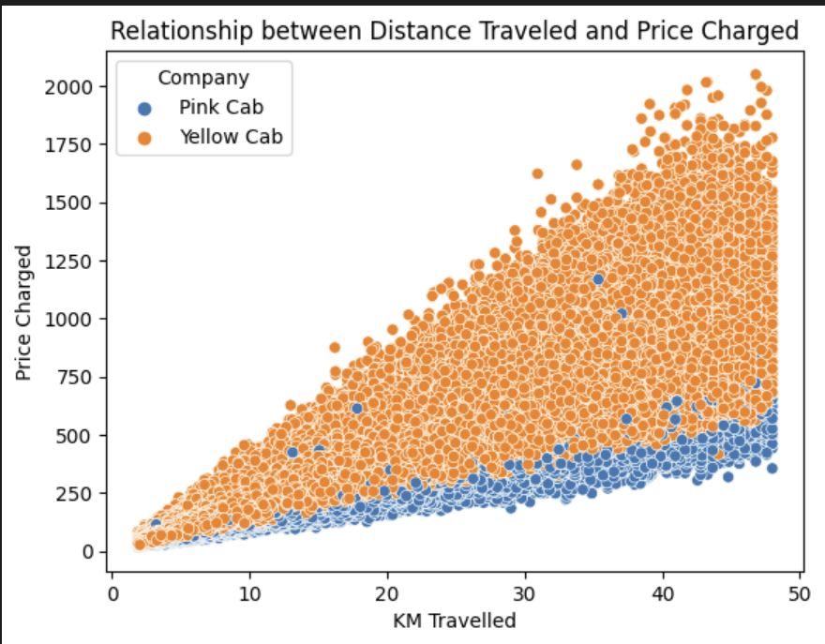
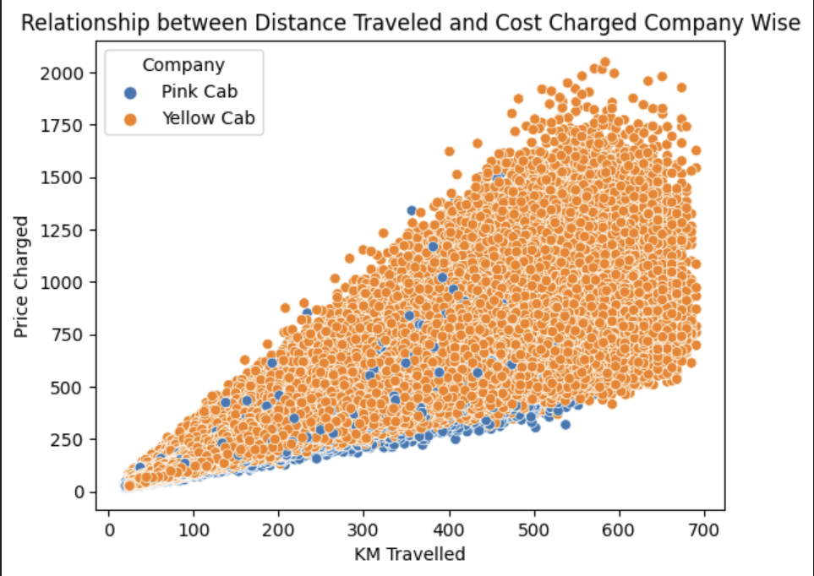

Slide 11
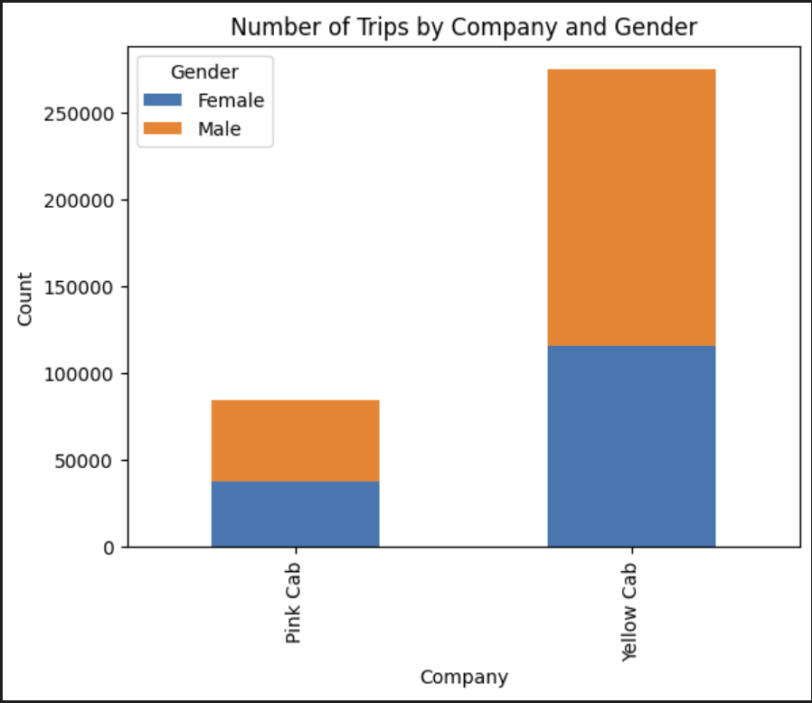
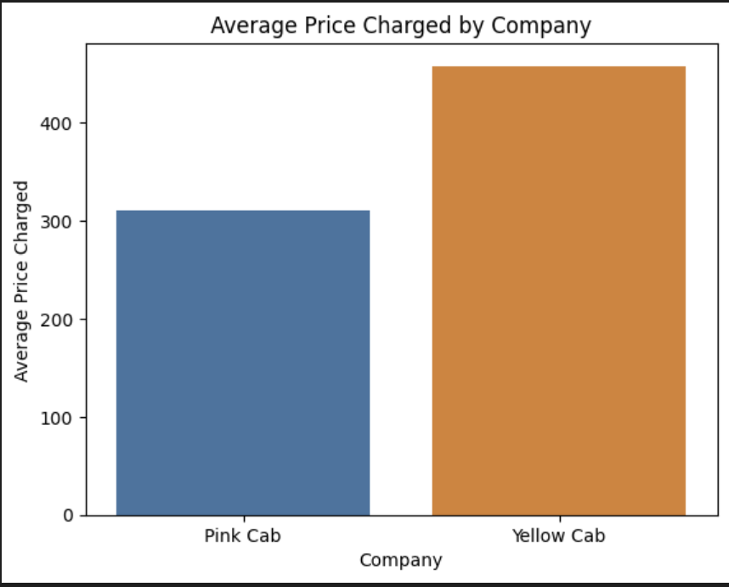

Slide 12
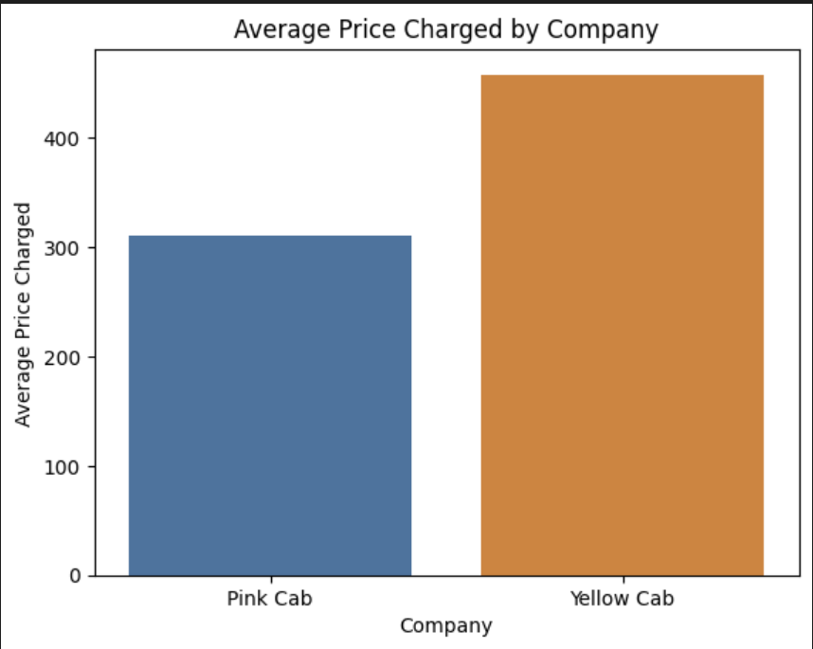
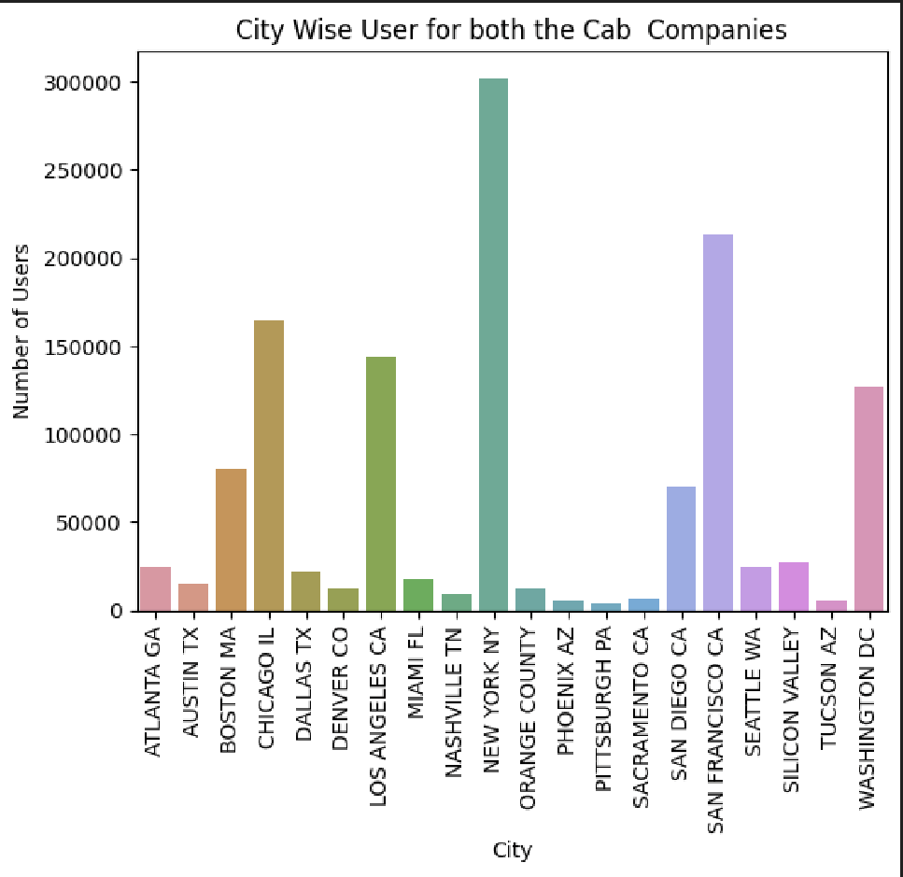

Slide 13
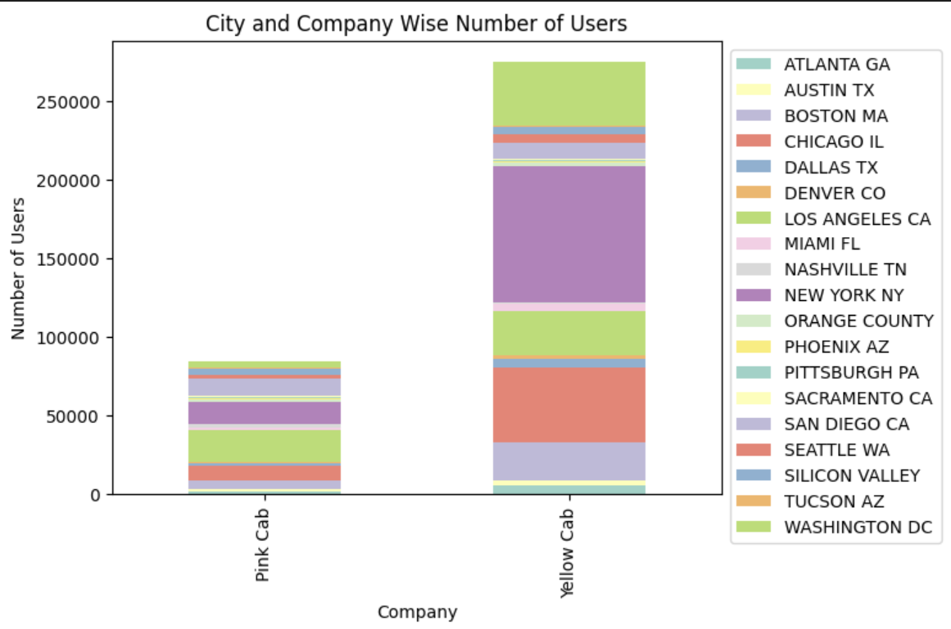

Slide 14
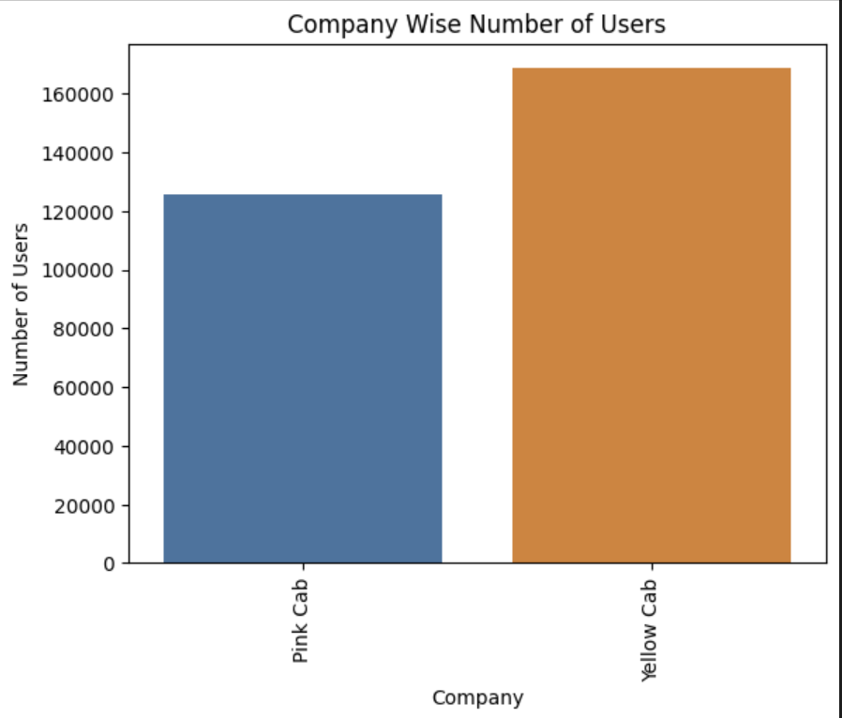
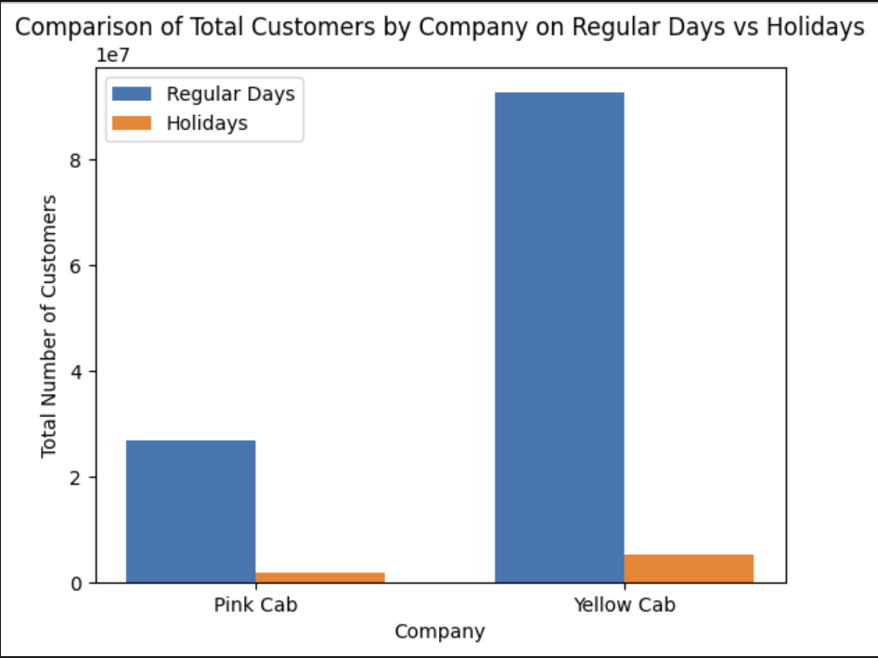

Slide 15
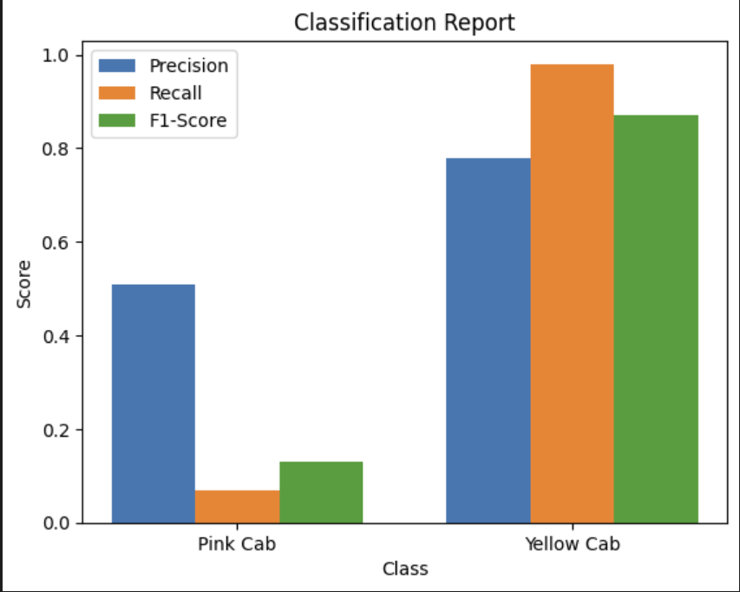
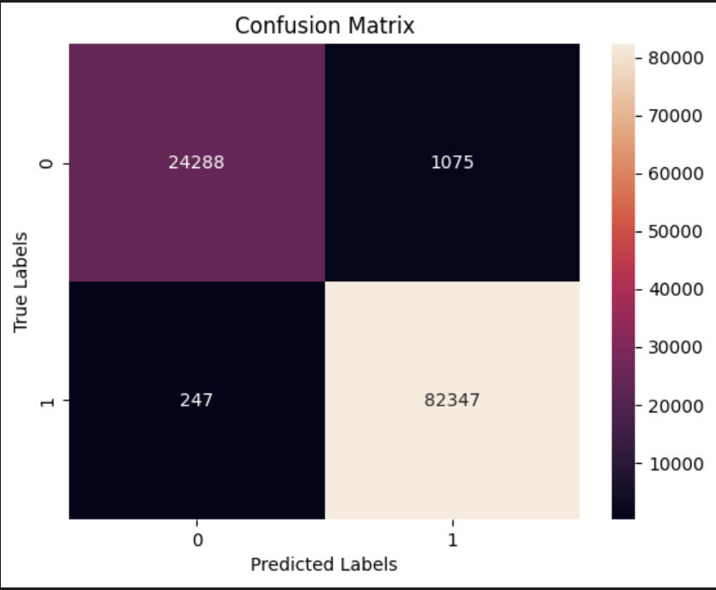
HistGradientBoostingClassifier Results

Slide 16
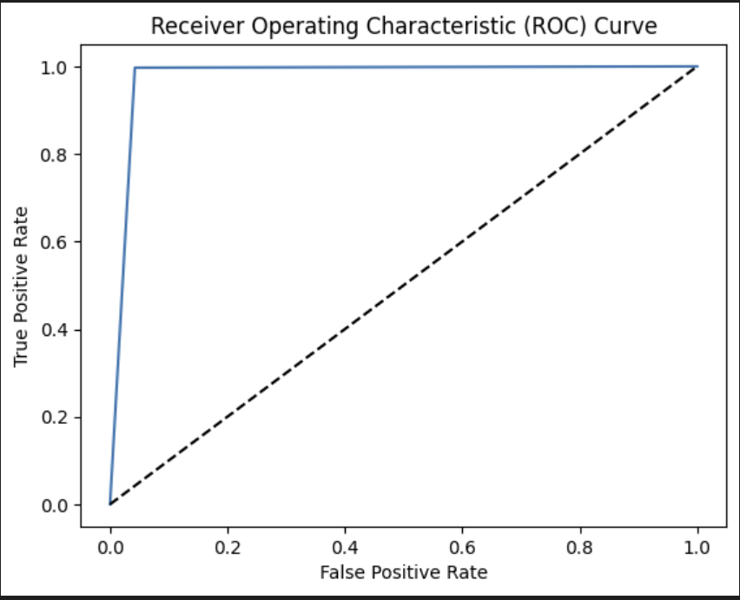

Slide 17
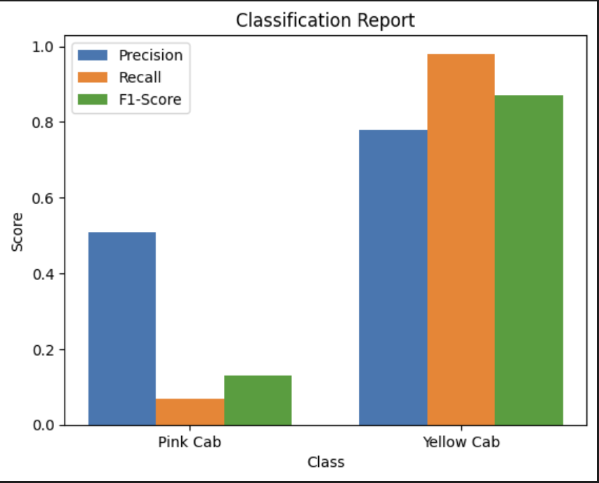
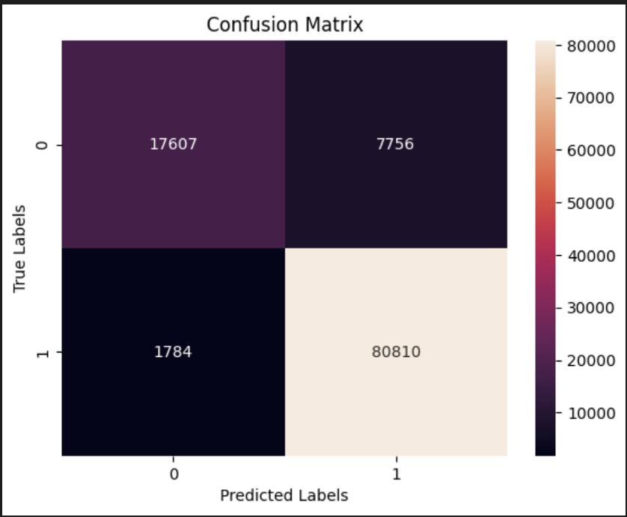
Logistic Regression Results

Slide 18
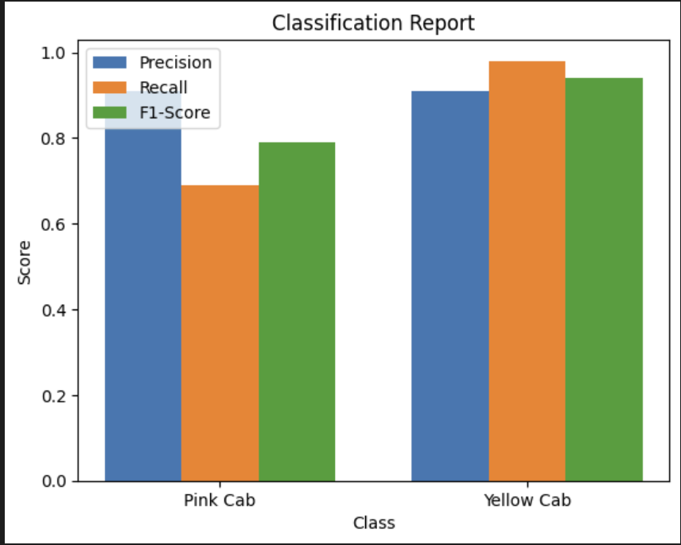
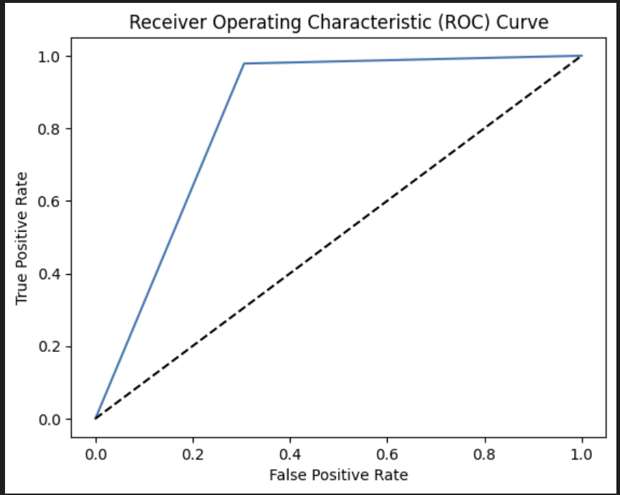
Random Forest Result

Slide 19
Recommendation
Hypothesis:
Pink Cab : m1
Yellow Cab : m2
H0 : Yellow Cab is more profitable to invest as compared to Pink Cab.
H1 : Pink Cab is more profitable to invest as compared to Yellow Cab.
The hypothesis can be formally defined as:
H0: m1 ≤ m2
H1: m1 > m2
After doing extensive analysis on both the car companies, I would recommend to invest in Pink Cab Company. My reasons for this recommendation is as follows:

Slide 20
1. Although in the dataset provided, number of users of pink cab company is less the yellow cab company, still I see more potential in Pink Cab company as compared to Yellow Cab Company as the prices charged by pink cab company is less as compared to yellow cab company.
2. Even after doing Gender comparison, one can say that Yellow Cab company is more popular in both the genders as compared to Blue Cab Company.
3. After doing City wise analysis, it can be observed even though at first sight, Yellow Cab users seems to be larger that Pink Cab users, but if one observes carefully, Yellow Cab dominates Pink Cab only in New York, Chicago, Boston and Los Angeles. In all the other Cities, both Yellow Cab and Pink Cab users are approximately the same. This shows that Yellow Cab mainly dominates Pink Cab majorly in big cities of East Coast. In all the other parts of East Coast and some part of West Coast Pink Cab uers are approximately the same as Yellow Cab users.
After doing above analysis, one can say that if Yellow Cab gets investment, the potential for this company to grow is expnonential because West Coast is major IT hub in USA. This part of USA is still growing and expanding. So the potetial number of users will also grow. Along with that, Pink Cab has lower prices as compared to Yellow Cab. This includes both per km cost and overall price of the trip.

Slide 21
The potential for pink cab to dominate yellow cab in future is bright given that it has enough funding to increase the number of cabs to improve its presence in areas where both the company's cab users are approximately the same.
So as per the analysis done above, it can be said that we have enough evidence to find out the we reject the null hypothesis and derive that investment on Pink Cab seems to be more profitable as compared to investment on Yellow Cab.

Slide 22
Thank You

